Slide 1
Unsupervised Learning: Clustering
Some material adapted from slides by Andrew Moore, CMU. See http://www.autonlab.org/tutorials/ for a repository of Data Mining tutorials

Slide 2
Unsupervised Learning
Supervised learning used labeled data pairs (x, y) to learn a function f : X→Y.
But, what if we don’t have labels?
No labels = unsupervised learning
Only some points are labeled = semi-supervised learning
  Getting labels may be expensive, so we only get a few
Clustering is the unsupervised grouping of data points. It can be used for knowledge discovery

Slide 3
Clustering algorithms
There are many clustering algorithms
Clustering is typically done using a distance measure defined between instances
The distance is defined in the instance feature space
Agglomerative approach works bottom up:
  Treat each instance as a cluster
  Merge the two closest clusters
  Repeat until the stop condition is met
Top-down approach starts a cluster with all instances
  Find a cluster to split into two or more smaller clusters
  Repeat until stop condition met

Slide 4
Clustering Data

Slide 5
K-Means Clustering
K-Means ( k , data )
Randomly choose k cluster center locations (centroids)
Loop until convergence
  Assign each point to the cluster of the closest centroid
  Re-estimate the cluster centroids based on the data assigned to each
Convergence: no point is assigned to a different cluster

Slide 6
K-Means Clustering
K-Means ( k , data )
Randomly choose k cluster center locations (centroids)
Loop until convergence
  Assign each point to the cluster of the closest centroid.
  Re-estimate the cluster centroids based on the data assigned to each
Convergence: no point is assigned to a different cluster

Slide 7
K-Means Clustering
K-Means ( k , data )
Randomly choose k cluster center locations (centroids)
Loop until convergence
  Assign each point to the cluster of the closest centroid
  Re-estimate the cluster centroids based on the data assigned to each
Convergence: no point is assigned to a different cluster

Slide 8
K-Means Clustering
K-Means ( k , data )
Randomly choose k cluster center locations (centroids)
Loop until convergence
  Assign each point to the cluster of the closest centroid
  Re-estimate the cluster centroids based on the data assigned to each
Convergence: no point is assigned to a different cluster

Slide 9
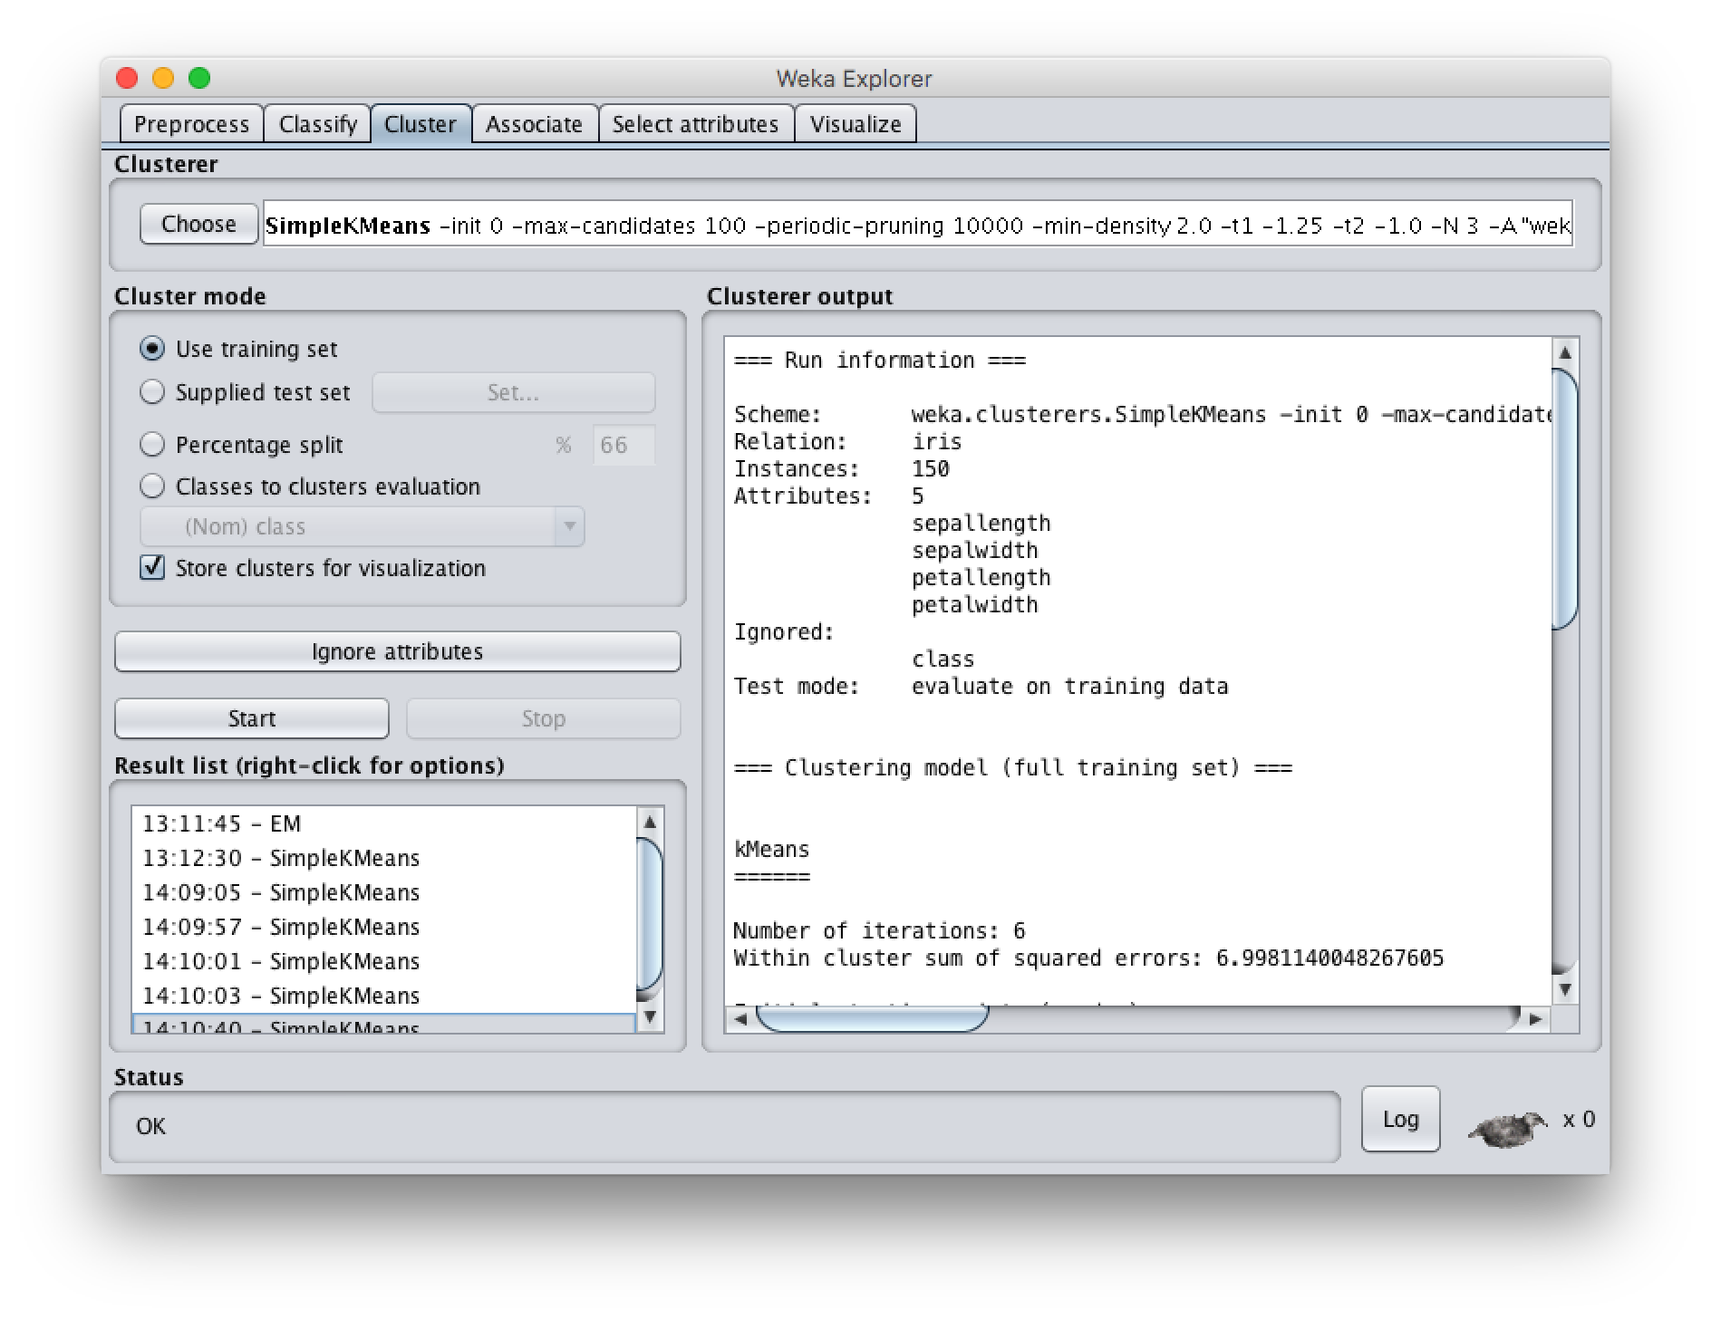

Slide 10
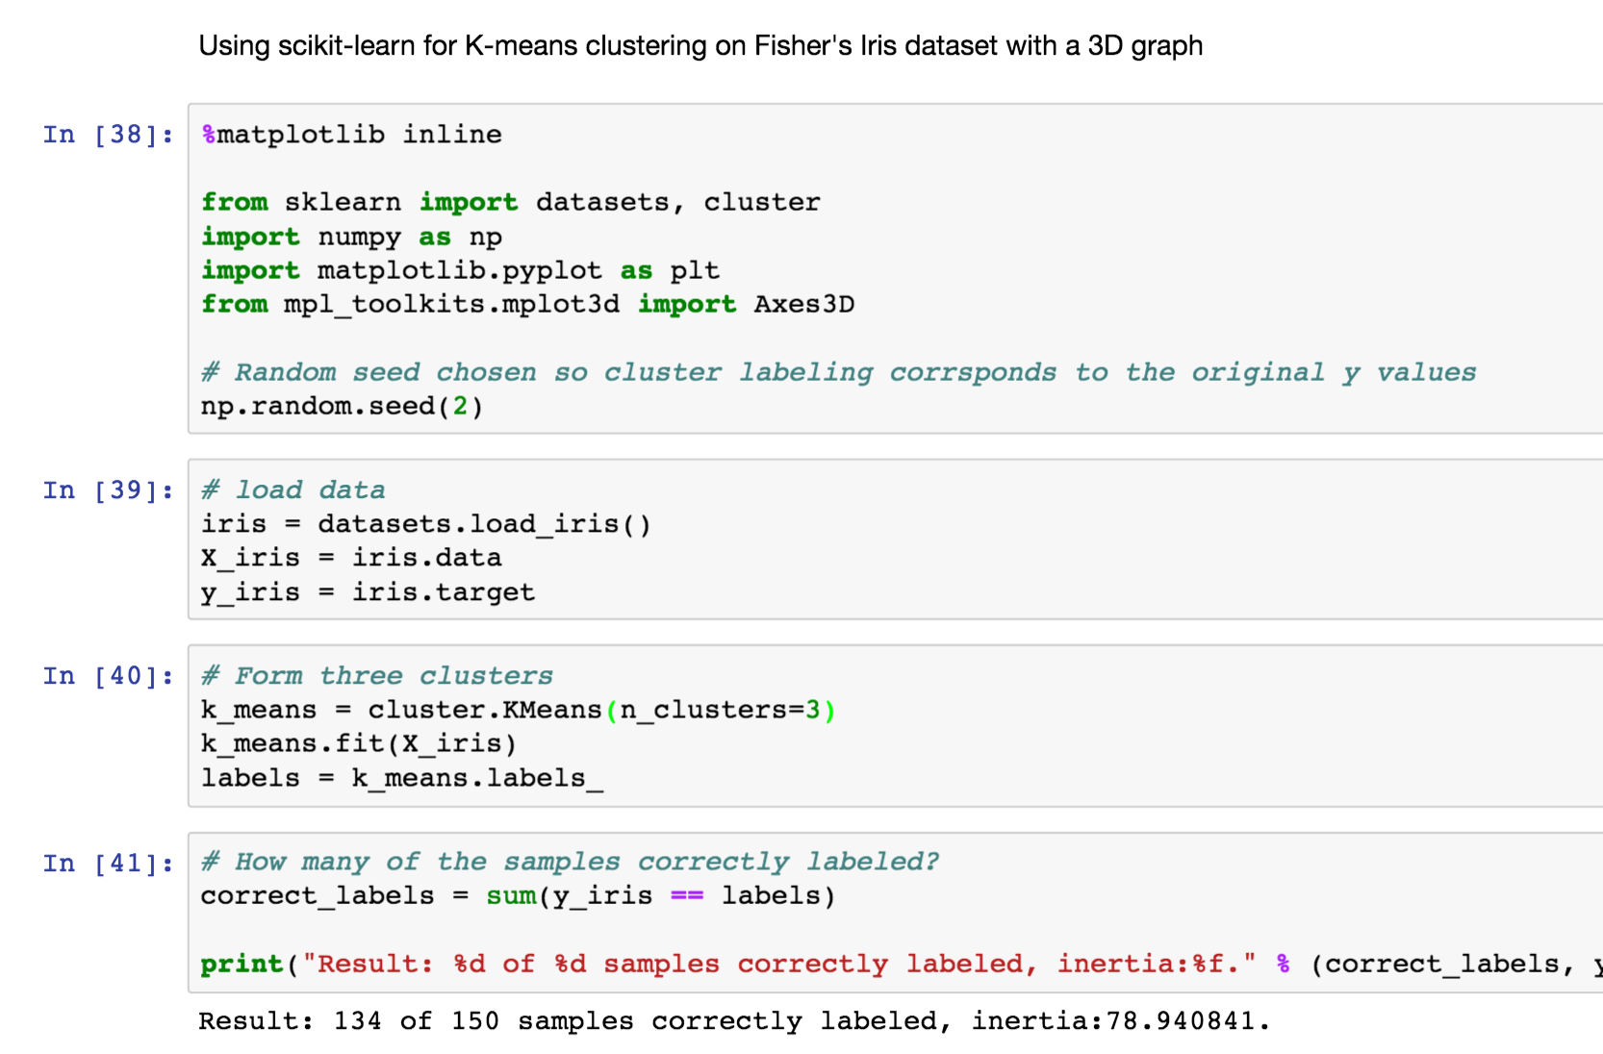

Slide 11
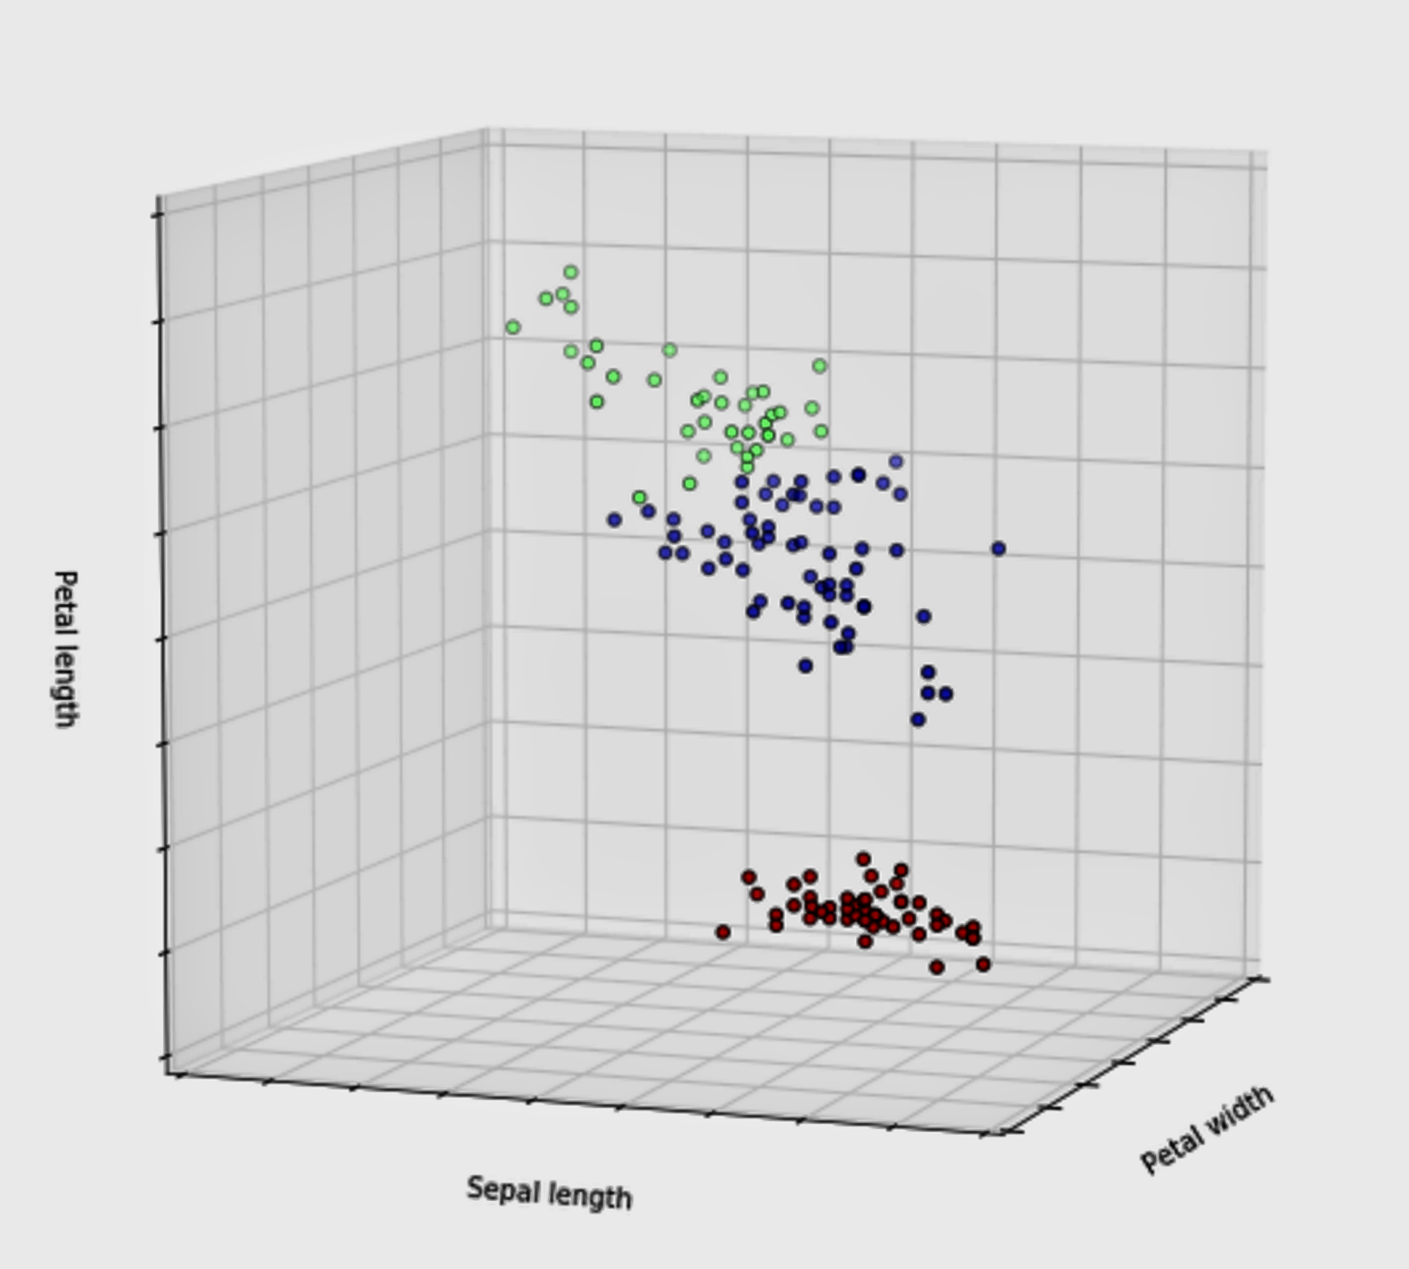

Slide 12
Problems with K-Means
Only works for numeric data (typical reals)
Very sensitive to the initial points
  Do many runs of k-Means, each with different initial centroids
  Seed the centroids using a better method than random. (e.g., Farthest-first sampling)
Must manually choose k
  Learn the optimal k for the clustering. (Note that this requires a performance measure)

Slide 13
Problems with K-Means
How do you tell it which clustering you want?
  Constrained clustering techniques
Same-cluster constraint
(must-link)
Different-cluster constraint
(cannot-link)

Slide 14
Hierarchical Clustering
Recursive partitioning/merging of a data set
1−clustering
5
2−clustering
1
3−clustering
4
2
4−clustering
3
5−clustering
1 2 3 4 5

Slide 15
Dendogram
  Represents all partitionings of the data
  We can get a K clustering by looking at the connected components at any given level
  Frequently binary dendograms, but n-ary dendograms are easy to obtain with minor changes
  to algorithms

Slide 16
Advantages of hierarchical clustering
Don’t need to specify the number of clusters
Good for data visualization
  See how the data points interact at many levels
  Can view the data at multiple levels of granularity
  Understand how all points interact
Specifies all of the K clusterings/partitions

Slide 17
Hierarchical Clustering
Common in many domains
  Biologists and social scientists
  Gene expression data
  Document/web page organization
    DMOZ
    Yahoo directories
Two main approaches…
animal
vertebrate
invertebrate
fish reptile amphib. mammal worm insect crustacean

Slide 18
Divisive hierarchical clustering
Top-down
Finding the best partitioning of the data is generally exponential in time
Common approach:
  Let C be a set of clusters
  Initialize C to be the one-clustering of the data
  While there exists a cluster c in C
    remove c from C
    partition c into 2 clusters using a flat clustering algorithm, c₁ and c₂
    Add to c₁ and c₂ C
Bisecting k-means

Slide 19
Divisive clustering

Slide 20
Divisive clustering
start with one cluster

Slide 21
Divisive clustering
split using flat clustering, e.g. Kmeans

Slide 22
Divisive clustering

Slide 23
Divisive clustering
split using flat clustering

Slide 24
Divisive clustering
split using flat clustering

Slide 25
Divisive clustering

Slide 26
Hierarchical Agglomerative Clustering
Let C be a set of clusters
Initialize C to all points/docs as separate clusters
While C contains more than one cluster
  find c₁ and c₂ in C that are closest together
  remove c₁ and c₂ from C
  merge c₁ and c₂ and add resulting cluster to C
History of merging forms a binary tree or hierarchy
Q: How to measure distance between clusters?

Slide 27
Distance between clusters
Single-link
  Similarity of the most similar (single-link)

Slide 28
Distance between clusters
Complete-link
  Similarity of the “furthest” points, the least similar
Why are these “local” methods used?
efficiency

Slide 29
Distance between clusters
Centroid
  Clusters whose centroids (centers of gravity) are the most similar

Slide 30
Distance between clusters
Average-link
  Average similarity between all pairs of elements

