Slide 1
Support Vector Machines
Some slides were borrowed from Andrew Moore’s PowetPoint slides on SVMs. Andrew’s PowerPoint repository is here: http://www.cs.cmu.edu/~awm/tutorials . Comments and corrections gratefully received.

Slide 2
Support Vector Machines
Very popular ML technique
Became popular in the late 90s (Vapnik 1995; 1998)
Invented in the late 70s (Vapnik, 1979)
Controls complexity and overfitting, so works well on a wide range of practical problems
Can handle high dimensional vector spaces, which makes feature selection less critical
Very fast and memory efficient implementations, e.g., svm_light
Not always the best solution, especially for problems with small vector spaces

Slide 3
Linear Classifiers
α
x
f
y^{est}
f(x,w,b) = sign(w. x - b)
denotes +1
denotes -1
How would you classify this data?

Slide 4
Linear Classifiers
α
x
f
y^{est}
f(x,w,b) = sign(w. x - b)
denotes +1
denotes -1
How would you classify this data?

Slide 5
Linear Classifiers
α
x
f
y^{est}
f(x,w,b) = sign(w. x - b)
denotes +1
denotes -1
How would you classify this data?
Notes:
q

Slide 6
Linear Classifiers
α
x
f
y^{est}
f(x,w,b) = sign(w. x - b)
denotes +1
denotes -1
How would you classify this data?

Slide 7
Linear Classifiers
α
x
f
y^{est}
f(x,w,b) = sign(w. x - b)
denotes +1
denotes -1
Any of these would be fine..
..but which is best?

Slide 8
Classifier Margin
α
x
f
y^{est}
f(x,w,b) = sign(w. x - b)
denotes +1
denotes -1
Define the margin of a linear classifier as the width that the boundary could be increased by before hitting a datapoint.

Slide 9
Maximum Margin
α
x
f
y^{est}
f(x,w,b) = sign(w. x - b)
denotes +1
denotes -1
The maximum margin linear classifier is the linear classifier with the, um, maximum margin
This is the simplest kind of SVM (Called an LSVM)
Linear SVM

Slide 10
Maximum Margin
α
x
f
y^{est}
f(x,w,b) = sign(w. x - b)
denotes +1
denotes -1
The maximum margin linear classifier is the linear classifier with the, um, maximum margin.
This is the simplest kind of SVM (Called an LSVM)
Support Vectors are those datapoints that the margin pushes up against
Linear SVM

Slide 11
Why Maximum Margin?
Intuitively this feels safest
If we’ve made a small error in the location of the boundary (it’s been jolted in its perpendicular direction) this gives us least chance of causing a misclassification
LOOCV is easy since the model is immune to removal of any non-support-vector datapoints
There’s some theory (using VC dimension) that is related to (but not the same as) the proposition that this is a good thing
Empirically it works very very well
f(x,w,b) = sign(w. x - b)
denotes +1
denotes -1
The maximum margin linear classifier is the linear classifier with the, um, maximum margin.
This is the simplest kind of SVM (Called an LSVM)
Support Vectors are those datapoints that the margin pushes up against
LOOCV = leave one out cross validation

Slide 12
Specifying a line and margin
Plus-Plane
“Predict Class = +1” zone
Classifier Boundary
Minus-Plane
“Predict Class = -1” zone
How do we represent this mathematically?
…in m input dimensions?

Slide 13
Specifying a line and margin
Plus-Plane
“Predict Class = +1” zone
Classifier Boundary
Minus-Plane
“Predict Class = -1” zone
wx+b=1
wx+b=0
wx+b=-1
Plus-plane = { x : w . x + b = +1 }
Minus-plane = { x : w . x + b = -1 }
Classify as.. | +1 | if | w . x + b >= 1
 | -1 | if | w . x + b <= -1
 | Universe explodes | if | -1 < w . x + b < 1

Slide 14
Learning the Maximum Margin Classifier
x⁺
M = Margin Width =
“Predict Class = +1” zone
x⁻
“Predict Class = -1” zone
wx+b=1
wx+b=0
wx+b=-1
Given a guess of w and b we can
Compute whether all data points in the correct half-planes
Compute the width of the margin
Write a program to search the space of ws and bs to find widest margin matching all the datapoints.
How? -- Gradient descent? Simulated Annealing? Matrix Inversion? EM? Newton’s Method?

Slide 15
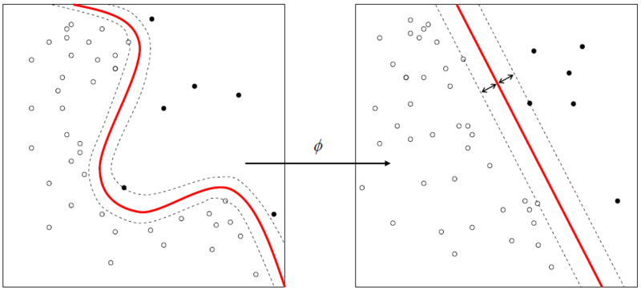
Learning SVMs
Trick #1: Just find the points that would be closest to the optimal separating plane (“support vectors”) and work directly from those instances
Trick #2: Represent as a quadratic optimization problem, and use quadratic programming techniques
Trick #3 (“kernel trick”):
Instead of using the raw features, represent data in a high-dimensional feature space constructed from a set of basis functions (e.g., polynomial and Gaussian combinations of the base features)
Find separating plane / SVM in that high-dimensional space
Voila: A nonlinear classifier!

Slide 16
SVM Performance
Can handle very large features spaces (e.g., 100K features)
Relatively fast
Anecdotally they work very very well indeed
Example: They are currently the best-known classifier on a well-studied hand-written-character recognition benchmark

Slide 17
Binary vs. multi classification
SVMs can only do binary classification
Two approaches to multi classification:
One-vs-all: can turn an n-way classification into n binary classification tasks
E.g., for zoo problem, do mammal vs. not-mammal, fish vs. not-fish, …
Pick the one that results in the highest score
N*(N-1)/2 One-vs-one classifiers that vote on results
Mammal vs. fish, mammal vs. reptile, etc…

Slide 18
Feature Engineering
Finding features for data instances that make machine learning algorithms more effective
Usually a combination of domain knowledge and experimentation
For example, consider the problem of classifying an email message as spam or not
What are good features?

Slide 19
Spam Features
Finding features for data instances that make machine learning algorithms more effective
Usually a combination of domain knowledge and experimentation
For example, consider the problem of classifying an email message as spam or not
What are good features?

Slide 20
Example of a Spam Message
Received: from nm37-vm8.bullet.mail.gq1.yahoo.com (nm37-vm8.bullet.mail.gq1.yahoo.com [98.136.217.44])
Date: Mon, 2 May 2016 15:26:36 +0000 (UTC)
From: "Mrs.Sabeen Gharam" <SabeenGharam1@outlook.com>
Reply-To: "Mrs.Sabeen Gharam" <aramsabeen1@gmail.com>
Subject: CAN YOU HANDLE INVESTMENT?
Â CAN YOU HANDLE INVESTMENT?
My name is Mrs. Sabeen Gharam Aram widow of late Mohamed Assad Aram from idlib in syria arab republic, am in an urgent need of an individual or organization abroad that is willing to help to secure, move and invest my late husband's fund which he has offshore; the investment will depend on the agreement with me.
Mrs.Sabeen Gharam Aram

Slide 21
Possible Features
Each of the words in the message
Is there a TO: header?
Does FROM: match REPLY-TO:?
Is FROM: address a free email service?
Is the subject in all caps?
Length of message in log(#bytes)
Are their attachments?
Extension of any attached file
TLD of FROM: address (e.g., .com, .edu, .org, …)
... dozens more ...

Slide 22
Evaluating Features
Choose some features, generate training data, train system, evaluation using 10-fold cross validation
Some systems can show you the features that contribute the most to classification
If not, perform ablation experiments by dropping a feature and re-training
And try adding a new feature and training
You can also automate this to try adding/removing various subsets of features
Rely on your own knowledge and intuition also

Slide 23
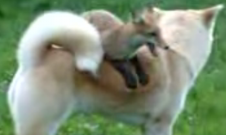
Feature Engineering for Text Classification
Typical features: words and/or phrases along with term frequency or (better) TF-IDF scores
ΔTFIDF amplifies the training set signals by using the ratio of the IDF for the negative and positive collections
Results in a significant boost in accuracy
Text: The quick brown fox jumped over the lazy white dog.
Features: the 2, quick 1, brown 1, fox 1, jumped 1, over 1, lazy 1, white 1, dog 1, the quick 1, quick brown 1, brown fox 1, fox jumped 1, jumped over 1, over the 1, lazy white 1, white dog 1

Slide 24
ΔTFIDF BoW Feature Set
Value of feature t in document d is
Where
C_{t,d} = count of term t in document d
N_{t} = number of negative labeled training docs with term t
P_{t} = number of positive labeled training docs with term t
Normalize to avoid bias towards longer documents
Gives greater weight to rare (significant) words
Downplays very common words
Similar to Unigram + Bigram BoW in other aspects

Slide 25
Example: ΔTFIDF vs TFIDF vs TF
Δtfidf tfidf tf
, city angels ,
cage is angels is the
mediocrity , city .
criticized of angels to
exhilarating maggie , of
well worth city of a
out well maggie and
should know angel who is
really enjoyed movie goers that
maggie , cage is it
it's nice seth , who
is beautifully goers in
wonderfully angels , more
of angels us with you
Underneath the city but
15 features with highest values for a review of City of Angels

Slide 26
Improvement over TFIDF (Uni- + Bi-grams)
Movie Reviews: 88.1% Accuracy vs. 84.65% at 95% Confidence Interval
Subjectivity Detection (Opinionated or not): 91.26% vs. 89.4% at 99.9% Confidence Interval
Congressional Support for Bill (Voted for/ Against): 72.47% vs. 66.84% at 99.9% Confidence Interval
Enron Email Spam Detection: (Spam or not): 98.917% vs. 96.6168 at 99.995% Confidence Interval
All tests used 10 fold cross validation
At least as good as mincuts + subjectivity detectors on movie reviews (87.2%)

