Slide 1
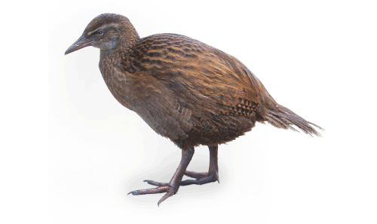
Machine Learning: Decision Trees in
AIMA and WEKA

Slide 2
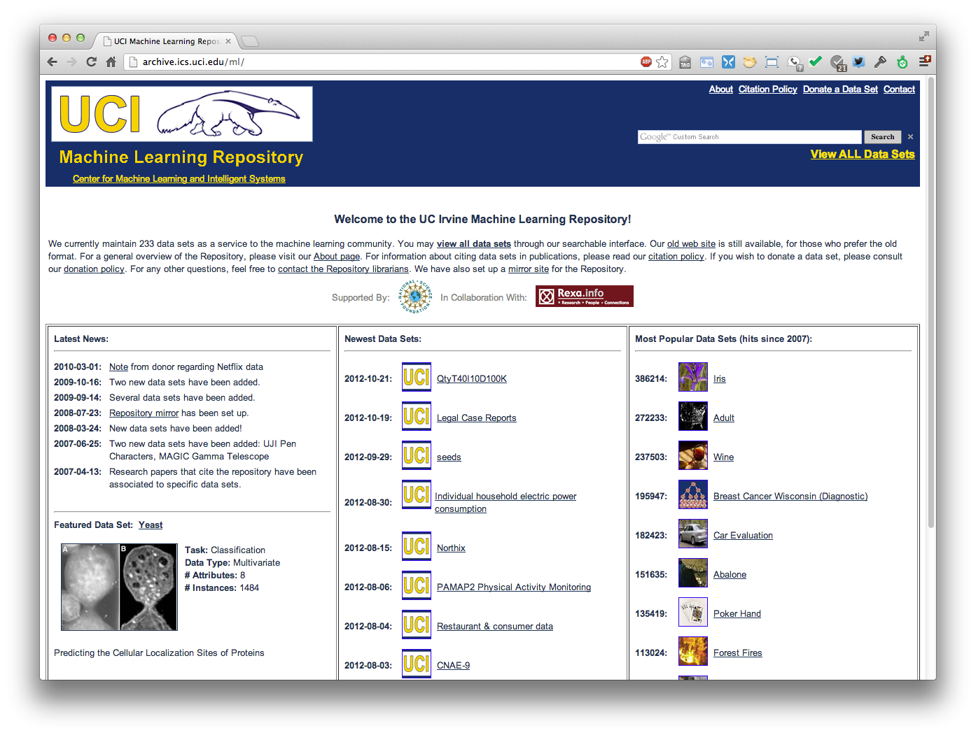
http://archive.ics.uci.edu/ml
233 data sets

Slide 3
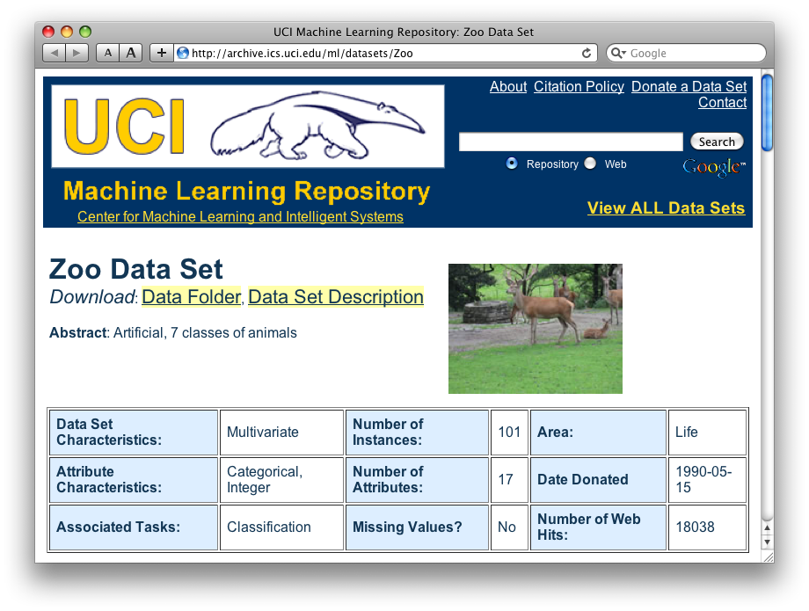
http://archive.ics.uci.edu/ml/datasets/Zoo

Slide 4
Zoo data
animal name: string
hair: Boolean
feathers: Boolean
eggs: Boolean
milk: Boolean
airborne: Boolean
aquatic: Boolean
predator: Boolean
toothed: Boolean
backbone: Boolean
breathes: Boolean
venomous: Boolean
fins: Boolean
legs: {0,2,4,5,6,8}
tail: Boolean
domestic: Boolean
catsize: Boolean
type: {mammal, fish, bird, shellfish, insect, reptile, amphibian}
101 examples
aardvark,1,0,0,1,0,0,1,1,1,1,0,0,4,0,0,1,mammal
antelope,1,0,0,1,0,0,0,1,1,1,0,0,4,1,0,1,mammal
bass,0,0,1,0,0,1,1,1,1,0,0,1,0,1,0,0,fish
bear,1,0,0,1,0,0,1,1,1,1,0,0,4,0,0,1,mammal
boar,1,0,0,1,0,0,1,1,1,1,0,0,4,1,0,1,mammal
buffalo,1,0,0,1,0,0,0,1,1,1,0,0,4,1,0,1,mammal
calf,1,0,0,1,0,0,0,1,1,1,0,0,4,1,1,1,mammal
carp,0,0,1,0,0,1,0,1,1,0,0,1,0,1,1,0,fish
catfish,0,0,1,0,0,1,1,1,1,0,0,1,0,1,0,0,fish
cavy,1,0,0,1,0,0,0,1,1,1,0,0,4,0,1,0,mammal
cheetah,1,0,0,1,0,0,1,1,1,1,0,0,4,1,0,1,mammal
chicken,0,1,1,0,1,0,0,0,1,1,0,0,2,1,1,0,bird
chub,0,0,1,0,0,1,1,1,1,0,0,1,0,1,0,0,fish
clam,0,0,1,0,0,0,1,0,0,0,0,0,0,0,0,0,shellfish
crab,0,0,1,0,0,1,1,0,0,0,0,0,4,0,0,0,shellfish
…

Slide 5
Zoo example
aima-python> python
>>> from learning import *
>>> zoo
<DataSet(zoo): 101 examples, 18 attributes>
>>> dt = DecisionTreeLearner()
>>> dt.train(zoo)
>>> dt.predict(['shark',0,0,1,0,0,1,1,1,1,0,0,1,0,1,0,0]) #eggs=1
'fish'
>>> dt.predict(['shark',0,0,0,0,0,1,1,1,1,0,0,1,0,1,0,0]) #eggs=0
'mammal’
Notes:
Sharks bear their young alive

Slide 6
Zoo example
>> dt.dt
DecisionTree(13, 'legs', {0: DecisionTree(12, 'fins', {0: DecisionTree(8, 'toothed', {0: 'shellfish', 1: 'reptile'}), 1: DecisionTree(3, 'eggs', {0: 'mammal', 1: 'fish'})}), 2: DecisionTree(1, 'hair', {0: 'bird', 1: 'mammal'}), 4: DecisionTree(1, 'hair', {0: DecisionTree(6, 'aquatic', {0: 'reptile', 1: DecisionTree(8, 'toothed', {0: 'shellfish', 1: 'amphibian'})}), 1: 'mammal'}), 5: 'shellfish', 6: DecisionTree(6, 'aquatic', {0: 'insect', 1: 'shellfish'}), 8: 'shellfish'})

Slide 7
Zoo example
>>> dt.dt.display()
Test legs
legs = 0 ==> Test fins
fins = 0 ==> Test toothed
toothed = 0 ==> RESULT = shellfish
toothed = 1 ==> RESULT = reptile
fins = 1 ==> Test eggs
eggs = 0 ==> RESULT = mammal
eggs = 1 ==> RESULT = fish
legs = 2 ==> Test hair
hair = 0 ==> RESULT = bird
hair = 1 ==> RESULT = mammal
legs = 4 ==> Test hair
hair = 0 ==> Test aquatic
aquatic = 0 ==> RESULT = reptile
aquatic = 1 ==> Test toothed
toothed = 0 ==> RESULT = shellfish
toothed = 1 ==> RESULT = amphibian
hair = 1 ==> RESULT = mammal
legs = 5 ==> RESULT = shellfish
legs = 6 ==> Test aquatic
aquatic = 0 ==> RESULT = insect
aquatic = 1 ==> RESULT = shellfish
legs = 8 ==> RESULT = shellfish

Slide 8
Zoo example
>>> dt.dt.display()
Test legs
legs = 0 ==> Test fins
fins = 0 ==> Test toothed
toothed = 0 ==> RESULT = shellfish
toothed = 1 ==> RESULT = reptile
fins = 1 ==> Test milk
milk = 0 ==> RESULT = fish
milk = 1 ==> RESULT = mammal
legs = 2 ==> Test hair
hair = 0 ==> RESULT = bird
hair = 1 ==> RESULT = mammal
legs = 4 ==> Test hair
hair = 0 ==> Test aquatic
aquatic = 0 ==> RESULT = reptile
aquatic = 1 ==> Test toothed
toothed = 0 ==> RESULT = shellfish
toothed = 1 ==> RESULT = amphibian
hair = 1 ==> RESULT = mammal
legs = 5 ==> RESULT = shellfish
legs = 6 ==> Test aquatic
aquatic = 0 ==> RESULT = insect
aquatic = 1 ==> RESULT = shellfish
legs = 8 ==> RESULT = shellfish
Add the shark example to the training set and retrain

Slide 9

Weka
Open-source Java machine learning tool
http://www.cs.waikato.ac.nz/ml/weka/
Implements many classifiers & ML algorithms
Uses a common data representation format, making comparisons easy
  Comprehensive set of data pre-processing tools and evaluation methods
Three modes of operation: GUI, command line, Java API

Slide 10

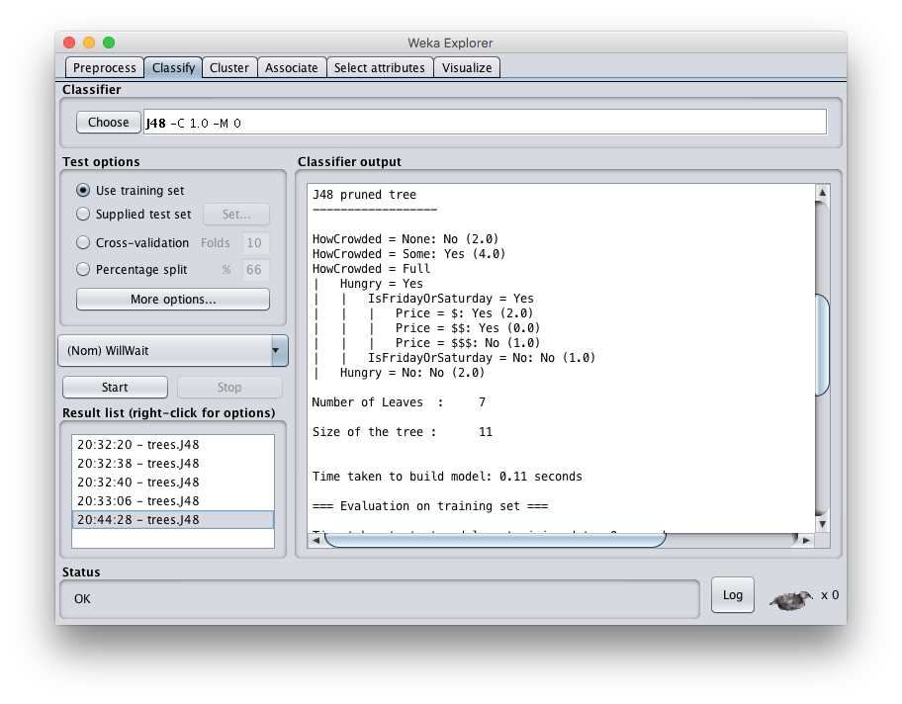

Slide 11
Common .arff data format
@relation heart-disease-simplified
@attribute age numeric
@attribute sex { female, male}
@attribute chest_pain_type { typ_angina, asympt, non_anginal, atyp_angina}
@attribute cholesterol numeric
@attribute exercise_induced_angina {no, yes}
@attribute class {present, not_present}
@data
63,male,typ_angina,233,no,not_present
67,male,asympt,286,yes,present
67,male,asympt,229,yes,present
38,female,non_anginal,?,no,not_present
...
Numeric attribute
Nominal attribute
Training data

Slide 12
Weka demo

Slide 13
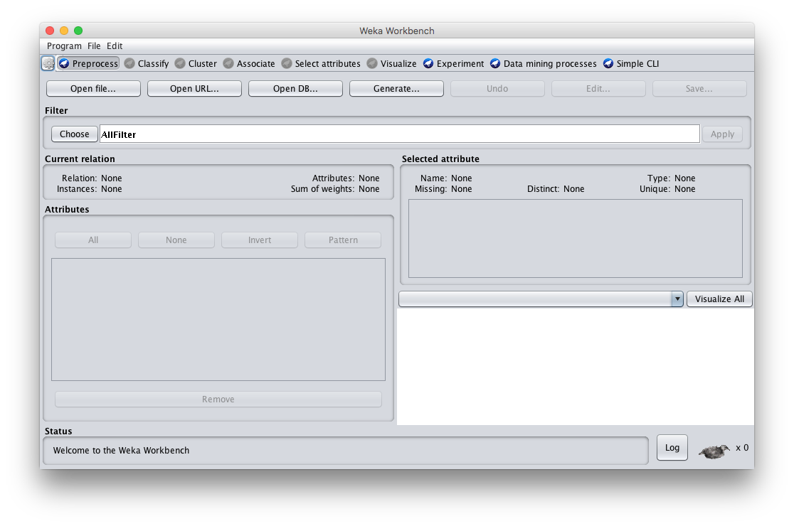
Open the Weka GUI

Slide 14
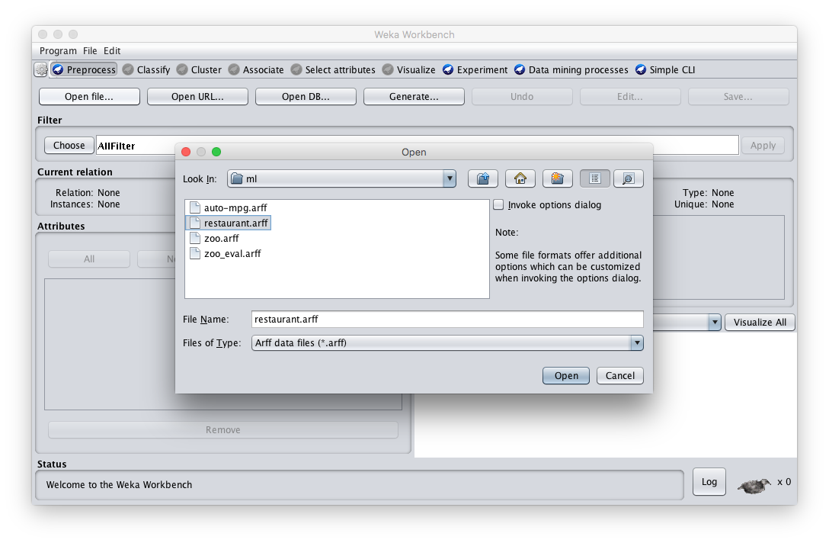
Load the restaurant .arff data

Slide 15
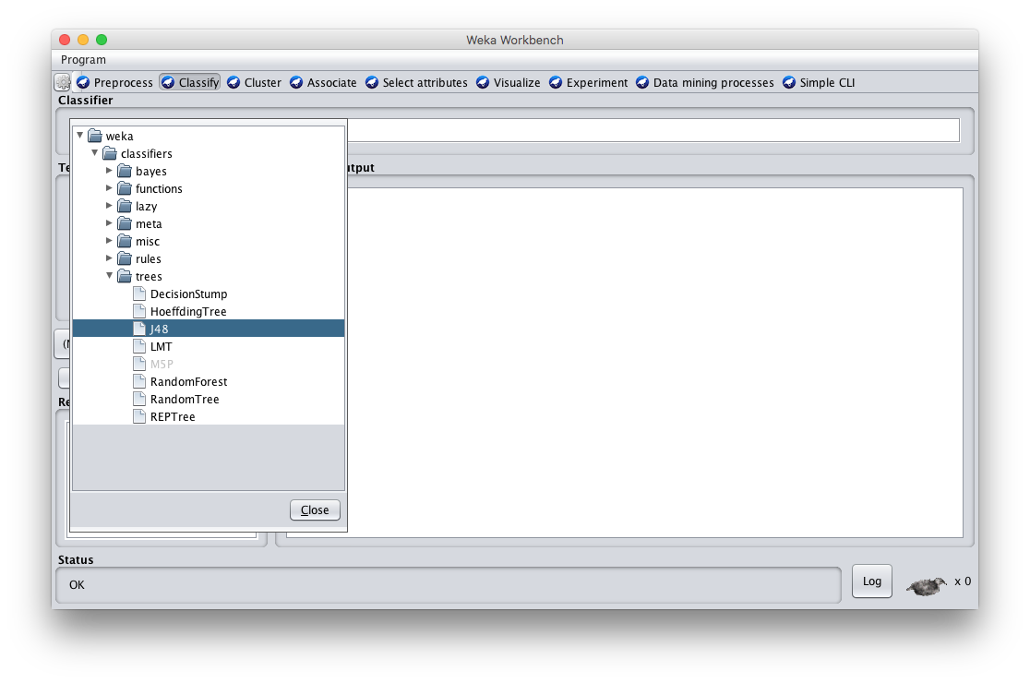
Select J48 tree classifier

Slide 16
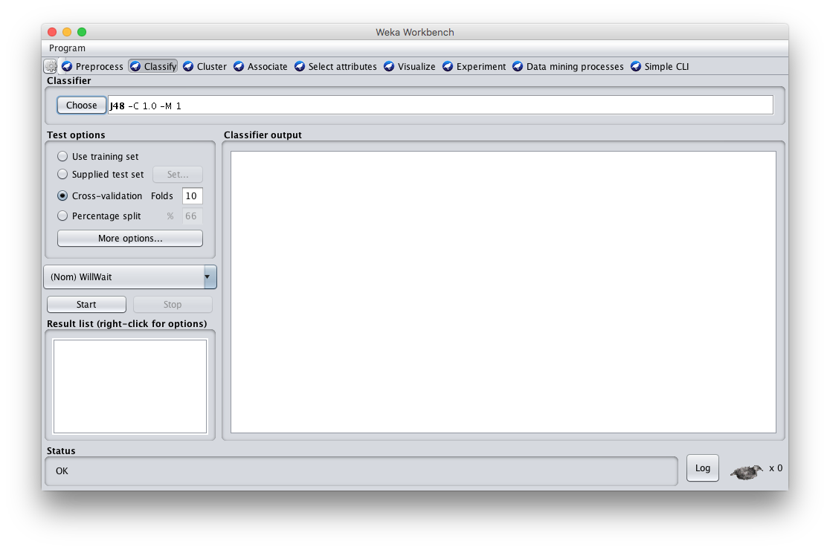
Click Start to train

Slide 17
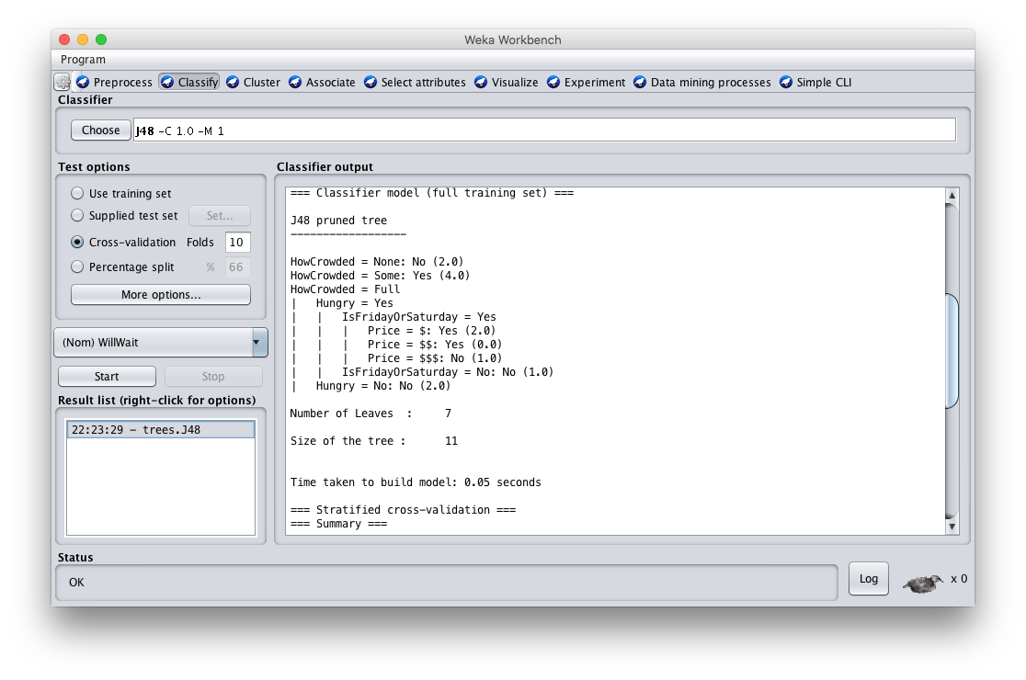
See the training results

Slide 18
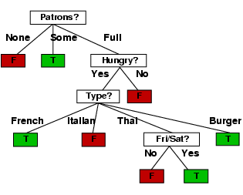
Compare results
HowCrowded = None: No (2.0)
HowCrowded = Some: Yes (4.0)
HowCrowded = Full
| Hungry = Yes
| | IsFridayOrSaturday = Yes
| | | Price = $: Yes (2.0)
| | | Price = $$: Yes (0.0)
| | | Price = $$$: No (1.0)
| | IsFridayOrSaturday = No: No (1.0)
| Hungry = No: No (2.0)
J48 pruned tree: nodes:11; leaves:7, max depth:4
ID3 tree: nodes:12; leaves:8, max depth:4

Slide 19

Weka vs. svm_light vs. …
Weka: good for experimenting with different ML algorithms
Other tools are much more efficient &scalable
Scikit-learn is a popular suite of open-source machine-learning tools in Python
  Built on NumPy, SciPy, and matplotlib for efficiency
  Use anaconda or do pip install scikit-learn
For SVMs many use svm_light

