Slide 1
Machine Learning overview Chapter 18, 21

Slide 2
What is learning?
“Learning denotes changes in a system that ... enable a system to do the same task more efficiently the next time” – Herbert Simon
“Learning is constructing or modifying representations of what is being experienced” – Ryszard Michalski
“Learning is making useful changes in our minds” – Marvin Minsky

Slide 3
Why study learning?
Understand and improve efficiency of human learning
Use to improve methods for teaching and tutoring people (e.g., better computer-aided instruction)
Discover new things or structure previously unknown
Examples: data mining, scientific discovery
Fill in skeletal or incomplete specifications in a domain
Large, complex systems can’t be completely built by hand & require dynamic updating to incorporate new information
Learning new characteristics expands the domain or expertise and lessens the “brittleness” of the system
Build agents that can adapt to users, other agents, and their environment

Slide 4
AI & Learning Today
Neural network learning was popular in the 60s
In the 70s and 80s it was replaced with a paradigm based on manually encoding and using knowledge
In the 90s, more data and the Web drove interest in new statistical machine learning (ML) techniques and new data mining applications
Today, ML techniques and big data are behind almost all successful intelligent systems
http://bit.ly/U2ZAC8

Slide 5
Machine Leaning Successes
Sentiment analysis
Spam detection
Machine translation
Spoken language understanding
Named entity detection
Self driving cars
Motion recognition (Microsoft X-Box)
Identifying paces in digital images
Recommender systems (Netflix, Amazon)
Credit card fraud detection

Slide 6
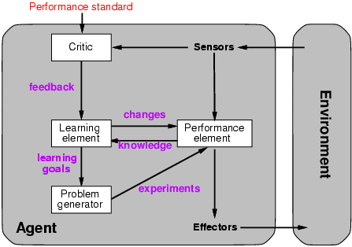
A general model of learning agents

Slide 7
Major paradigms of machine learning
Rote learning: 1-1 mapping from inputs to stored representation, learning by memorization, association-based storage and retrieval
Induction: Use specific examples to reach general conclusions
Clustering: Unsupervised discovery of natural groups in data
Analogy: Find correspondence between two different representations
Discovery: Unsupervised, specific goal not given
Genetic algorithms: Evolutionary search techniques, based on an analogy to survival of the fittest
Reinforcement – Feedback (positive or negative reward) given at the end of a sequence of steps

Slide 8
What we will and won’t cover
We’ll look at a few popular machine learning problems and algorithms
Take CMSC 478/678 Machine Leaning for more
Use online resources & experiment on your own
We’ll focus on when/how to use techniques and only touch on how/why they work
We’ll cover basic methodology and evaluation
We’ll use the Weka platform for examples and demonstrations
Great for exploration and learning

Slide 9
Types of learning problems
Supervised: learn from training examples
Regression
Classification: Decision Trees, SVM
Unsupervised: learn w/o training examples
Clustering
Word semantics
Lots more we won’t cover
Hidden Marrkov models
Learning to rank
Semi-supervised learning
Reinforcement learning
Active learning

Slide 10
Supervised learning
Given training examples of inputs and corresponding outputs, produce the “correct” outputs for new inputs
Two main scenarios:
Classification: outputs typically labels (goodRisk, badRisk); learn a decision boundary that separates classes
Regression: also known as “curve fitting” or “function approximation.” Learn a continuous input-output mapping from examples (possibly noisy)

Slide 11
Unsupervised Learning
Given only unlabeled data as input, learn some sort of structure
E.g., cluster your Facebook friends based on similarity of posts
E.g., find sets of words whose meanings are related

Slide 12
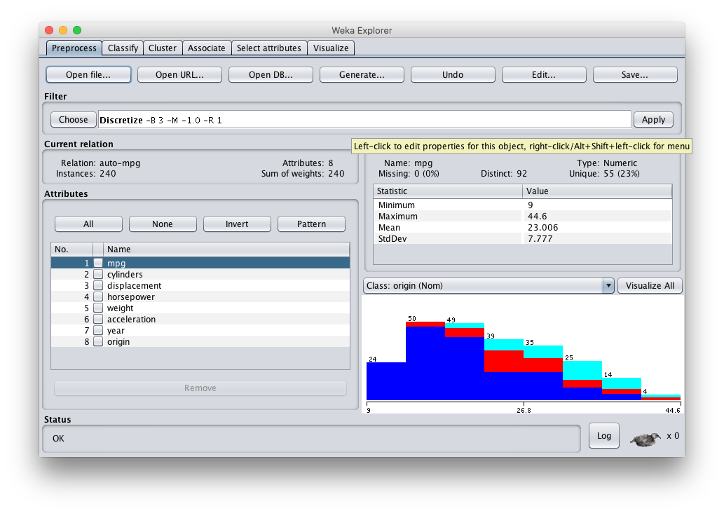
Weka
Open source Java software for ML and datamining
http://cs.waikato.ac.nz/ml/weka/

