Slide 1
Knowledge Representation and Reasoning
Chapter 12
Some material adopted from notes by Andreas Geyer-Schulz
and Chuck Dyer

Slide 2
Overview
Approaches to knowledge representation
Deductive/logical methods
Forward-chaining production rule systems
Semantic networks
Frame-based systems
Description logics
Abductive/uncertain methods
What’s abduction?
Why do we need uncertainty?
Bayesian reasoning
Other methods: Default reasoning, rule-based methods, Dempster-Shafer theory, fuzzy reasoning

Slide 3
Semantic Networks
Simple representation scheme: a graph of labeled nodes and labeled, directed arcs to encode knowledge
often used for static, taxonomic, concept dictionaries
Typically used with a special set of accessing procedures that perform “reasoning”
e.g., inheritance of values and relationships
Semantic networks popular in 60s & 70s, less used in ‘80s &’90s, back since‘00s as RDF
less expressive than other formalisms: both a feature & bug!
The graphical depiction associated with a semantic network is a significant reason for their popularity

Slide 4
Nodes and Arcs
Arcs define binary relationships that hold between objects denoted by the nodes
mother
age
sue
john
5
age
wife
father
husband
mother(john, sue)
age(john, 5)
wife(sue, max)
age(max, 34)
...
34
max
age

Slide 5
What do these nodes and edges mean?
Notes:
An example f a semantic network. What do the nodes and arcs mean?

Slide 6
Semantic Networks
ISA (is-a) or AKO (a-kind-of) relations often used to link instances to classes and classes to super-classes
Some links (e.g. hasPart) are inherited along ISA paths
Meaning of a semantic net can be relatively informal or very formal
often defined by implementation
See W. Woods, What’s in a Link, 1975.
Animal
isa
hasPart
Bird
isa
Wing
Robin
isa
isa
Rusty
Red

Slide 7
Reification
Non-binary relationships can be represented by “turning the relationship into an object”
Logicians and philosophers call this reification
reify v : consider an abstract concept to be real
We might want to represent the generic give event as a relation involving three things: a giver, a recipient and an object, give(john,mary,book32)
give
isa
giver
john
give42
recipient
object
mary
book32

Slide 8
Individuals and Classes
Genus
Many semantic networks distinguish
nodes representing individuals & those representing classes
E.g., subclass from instance_of relation
Formalization must deal with nodes like Bird
OWL uses punning
Animal
subclass
instance
hasPart
Bird
subclass
Wing
Robin
instance
instance
Rusty
Red

Slide 9
Inference by Inheritance
One kind of reasoning done in semantic nets is inheritance along subclass & instance links
It’s like inheritance in object-oriented languages
Semantic networks differ in details of
Inheriting along subclass or instance links, e.g
Only inherit values on instance links
inheriting multiple different values, e.g.
All possible values are inherited, or
Only the “closest” value or values are inherited

Slide 10
From Semantic Nets to Frames
Semantic networks evolved into frame representation languages in the 70s and 80s
Frames like a OO classes with more meta-data
Cf. AI’s focus on knowledge over data
A frame has a set of slots
Slots represents relations to other frame or literal values (e.g., number or string)
A slot has one or more facets
A facet represents some aspect of the relation

Slide 11
Facets
A slot in a frame can hold more than a value
Other facets might include:
Value: current fillers
Default: default fillers
Cardinality: minimum and maximum number of fillers
Type: type restriction on fillers, e.g another frame
Procedures: if-needed, if-added, if-removed
Salience: measure on the slot’s importance
Constraints: attached constraints or axioms
In some systems, the slots themselves are instances of frames.

Slide 12
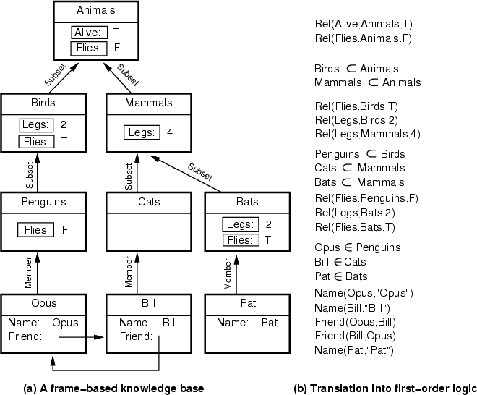

Slide 13
Description Logics
Description logics are a family of frame-like KR systems with a formal semantics
E.g., KL-ONE, OWL
Additional kind of inference is automatic classification of Frames and objects
Automatically finding right place in a hierarchy
Many current systems limit languages to support decidably complete reasoning
The Semantic Web language OWL based on description logic

Slide 14
Beyond Deduction
Logical deduction is not the only kind of reasoning that’s useful

Slide 15
Deduction, Abduction, Induction
A => B
A
---------
B
Deduction: major premise: All balls in the box are black
minor premise: These balls are from the box
conclusion: These balls are black
Abduction: rule: All balls in the box are black
observation: These balls are black
explanation: These balls are from the box
Induction: case: These balls are from the box
observation: These balls are black
hypothesized rule: All ball in the box are black
A => B
B
-------------
Possibly A
Whenever A then B
-------------
Possibly
A => B
Deduction: from causes to effects
Abduction: from effects to causes
Induction: from specific cases to general rules

Slide 16
Abduction
Abduction: reasoning that derives an explanatory hypothesis from a given set of facts
Inference result is a hypothesis that, if true, could explain the occurrence of the given facts
Inherently unsound and uncertain
Example: Medical diagnosis
Facts: symptoms, test results, other observed findings
KB: causal associations between diseases & symptoms
Reasoning: diseases whose presence would causally explain the occurrence of the given manifestations

Slide 17
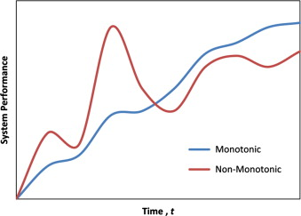
Non-monotonic reasoning
Abduction is non-monotonic reasoning
Monotonic: your knowledge only increases
Propositions don’t change their truth value
You never unknow things
In abduction: plausibility of hypotheses can increase/decrease as new facts are collected
Deductive inference is monotonic: it never change a sentence’s truth value, once known
In abductive and inductive reasoning, hypotheses may be discarded and new ones formed when new observations are made

Slide 18
Default logic
Default reasoning is another kind of non-monotonic reasoning
We know many facts which are mostly true, typically true, or good default assumptions
E.g., birds can fly, dogs have four legs, etc.
Sometimes these facts are wrong however
Ostriches are birds, but can not fly
A dead bird can not fly
Uruguay President José Mujica had a 3-legged dog

Slide 19
Negation as Failure
Prolog introduced the notion of negation as failure, which is widely used in logic programming languages and many KR systems
Proving P in classical logic can have three outcomes: true, false, unknown (+ still thinking)
Sometimes being unable to prove something can be used as evidence that it is not true
This is typically the case in a database context
Is John registered for CMSC 671?
If there’s no record for John in the registrar’s database, assume he’s not registered

Slide 20
Default Logic
There are several models for default reasoning
All have advantages and disadvantages, supporters and detractors
Implementations often use negation as failure
canfly(x) :- bird(x), \+ cannotfly(X).
cannotfly(X) :- ostritch(X); dead(X).
Autoepistemic reasoning (reasoning about what you know) is useful also
Does President Obama have a wooden leg?

Slide 21
Dealing with Uncertain Knowledge
The world is not a well-defined place
There is uncertainty in the facts we know:
What’s the temperature? Imprecise measures
Is Obama tall? Imprecise definitions
Where is the pit? Imprecise knowledge
There is uncertainty in our inferences
If I have a blistery, itchy rash and was gardening all weekend I probably have poison ivy
People make successful decisions all the time anyhow

Slide 22
Sources of Uncertainty
Uncertain inputs -- missing and/or noisy data
Uncertain knowledge
Multiple causes lead to multiple effects
Incomplete enumeration of conditions or effects
Incomplete knowledge of causality in the domain
Probabilistic/stochastic effects
Uncertain outputs
Abduction and induction are inherently uncertain
Default reasoning, even deductive, is uncertain
Incomplete deductive inference may be uncertain
Probabilistic reasoning only gives probabilistic results (summarizes uncertainty from various sources)

Slide 23
Reasoning Under Uncertainty
How can we reason under uncertainty and with inexact knowledge?
Heuristics
mimic expert’s heuristic knowledge processing methods
Empirical associations
experiential reasoning
based on limited observations
Fuzzy sets and fuzzy logic
Probabilities
objective (frequency counting)
subjective (human experience )

Slide 24
Decision making with uncertainty
Rational behavior:
For each possible action, identify the possible outcomes
Compute the probability of each outcome
Compute the utility of each outcome
Compute the probability-weighted (expected) utility over possible outcomes for each action
Select action with the highest expected utility (principle of Maximum Expected Utility)

