Slide 1
Logical
Agents

Slide 2

Logical agents for Wumpus World
We’ll use the Wumpus World domain to explore three (non-exclusive) agent architectures:
Reflex agents
  Rules classify situations based on percepts and specify how to react to each possible situation
Model-based agents
  Construct an internal model of their world
Goal-based agents
  Form goals and try to achieve them

Slide 3
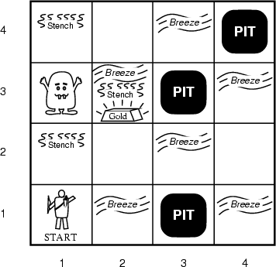
AIMA’s Wumpus World
The agent always starts in the field [1,1]
Agent’s task is to find the gold, return to the field [1,1] and climb out of the cave

Slide 4
A simple reflex agent: if-then rules
Rules to map percepts into observations:
  ∀b,g,u,c,t Percept([Stench, b, g, u, c], t) → Stench(t)
  ∀s,g,u,c,t Percept([s, Breeze, g, u, c], t) → Breeze(t)
  ∀s,b,u,c,t Percept([s, b, Glitter, u, c], t) → AtGold(t)
Rules to select action given observations:
  ∀t AtGold(t) → Action(Grab, t);
Difficulties:
  Consider Climb: No percept indicates agent should climb out; position & holding gold not part of percept sequence
  Loops: percepts repeated when you return to a square, causing same response (unless we maintain some internal model of the world)

Slide 5
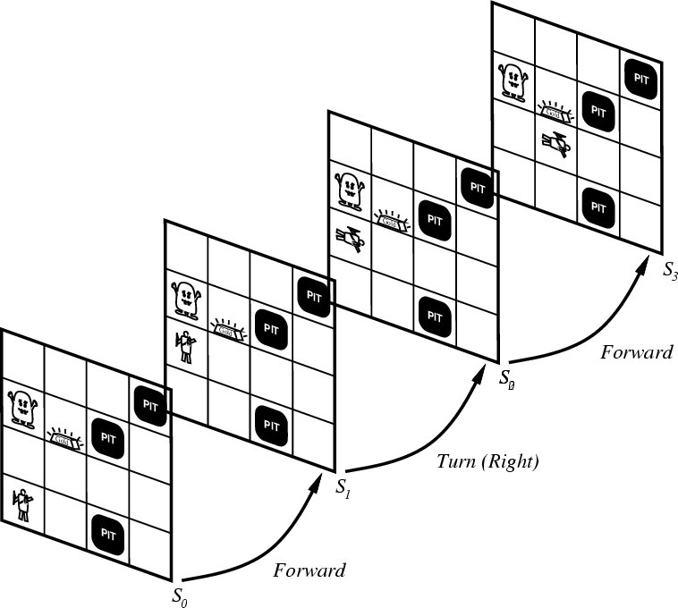
Representing change
Representing changing world in logic is tricky
One way: just change the KB
  Add and delete sentences from KB to reflect changes
  How do we remember past, or reason about changes?
Situation calculus is another way
Situation: snapshot of the world
at some instant in time
When the agent performs
action A in situation S1,
result is new situation S2

Slide 6
Situation calculus
A situation is a snapshot of the world at an interval of time during which nothing changes w.r.t a particular situation
  Add situation variables to every predicate.
  at(Agent, L) becomes at(Agent, L, s0): at(Agent, L) true in situation (i.e., state) s0
  Or, add a special second order predicate, holds(f, s), meaning “f is true in situation s”, e.g., holds(at(Agent, L), s0)

Slide 7
Situation calculus
Add new function, result(a, s), mapping situation s to new situation as result of performing action a
  i.e., result(forward, s) is a function returning next situation
Example: The action agent-walks-to-location-y could be represented by
  (∀x)(∀y)(∀s) (at(Agent, L1, S) ∧ ¬onbox(S)) → at(Agent, L2, result(walk(L2), S))

Slide 8
Deducing hidden properties
From the perceptual information we obtain in situations, we can infer properties of locations
  ∀l,s at(Agent, L, s) ∧ Breeze(s) → Breezy(L)
  ∀l,s at(Agent, L s) ∧ Stench(s) → Smelly(L)
Neither Breezy nor Smelly need situation arguments because pits and the Wumpus do not move around

Slide 9
Deducing hidden properties II
Need rules relating aspects of single world state (as opposed to between states)
Two main kinds of such rules:
  Causal rules reflect assumed direction of causality
    (∀L1,L2,S) at(Wumpus,L1,S) ∧ adjacent(L1,L2) → Smelly(L2)
    (∀ L1,L2,S) at(Pit,L1,S) ∧ adjacent(L1,L2) → Breezy(L2)
    Systems that reason with causal rules are model-based reasoning systems
  Diagnostic rules infer presence of hidden properties directly from percept-derived information, e.g.
    (∀ L,S) at(Agent,L,S) ∧ Breeze(S) → Breezy(L)
    (∀ L,S) at(Agent,L,S) ∧ Stench(S) → Smelly(L)

Slide 10
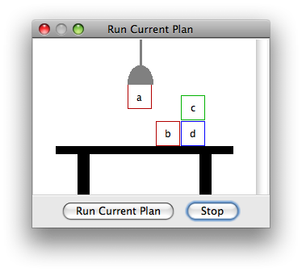
Blocks world
The blocks world is a micro-world consisting of a table, a set of blocks and a robot hand.
Some domain constraints:
  Only one block can be on another block
  Any number of blocks can be on
  the table
  The hand can only hold one block
Typical representation:
  ontable(b) ontable(d)
  on(c,d) holding(a)
  clear(b) clear(c)
Meant to be a simple model!

Slide 11
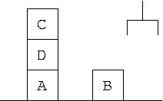
Representing change
blocks world
Frame axioms encode what’s not changed
by an action
E.g., moving a clear block to the table doesn’t change the location of any other blocks
    On (x, z, s) ∧ Clear (x, s) →
    On (x, table, Result(Move(x, table), s)) ∧
    ¬On(x, z, Result (Move (x, table), s))
    On (y, z, s) ∧ y≠ x → On (y, z, Result (Move (x, table), s))
Proliferation of frame axioms becomes very cumbersome in complex domains
  What about color, size, shape, ownership, etc.
Notes:
The first frame axiom says that when we move a clear clock to the table it’s not on what It used to be on and is now on the table
The second says that the on relationship of any other block has not changed

Slide 12
The frame problem II
Successor-state axiom characterizes every way in which a particular predicate can become true:
  Either it can be made true, or it can already be true and not be changed:
  On (x, table, Result(a,s)) ↔
  [On (x, z, s) ∧ Clear (x, s) ∧ a = Move(x, table)] v
  [On (x, table, s) ∧ a ≠ Move (x, z)]
Complex worlds require reasoning about long action chains; even these types of axioms are too cumbersome
  Planning systems use custom inference methods to reason about the expected state of the world during multi-step plans

Slide 13
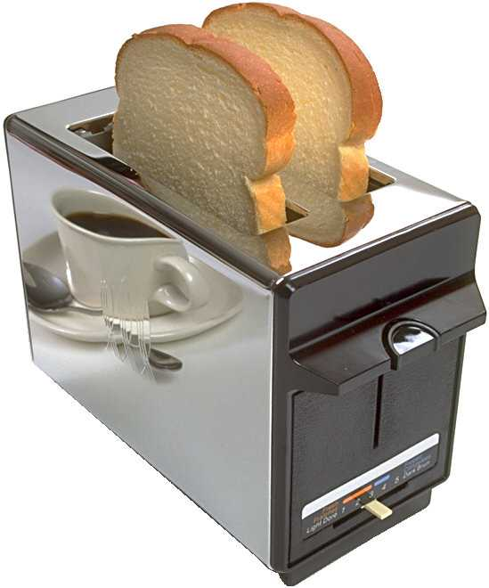
Qualification problem
How can you characterize every effect of
an action, or every exception that might occur?
Putting my bread into the toaster, & pushing the button, it will become toasted after two minutes, unless…
  The toaster is broken, or…
  The power is out, or…
  I blow a fuse, or…
  A neutron bomb explodes nearby and fries all electrical components, or…
  A meteor strikes the earth, and the world we know it ceases to exist, or…

Slide 14
Ramification problem
Nearly impossible to characterize every side
effect of every action, at every level of detail
When I put my bread into the toaster, and push the button, the bread will become toasted after two minutes, and…
  The crumbs that fall off the bread onto the bottom of the toaster over tray will also become toasted, and…
  Some of the those crumbs will become burnt, and…
  The outside molecules of the bread will become “toasted,” and…
  The inside molecules of the bread will remain more “breadlike,” and…
  The toasting process will release a small amount of humidity into the air because of evaporation, and…
  The heating elements will become a tiny fraction more likely to burn out the next time I use the toaster, and…
  The electricity meter in the house will move up slightly, and…

Slide 15
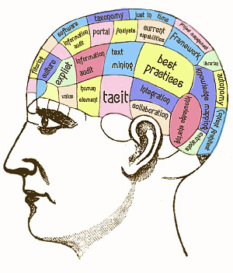
Knowledge engineering!
Modeling the right conditions and the right effects at the right level of abstraction is difficult
Knowledge engineering (creating & maintaining KBs for intelligent reasoning) is field unto itself
We hope automated knowledge acquisition and machine learning tools can fill the gap:
  Intelligent systems should learn about conditions and effects, just like we do!
  Intelligent systems should learn when to pay attention to, or reason about, certain aspects of processes, depending on context. (metacognition?)

Slide 16
Preferences among actions
A problem with the WWKB described so far is how to decide which of several actions is best
E.g., how to decide between forward and grab, axioms describing when it is OK to move to a square would have to mention glitter
This is not modular!
We can solve this problem by separating facts about actions from facts about goals
This way our agent can be reprogrammed just by asking it to achieve different goals

Slide 17
Preferences among actions
First step: describe the desirability of actions independent of each other
We can use a simple scale: actions can be Great, Good, Medium, Risky, or Deadly
Obviously, the agent should always do the best action it can find:
  (∀a,s) Great(a,s) → Action(a,s)
  (∀a,s) Good(a,s) ∧ ¬(∃b) Great(b,s) → Action(a,s)
  (∀a,s) Medium(a,s) ∧ (¬(∃b) Great(b,s) ∨ Good(b,s)) → Action(a,s)
  ...

Slide 18
Preferences among actions
Until it finds gold, basic agent strategy can be:
Great actions: picking up the gold when found, climbing out of the cave with the gold
Good actions: moving to a square that’s OK and hasn't been visited yet
Medium actions: moving to a square that is OK and has already been visited
Risky actions: moving to a square that’s not known to be deadly or OK
Deadly actions: moving into a square that is known to have a pit or a Wumpus

Slide 19
Goal-based agents
Once gold is found, we must change strategies, requiring a new set of action values.
We could encode this as a rule:
  (∀s) Holding(Gold,s) → GoalLocation([1,1]),s)
We must decide how the agent will work out a sequence of actions to accomplish the goal
Three possible approaches:
  Inference: good versus wasteful solutions
  Search: a problem with operators and set of states
  Planning: to be discussed later

Slide 20
Coming up next
Logical inference
Knowledge representation
Planning

