Slide 1
History of Computing
CMSC 304, September 25, 2013 – Prof. Marie desJardins

Slide 2
What is the History of Computing?
???

Slide 3
Movie Day
Computer History in 90 Seconds
  https://www.youtube.com/watch?v=wfU___GMMJw
Pre-Computing and Today: Abacus Action
  https://www.youtube.com/watch?v=wIiDomlEjJw
World War I: Breaking the Code clip (Alan Turing)
  http://www.youtube.com/watch?v=gV67Sj2jkVg
World War II: ENIAC / “Top Secret Rosies”
  http://vimeo.com/24993772
Making History Today: Self-Driving Car
  http://www.slate.com/blogs/future_tense/2012/03/29/google_s_self_driving_car_takes_a_blind_man_to_taco_bell_video_.html

Slide 4
Discussion Questions
Is the advent of the smartphone in the ’10s the same kind of revolution as the PC in the ’80s? What are the similarities and differences?
“Machine of the Year,” Time, 1982
  Quiz: In 85 years, how many Women of the Year do you suppose there have been?
    (Don’t even get me started about how nobody would ever buy a computer for Susie!!!!!!!! This article was written when I was in college, for criminy’s sake! It wasn’t exactly the dark ages, though you would think so from that stupid comment...)
  “The most visible aspect of the computer revolution, the video game, is its least significant.” True?
Notes:
Started in 1927. Four Women of the Year (Wallis Simpson, Madame Chiang Kai-Shek (with Chiang Kai-Shek), Queen Elizabeth II, and Corazon Aquino) before 1999, when it was changed to “Person of the Year.” Since then, four: three in a group (Cynthia Cooper, Coleen Rowley, and Sherron Watkins) and one individual (Melinda Gates). Plus “American Women” in 1975. Mostly women who are famous for being married to famous men. Even the 15 “American Scientists” in 1960 managed to all be men.

Slide 5
Discussion Questions cont.
In 1982, there were 1450 databases in the US. How many do you think there are now?
“’You cannot rely on being able to find what you want [on the Internet],” says Atari’s Kay. ‘It’s really more useful to go to a library.’”
  Enter Google, stage left...
How many typos did you find in the Time article?
Will MOOCs make the traditional classroom obsolete in the not-too-distant future?
What’s your prediction for the next big technology revolution?

Slide 6
And now, for something completely different...

Slide 7
Paper Enigma Machine
German rotor-based encoding/decoding machine
Alan Turing and others developed techniques to break the Enigma code
You get to be a codebreaker today...
  http://www.tandfonline.com/doi/pdf/10.1080/0161-110491892881

Slide 8
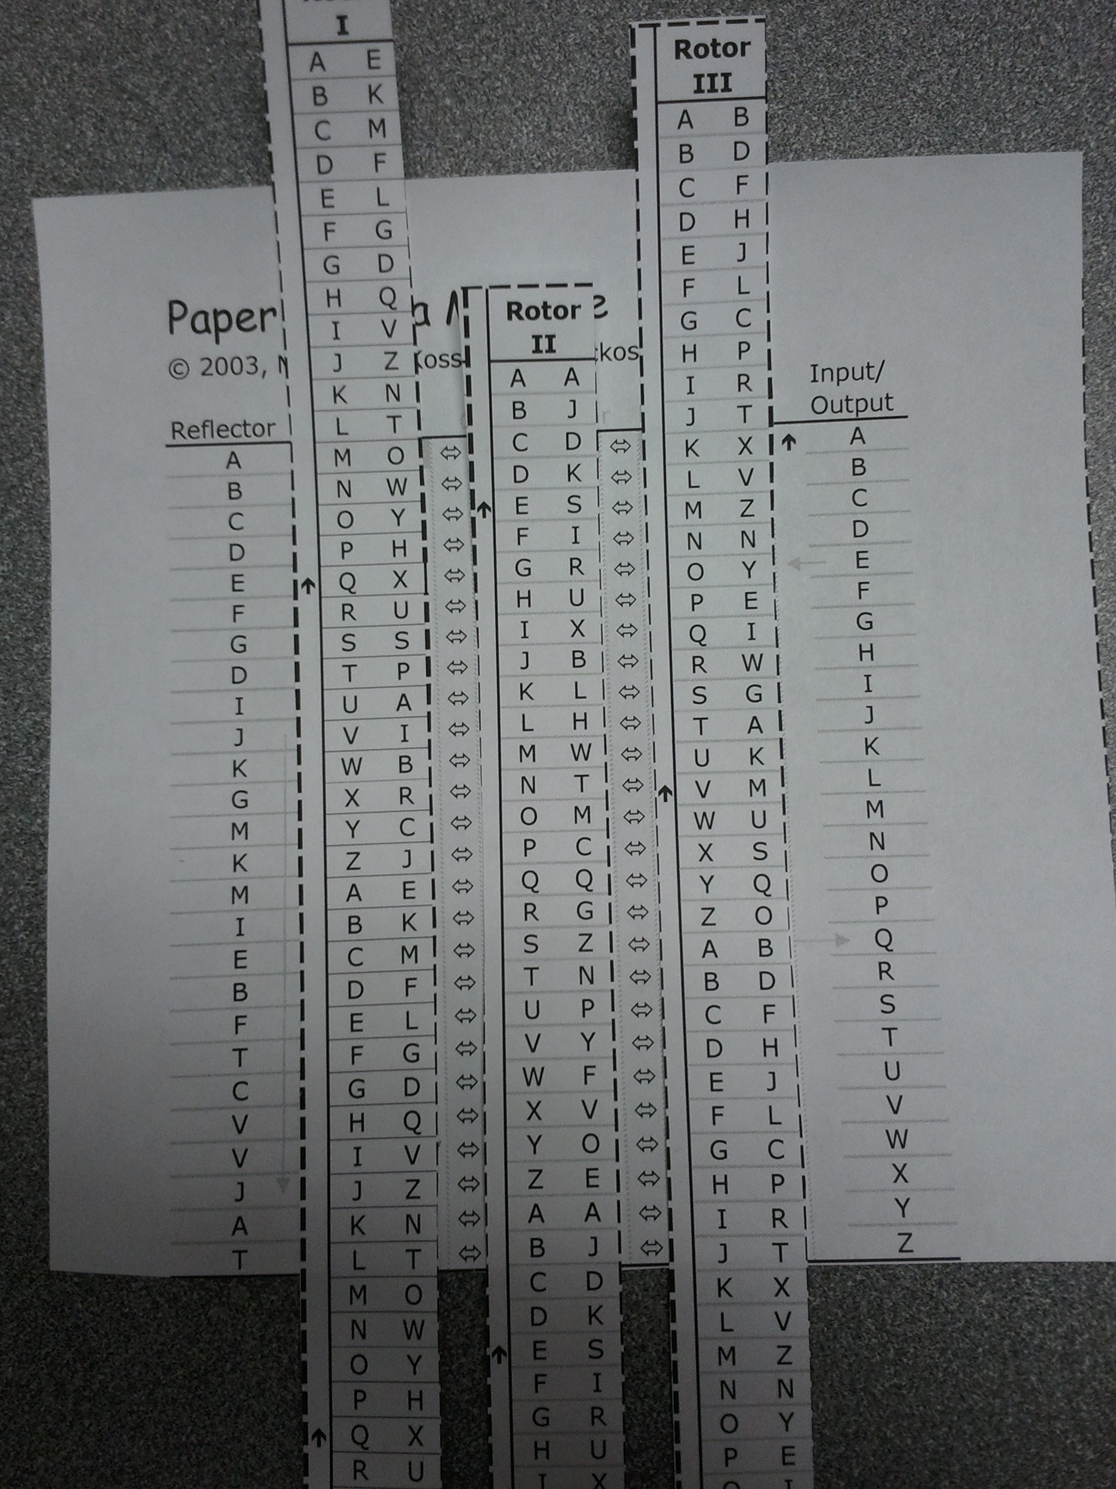
Order the rotors as specified
from left to right.
Position the rotors vertically
so that the three letters in the
initial code position align
with the As in the left and
right columns (“Row A”).
Repeat:
  Slide up each rotor that
  has an arrow in Row A
  on either side. (The
  right rotor always slides
  up, since there is an
  arrow to its right.)
  Find the next letter to be
  encoded/decoded in
  the right row.
  Map through the rotors
  leftwards to the Reflector
  column then right again
  to the Input/Output
  column

Slide 9
Initial setting: I-II-III, MCK
Message to decode:
QMJIDO MZWZJFJR

Slide 10
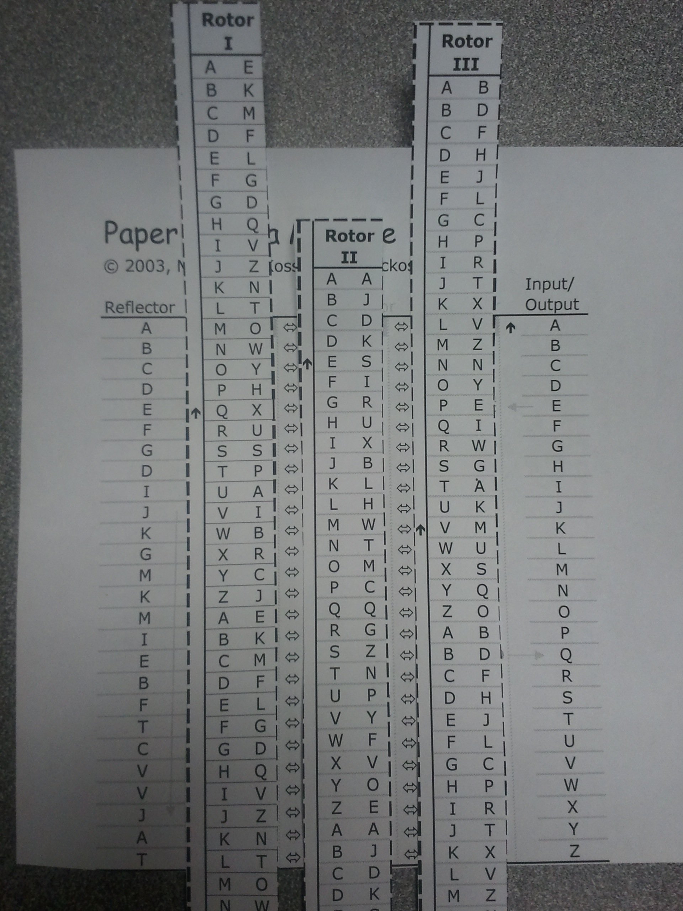
Initial setting: I-II-III, MCK
Message to decode:
QMJIDO MZWZJFJR
Slide right rotor up (MCL)

Slide 11
Initial setting: I-II-III, MCK
Slide right rotor up (MCL)
Map:
  Q (Input/Output)
  D (Rotor III right)
  P (Rotor II right)
  J (Rotor I right)
  J (Reflector)
  V (Rotor I left)
  Y (Rotor II left)
  E (Rotor III left)
  E (Input/Output
So Q decodes to E
Slide right rotor up (MCM) and continue...

Slide 12
Decoding the Example
Initial setting: I-II-III, MCK
Q ➔ E (MCL)
M ➔ N (MCM)
J ➔ I (MCN)
I ➔ G (MCO)
D ➔ M (MCP)
O ➔ A (MCQ)
M ➔ R (MCR)
Z ➔ E (MCS)
W ➔ V (MCT)
Z ➔ E (MCU)
J ➔ A (MC⬆V)
F ➔ L (MDW)
J ➔ E (MDX)
R ➔ D (MDY)

Slide 13
Your Turn...
Initial settings: III-II-I, MDJ
Message: KFI NIL G EAUEQ

