Slide 1
Algorithmic Problem Solving IS 101Y/CMSC 101 Computational Thinking and Design Tuesday, September 10, 2013 Marie desJardins University of Maryland, Baltimore County
Notes:
(test of piazza real-time quiz/clicker question)

Slide 2
Meta-Piazza Mini-Quiz
Say wha???

Slide 3
Important Problems
Parking and traffic
Recession / collapse of the economy
Disease and obesity
Personal privacy
Cybersecurity
Getting enough sleep
Energy crisis
Environmental degradation
World hunger
Drug abuse
Syria
Losing your keys

Slide 4
Algorithms
An algorithm is an ordered set of unambiguous steps that describes a process
Examples from real life:
Recipes
Project directions - chemistry lab, writing prompt
Instruction manual (IKEA)
Construction/building anything
Scientific method
Deciding what you want for lunch
Krebbs cycle (breathing/photosynthesis)
Medical protocols

Slide 5
Algorithms Express Solutions to Computational Problems
Algorithms are expressed and implemented using languages
Possibilities: natural language, pseudocode, visual and textual programming languages
Different languages may be more suitable for solving different problems
The choice of language can affect clarity or readability, but not whether a solution exists
Algorithms can solve many, but not all, problems
Many problems can be solved in a reasonable time
Some require heuristic (approximate) approaches to solve them in a reasonable time
Some problems cannot be solved using any algorithm
Algorithms are evaluated analytically and empirically
Many possible criteria (e.g., efficiency, correctness, usability, ...)
Different algorithms for the same problem can have different measurements for these criteria

Slide 6
Your Examples
Solving Rubik’s code
Life
Sports plays (diagrams)
How to win at chess
Grammar and languages
Making coffee
Notes:
Ask students to suggest examples of algorithms.
Some possibilities: recipe, assembly instructions, origami, driving directions, musical score, line/square/contra dance steps, diagrammed basketball/football/soccer plays,

Slide 7
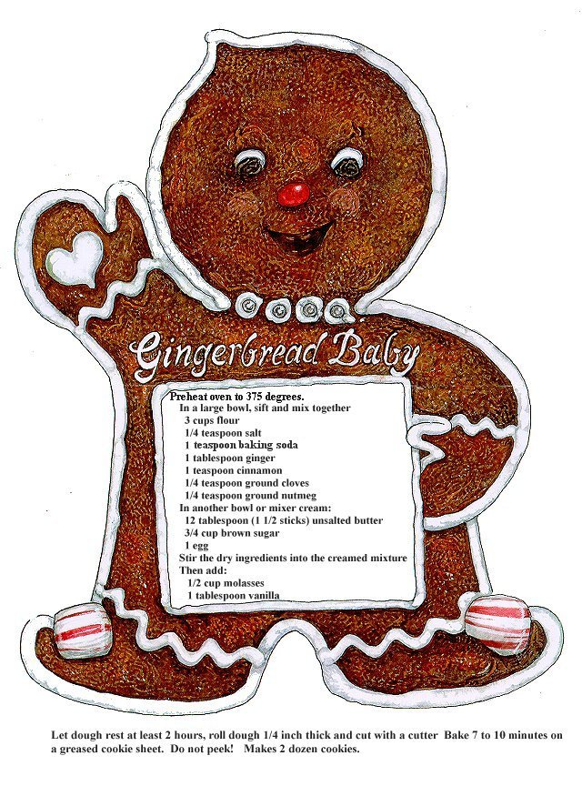

Slide 8
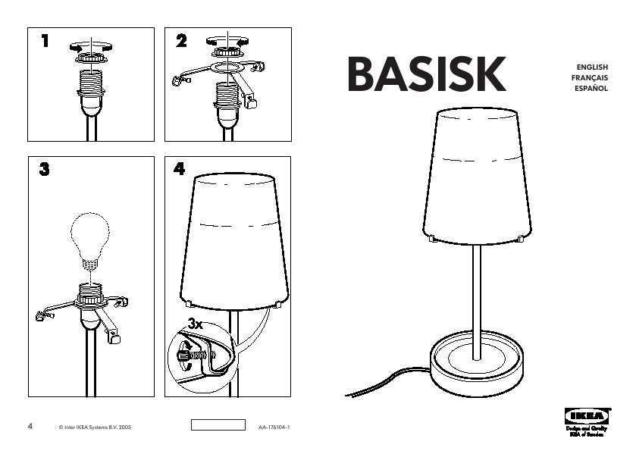

Slide 9
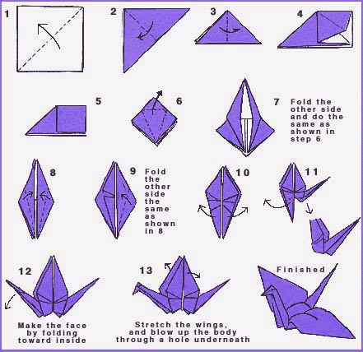

Slide 10
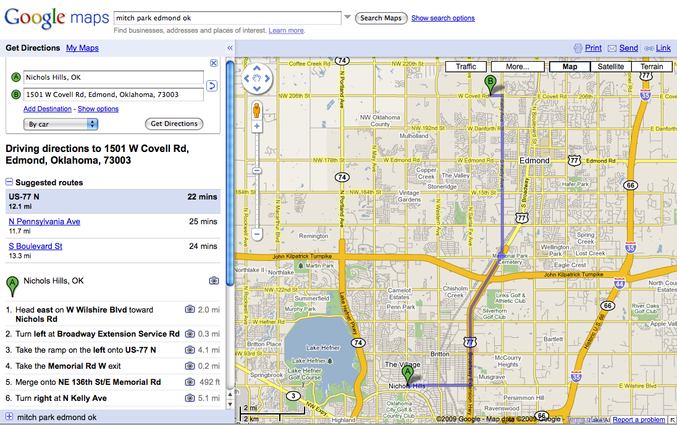

Slide 11
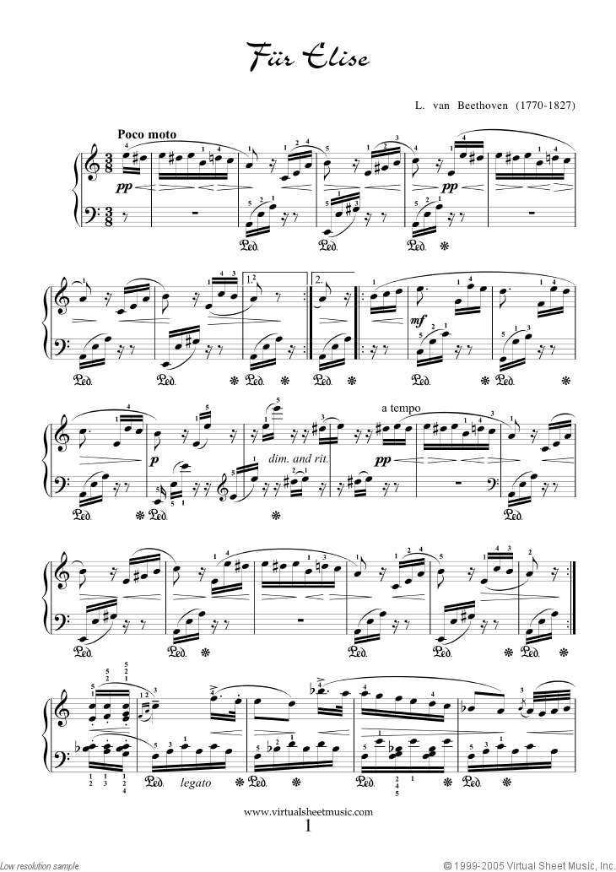

Slide 12
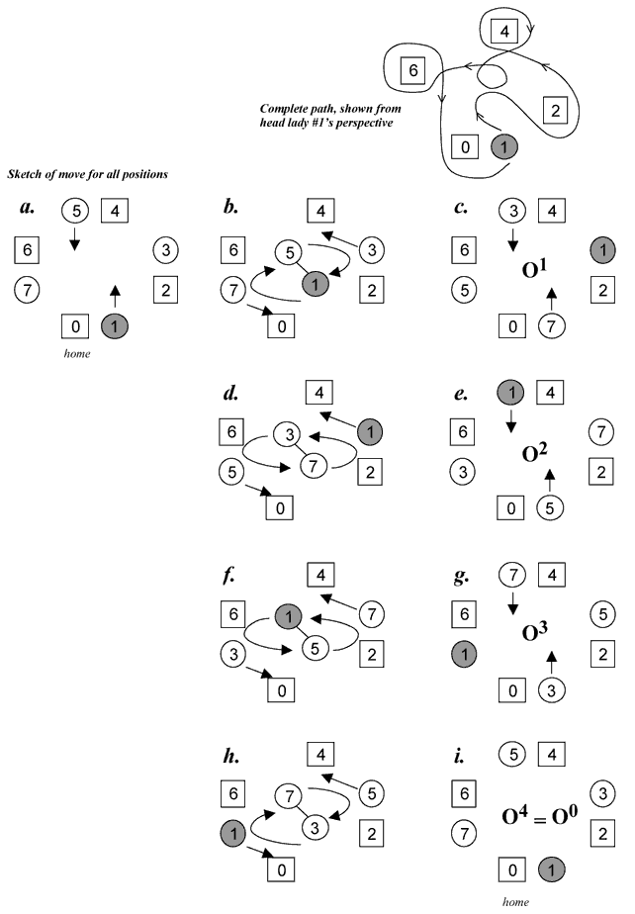

Slide 13
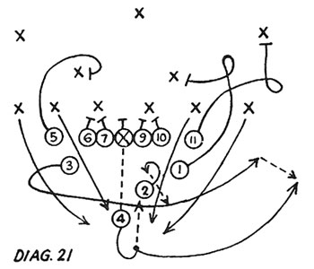
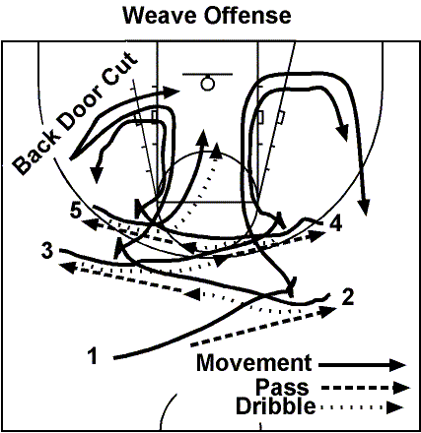
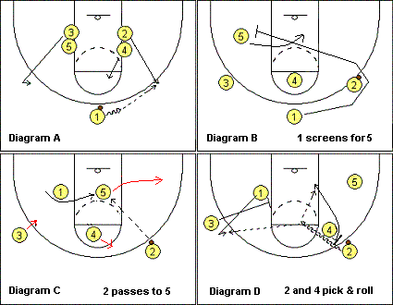
Notes:
Maybe these are parallel algorithms?

Slide 14
Friendship
Sheldon’s Friendship Algorithm http://www.youtube.com/watch?v=k0xgjUhEG3U
Notes:
BBT Friendship algorithm: http://www.youtube.com/watch?v=k0xgjUhEG3U

Slide 15
Algorithms: Syntax and Semantics
Before you can write an algorithm, you have to have a language in which to express it
Basic components of every algorithmic language:
“Primitive” actions
Conditionals: if <condition> then <actions>
Loops: repeat <actions> until <condition>
Variables: places to store information
Input and output: ways to get information into the algorithm and to return information to the invoker
Functions: ways to group instructions into a “macro-action” or “subgoal”

Slide 16
Whipped Butter Frosting
7 1/2 T all purpose flour
1 1/2 C milk
1 1/2 C butter
1 1/2 C granulated sugar
3/8 t salt
3 t vanilla
Blend flour and milk until smooth. Cook over medium heat until very thick. Stir constantly. Cool. Cream butter at medium speed. Add sugar gradually, 1/4 C at a time. Add milk mixture. Beat until smooth and fluffy. Add salt and vanilla. Beat well.
Is this a reasonable primitive action? (for Julia Child? for a 5-year-old?)
Here’s a loop termination condition...
What’s the termination condition??
Is this a reasonable primitive action? Maybe it should be written as a loop...
Notes:
Identify loops.
Identify control flow (what actions proceed in what order and what manner). For instance, logically, stirring of the milk mixture won’t happen until after the milk mixture is finished thickening (which would be wrong).

Slide 17
Peanut Butter and Jelly
In your group, write an algorithm to make a peanut butter and jelly sandwich.
What could possibly go wrong?
Notes:
Bring a loaf of bread, an unopened jar of peanut butter, an unopened jar of jelly, a knife, and a roll of paper towels.
Pick a group and have them read their steps.
Follow the student’s instructions LITERALLY, in the most un-useful way possible.
Revisit the idea of “primitive actions” and “conditions”

Slide 18
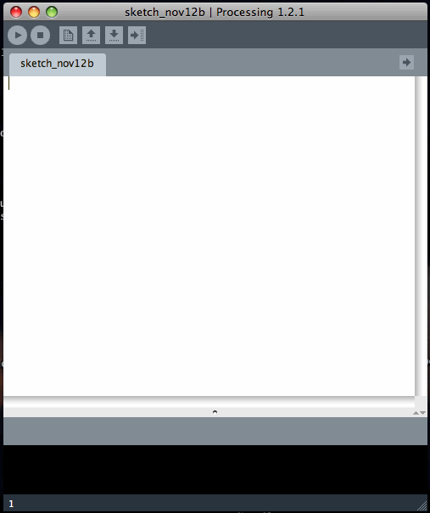
Processing
Language for programming graphical and interactive computations

Slide 19
Processing Demonstration
“My Crazy Squares” by Marcella Todaro
http://www.openprocessing.org/sketch/49183
CrazySquares.pde
Notes:
Run the CrazySquares.pde program
Explain what it’s doing
Show the code and make a few simple changes: fewer squares, moving slower, different colors before and after clicked

Slide 20
Processing: Program Basics
size() is a function that
changes the size of the
display window. size(w,h)
sets the display to be w pixels
wide and h pixels high.
setup: initialize the display void setup() { size (500, 500); }
draw: invoked each time step to update the display. Example: void draw() { if (mousePressed) { background(0); } else { background(255); } }
A ; character is needed
after every statement in
Processing
background() changes the
color of the display background.
0 is black; 255 is white; numbers
in between are shades of gray. If
you give three values to background(),
it uses them as RGB (red/green/blue)
color components.
Notes:
Start a new Processing window and demonstrate these examples. Try different grayscale and non-grayscale colors in “background”

Slide 21
Processing: Defining Variables
A variable stores a piece of information (i.e., a value)
Variable types:
int (integer)
float (real-valued)
boolean (“true” or “false”)
char (character, such as ‘x’ or ‘+’)
Variable definition:
<type> <name> [<value>]
Examples: int brightness 0; float xPosition; boolean makeBrighter;
Variable definitions should always go at the top of your program or at the beginning of a function
Variables should have meaningful
names. We’ll generally use “camel
case” as shown here to separate
words in a variable name.

Slide 22
Processing: Manipulating Variables
Changing the value of a variable: <name> = <expression>
<expression> must be an expression that evaluates to a value of the correct type
Examples: brightness = 255; brightness = brightness + 1; brightness++; xPosition = xPosition – 3.0; makeBrighter = ! makeBrighter;
Note: White space (spaces, tabs, carriage returns) are ignored by Processing – white space is primarily used to make code more readable
These do the same thing! What do you think “brightness--” does?
The “!” operator means “not” – it changes
“true” to “false” and “false” to “true”. Other
boolean operators include && (and) and
|| (or)

Slide 23
Processing: Drawing Pictures
All locations on the screen are specified by two values: x (distance from left edge) and y (distance from top edge). The upper left corner is (0, 0).
Lines: line(x1, y1, x2, y2);
Basic shapes: rect(x, y, width, height); // x,y = upper left ellipse (x, y, width, height); triangle(x1, y1, x2, y2, x3 y3);
General polygon: beginShape(); vertex(x,y); ...; endShape();
Line attributes: strokeWeight(thickness); fill(grayscale) OR fill(R, G, B);
Notes:
Show examples!!

Slide 24
Processing: Conditionals
<if> <boolean expression> { <commands> }
<if> <boolean expression> { <commands> } else { <commands> }
Example: if ( makeBrighter ) { brightness--; } else { brightness++; }
Notes:
Set up “brightness” and “makeBrighter” variables in Processing.
Add this conditional to “draw”.
Coach them through the process of two if statements – one that will switch the direction of makeBrighter when “brightness” reaches 0 or 255, and one this one that increments/decrements makeBrighter. Show the resulting program – screen glows/darkens.
Glow.pde

Slide 25
Processing: for Loops
for ( <init> ; <condition> ; <update> ) { <commands> }
Performs the initialization step <init>
Tests <condition> - if false, STOPS! Else...
Performs <commands>
Performs <update>
Goes back to “Tests” step
Example: int i; for ( i=0 ; i<3 ; i++ ) { rect (100*i, 50, 50, 50); }

Slide 26
Mini-Exercises
What if we want a program that will draw any number of squares?
Notes:
Coach them through modifying the for loop on the previous slide to use a NumSquare parameter that’s defined as a variable
Show that the squares will go off the edge of the screen if you make too many of them
That code will be a starting point for the tutorial exercises they’ll do in their groups in the next class, which will lead into the Garden assignment (PA2)

Slide 27
Code Tracing
An important skill is to be able to read code (whether you wrote it or someone else did!) and be able to predict what it will do
In your groups, work through the code tracing examples in the handout
If you don’t finish in class, you should work on these outside of class and be sure that you understand them before Thursday
Come to office hours if you need to!! Office hour options between now and Thursday’s class:
Emily – Tue 5:30-6:30
Amanda – Wed 10-11
Alec – Wed 11-12
Dr. dJ – Wed 2-3

Slide 28
Parting Thoughts
For Thursday, be sure you understand the meaning/behavior of these Processing commands and concepts:
size ()
variable declaration and assignment (including simple mathematical operations, < > comparisons, “++” and “--” operations)
rect, ellipse, triangle (and what the parameters mean / what effect they have)
fill (parameters and effects), strokeWeight
for loops (what the three parts mean and how the loop will behave)
if... then ... else

