Slide 1
Computational Thinking IS 101Y/CMSC 101 September 5, 2013 Marie desJardins University of Maryland Baltimore County

Slide 2
What are Important Problems?
Break into your groups
Each group should come up with five problems/goals in world/life
Could be important societal challenges
Could be something important to you
Could be something you enjoy
Report out by random group member

Slide 3
Important Problems
UMBC parking
Expensive textbooks
Traffic for commuters
Collapse of the economy
Miley Cyrus
Need RedBox rentals on campus
Chick-fil-a closed on Sundays
Hitler existed
Notes:
Record important problems here, revisit at the end of each area unit

Slide 4
Important Problems
It’s only hot during the summertime (in some parts of the world)
Hand sanitizer only kills 99.9% of germs
College desks and lecture halls too small
Google still can’t find my keys
There are diseases
Sleeping in your contacts
Privacy in your dorm room
Notes:
Record important problems here, revisit at the end of each area unit

Slide 5
Important Problems
Morning classes
Squeaky beds
Not getting adequate sleep
Energy crisis
Environmental degradation
World hunger
Drug abuse

Slide 6
Important Problems
The recession
Syria
Obesity crisis
Cybersecurity
Having to wake up early
Students who won’t tell you their names

Slide 7
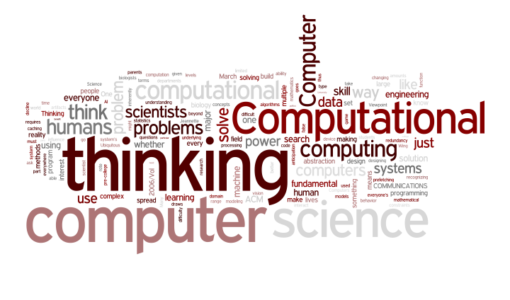
Computational Thinking
Notes:
What were the main points of this article?
Do you agree?
Should everyone learn about CT? When?

Slide 8
Computational Ideas
Solving problems by “reduction, embedding, transformation, or simulation”
Thinking recursively
Parallel processing
“type checking as the generalization of dimensional analysis”
“virtues and dangers of aliasing”
“cost and power of indirect addressing and procedure call”
Notes:
Some terms from the article that may be unfamiliar - discuss

Slide 9
Discussion Questions (one for each team, 60 second report-back)
How many of the computing terms used in the article were unfamiliar to you? At what point in your computing education do you think you’d be able to understand all the computing references in the article?
Dr. Wing uses the term “computer science” throughout the article. Based on what you know now, do you think the article equally applies to all computing majors at UMBC (CS, IS, BTA, CE)?
Do you think computational thinking is something that should be taught? When? To whom?
Do you think everyone is capable of computational thinking?
Do you think computational thinking is geeky? Why or why not? Is that good or bad?
Can you come up with an example of a situation where computational thinking would NOT be appropriate?
Do you think computational thinking is more or less important for people to learn than good writing skills? Why?

Slide 10
AP CS Principles: Big Ideas
Did any of you take AP CS?
Why/why not?
Joint effort between CRA and College Board to develop new AP CS Principles course
The computing content of this course generally follow that model

Slide 11
AP CS Principles: Big Ideas
Computing is a creative activity.
Abstraction reduces information to focus on relevant concepts.
Data and information facilitate the creation of knowledge.
Algorithms are used to express solutions to computational problems.
Programming enables problem solving, expression, and knowledge creation.
The Internet pervades modern computing.
Computing has global impacts.

Slide 12
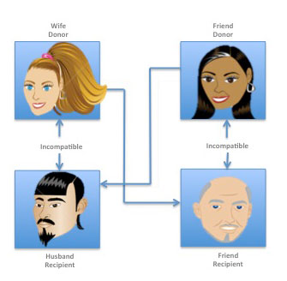
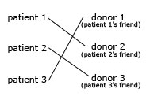
A Kidney Story
Kidney disease affects 50,000 new Americans a year
A great example of computational abstraction!
Pairs
Cycles
Chains
Two cycle Three cycle
Notes:
Review these examples on the board to be sure they understand the idea of a chain/cycle

Slide 13
A Big Kidney Story
What about really big chains?
How do you come up with an optimal series of swaps?
NY Times, Feb 19, 2012
Exercise taken from:
http://www.nsf.gov/cise/csbytes/newsletter/vol1/vol1i6.html
Notes:
http://www.nytimes.com/2012/02/19/health/lives-forever-linked-through-kidney-transplant-chain-124.html?_r=1

Slide 14
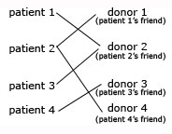
Kidney Exchange
Consider the exchange below. A patient is connected to a donor if they are biologically compatible. A donor will only donate a kidney if his or her friend also receives a kidney. What is the optimal exchange for this situation? Why?
What technique did you use to solve this problem? How would your technique scale if there were ten donors and patients? 100? Thousands?

Slide 15
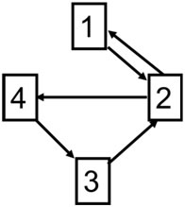
Alternative Representation
A graph data structure can capture the important relationships among patients and donors
This representation is an abstraction of the matching problem
In reality, the problem is more complex – edges are labeled with weights that represent the degree/quality of the match
A legal exchange is a path that never visits any vertex twice
A cycle returns to the starting vertex; a chain does not
If every node was visited (every patient received a kidney and every donor donated one), this would be called a Hamiltonian cycle
Discovering a Hamiltonian cycle is a famous NP-complete (i.e., computationally hard) problem
What is the longest legal chain in this graph? Longest legal cycle?

Slide 16
Reminders
Processing Assignment 1 is due next Tuesday, 9/10
Very important to complete this before class
We will be starting to learn Processing, including in-class labs
Start early with the reading for next week!

