Slide 1


Artificial Intelligence:
Fact or Fiction?
CMSC 101 / IS 101Y
Dr. Marie desJardins
December 3, 2013

Slide 2







AI: A Vision
Could an intelligent agent living on your home computer manage your email, coordinate your work and social activities, help plan your vacations…… even watch your house while you take those well planned vacations?

Slide 3
What is AI?

Slide 4
Main Goals of AI
Represent knowledge
Reason about knowledge
Behave intelligently in complex environments
Develop interesting and useful applications
Interact with people, agents, and the environment

Slide 5
Foundations of AI
Computer
Science &
Engineering
Mathematics
Philosophy
AI
Economics
Biology
Psychology
Linguistics
Cognitive
Science

Slide 6
Big Questions
Can machines think?
If so, how?
If not, why not?
What does this say about human beings?
What does this say about the mind?
And if we can make machines think, should we?

Slide 7
Early AI: Eliza
ELIZA: A program that simulated a psychotherapist interacting with a patient
Implemented at MIT during 1964-1966 by Joel Weizenbaum
Really simple “chatbot” approach – pattern matching without any understanding
People thought that AI was solved!!

Slide 8
Eliza Speaks
I am the psychotherapist. Please, describe your problems.
i'm having a hard time with my students
Why do you say that?
well, they keep asking me for money
Maybe your plans have something to do with this.
what plans?
Is it because of your life that you say what plans?
No, it's because I didn't know what you were talking about
Is it because you didn't know what I was talking about that you came to me?
no, it's because i wanted to see if you could pass the turing test
Does it bother you that you wanted to see if I could really pass the turing test?
…..
How do you reconcile problems at school?
This is a waste of time. Good bye
My secretary will send you a bill.

Slide 9
Early AI: Parry
Kenneth Colby modeled a paranoid using the same techniques as Eliza, around 1968
PARRY has basic emotions. If it gets angry, its replies become more hostile
Expert psychiatrists were unable to distinguish PARRY’s ramblings from those of real paranoids!

Slide 10
PARRY Speaks
Good afternoon. My name is Doctor Jones.
Pleased to meet you.
How are you?
All right I guess.
Could you tell me your name?
Pat Smith.
I though you might have some problems.
I've been upset lately.
By what?
People get on my nerves sometimes.
Tell me more.
Do you know anything about bookies?
...

Slide 11
Eliza Meets Parry
P: I don't understand your motives.
E: Why don't you understand my motives?
P: Shouldn't I be?
E: Why do you say that just now?
P: That's just the way it is.
E: Suppose that's the way it were not.
P: So?
E: I am not sure I understand you fully.
P: You harp on the same questions too much.
E: What does that similarity suggest to you?
P: I don't get you.
E: Do you wish that you did get I?
Please tell me *this* isn't AI!

Slide 12
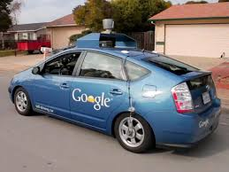
The Coolest AI Technology Today
  Your kids probably won’t even need to learn to drive...
  Google self-driving car
  Nissan self-driving car
Notes:
We’ve already seen the Google video in class, so I was planning to just show the Nissan video

Slide 13
State Space Search

Slide 14
Important Ideas in AI
Abstraction
  GPS navigation == Graph search
  Academic class scheduling == Constraint-based search
  Creating a cool game avatar == Search through design space
Hey, what’s this search stuff?
  The most important idea behind AI systems
  Define a set of possible solutions to a problem
  Define ways to transform one possible solution to another
  Start from some random (maybe bad/wrong solution)
  Apply transformation steps until you find a good solution

Slide 15
For Example...
GPS navigation == Graph search
  Start from a bad solution (stay where you are)
  Apply transformations (drive along a road segment)
  Find the right solution (drive to your destination!)
Academic class scheduling == Constraint-based search
  Start from a bad solution (an empty schedule)
  Apply transformations (add a class that results in a better schedule)
  Find the right solution (best set of classes)
Creating a cool game avatar == Search through design space
  Start from a bad solution (random/default avatar)
  Apply transformations (change one feature to make a better avatar)
  Find the right solution (the coolest avatar ever)

Slide 16
Now You Try It!
Teenagers and Zombies
  Three teenagers and three zombies are on the west side of a river
  There is one boat that will hold up to two people/zombies (and can’t row itself, so must carry at least one at a time)
  If zombies ever outnumber teenagers (on either side of the river), the zombies will eat all of the teenagers
  How can all of the teenagers and zombies get across to the east side of the river?
Think about that for a while... Talk amongst yourselves!

Slide 17
Saving Teenagers Through State-Space Search
What are the possible “states”?
  [Z,T,*] = [Number of zombies on west, number of teenagers on west, whether the boat is in the west or east]
  Initial state is [3,3,W]. What is the goal state?
  How many possible states are there?
  How many of those states are illegal?
    Any state where zombies outnumber teenagers ([3,2] or [1,2] – why?)
    Note that [3,0] is OK since there are no teenagers to be eaten!
Start with the goal state and build the “graph” of possible moves
  From the goal state, what are the next states you can get to?
  Then what?
  Solution = path through graph from [3,3,W] to [0,0,E]
Notes:
- First have the class identify the goal state, which is [0, 0, E].
- Next have them generate a list of all illegal states: [1,0,*], [2,0,*], [2,1,*], [1,2,*], [0,2,*]
- Finally, have the students draw the state space graph in their groups, being sure that they indicate loops as “back arrows” (undoing the previous move), and that they cross out any illegal states (indicating a dead end path).
- Have some group come to the board to show their solution as a path through the graph.
- Alternatively, you could work through the whole thing as an exercise on the board as a class.

Slide 18
Game Playing

Slide 19
Let’s Play Nim!
Seven tokens (coins, sticks, whatever)
Each player must take either 1 or 2 tokens
Whoever takes the last token loses
You can go first…
Notes:
- Let a couple of students volunteer; you can beat them every time.
- The trick to this game is to let the other player go first. Each time they take k tokens, you take 3-k. They will be left holding the bag at the end of the game. That strategy works for any game of Nim that starts with N tokens if N mod 3 = 1. (For any other N, you should insist on starting, and take either 1 or 2 tokens so that the other player is back to starting with N mod 3 = 1 tokens.)

Slide 20
How to Play a Game
A way to play such a game is to:
  Consider all the legal moves you can make
  Compute the new position resulting from each move
  Evaluate each resulting position and determine which is best
  Make that move
  Wait for your opponent to move and repeat
Key problems are:
  Representing the “board”
  Generating all legal next boards
  Evaluating a position

Slide 21
Evaluation Function
Evaluation function or static evaluator is used to evaluate the “goodness” of a game position.
  Contrast with heuristic search where the evaluation function was a non-negative estimate of the cost from the start node to a goal and passing through the given node
The zero-sum assumption allows us to use a single evaluation function to describe the goodness of a board with respect to both players.
  f(n) >> 0: position n good for me and bad for you
  f(n) << 0: position n bad for me and good for you
  f(n) near 0: position n is a neutral position
  f(n) = +infinity: win for me
  f(n) = -infinity: win for you

Slide 22
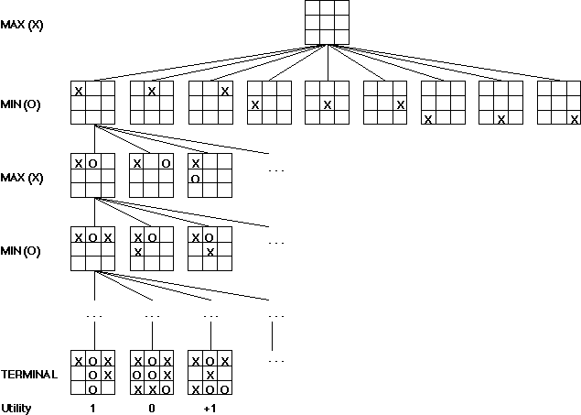
Game Trees
Problem spaces for typical games are represented as trees
(a tic-tac-toe tree is shown to the right)
The root node represents the current
board configuration; player must
decide the best move to make next
Static evaluator function rates a
board position. f(board) = real number
with f>0 (I’m ahead), f<0 for black
(you’re ahead)
Arcs represent the possible legal
moves for a player
If it is my turn to move, then the root
is labeled a "MAX" node; otherwise
it is labeled a "MIN" node, indicating
my opponent's turn.
Each level of the tree has nodes that are all MAX or all MIN; nodes at level i are of the opposite kind from those at level i+1

Slide 23
Minimax Procedure
Create start node as a MAX node with current board configuration
Expand nodes down to some depth (a.k.a. ply) of lookahead in the game
Apply the evaluation function at each of the leaf nodes
“Back up” values for each of the non-leaf nodes until a value is computed for the root node
  At MIN nodes, the backed-up value is the minimum of the values associated with its children. (Best move for the MIN player)
  At MAX nodes, the backed-up value is the maximum of the values associated with its children. (Best move for the MAX player)
Pick the operator associated with the child node whose backed-
up value determined the value at the root

Slide 24
Nim-4: First Ply
State: # coins left,
whose turn it is
Win for MAX: +1
Win for MIN: -1
Left branch: take 1 coin
Right branch: take 2 coins
4 MAX
3 MIN
2 MIN
Notes:
- Group exercise: FInish drawing the Nim-4 game tree, then (optionally) have someone come to the board and show it. Or they can just answer the question: What should the first player do? (Does it matter??)
- Full solution shown in the following slides

Slide 25
Nim-4: Second Ply
4 MAX
3 MIN
2 MIN
+1
2 MAX
1 MAX
1 MAX
0 MAX

Slide 26
Nim-4: Third Ply
4 MAX
3 MIN
2 MIN
+1
2 MAX
1 MAX
1 MAX
0 MAX
-1
-1
-1
1 MIN
0 MIN
0 MIN
0 MIN

Slide 27
Nim-4: Fourth Ply
4 MAX
3 MIN
2 MIN
+1
2 MAX
1 MAX
1 MAX
0 MAX
-1
-1
-1
1 MIN
0 MIN
0 MIN
0 MIN
Complete game tree!
All “leaf nodes” are terminal
states (end of the game),
so no need to evaluate
intermediate (non-end) states
+1
0 MAX

Slide 28
Backup to Level 3
4 MAX
3 MIN
2 MIN
2 MAX
1 MAX
1 MAX
0 MAX
+1
-1
-1
-1
1 MIN
0 MIN
0 MIN
0 MIN
+1
0 MAX

Slide 29
Backup to Level 2
4 MAX
3 MIN
2 MIN
+1
-1
-1
+1
2 MAX
1 MAX
1 MAX
0 MAX
+1
-1
-1
-1
1 MIN
0 MIN
0 MIN
0 MIN
+1
0 MAX

Slide 30
Backup to Level 1
4 MAX
-1
-1
3 MIN
2 MIN
+1
-1
-1
+1
2 MAX
1 MAX
1 MAX
0 MAX
+1
-1
-1
-1
1 MIN
0 MIN
0 MIN
0 MIN
+1
0 MAX

Slide 31
Backup to Level 0 (Root)
-1
4 MAX
-1
-1
3 MIN
2 MIN
+1
-1
-1
+1
2 MAX
1 MAX
1 MAX
0 MAX
+1
-1
-1
-1
1 MIN
0 MIN
0 MIN
0 MIN
MAX always loses!
(unless MIN does something
stupid...)
+1
0 MAX

Slide 32
The Future of AI?

Slide 33
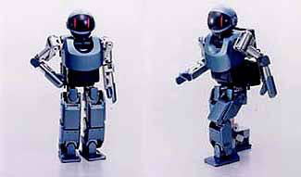
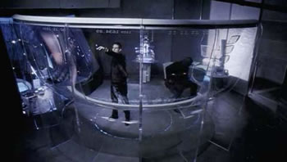
Just You Wait...
Give us another 10 years!
or 20...
or 30...
or 50...

