Slide 1
Social and Ethical Implications
CMSC 101
November 21, 2013
Bhuvana Bellala and Marie desJardins

Slide 2

Getting Started…
Notes:
First talk about piracy: how it is an ethical issue
Get the students’ opinion on piracy (music, software, movies, games, textbooks, and so on)
Ask them the question: how would they feel if it were they who were behind these?

Slide 3
Ethics
Ethics: moral principles that help us differentiate between right and wrong behavior
Ethical Dilemma: arises in a situation concerning right or wrong when values are in conflict
“Should I let my friend copy my answers on an exam?”
“Should I keep the excessive change that the cashier gave to me?”
Notes:
Then shouldn’t it be easy to differentiate right from wrong…but not everything is black and white and people have differing opinions about what is right or wrong

Slide 4
Ethics in Computing
Wiener: Cybernetics and The Human Use of Human Beings
  Published in 1950 – overview of ethical issues in computing
  Computers and security
  Computers and unemployment
  Responsibilities of computer professionals
  Computers and religion
  Robot ethics
James Moor:
  We can do a lot with computers but should we do them?
  “Policy Vacuums” and “Conceptual Muddles”

Slide 5
Framework
Stakeholders
Utilitarianism Approach
Individualism Approach
Moral – Rights Approach
Justice Approach
ACM Code of Ethics
  Other professional codes of ethics
Laws and Policies

Slide 6
ACM Code of Ethics
1.1 Contribute to society and human well-being
1.7 Respect the privacy of others
2.1 Strive to achieve the highest quality, effectiveness, and dignity in both the process and products of professional work
2.6 Give comprehensive and thorough evaluations of computer systems and their impacts, including analysis of possible risks

Slide 7
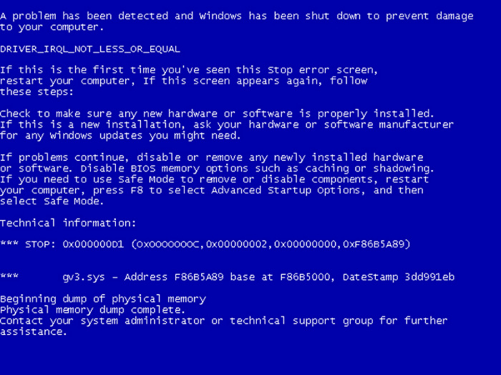
Example: Vulnerabilities
Notes:
Ask how many know what this is? When does it happen? How can it happen? (Basically gauge their knowledge)

Slide 8
Vulnerabilities
What is a virus?
Who is affected?
Zero-day vulnerabilities
The big picture: goes beyond individual

Slide 9
Privacy and Stalking
You’ve each been assigned someone on your team to “cyberstalk” (10 minutes)
Instructions:
  You can use any of the information you already know about the person to narrow down your search
    Their name, the school they attended, their high school, the clubs they are part of, their gamer name, and so on
  General Search
    Bing and Google
  http://www.irongeek.com/i.php?page=security/doxing-footprinting-cyberstalking
    This website gives you some good websites that you can use to stalk someone
  Share what you learned: If you have time, stalk other people

Slide 10
Discussion
How do you feel about privacy?
Is there anything you are going to do to protect yourself?
Whose responsibility is it to protect your private information?
  Yourself, website developers, government,…

Slide 11
Readings
Each team has been assigned a special topic related to ethics
Read over the article and discuss among your group the main points and ethical implications:
  Identify the main topic of the article
  Identify the main points of the article
  Identify the ethical issues (what is to be decided?)
  Identify the stakeholders (affected groups)
  Identify the tradeoffs (costs and benefits to various groups)
After 10 minutes, share with the rest of the class a 1-2 minute summary of the questions above (main topic/points, ethical issues, stakeholders, major tradeoffs)

