Slide 1
Theory of Computation
IS 101Y/CMSC 101Y
November 12, 2013
Marie desJardins
University of Maryland Baltimore County

Slide 2
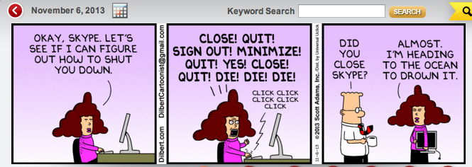
Epic Interface Design Fail

Slide 3
Overview
What is “computation”?
What can be computed?
What makes a “good” algorithm?
  Correctness
  Ease of understanding
  Elegance
  Efficiency

Slide 4
What is Computation?
Computation = input + processing + output
  Processing = state updates
Models of computation:
  Finite state machines
  Turing machines
  Cellular automata

Slide 5
Finite State Machines
Represent as a graph:
  Nodes are states
  One node is the designated start state (usually marked as “S”)
  One or more nodes are designated as terminal states (usually marked with a double circle)
  Edges are labeled with inputs (symbols) that cause the machine to move (transition) from one state to another
  Inputs are processed sequentially, causing the machine to move into a series of states
  At the end of the input, if the machine is in a terminal state, it is said to accept the input string

Slide 6
FSA Example
Accepts any binary string with an odd number of digits
0,1
S
G
0,1

Slide 7
Designing an FSA
Design an FSA that accepts any binary string with an even number of digits
0,1
G
S
0,1

Slide 8
Interpreting an FSA
What does this FSA do (i.e., what strings does it accept)?
0
1
0,1
S
A
G
0
0,1
1
X

Slide 9
Turing Machines
The controller is a finite state automaton
A Turing machine also has storage – an infinite binary “tape” that can be used to keep track of information about the program
  Qualitatively more expressive than a single FSA
Church-Turing thesis:
  A Turing machine can do anything that a digital computer can do

Slide 10
Cellular Automata
More powerful than finite state automata
  Next state of each “cell” depends on state variables (memory) and on states of neighboring cells
Game of Life
  http://www.bitstorm.org/gameoflife/
A cellular automaton can simulate a Turing machine:
  http://www.youtube.com/watch?v=My8AsV7bA94
Mandelbrot set:
  http://www.youtube.com/watch?v=0jGaio87u3A

Slide 11
Computability
What is possible to compute?
Classic “undecidable” (noncomputable) question:
  Halting problem
  (Prove by paradox – if you could solve it, then it would be possible to construct a program such that you couldn’t tell if it would stop or not. Er... what?!)
Related paradoxes:
  Godel’s Incompleteness Theorem: There are true statements in any mathematical system that can’t be proved to be true within the system
  Heisenberg’s Uncertainty Principle: It is impossible to know both the precise mass and the precise momentum (directional velocity) of a particle at the same moment in time

Slide 12
Heisenberg
A police officer pulls Heisenberg over and says, “Did you know you were going 87 miles per hour?”
Heisenberg responds, “Well, crap, now I’m lost!”

Slide 13
Evaluating Algorithms
There are many solutions to any given computable problem
How can we judge and compare algorithms?
Analogy: Purchasing a car:
  safety
  ease of handling
  style
  fuel efficiency
Evaluating an algorithm:
  correctness
  ease of understanding
  elegance
  time/space efficiency

Slide 14
Attributes of Algorithms
Attributes of interest: correctness, ease of understanding, elegance, and efficiency
Correctness:
  Is the problem specified correctly?
  Does the algorithm produce the correct result?
Example: pattern matching
  Problem specification: “Given pattern p and text t, determine the location, if any, of pattern p occurring
  in text t”
  Correctness: does the algorithm always work?
    If p is in t, will it say so?
    If the algorithm says p is in t, is it?

Slide 15
Attributes of Algorithms II
Ease of understanding, useful for:
  checking correctness
  program maintenance
Elegance: using a clever or non-obvious approach
  Example: Gauss’ summing of 1 + 2 + … + 100
Attributes may conflict:
  Elegance often conflicts with ease of understanding
Attributes may reinforce each other:
  Ease of understanding supports correctness

Slide 16
Attributes of Algorithms III
Efficiency: an algorithm’s use of time and space resources
  We’ll focus on computational efficiency (time)
  Timing an algorithm with a clock is not always useful
  Confounding factors: machine speed, size of input
Benchmarking: timing an algorithm on standard data sets
  Testing hardware and operating system, etc.
  Testing real-world performance limits
Analysis of algorithms: the study of the efficiency of algorithms
Order of magnitude: Θ() or just O() (“big O”):
  The class of functions that describes how time increases as a function of problem size (more on which later)

Slide 17
Search
Searching: the task of finding a specific value in a set of values, or deciding it is not there:
Given a list of values and some target value, find the location (index) of the target in the list, or determine that it is not in the list
Solution #1: Sequential search
Solution #2: Binary search
Notes:
Pause here to have the students discuss how they could write this algorithm and (re)“discover” sequential and binary search

Slide 18
Measuring Efficiency
Central unit of work: constant-time operation(s) at each iteration
Central units of work in sequential search:
  Compare target Name to the ith name in the list
  Add 1 to i
  These two steps together represent one “unit”
Given a large input list of length N:
  Best case: smallest amount of work algorithm must do (in terms of N)
  Worst case: greatest amount of work algorithm must do
  Average case: depends on likelihood of different scenarios occurring
What are the best, worst, and average cases (number of units) for sequential search? For binary search?
Notes:
Pause here to have the students think about the best case (find first), worst case (find last), average case (find halfway through)
Then ask them: How many iterations of the loop for each of those cases?

Slide 19
Efficiency of
Sequential Search
Best case: target found with the first comparison (1 iteration)
Worst case: target never found or last value (N iterations)
Average case: if each value is equally likely to be searched, work done varies from 1 to N, on average N/2 iterations
Most often we will consider the worst case
  Best case is too lucky – can’t count on it
  Average case is much harder to compute for many problems (hard to know the distribution of possible solutions)

Slide 20
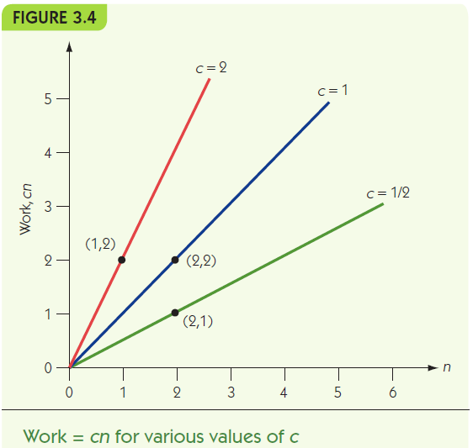
Linear Complexity
Sequential search worst case (N) grows linearly in the size of the problem
  2N steps (one comparison and one addition per loop)
  (Also some negligible initialization
  and cleanup steps...)
We just focus on the
dominant term (N)
Order of magnitude O(N): the
class of all linear functions
(any algorithm that takes C₁N + C₂ steps for any constants C₁ and C₂)
Figures taken from Brookshear “Introduction to Computer Science”

Slide 21
Binary Search
Solution #2: Binary search
  Assume list is sorted
  Split the list in half on each iteration
  On each iteration:
    If we’ve run out of things to look at, quit
    Is the centerpoint of the list the name we’re looking for?
    If so, we’re done!
    If not, check whether the name is alphabetically after or before the centerpoint of the list
      If it’s after, take the second half of the list and continue looping
      If it’s before, take the first half of the list and continue looping

Slide 22
Efficiency of Binary Search
Best case: target found with the first comparison (1 iteration)
Worst case: target never found or last value (split the list in half repeatedly until only one item to examine)
  For a list of length 2, test twice
  For a list of length 4, test three times (split twice)
  For a list of length 8, only test four times! (split three times)
  For a list of length 2^{k}, how many times to test?
  For a list of length N, how many times to test?
Average case: harder than you would think to analyze...
  ...and surprisingly, the average case is only one step better than the worst case
  Why? Hint: Try drawing a tree of all of the cases (left side, right side after each time the list is split in half)
Notes:
Answer for 2^k is, of course, k+1... For a list of length N, log₂ N
They do NOT need to understand or remember the average case analysis, but they SHOULD understand and remember the worst case!

Slide 23
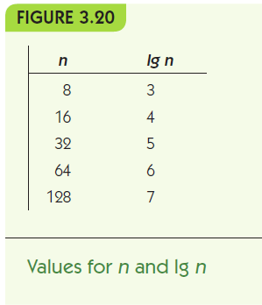
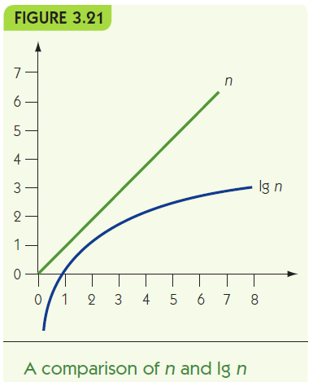
Orders of Magnitude: log N
Binary search has order of magnitude O(log₂ N): grows very slowly
  Here: log₂ (base 2) but other bases behave similarly

Slide 24
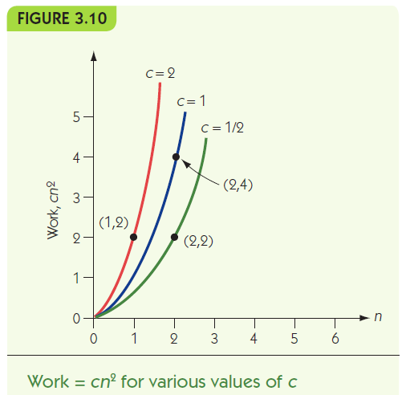
Sorting
Sorting: The task of putting a list of values into numeric or alphabetical order
Classic algorithmic problem
Lots of different algorithms:
  Selection sort: (O(N²)) in the
  average and worst case
  Quicksort: O(N log N) in the
  average case (but O(N²) in the
  worst case...)

Slide 25
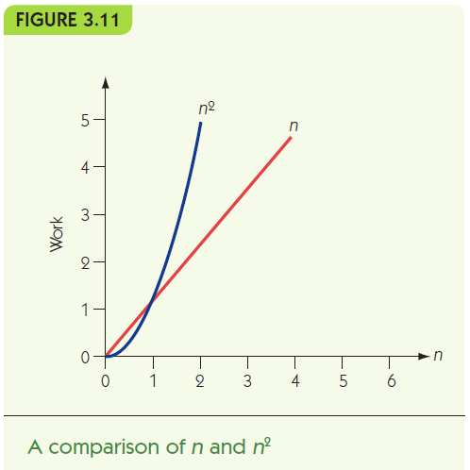
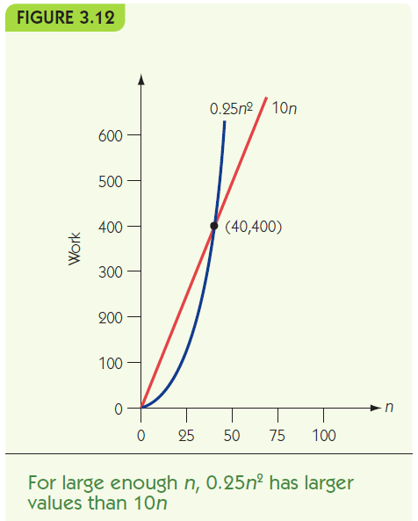
Order of Magnitude
Eventually, every function with order N² has greater values than any function with order N

Slide 26
Getting Out of Control
Polynomially bounded: an algorithm that does work on the order of O(N^{k}) (or less)
  linear, log, quadratic, ... degree k polynomial
Most common problems are polynomially bounded (in “P”)
Hamiltonian circuit (“traveling salesman problem”): no known polynomial solution—it is in “NP” (nondeterministically polynomial)
  Given a graph, find a path that passes through each vertex exactly once and returns to its starting point

Slide 27
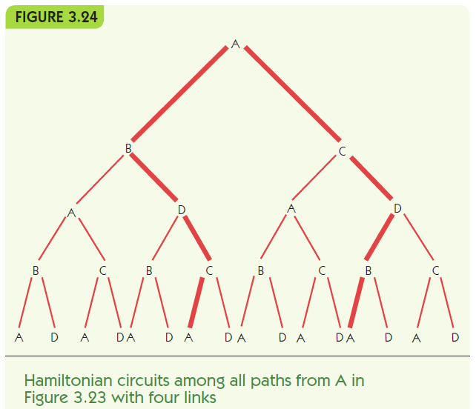
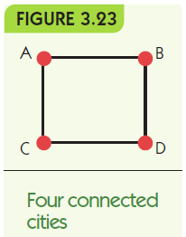
# possible circuits grows exponentially in the number of cities → takes a long time to find the best one!

Slide 28
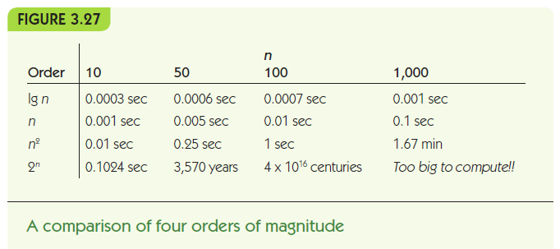

Slide 29
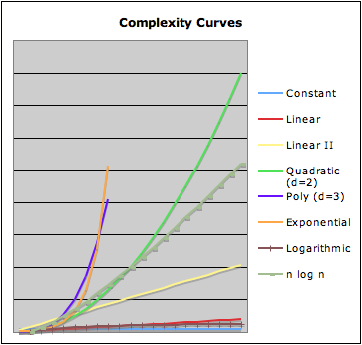
Summary of
Complexity Classes
Notes:
Handout sample problems...

