Slide 1
People: Usability IS 101Y/CMSC 101Y November 5, 2013 Marie desJardins Amanda Mancuso University of Maryland Baltimore County

Slide 2
Thursday’s Class
Data analysis presentations
Test your laptop with the project BEFOREHAND
Submit your PowerPoint and Excel files on Blackboard BEFORE CLASS
Be ready to answer questions!

Slide 3
Usability
Usability is the ease of use and learnability of a human-made object
Ease of use
Effectiveness: can I use the system to do what needs to be done?
Efficiency: can I do it easily, without too much effort?
User satisfaction: is it something that gives me satisfaction or even enjoyment as I do it?
Learnability
Ease of learning the first time
Retention

Slide 4
User Interface
The interface of an object is a particularly important design element. It controls how an object interacts with the rest of the system/world—in particular, how the object can be controlled.
What are some examples of interfaces?
Good ones?
Bad ones?
Notes:
Example interfaces: steering wheel of car, number pad of phone, pull-down menus of a program, touch screen interface, door handles, light switches, stove knobs, window shade controls, TV remotes,

Slide 5
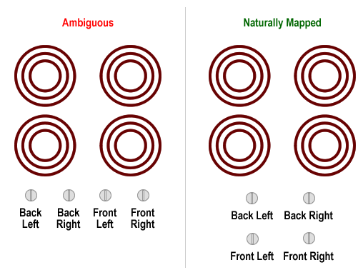
Good or Bad Design?

Slide 6
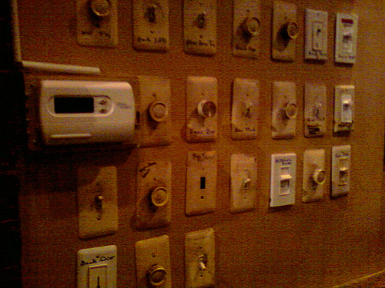

Slide 7
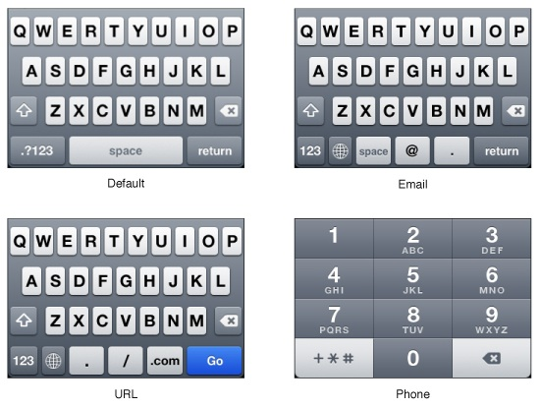

Slide 9
Interface
What are characteristics of a good interface?
Notes:
Example interfaces: steering wheel of car, number pad of phone, pull-down menus of a program, touch screen interface, door handles, light switches, stove knobs, window shade controls, TV remotes,

Slide 10
User Interface Design
“Well-designed objects are easy to interpret and understand. They contain visible clues to their operation.” -- Donald Norman
Principles
Visibility: By looking, the user can tell the state of the device and the alternatives for action.
A good conceptual model: Provides consistency in the presentation of operations and results and a coherent, consistent system image.
Good mappings: It is possible to determine the relationships between actions and results, between the controls and their effects, and between the system state and what is visible.
Feedback: The user receives full and continuous feedback about the results of actions.

Slide 11
UI Design Strategies
Start with the user in mind
“user stories”
user point of view comes out of systems analysis
Test with users
early and often
usability testing, heuristic walkthroughs, focus groups
Update to reflect new input from users
requires a flexible system design
prototyping

Slide 12
Consistency
Consistency is the MOST important design principle!
Throughout the system:
use the same colors for the same purposes
use the same highlighting or borders to convey similar meanings
use terminology and acronyms consistently
put similar pieces of information (especially buttons) in the same location

Slide 13
Learnability
How easily can one:
Determine the function of the system?
Tell what actions are possible?
Determine a mapping from intention to physical movement?
Perform the action?
Tell if the system is in the desired state?
Determine a mapping from system state to interpretation?
Tell what state the system is in?
Remember all this the next time?
Measuring learnability:
X% of users can use the system with an error rate of less than Y% after training time Z
X% of users can use the system with an error rate of less than Y% after training time Z and then an elapsed time of N

Slide 14
Error Avoidance and Recovery
It should be easier to do the right thing than the wrong thing
It should be easier to correct mistakes than to make them
Design should anticipate the kinds of errors users are likely to make and either:
make them impossible,
make them hard, or
make them recoverable

Slide 15
BTA and IS
Required (for BTA)
303: Fundamentals of Human Computer Interaction
Electives
387: Web Content Development
403: User Interface Design
413: GUI Systems Using Java
Certificates
Web Development Certificate

Slide 16
CS/CE
Electives
435: Graphics
436: Data Visualization
437: GUI Programming
491: Graphics for Games

