Slide 1
HW & Systems: Networks IS 101Y/CMSC 101 Computational Thinking and Design Thursday, October 24, 2013 Marie desJardins University of Maryland, Baltimore County

Slide 2
Introduction
Computer networks have had a revolutionary impact on society and technology
Electronic commerce
Worldwide communications
Spread of information and data
We take for granted:
access to information on any subject
immediate contact with people around the world
streaming audio and video
wired or wireless access from every device

Slide 3
Communication Protocols
Protocol: a standard set of rules for communicating
Standards evolve over time
International agreements make Internet possible
Internet Society makes standards and promotes research: www.isoc.org

Slide 4
Network Layers (more abstraction!)
Link layer
Hardware, routers
Network/Internet layer
Layer of abstraction above routers/hardware
Deliver an individual message – no guarantees
IP (Internet Protocol) – IP addresses, message format
Transport layer
Layer of abstraction above messages
Ensures reliability – retransmission, host-to-host communication
TCP (Transmission Control Protocol)
Application layer
Layer of abstraction provides seamless view of inter-application communication
Many protocols: HTTP [www], VoIP [voice], POP [mail], ...

Slide 5
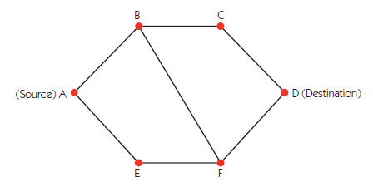
Routing
Routing algorithms are used to move packets efficiently and balance load across the network
Routing of packets is determined dynamically (and locally)
A-B-C-D or A-B-F-D or A-E-F-D or A-E-F-B-C-D
Challenges: Redundant paths, fault tolerance, responsiveness to traffic load
Picture from J. Glenn Brookshear, “Computer Science: An Overview”

Slide 6
HTTP
Hypertext Transfer Protocol (HTTP)
Web page/service identified by unique URL (Uniform Resource Locator)
protocol://host name/page
Multiple protocols: http, mailto, news, ftp
Web browser uses TCP to send formatted messages to Web server, and vice versa
TCP in turn uses IP, which in turn uses link layer protocols

Slide 7
HTTP (cont.)
Process: http://hostname/page
Browser reads protocol, extracts host name (and requests IP address from DNS server)
Sends a connect message to port 80 on that machine
After connection established, sends “Get” message with page information
Server responds with message containing page contents, size, and indicates connection closes at end of message

Slide 8
Courses in Systems Topics

Slide 9
BTA
Required
350: Business Communication Systems
Electives
310: Software and Hardware Concepts
430: Information Systems and Security
432: Computer Viruses

Slide 10
Information Systems
Required
310: Software and Hardware Concepts
450: Data Communications and Networks
451: Network Design and Management
Electives
430: Information Systems and Security
432: Computer Viruses
451M,U,W: Specialized networking courses
452: Internetworking
Certificates
Network Administration (NETC)

Slide 11
Computer Science
Required
313: Computer Organization and Assembly Language Programming
411: Computer Architecture
421: Operating Systems
Electives
426: Principles of Computer Security
481: Computer Networks
483: Parallel and Distributed Processing
487: Introduction to Network Security

Slide 12
Computer Engineering
Required
212: Principles of Digital Design
306: Introduction to Circuit Theory
310: Systems Design and Programming
311: C Programming and Embedded Systems
314: Principles of Electronic Circuits
411: Computer Architecture
421: Operating Systems
Electives
315: Principles of VLSI Design
415: Programmable Logic Devices
423: Principles of Communication Engineering
447: Analog Integrated Circuit Design
LOTS of others!
Tracks
Systems Architecture
Communications

Slide 13
Careers in Hardware and Systems

Slide 14
System on a Chip Design
Create full computing systems on one chip for mobile devices
Apple, Nvidia, Qualcomm, Intel, Samsung
CMPE

Slide 15
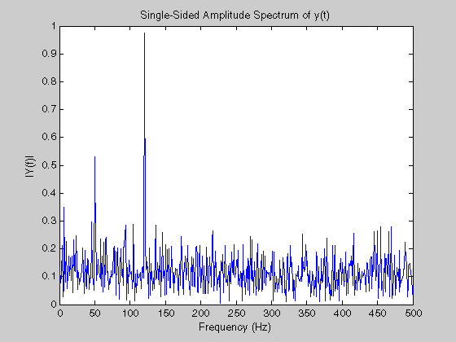
Signal Processing
Analyze signals to translate data to something people can use
SAIC, Northrop Grumman, Lockheed Martin, Google
CMPE, CMSC

Slide 16
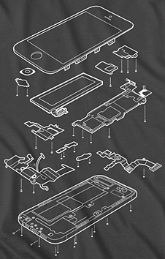
Hardware Design Engineer
Design boards so that all necessary components fit inside physical hardware constraints like size
Apple, Samsung, HTC, Nokia
CMPE

Slide 17
Operating System Development
Develop the operating system for devices to perform tasks for users
Apple, Microsoft, device manufacturers
CMSC, CMPE

Slide 18
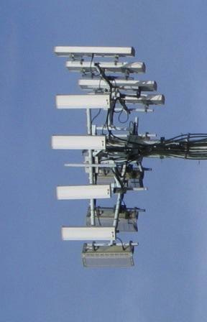
Information Protection
Create secure ways to transfer information both wirelessly and locally
Secure data once it is on the device
Verizon, AT&T, NSA, government contractors
IS, CMSC, CMPE

Slide 19
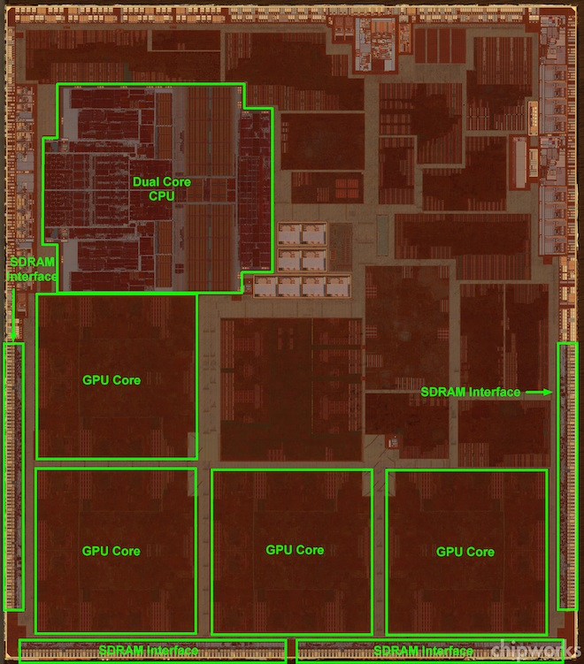
Computer Architecture
Research new ways to create chips
Research new technologies and develop new algorithms
Intel, Samsung, AMD, Nvidia, Apple
CMPE, CMSC

Slide 20
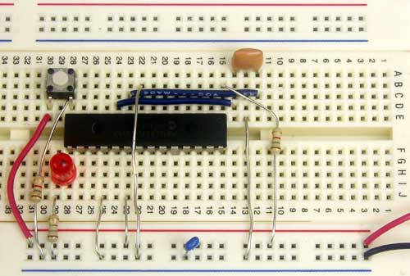
Systems Testing
Test systems of preexisting hardware to make sure all components are working together properly
Basically anywhere that hires computer engineers
CMPE

Slide 21
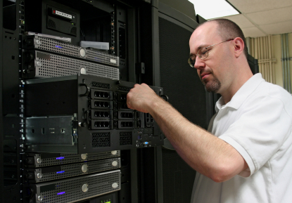
Network Administrator
Maintain computer hardware and software for a company
Deploy new technology and ensure a smooth transition
All companies that use technology need a network administrator
IS, BTA, CMSC

Slide 22
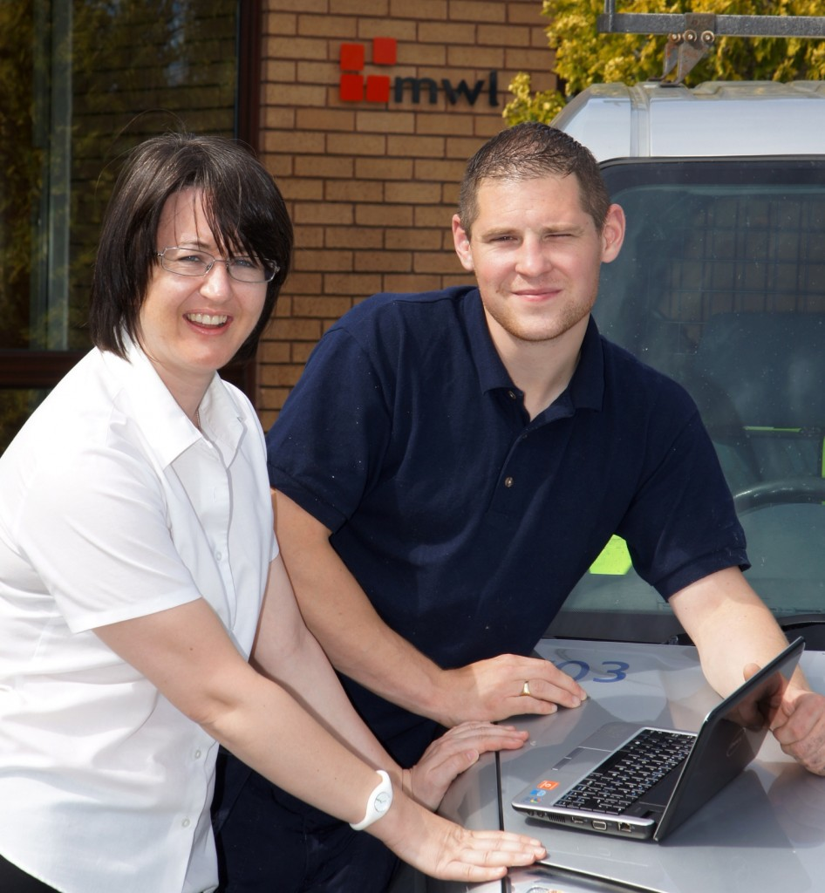
Systems Development
Teach employees how to use new technology to improve their workflow
Most companies utilize systems development personnel
IS, BTA

Slide 23
Giving Effective Presentations

Slide 24
Rule
# 1
Know what on earth you’re doing up there!
Rule #2: Know what you want to say
Rule #3: Know your audience
Rule #4: Know how long you have

Slide 25
Rule #2: Know What You Want to Say
Just reciting a series of statistics or showing a bunch of numbers is not interesting to most people
You should give enough detail to get your interesting ideas and observations across, but not enough to lose your audience
They want to hear what you learned that was interesting and why they should care
Whatever you do, don’t just read your slides!

Slide 26
Rule #3: Know Your Audience
You’re talking to the other students (not me)
You need to be sure you’re explaining each new idea clearly
The most important thing is to emphasize what you’ve discovered and why they should care!

Slide 27
Rule #4: Know How Long You Have
How long is the talk? Are questions included?
A good heuristic is 1-2 minutes per slide
...but it depends a lot on the content of those slides!
If you have too many slides, you’ll skip some or—worse—rush desperately to finish. Avoid this temptation!!
Almost by definition, you never have time to say everything about your topic, so don’t worry about skipping some things!
Unless you’re very experienced giving talks, you should practice your timing

Slide 28
Rule
# 1
Know what on earth you’re doing up there!
Rule #2: Know what you want to say
Rule #3: Know your audience
Rule #4: Know how long you have

Slide 29
Rule #2: Know What You Want to Say
Just reciting a series of statistics or showing a bunch of numbers is not interesting to most people
You should give enough detail to get your interesting ideas and observations across, but not enough to lose your audience
They want to hear what you learned that was interesting and why they should care
Whatever you do, don’t just read your slides!

Slide 30
Rule #3: Know Your Audience
You’re talking to the other students (not me)
You need to be sure you’re explaining each new idea clearly
The most important thing is to emphasize what you’ve discovered and why they should care!

Slide 31
Rule #4: Know How Long You Have
How long is the talk? Are questions included?
A good heuristic is 1-2 minutes per slide
...but it depends a lot on the content of those slides!
If you have too many slides, you’ll skip some or—worse—rush desperately to finish. Avoid this temptation!!
Almost by definition, you never have time to say everything about your topic, so don’t worry about skipping some things!
Unless you’re very experienced giving talks, you should practice your timing

Slide 32
Slideology 101
Don’t just read your slides!
Use the minimum amount of text necessary
Use examples
Use a readable, simple, yet elegant format
Use color to emphasize important points, but avoid the excessive use of color
“Hiding” bullets like this is annoying (but sometimes effective), but…
Don’t fidget, and…
Don’t just read your slides!
Abuse
of
animation
is
a
cardinal
sin!

Slide 33
How to Give a Bad Talk Advice from Dave Patterson, summarized by Mark Hill
Thou shalt not be neat
Thou shalt not waste space
Thou shalt not covet brevity
Thou shalt cover thy naked slides
Thou shalt not write large
Thou shalt not use color
Thou shalt not illustrate
Thou shalt not make eye contact
Thou shalt not skip slides in a long talk
Thou shalt not practice

Slide 34
Data Presentations
Presenting: You should plan to use your own laptop.
Be sure you know how to use your laptop with a projector!
Test your setup before class (or after class on an earlier day)
Content: You should provide a well organized presentation that clearly answers the four questions and subquestions (don’t forget the one specifically for the presentation) in the assignment
Timing: Each group should aim for a 7-minute presentation
This works out to (roughly) 5 to 10 slides
(but you could have more, depending on how much material there is on each slide)
I will cut you off if you go too long!
There will be a few minutes after each presentation for questions

Slide 35
Data Presentations
Other requirements:
Include charts from your Excel file that you need to answer the questions
But add explanatory text!
At least one PowerPoint animation
At least one graphic not from your Excel file
Team involvement:
EVERY team member must present at least one slide
Individual team members will be asked questions
EACH team member must understand all parts of the analysis that was done, even if they didn’t do it themselves.

Slide 36
Presentation Grading
Your grade will be based on:
The quality of your presentation materials
Content
Appearance
Organization
Your level of preparation (group and individual)
The clarity of your presentation (individual)
The timing of your presentation (group and individual)

Slide 37
Presentation Grading
Review the assigned readings on the online schedule for Oct. 18
Very good tips
We based our grading criteria on the previous slides plus those readings
Your grade will be based on:
The quality of your slides
Content
Appearance
Organization
Your professionalism (group and individual)
The clarity of your presentation (individual)
The timing of your presentation (group)
How well you answer questions (individual)

Slide 38
Next Class
Next Tuesday is an in-class lab
You’ll have time to work with your team on the semester game project
You’ll have access to the TFs and me to help you
You’ll get feedback on your design by the weekend
Meet with your team before Tuesday and start working on pieces of your project
Come to class on Tuesday with some SPECIFIC part of the project you want to work on, either individually or together

