Slide 1
Simulation and Modeling: Predator-Prey Processing Lab IS 101Y/CMSC 101 Computational Thinking and Design Tuesday, October 1, 2013 Marie desJardins University of Maryland, Baltimore County

Slide 2
Today’s Concepts
Simulating processes
Using data:
Visualizing data (generating graphs)
Outputting data (for use by Excel or other analysis programs)
Design considerations:
Visual design / sketching as a tool
Conceptual design / storyboarding as a tool

Slide 3
Simulating Processes
Process model:
We can represent “states” as collections of variables
Semester game: Happiness, grades, wealth
We can represent “actions” as choices from a list, parameter settings, ...
Semester game: Hours studying, hours in class...
State1
State2
State3
Action1
Action2
Action3
...

Slide 4
Data Representations for Simulations
States: set of variables x, y, z, ... at each time t
x₁, x₂, x₃, ... (values at time 1, 2, 3...)
Can represent the sequence of values for state variable x as an array x[]
Multiple state variables ➔ multiple arrays
Alternative: if we don’t need to remember all of the values, we can just represent one or two values for each state variable:
currentX
currentX and prevX (if we want to measure/track change over time)

Slide 5
Visualizing Data
How might we want to see (say) happiness, grades, and wealth over time?
One way: table of numbers
Another way: as a graph
Time | Happiness | Grades | Wealth
1 | 90% | 60% | $100
2 | 85% | 70% | $200
3 | 60% | 70% | $600
4 | 70% | 80% | $500
5 | 85% | 90% | $200

Slide 6
Outputting Data Tables in Processing
// open file for recording data PrintWriter OUTPUT = createWriter (FILENAME);
Example: PrintWriter datafile= createWriter ("outfile.csv");
// print to output file OUTPUT.println (OUTPUTSTRING);
Example: datafile.println ("time, happiness, grades, wealth");
// close output file when you’re all done with it datafile.flush(); datafile.close();

Slide 7
Visualizing Data in Processing
Graphs are just lines!
Tricky part: figuring out how a particular state variable value will map to a screen location
Time value has to “scale” to the width of the screen
State variable value has to “scale” to the height of the screen

Slide 8
Graphing in Processing: Quadratic Example
void setup() {
float x, prevX;
float y, prevY;
size (500, 500);
// Generate the first (x,y) pair and // save it as prev
prevY = (-20*-20) - 10;
for ( x=-19 ; x<=20 ; x++ ) {
y = x*x – 10;
drawLine (x-1, prevY, x, y);
prevY = y;
}
}
void drawLine (float prevX, float prevY, float x, float y) {
line (screenX (prevX), screenY (prevY), screenX (x), screenY (y));
}
// Graph the function y=x^2 - 10, x=-20...20
// Range of function: [-10, 390]
// Let's say 400 will appear at screenY = 50
// y=0 will appear at screenY = 450
// y=-10 will appear at screenY=460
// So screenY = 450 – y
// Let's put x=-20 at screenX = 50
// x=0 at screenX = 250
// x=20 at screenX = 450
// So screenX = (x+20)*10 + 50
float screenX (float x) {
return ( (x+20)*10 + 50 );
}
float screenY (float y) {
return ( 450-y );
}
Notes:
Go over this, show it, drop it into the Dropbox folder

Slide 9
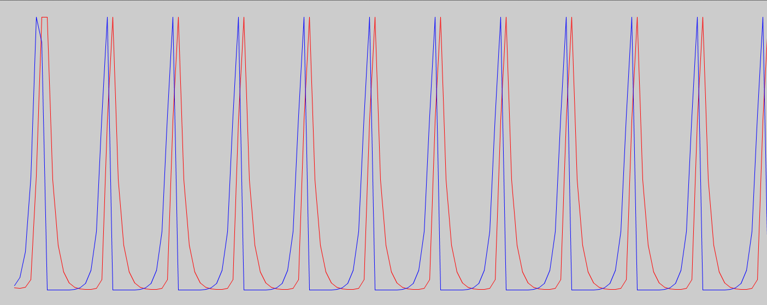
The Predator-Prey Cycle
Lotka-Volterra equations
“Actions” (fixed): birth rate (b_{pred}, b_{prey}) and death rate (d_{pred}, d_{prey}) of predators and prey
States: population (n_{pred}, n_{prey}) of predators and prey
n_{prey} = n_{prey} + b_{prey}*n_{prey} - (d_{prey}*n_{prey}*n_{pred})
n_{pred} = n_{pred} + b_{pred}*n_{pred}*n_{prey} - (d_{pred}*n_{pred})
Notes:
Go over the equations – that’s a screenshot of the PredPrey.pde program
Point out that they need to have new values to put new predators and prey in, because if they change “prey” before updating predators, then predators won’t properly depend on the *previous* value of “prey”

Slide 10
Live Design & Coding
Use static mode (we won’t use any functions)
First, we’ll design and write the basic simulation code
What is the data representation? (variables and constants to be stored)
Next, we’ll output the graphs
Notes:
Board work for data design, distribute PredPreyData1.pde
Board work for simulation design, distribute PredPreySim2.pde

