Slide 1
Academic Success Strategies & Exams

Slide 2
Pause: Class is shifting to Design Team & Project Work
JE3= Applied Strengths Quest to your Design Team
Scavenger Hunt Last Week (Now you know where to go to ask for help)
Career Panel (Aaron Stahl, Luke Lackrone, Emily Scheerer, Catherine Liou)- IS or CS?
Reading & Taking Notes (on Reading & in Class)
Getting Organized (Time Management Tools)
Strengths Quest-Looking at yourself (themes connect to academic success, career, life happiness); JE2=Reflected on your Strengths
Academic Skills Survey
Got started: JE1=Introduced yourself

Slide 3
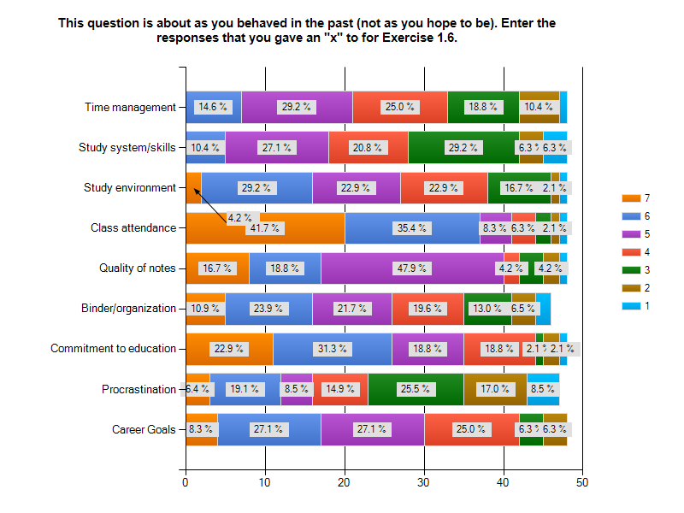
Class’s Reported
Study habits
62% of class respondents rated their study system as “4” of lower!
Only 10% rated themselves as “6”.
NO 7’s!
More than half of the class rated time management skills as 4 or lower!

Slide 4
Think for a moment and respond in your notebook
How effective have you been at maintaining a study schedule and managing your time?
If the semester ended tomorrow, what grades would you have in each of your classes, based on the work that has been graded/handed in so far? List them.
What techniques have you been using to prepare for exams so far?
What steps will you take to prepare for the mid-term in this class?

Slide 5
Normal Freshman experiences
At the 4-6 week mark, “the honeymoon is over”
Settling in socially, forging new relationships in residence halls and classes; experiencing differences or conflict
Perhaps some changes in high school/ past relationships
New freedom and choices-both good and bad
Academic feedback - grades on homework, quizzes, and exams in most classes
Workload increasing
Feeling accomplished or overwhelmed or somewhere in between!

Slide 6

Study Skills and Exams
Modified Version of the show
Peers are contestants
3 have “baggage” which will be revealed about preparing for exams.
Audience members with cards ask each of the three a question to learn more details about the “baggage”
Audience votes on the one they want to know how to remedy
Peer “Expert” will give top 3 pieces of advice and how to’s from experience and

Slide 7
Contestants
Round 1: Math and Science Classes (Austin, Mark)
Round 2: General Education Classes (Max, Catherine)
Round 3: CS/IS Programming Classes (Brandon, John)
Round 4: Test Anxiety (Nicole, Gloria)

Slide 8
Resources and How To’s
Ch 4 Making Your Mark, Study Hints and Shortcuts
  17 Ways to Study Smarter; Can’t Concentrate; How to remember
Ch 6, How to Study for Exams
  Study Checklist
  Make a Summary Sheet
  Create Practice Tests
  Grab Bag of Study Tips
  Tips for Multiple-choice, True-false, Open-ended, Essay, Math and Science
  Test Anxiety
Dartmouth Study Skills Videos and Handouts

Slide 9
Just DO IT
It takes 3 weeks to Make a new habit
Pick one or two new techniques
Begin practicing these consistently
Know that you won’t do it perfectly and it may be difficult
RE-evealuate & Refine your study habits

Slide 10
REminders
Counseling Center’s Student Success Workshops on Wednesdays
Homecoming is this weekend
Take action to apply what you learned today to prepare for the midterm in this class and others
Read and get started on the resume and cover letter assignment (Bb documents folder)
Get to Career Services next week for a resume critique

