Slide 1
“Professional Development” CMSC101/IS101Y
Friday 1 & 2 PM
Dr. Susan Martin & Peers

Slide 2
Staff Introductions
2 PM- Dr. desJardins lecture
1 PM- Dr. Seaman’s lecture
Mark Cirincione (IS)
Gloria Diederich (Math/CS)
Catherine Liou (IS)
John Swank (CS)
Austin Cole (IS)
Nicole Dawson (IS)
Brandon Walsh (CS)
Max Weinberg (CS)
Peer Mentors Role = Guide & Community Builder
Plan & implement sessions
Communicate regularly with you in Bb
Invite you to events throughout the semester

Slide 3
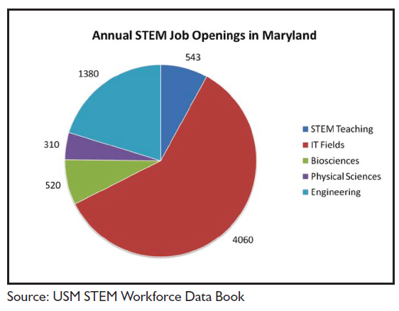
It’s about Jobs!

Slide 4
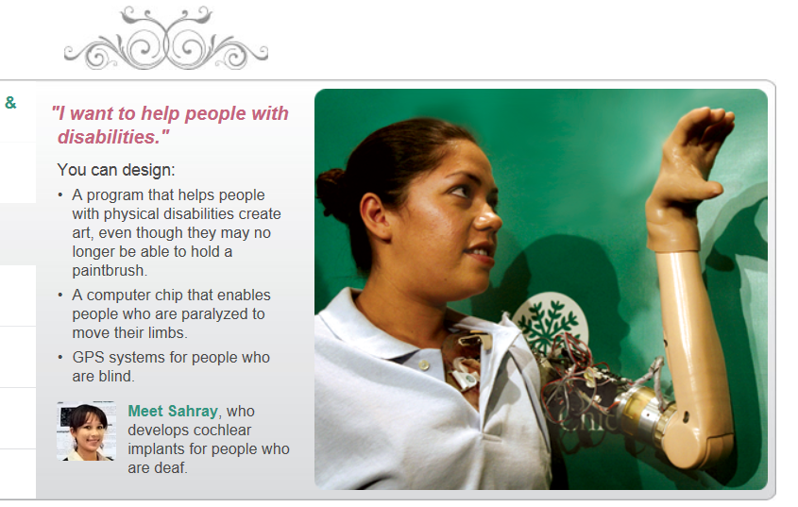
IT/CS Careers ARE Diverse & Changing
IT/CS is integral to all fields. Your job is to expand your knowledge about the possible career paths.
Entry level job postings don’t represent the diversity of opportunities.

Slide 5
Top Skills/Qualities Employers Look For:
1. Ability to work in a team
2. Leadership
3. Communication skills (written)
4. Problem-solving skill
5. Strong work ethic
6. Analytical/quantitative skill
7. Communication skills (verbal)
8. Initiative
9. Technical skills
10. Detail-oriented
Source: National Association of Colleges and Employers (NACE) 2012 Job Outlook Survey
11. Flexibility/adaptability
12. Computer skills
13. Interpersonal skills
14. Organizational ability
15. Strategic planning skill
16. Friendly/outgoing personality
17. Creativity
18. Entrepreneurial skills/risk-taker
19. Tactfulness

Slide 6
Freshman year = Transition Ask the Peers!
A time of NORMAL academic, social & other transitions.
Study habits from the past WILL not be adequate going forward.
Time management and being organized are ESSENTIAL.
You are beginning to develop your professional identity and skills TODAY!

Slide 7
Intentional PD Topics in Syllabus
Focus on Your Strengths
Organization/Time
Teamwork
Study Habits
UMBC Help
Technical Presentations
Academic Planning
Giving and Using Feedback
Career Management Skills & Tools
Final Exam Preparation
School/Work/Life Balance

Slide 8
Focusing on You & Strengths
Journal Entries =Reflection & Application
StrengthsQuest
Strengths Approach =More Success, Joy, Happiness in Life.

Slide 9
Friday=Relationship Building
No Devices
Lots of getting to know you activities led by peers
45 Minutes of Content
Small Group Activity
Discussion & Reporting Back
End of class feedback forms

Slide 10
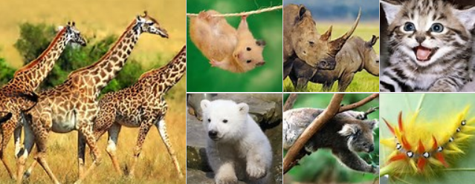
Getting to Know You Activity

Slide 11
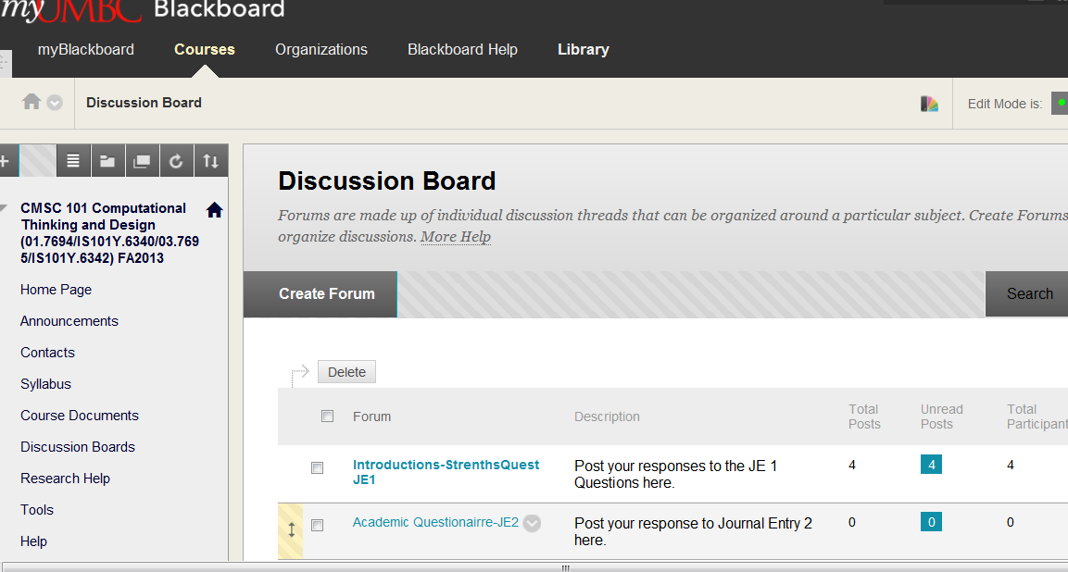
Blackboard and JE1 Demo

