Slide 1
Getting Ready for Finals!
PD Session 10
CMSC101/IS101Y

Slide 2
Today
Talk briefly about the Final Presentations & Poster (5 Minutes)
JE4 Group Conversation
Really Quick Review of Success Strategies You can Choose to Apply (10 Minutes)
Hear from a Panel of Experts (Your Peer Mentors!)
  what to expect during finals
  advice about how to do well

Slide 3
Posters
Get started as soon as guidelines are given to you. Make sure your poster meets the guidelines-this is what it is like for professional meetings.
Go back and look at Alec’s poster and Amanda’s URCAD video
Look around this ITE building for poster examples.
Follow the instructions for handing them in on time so I can get them printed.

Slide 4
Tuesday, December 10th
During Normally Scheduled Class
Engineering Atrium
Dress Professionally
6 foot table & poster will be set up
Bring game on laptop that has enough battery
Class is in small groups which rotate to each poster and demo. 8 minutes at each game
One team member stays with game during each rotation to talk with the group. Each team member will have at least one time at poster session.
Guests are invited (faculty from CSEE, IS, Dean, other campus professionals)

Slide 5
JT

Slide 6
Matt

Slide 7
Quick: JE 4 Group Conversation
If the semester ended today, how many of you would be happy with your grades?
What did you realize as you completed the worksheet about where you stand in each class?
Have you achieved the academic behaviors that you said you wanted to do at the start of the semester?
How do your study habits compare to those recommended in the Dartmouth College video?

Slide 8
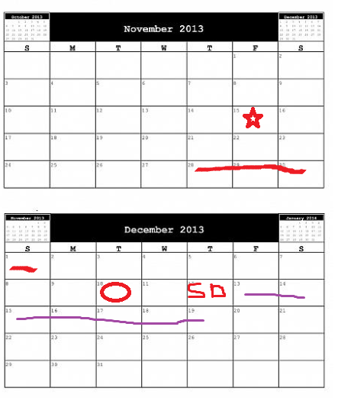
4 Weeks Until Finals! What choices will you make?

Slide 9
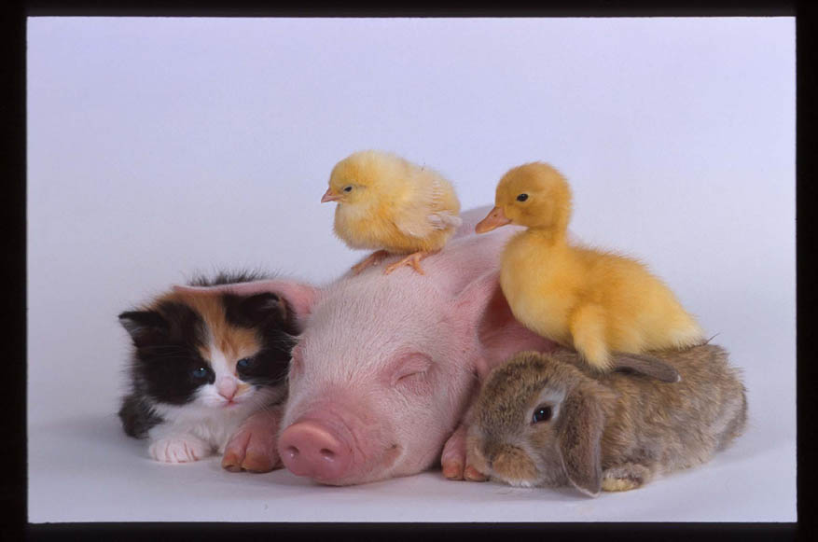
Peer Panel of Experts (15 minutes)

Slide 10
RECAP of Advice
Finals Schedule- Know when and where all of your finals are being given
Make a list of work/assignments that are still due before finals
Organize all materials for each class
Know what the final will cover
Know exactly where you stand in each class and what grades you want/need on each final
Apply Dartmouth College Videos Advice/ Making Your Mark Text/ Strengths Text about academic strategies
Create a study time plan & Strategy (Individual & Study Groups)
Take care of yourself!

Slide 11
Wrap up
5 minute assessment
Questions
Skills for Success Workshops
  Wed. Nov 20-Motivation, Commons 327 noon
  Wed. 12/4-Get through Finals, Commons 327, noon

