Slide 1
Knowledge-Based Agents
Wrap up
Some material adopted from notes by Andreas Geyer-Schulz and Chuck Dyer

Slide 2
Inference, Soundness, Completeness
KB ├_{i} α : sentence α can be derived from KB by procedure i
Soundness: i is sound if whenever KB ├_{i} α, it is also true that KB╞ α
Completeness: i is complete if whenever KB╞ α, it is also true that KB ├_{i} α
Preview: first-order logic is expressive enough to say almost anything of interest and has a sound and complete inference procedure

Slide 3
Soundness and completeness
A sound inference method derives only entailed sentences
Analogous to the property of completeness in search, a complete inference method can derive any sentence that is entailed

Slide 4
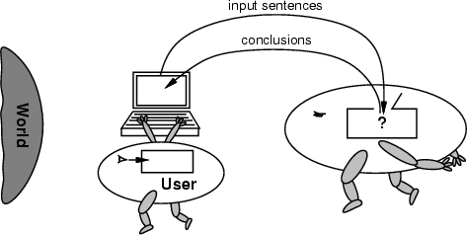
No independent access to the world
Reasoning agents often gets knowledge about facts of the world as a sequence of logical sentences and must draw conclusions only from them w/o independent access to world
Thus, it is very important that the agents’ reasoning is sound!

Slide 5
Summary
Intelligent agents need knowledge about world for good decisions
Agent’s knowledge stored in a knowledge base (KB) as sentences in a knowledge representation (KR) language
Knowledge-based agents needs a KB & inference mechanism. They store sentences in KB, infer new sentences & use them to deduce which actions to take
A representation language defined by its syntax & semantics, which specify structure of sentences & how they relate to facts of the world
Interpretation of a sentence is fact to which it refers. If fact is part of the actual world, then the sentence is true

Slide 6
Fin

