Slide 1

Knowledge-Based Agents
Chapter 7.1-7.3
Some material adopted from notes by Andreas Geyer-Schulz and Chuck Dyer

Slide 2

Big Ideas
Drawing reasonable conclusions from
a set of data (observations, beliefs, etc.)
seems key to intelligence
Logic is a powerful and well-developed approach to this & highly regarded by people
Logic is also a strong formal system that computers can use (cf. John McCarthy’s work)
We can solve some AI problems by represent-ing them in logic and applying standard proof techniques to generate solutions

Slide 3
Inference in People
People can do logical inference, but are not always very good at it
Reasoning with negation and disjunction seems particularly difficult
But people seem to employ many kinds of reasoning strategies, most of which are neither complete nor sound

Slide 4
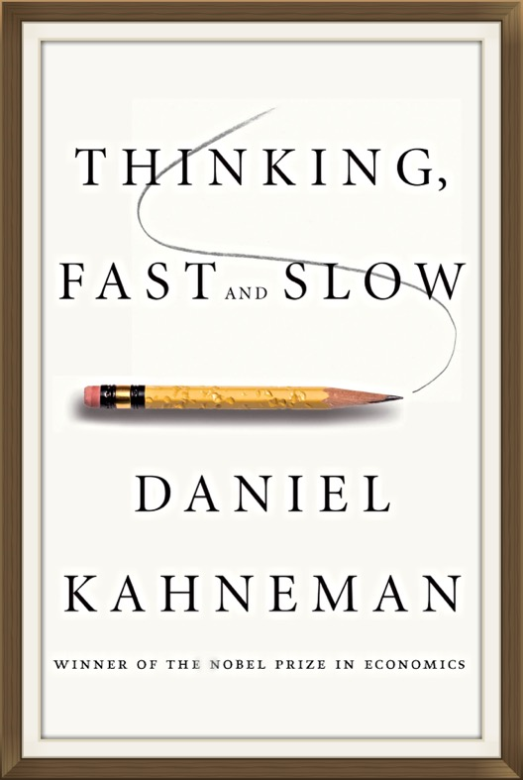
Thinking Fast and Slow
A popular 2011 book by a Nobel prize winning author
His model is we have two different types of reasoning facilities
System 1 operates automatically and quickly, with little or no effort and no sense of voluntary control
System 2 allocates attention to effortful mental activities that demand it, including complex computations (e.g., logic, arithmetic, writing software, etc.)

Slide 5
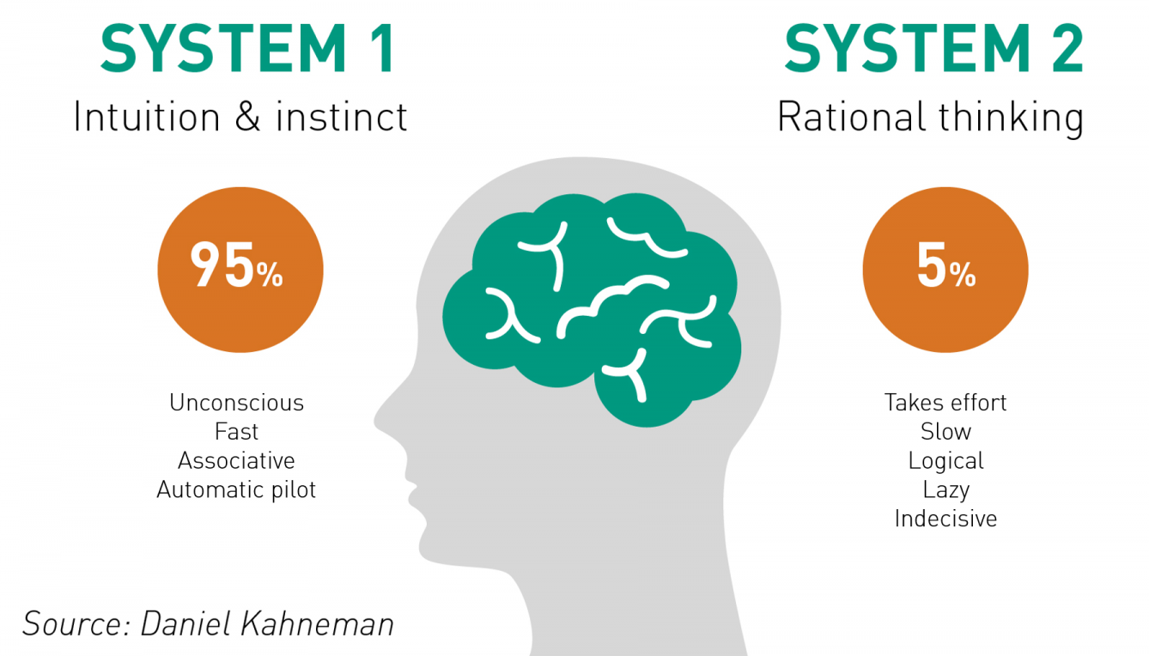
Who has the motive, means, and opportunity to do this?
Does that person look suspicious?

Slide 6
Question #1
Here is a simple puzzle
Don’t overthink it – give a quick answer

Slide 7
Question #1
Here is a simple puzzle
Don’t overthink it – give a quick answer
A bat and ball cost $1.10
The bat costs one dollar more than the ball
How much does the ball cost?

Slide 8
Question #1
Here is a simple puzzle
Don’t overthink it – give a quick answer
A bat and ball cost $1.10
The bat costs one dollar more than the ball
How much does the ball cost?
The ball costs $0.05

Slide 9
Question #2
Try to determine, as quickly as you can, if the argument is logically valid. Does the conclusion follow the premises?

Slide 10
Question #2
Try to determine, as quickly as you can, if the argument is logically valid. Does the conclusion follow the premises?
All roses are flowers
Some flowers fade quickly
Therefore, some roses fade quickly

Slide 11
Question #2
Try to determine, as quickly as you can, if the argument is logically valid. Does the conclusion follow the premises?
All roses are flowers
Some flowers fade quickly
Therefore, some roses fade quickly
It is possible that there are no roses among the flowers that fade quickly

Slide 12
Question #2
Try to determine, as quickly as you can, if the argument is logically valid. Does the conclusion follow the premises?
All roses are flowers
Some flowers fade quickly
Therefore, some roses fade quickly
It is possible that there are no roses among the flowers that fade quickly
Flowers
quick faders
roses

Slide 13
Question #3
It takes 5 machines 5 minutes to make 5 widgets
How long would it take 100 machines to make 100 widgets?

Slide 14
Question #3
It takes 5 machines 5 minutes to make 5 widgets
How long would it take 100 machines to make 100 widgets?
100 minutes or 5 minutes?

Slide 15
Question #3
It takes 5 machines 5 minutes to make 5 widgets
How long would it take 100 machines to make 100 widgets?
100 minutes or 5 minutes?
5 minutes

Slide 16
Wason Selection Task
I have a pack of cards; each has a letter on one side and a number on the other
I claim the following rule is true:
  If a card has a vowel on one side, then it has an even number on the other
Which cards should you turn over in order to decide whether the rule is true or false?
E
4
T
7
Wikipedia
Notes:
Turn over e and 7

Slide 17
Wason Selection Task
Wason (1966) showed people are bad at this task
To disprove rule P=>Q, find a situation in which P is true but Q is false, i.e., show P^~Q
To disprove vowel => even, find a card with a vowel and an odd number
Thus, turn over the cards showing vowels and those showing odd numbers
E
4
T
7

Slide 18

Wason Selection Task
But this version is easier for people, as shown by Griggs & Cox, 1982
You are the bouncer in a bar. You must be 21 or older to drink beer.
Each of the 4 people at a table has an age and a drink. Which of these do you check?
beer
coke
22
20

Slide 19
Wason Selection Task
This version is easier for people, as shown by Griggs & Cox, 1982
You are the bouncer in a bar; which of these people do you card given the rule: You must be 21 or older to drink beer.
beer
coke
22
20
Perhaps easier because it’s more familiar or because people have special strategies to reason about certain situations, such as cheating in a social situation

Slide 20

Negation in Natural Language
We often model the meaning of natural language sentences as a logic statements
This maps these into equivalent statements
  All elephants are gray
  No elephant are not gray
  Elephant(X) => colot(X,gray)
Double negation is common in informal language as a way to state a negative more strongly, e.g.: “that won’t do you no good”
Notes:
There is no regard for logic that is too low
We consider logic to be of zero importance

Slide 21
Negation in Natural Language
It’s not just informal language actually
What does this mean:
    we cannot underestimate the
    importance of logic
Does is mean logic is important or not?
See the Language Log blog misnegation archive for lots of real-world examples
Notes:
There is no regard for logic that is too low
We consider logic to be of zero importance

Slide 22
Logic as a Methodology
Even if people don’t use formal logical reason-ing for solving a problem, logic might be a good approach for AI for many reasons
  Airplanes don’t need to flap their wings to fly
  Logic may be a good implementation strategy
  Solution in a formal system offers other benefits, e.g., letting us prove properties of the approach
See neats vs. scruffies

Slide 23
Knowledge-based agents
Knowledge-based agents have a knowledge base (KB) and an inference system
KB: a set of representations of facts believed true
Each individual representation is called a sentence
Sentences are expressed in a knowledge represent-ation language
The agent operates as follows:
  1. It TELLs the KB what it perceives
  2. It ASKs the KB what action it should perform
  3. It performs the chosen action

Slide 24
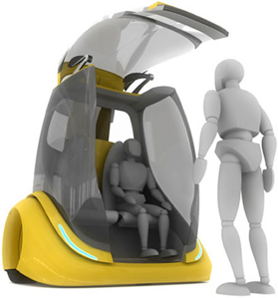
Architecture of a KB agent
Knowledge Level
  Most abstract: describe agent by what it knows
  Ex: Autonomous vehicle knows Golden Gate Bridge connects San Francisco with the Marin County
Logical Level
  Level where knowledge is encoded into sentences
  Ex: links(GoldenGateBridge, SanFran, MarinCounty)
Implementation Level
  Software representation of sentences, e.g.
  (links,goldengatebridge,sanfran,marincounty)

Slide 25
Wumpus World environment
Based on Hunt the Wumpus computer game from 1972
Agent explores cave of rooms connected by passageways
Lurking in a room is the Wumpus, a beast that eats any agent that enters its room
Some rooms have bottomless pits that trap any agent that wanders into the room
Somewhere is a heap of gold in a room
Goal: collect gold and exit without being eaten

Slide 26
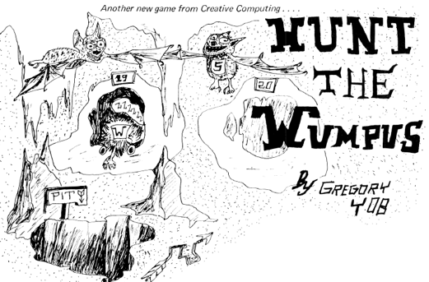
Wumpus History
See Hunt_the_Wumpus for
details
Early (c. 1972) text-based game
written in BASIC written by Gregory Yob, a student at UMASS, Dartmouth
Defined a game genre of including adventure, zork, and nethack
Eventually commercialized (c. 1980) for early personal computers
The Hunt the Wumpus basic code is available in a 1976 article in Creative Computing by Yob!

Slide 27
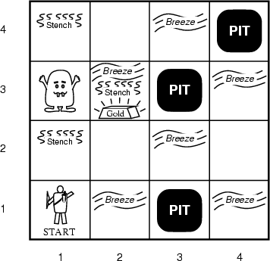
AIMA’s Wumpus World
The agent always starts in the field [1,1]
Agent’s task is to find the gold, return to the field [1,1] and climb out of the cave

Slide 28
Agent in a Wumpus world: Percepts
The agent perceives
  stench in square containing Wumpus and in adjacent squares (not diagonally)
  breeze in squares adjacent to a pit
  glitter in the square where the gold is
  bump, if it walks into a wall
  Woeful scream everywhere in cave, if Wumpus killed
Percepts given as 5-tuple, e.g., if stench, breeze, no glitter, no bump, no scream:
  (Stench, Breeze, None, None, None)
Agent cannot perceive its location, e.g., (2,2)

Slide 29
Wumpus World Actions
go forward
turn right 90 degrees
turn left 90 degrees
grab: Pick up object in same square as agent
shoot: Fire arrow in direction agent faces. It continues until it hits & kills Wumpus or hits an outer wall. Agent has one arrow, so only first shoot action has effect
climb: leave cave, only effective in start square
die: automatically and irretrievably happens if agent enters square with pit or living Wumpus

Slide 30
Wumpus World Goal
Agent’s goal is to find the gold and bring it back to the start square as quickly as possible, without getting killed
  1,000 point reward for climbing out of cave with gold
  1 point deducted for every action taken
  10,000 point penalty for getting killed

Slide 31
Wumpus world characterization
Fully Observable?
Deterministic?
Episodic?
Static?
Discrete?
Single-agent?

Slide 32
Wumpus world characterization
Fully Observable: No – only local perception
Deterministic: Yes, outcomes exactly specified
Episodic: No – sequential at the level of actions; Yes episodic w.r.t. multiple games
Static: Yes – Wumpus and Pits do not move
Discrete: Yes
Single-agent: Yes, Wumpus is essentially a natural feature

Slide 33
AIMA’s Wumpus World
The agent always starts in [1,1]
Agent’s task:
Find the gold,
Return to [1,1]
Climb out of the cave

Slide 34
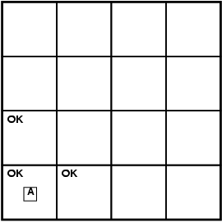
Exploring a wumpus world
label
fact
A agent
B breeze
G glitter
OK safe cell
P pit
S stench
W wumpus
We label cells with facts agent learns about them as it moves through world

Slide 35
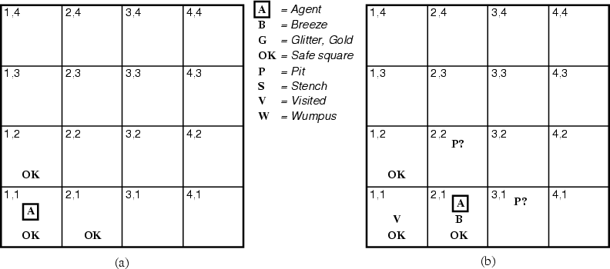
The Hunter’s first steps
Since agent’s alive and perceives neither breeze nor stench at (1,1), it knows (1,1) and its neighbors are OK

Slide 36
The Hunter’s first steps
¬W
¬W
Moving to (2,1) is a safe move that reveals a breeze but no stench, implying that Wumpus isn’t adjacent, but one or more pits are

Slide 37
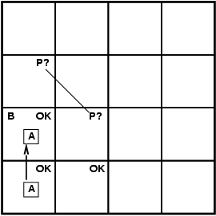
Exploring a wumpus world
A agent
B breeze
G glitter
OK safe cell
P pit
S stench
W wumpus
Let’s start over: assume the agent moves to (1,2) and detects a Breeze. A pit must be in (1,3) or (2,2). What should the agent do next?

Slide 38
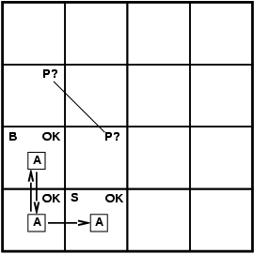
Exploring a wumpus world
A agent
B breeze
G glitter
OK safe cell
P pit
S stench
W wumpus
Returning to (1,1) and then going to (2,1) is a safe move. Always prefer a safe move to a risky one. If the agent perceives a stench but no breeze in (2,1), what can it conclude?

Slide 39
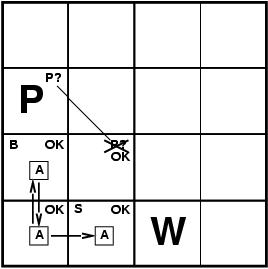
Exploring a wumpus world
A agent
B breeze
G glitter
OK safe cell
P pit
S stench
W wumpus
No stench in (1,2) => Wumpus not in (2,2) => Wumpus in (1,3)
No breeze in (2,1) => no pit in (2,2) => pit in (1,3)

Slide 40

Exploring a wumpus world
A agent
B breeze
G glitter
OK safe cell
P pit
S stench
W wumpus
The agent goes to (2,2) since it’s safe

Slide 41
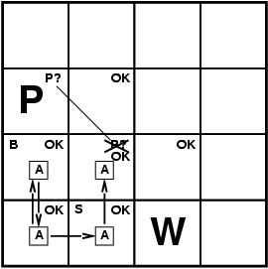
Exploring a wumpus world
A agent
B breeze
G glitter
OK safe cell
P pit
S stench
W wumpus
Detecting neither a stench nor breeze in (2,2) means that both (2,3) and (3,2) are safe

Slide 42
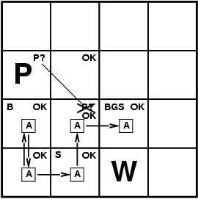
Exploring a wumpus world
A agent
B breeze
G glitter
OK safe cell
P pit
S stench
W wumpus
We pick one of the safe moves, (2,3), and detect a breeze, stench and glitter.

Slide 43
Exploring a wumpus world
A agent
B breeze
G glitter
OK safe cell
P pit
S stench
W wumpus
P?
P?
Found gold! Now it must find way back to (1,1). Hopefully, it has been remembering its moves, so can quickly return to (1,1) via safe moves

Slide 44
Logical reasoning
As we’ll see, the agent can represent
  Knowledge about the world in general, e.g., you can smell the Wumpus in the next cave
  New facts it learns, e.g., no smell in (1,1)
And then draw conclusions, e.g., no Wumpus in (1,2) or in (2,1)

Slide 45
Logic in general
Logics are formal languages for representing information so that conclusions can be drawn
Syntax defines the sentences in the language
Semantics define the "meaning" of sentences
  i.e., define truth of a sentence in a world
E.g., the language of arithmetic
  x+2 ≥ y is a sentence; x2+y > {} is not a sentence
  x+2 ≥ y is true iff the number x+2 is no less than the number y
  x+2 ≥ y is true in a world where x = 7, y = 1
  x+2 ≥ y is false in a world where x = 0, y = 6
  x+1> x is true for all numbers x

Slide 46
Entailment
Entailment: one thing follows from another
KB ╞ α
Knowledge base KB entails sentence α iff α is true in all possible worlds where KB is true
A possible world where KB is true can contain additional facts as long as they don’t contradict anything in the KB
  E.g.: ‘what’s known today’ + ‘there’s life on Mars’

Slide 47
Entailment
Entailment: one thing follows from others
KB ╞ α
Knowledge base KB entails sentence α iff α is true in all possible worlds where KB is true
  E.g., the KB containing “UMBC won” and “JHU won” entails “Either UMBC won or JHU won”
  E.g., x+y = 4 entails x = 4 - y
  Entailment is a relationship between (sets of) sentences (i.e., syntax) that is based on semantics

Slide 48
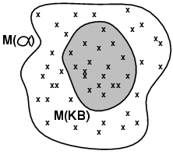
Models
Logicians talk of models: formally structured worlds w.r.t which truth can be evaluated
m is a model of sentence α if α is true in m
  Lots of other things might or might not be true or might be unknown in m
M(α) is the set of all models of α
Then KB ╞ α iff M(KB) ⊆ M(α)
  KB = UMBC and JHU won
  α = UMBC won
  Then KB ╞ α

Slide 49
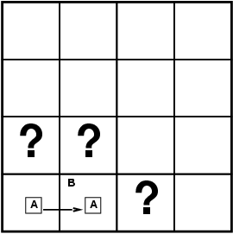
Entailment in the Wumpus World
Situation after detecting nothing in [1,1], move right, breeze in [2,1]
Possible models for KB assuming only pits and restricting cells to {(1,3)(2,1)(2,2)}
Two observations: ~B11, B12
Three more propositional variables: P13, P21, P22
Proposition variables: either True or False
⇒ 8 possible models
4
3
2
1
1
2
3
4
B12: breeze in (1,2)
P13: pit in (1,3)
A notation for propositional variables for Wumpus World

Slide 50
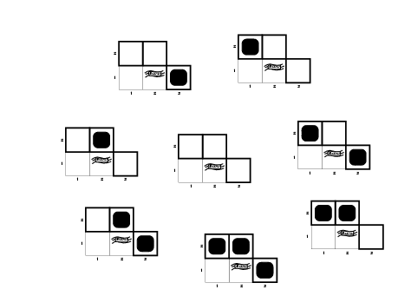
Wumpus models
P13 | P21 | P22
F | F | F
F | F | T
F | T | F
F | T | T
T | F | F
T | F | T
T | T | F
T | T | T
Each row is a potential world
Some of these are inconsistent with the observed facts

Slide 51
Wumpus World Rules (1)
If a cell has a pit, then a breeze is observable in every adjacent cell
In propositional logic we can not have rules with variables (e.g., forall X…)
  P11 => B21 # if (1,1) has a pit, (2,1) has a breeze
  P11 => B12 # if (1,1) has a pit, (1,2) has a breeze
  P21 => B11 # if (2,1) has a pit, (1,1) has a breeze
  P21 => B22 # if (2,1) has a pit, (2,2) has a breeze
  …

Slide 52
Wumpus World Rules (1)
If a cell has a pit, then a breeze is observable in every adjacent cell
In propositional calculus we can not have rules with variables (e.g., forall X…)
  P11 => B21
  P11 => B12
  P21 => B11
  P21 => B22 …
these also follow
~B21 => ~P11
~B12 => ~P11
~B11 => ~P21
~B22 => ~P21
…
…
If a pit in (1,1) then a breeze in (2,1), …

Slide 53
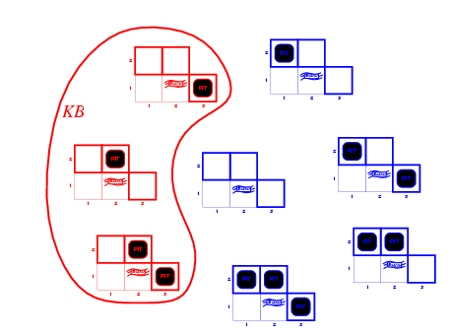
Wumpus models
P13 | P21 | P22
F | F | F
F | F | T
F | T | F
F | T | T
T | F | F
T | F | T
T | T | F
T | T | T
KB = wumpus-world rules + observations
Only three of the possible models are consistent with what is known
Any might be the way the world really is
(P13 ∨ P22) ∧ ~P21
what is known

Slide 54
Wumpus World Rules (2)
Cell safe if it has neither a pit
nor wumpus
  OK11 => ~P11 ∧ ~W11
  OK12 => ~P12 ∧ ~W12 …
From which we can derive the more useful “rules”
P11 ∨ W11 => ~OK11
P11 => ~OK11
W11 => ~OK11 …
OK11: (1,1) is safe
W11: Wumpus in (1,1)

Slide 55
Wumpus models
KB = wumpus-world rules + observations

Slide 56
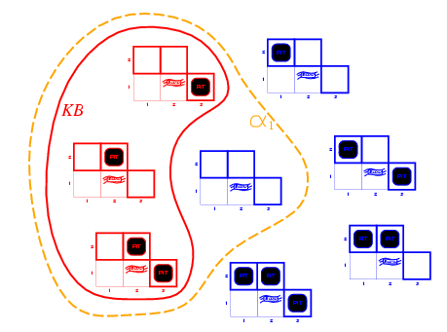
Is (1,2) Safe? Yes!
KB = wumpus-world rules + observations
α₁ = “[1,2] is safe”
Since all models include α₁
KB ╞ α₁, proved by model checking

Slide 57
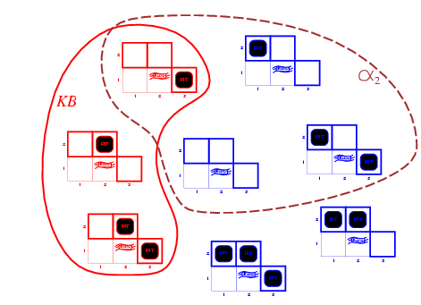
Is (2,2) Safe? Maybe, Maybe Not!
KB = wumpus-world rules + observations
α₂ = "[2,2] is safe"
Since some models don’t include α_{2,} KB ╞ α₂
We cannot prove OK22; it might be true or false

Slide 58
Inference, Soundness, Completeness
KB ├_{i} α : sentence α can be derived (inferred) from KB by procedure i
Soundness: i is sound if whenever KB ├_{i} α, it is also true that KB╞ α
Completeness: i is complete if whenever KB╞ α, it is also true that KB ├_{i} α
Preview: first-order logic is expressive enough to say almost anything of interest and has a sound and complete inference procedure

Slide 59
Soundness and completeness
A sound inference method derives only entailed sentences
A complete inference method can (eventually) derive any entailed sentence
Analogous to the property of soundness and completeness in search

Slide 60
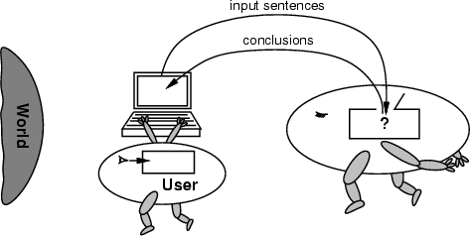
No independent access to the world
Reasoning agents often get knowledge about world as a sequence of logical sentences and draw conclusions from them w/o independent access to the world
Very important that the agents’ reasoning is sound!
Completeness is harder, but maybe less fundamental

Slide 61
Summary
Intelligent agents need knowledge about world for good decisions
Agent’s knowledge stored in a knowledge base (KB) as sentences in a knowledge representation (KR) language
Knowledge-based agents needs a KB & inference mechanism. They store sentences in KB, infer new sentences & use them to deduce which actions to take
A representation language defined by its syntax & semantics, which specify structure of sentences & how they relate to facts of the world
Interpretation of a sentence is fact to which it refers. If fact is part of the actual world, then the sentence is true

Slide 62
Fin

