Slide 1
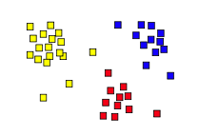
Unsupervised Learning: Topic Modeling
14.7

Slide 2
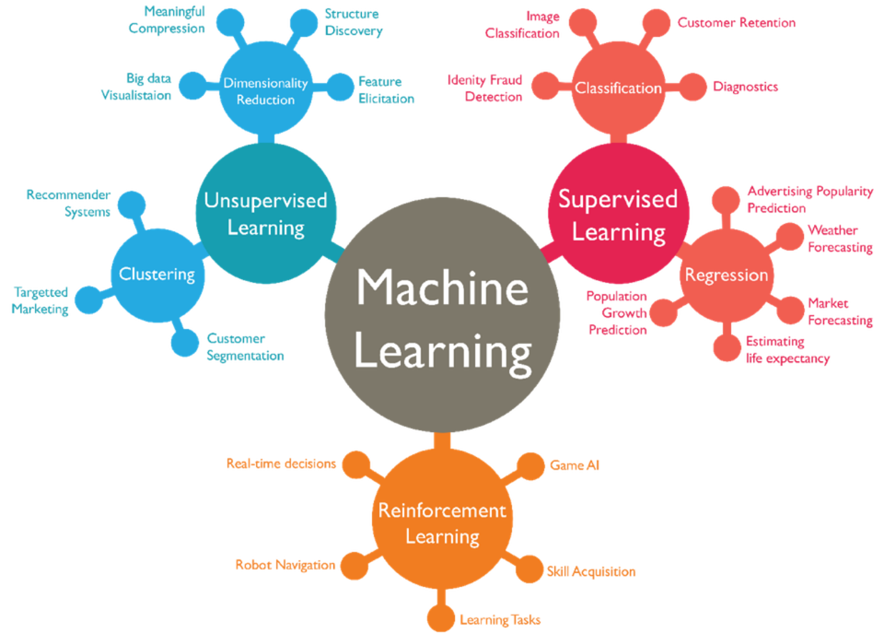

Slide 3
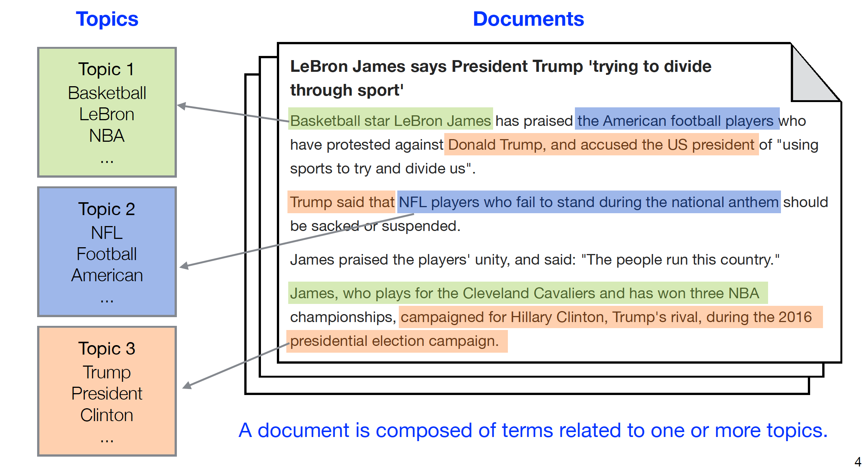
Documents cover multiple topics

Slide 4

Topic Modeling
Topic 1
Data
Pre- processing
Topic
Modelling Algorithm
Topic 2
Topic k
Topic Modeling induces a set of topics from a document collection based on their words
Output: A set of k topics, each of which is represented by
  A descriptor, based on the top-ranked terms for the topic
  Associations for documents relative to the topic.

Slide 5
Topic Modeling
If we want five topics for a set of newswire articles, the topics might correspond to politics, sports, technology, business & entertainment
Documents are represented as a vector of numbers (between 0.0 & 1.0) indicating how much of each topic it has
Document similarity is measured by the cosign similarity of their vectors

Slide 6
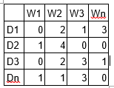
Document-term matrix
Given collection of documents, find all the unique words in them
  Eliminate common stopwords (e.g., the, and, a) that carry little meaning and very infrequent words
Represent each word as an integer
and construct document-term matrix
Cell values are term frequency (tf),
number of times word occurs
Alternatively: use tf-idf to give
less weight to very common words
10,000 words
1000
documents

Slide 7
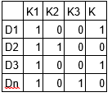
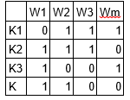
Dimensionality reduction
A dimensionality-reduction algorithm converts this matrix into the product of two smaller matrices
  Documents to topics and topics to words
Document represented as a vector of topics
Understand what K₃ is about by looking at its words with the highest values
Documents about topic K₃ are those with high values for K₃
Documents similar to D₄₃ will have similar topic vectors (use cosine similarity)
document-term
W
H
X
n documents x m words
n documents x k topics
k topics x m words

Slide 8
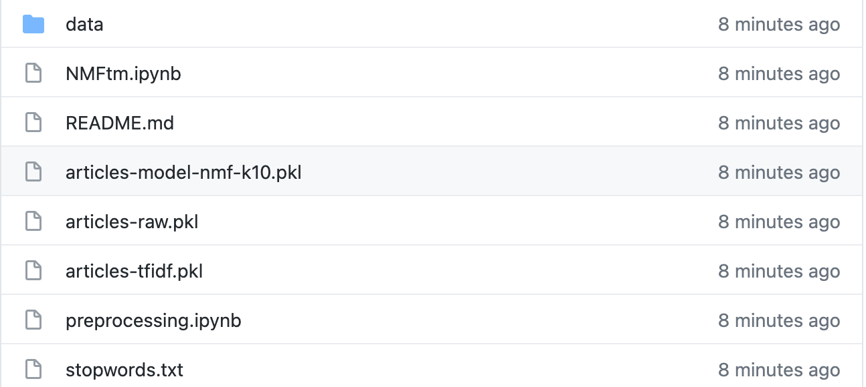
Topic modeling with sklearn
See and try the notebooks and data in this github repo

Slide 9
Dimensionality reduction
There are many dimensionality-reduction algorithms with different properties
They are also used for word embeddings
General idea: represent a thing (i.e., document, word, node in a graph) as a relatively short (e.g., 100-300) vector of numbers between 0.0 and 1.0
Some information lost, but the size is manageable

Slide 10
Topic Modeling Summary
Topic Modeling is an efficient way for identifying latent topics in a collection of documents
The topics found are ones that are specific to the collection, which might be social media posts, medical journal articles or cybersecurity alerts
It can be used to find documents on a topic, for document similarity metrics and other applications

