Slide 1
What’s better than a tree?
14.5

Slide 2
Random Forest
Can often improve performance of decision tree classifiers using a set of decision trees (a forest)
Each tree trained on a random subset of training data
Classify a data instance using all trees
Combine answers to make classification
  E.g., vote for most common class

Slide 3
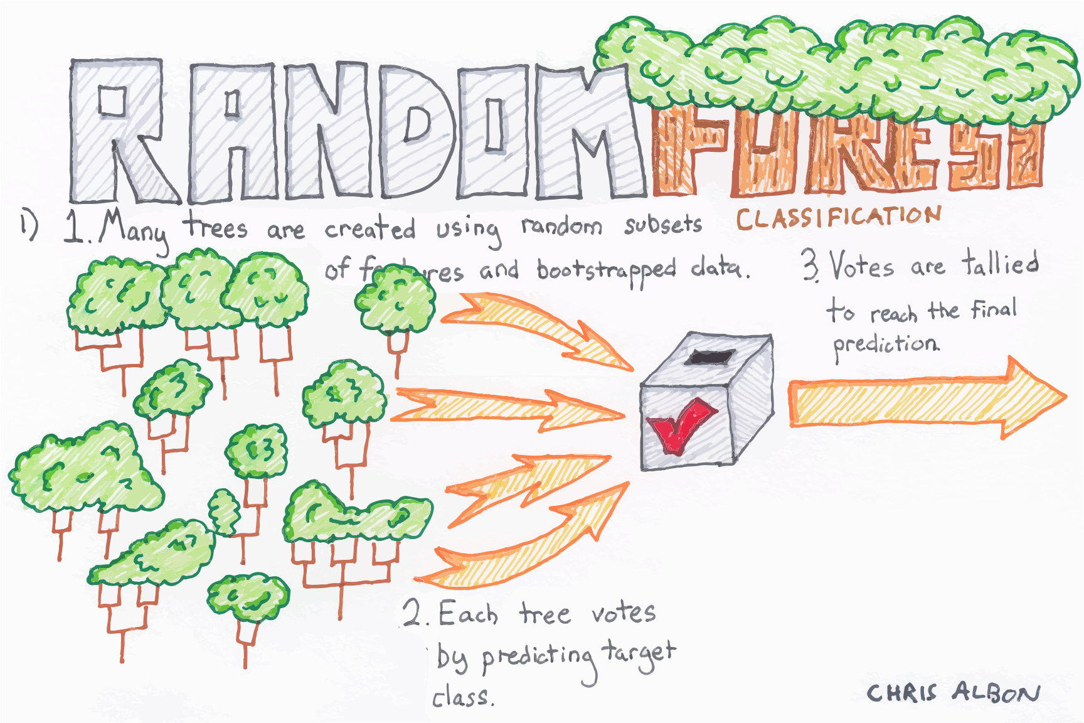

Slide 4

cf. Wisdom of the Crowd
Statistician Francis Galton observed a 1906 contest to guess an ox’s weight at a country fair. 800 people entered. He noted that their average guess (1,197lb) was very close to the actual weight (1,198lb)
When getting human annotations training data for machine learning, standard practice is get ≥ 3 annotations and take majority vote
cf. abbreviation (short for Latin: confer/conferatur) refer reader to other material to make a comparison

Slide 5
Random Forests Benefits
Decision trees not the strongest modeling approach
Random forests make them much stronger
=> more robust than a single decision tree
  Limit overfitting to given dataset
  Reduce errors due to training data bias
  Stable performance if some noise added to training data

Slide 6
Bagging
Idea can be used on any classifier!
Improve classification by combining classify-cations of randomly selected training subsets
Bagging = Bootstrap aggregating
  ensemble meta-algorithm that can improve stability & accuracy of algorithms for statistical classification and regression
Helps avoid overfitting
AKA ensembling

Slide 7
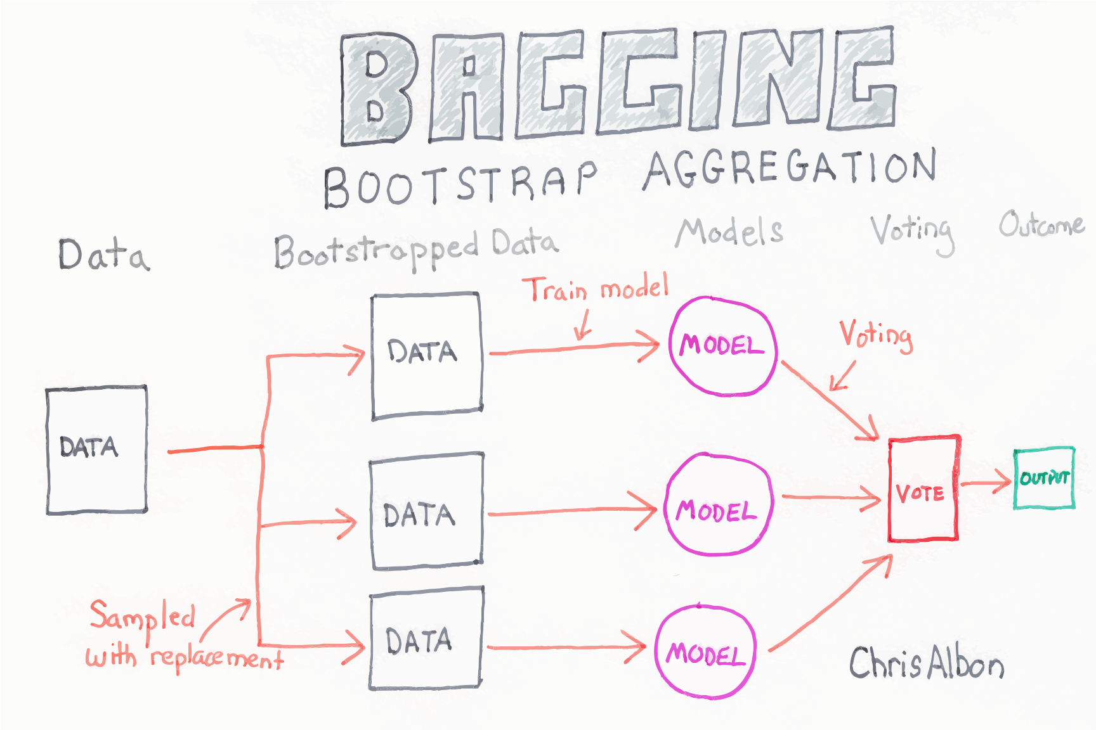

Slide 8

Choosing training data subsets
Classic bagging: select random subset of training instances with replacement
Pasting: select random subset of training instances (i.e., without replacement)
Random Subspaces: use all training instances, but with a random subset of features
Random Patches: random subset of instances and random subset of features
Best? depends on problem, training data, algorithm

Slide 9
Examples
Two examples using Weka
  UCI Auto mpg prediction dataset
  UCI Adult income prediction dataset
RandomForest improves over J48 for the smaller dataset, but not for the larger
Takeaway: more data is always best

Slide 10

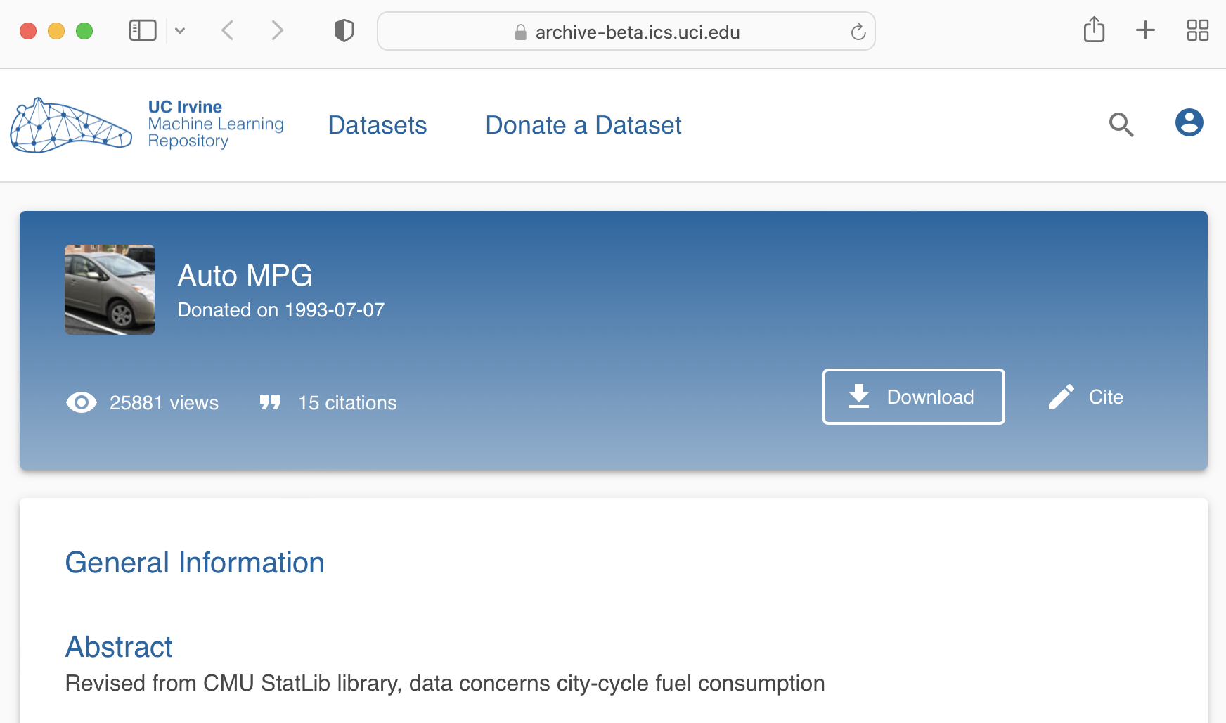
UCI Auto MGP Dataset
398 instances with 8 attributes from 1983:
1. mpg: continuous; 2. cylinders: multi-valued discrete; 3. displacement: continuous; 4. horsepower: continuous; 5. weight: continuous; 6. acceleration: continuous; 7. model year: multi-valued discrete; 8. origin: multi-valued discrete; 9. car name: string (unique for each instance)
Predict MPG
from other 7
attributes
Arff training data (240); test data (132)

Slide 11
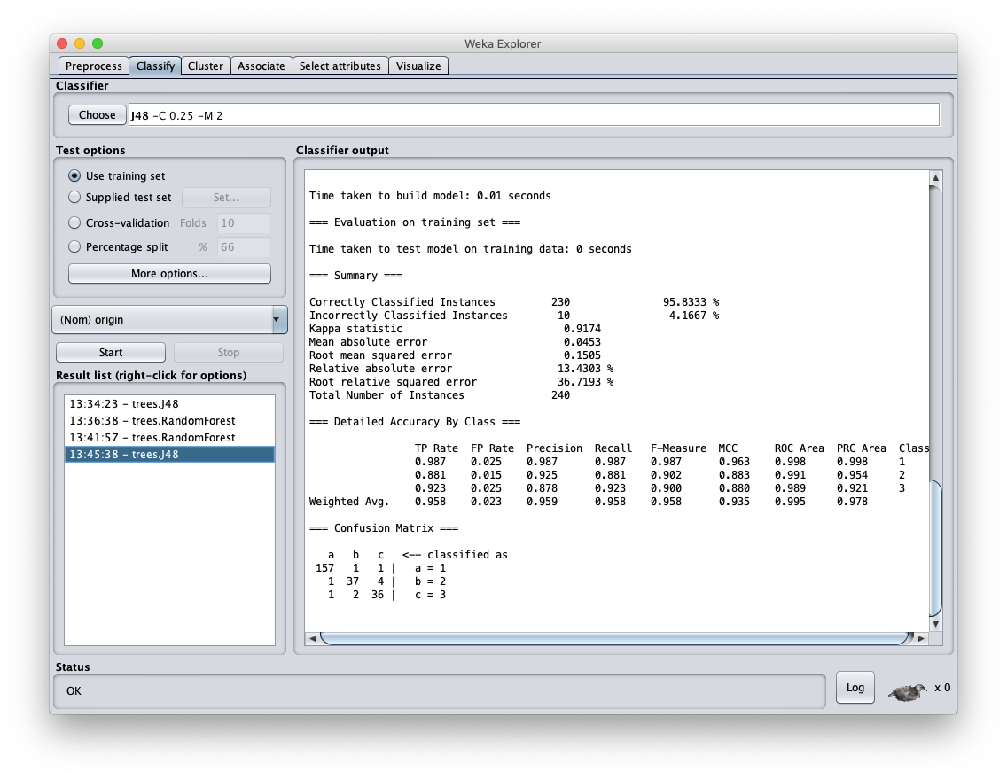
Avg F1 = 0.98 very high!

Slide 12
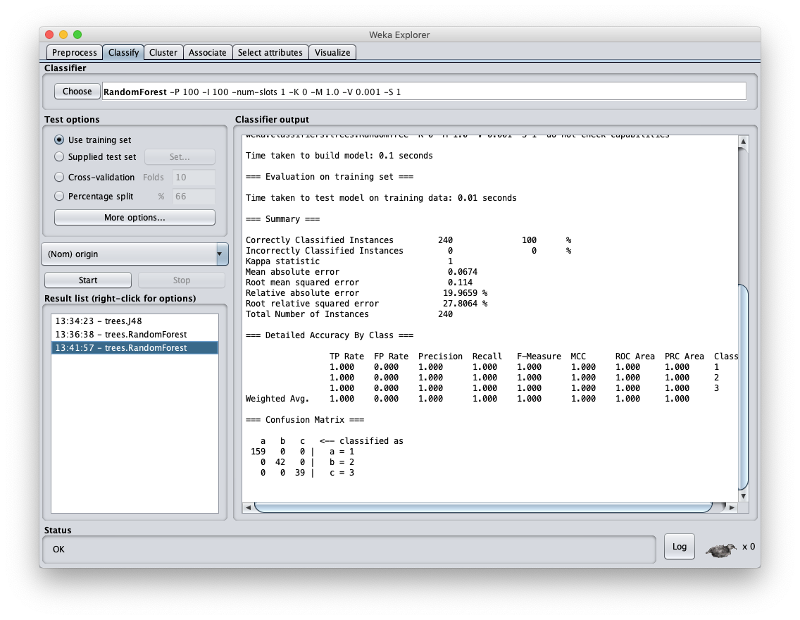
Avg F1 = 1.0 perfect!

Slide 13

100% … Wait, What ?
Results are too good to be true!
  Something must be wrong
ML results tend to be asymptotic
  Asymptotic lines approach a curve but never touch
Closer you get to F1=1.0, the harder it is to improve
What did we do wrong?

Slide 14
Results are too good
Relatively small dataset allows construction of a DT model that does very well
Using Random Forest still got perfect results!
We trained and tested on the same data!
Very poor methodology since it overfits to this particular training set
This training dataset has a separate test data set
  We can also try 10-fold cross validation

Slide 15
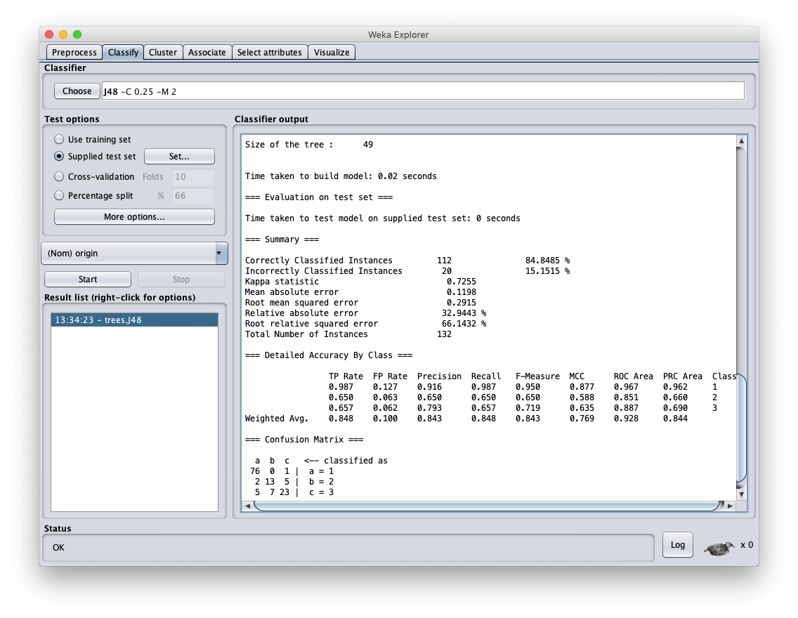
Avg F1 = 0.843 good

Slide 16
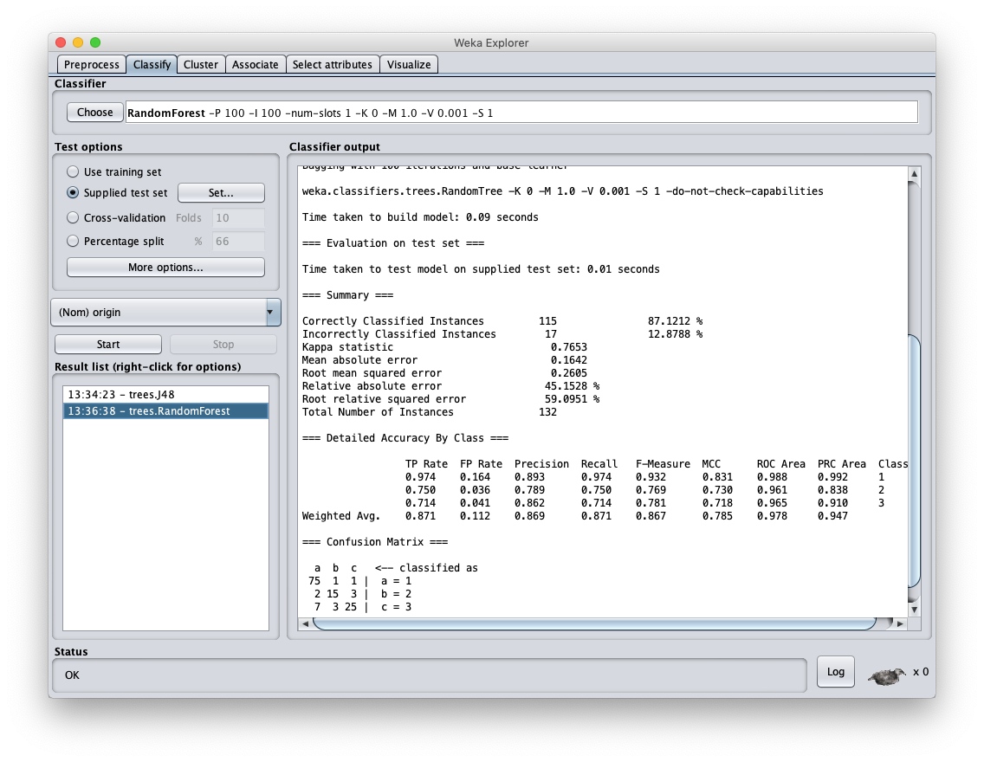
Avg F1 = 0.867 better

Slide 17
New AUTO MPG Results
Using an independent test set shows more realistic balanced F1 score of .843
Using Random Forest raises this to .867
While the increase is not large, it is probably statistically significant
F1 scores this high are difficult to increase dramatically
  Human scores for many tasks are often in this range (i.e., 0.8 – 0.9)

Slide 18
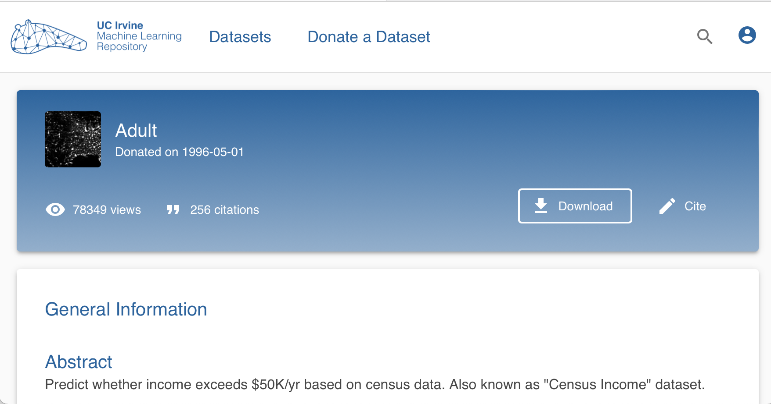
UCI Adult Census Income Dataset
~49K instances with 15 attributes from 1994:
1. >50K: binary; age: continuous. workclass: Private, Self-emp-not-inc, Self-emp-inc, Federal-gov, Local-gov, State-gov, Without-pay, Never-worked. fnlwgt: continuous. education: Bachelors, Some-college, 11th, HS-grad, Prof-school, …
Predict income
>50k from 15
attributes
Arff data

Slide 19
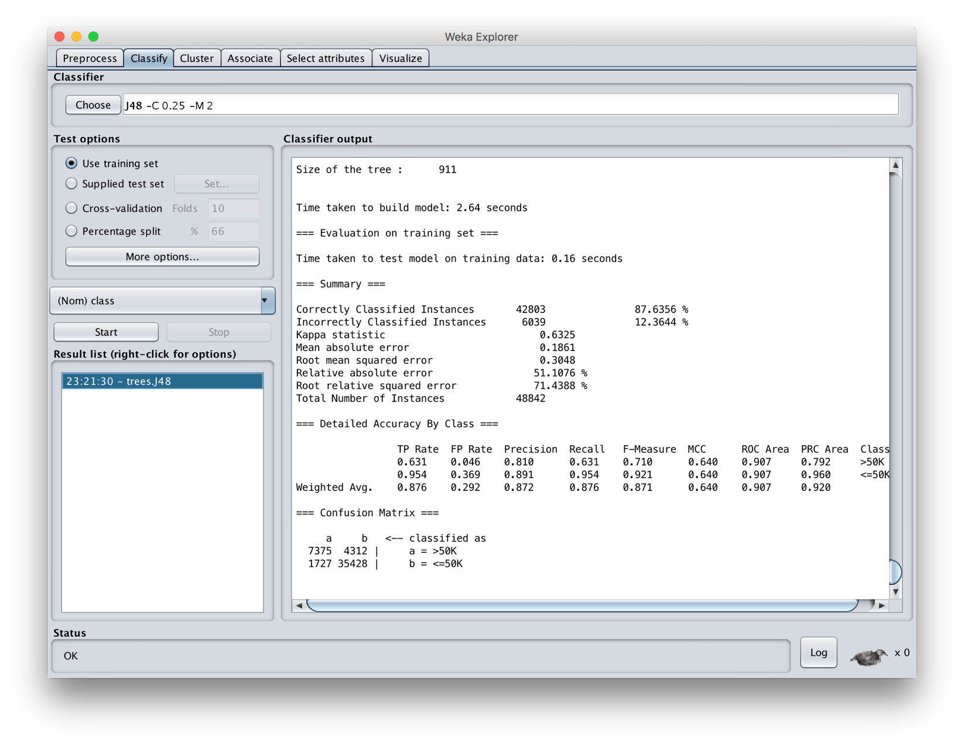

Slide 20
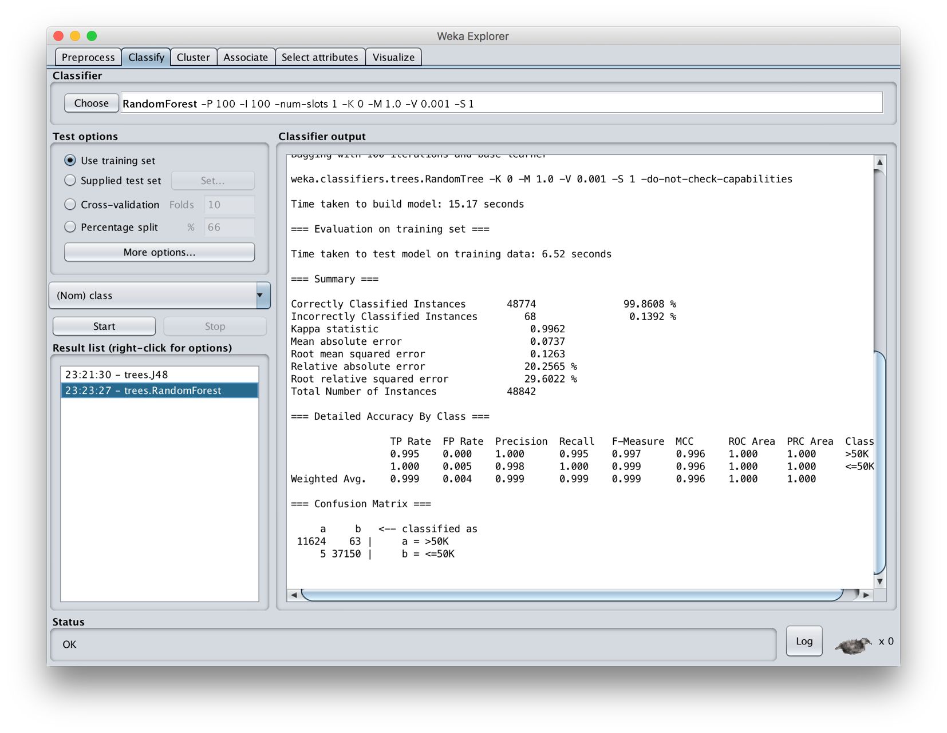

Slide 21
Result
Significant increase on F1 scores when both trained and evaluated on training set
This is considered to be poor methodology since it overfits to the particular training set

Slide 22
Create train and test collection
Train has ~95% of data, test 5%
Trained models for J48 and random forest using train dataset
Tested on test data set
Results were that random forest was (at best) about the same as J48
Large dataset reduced problem of overfitting, so random forest did not help

Slide 23
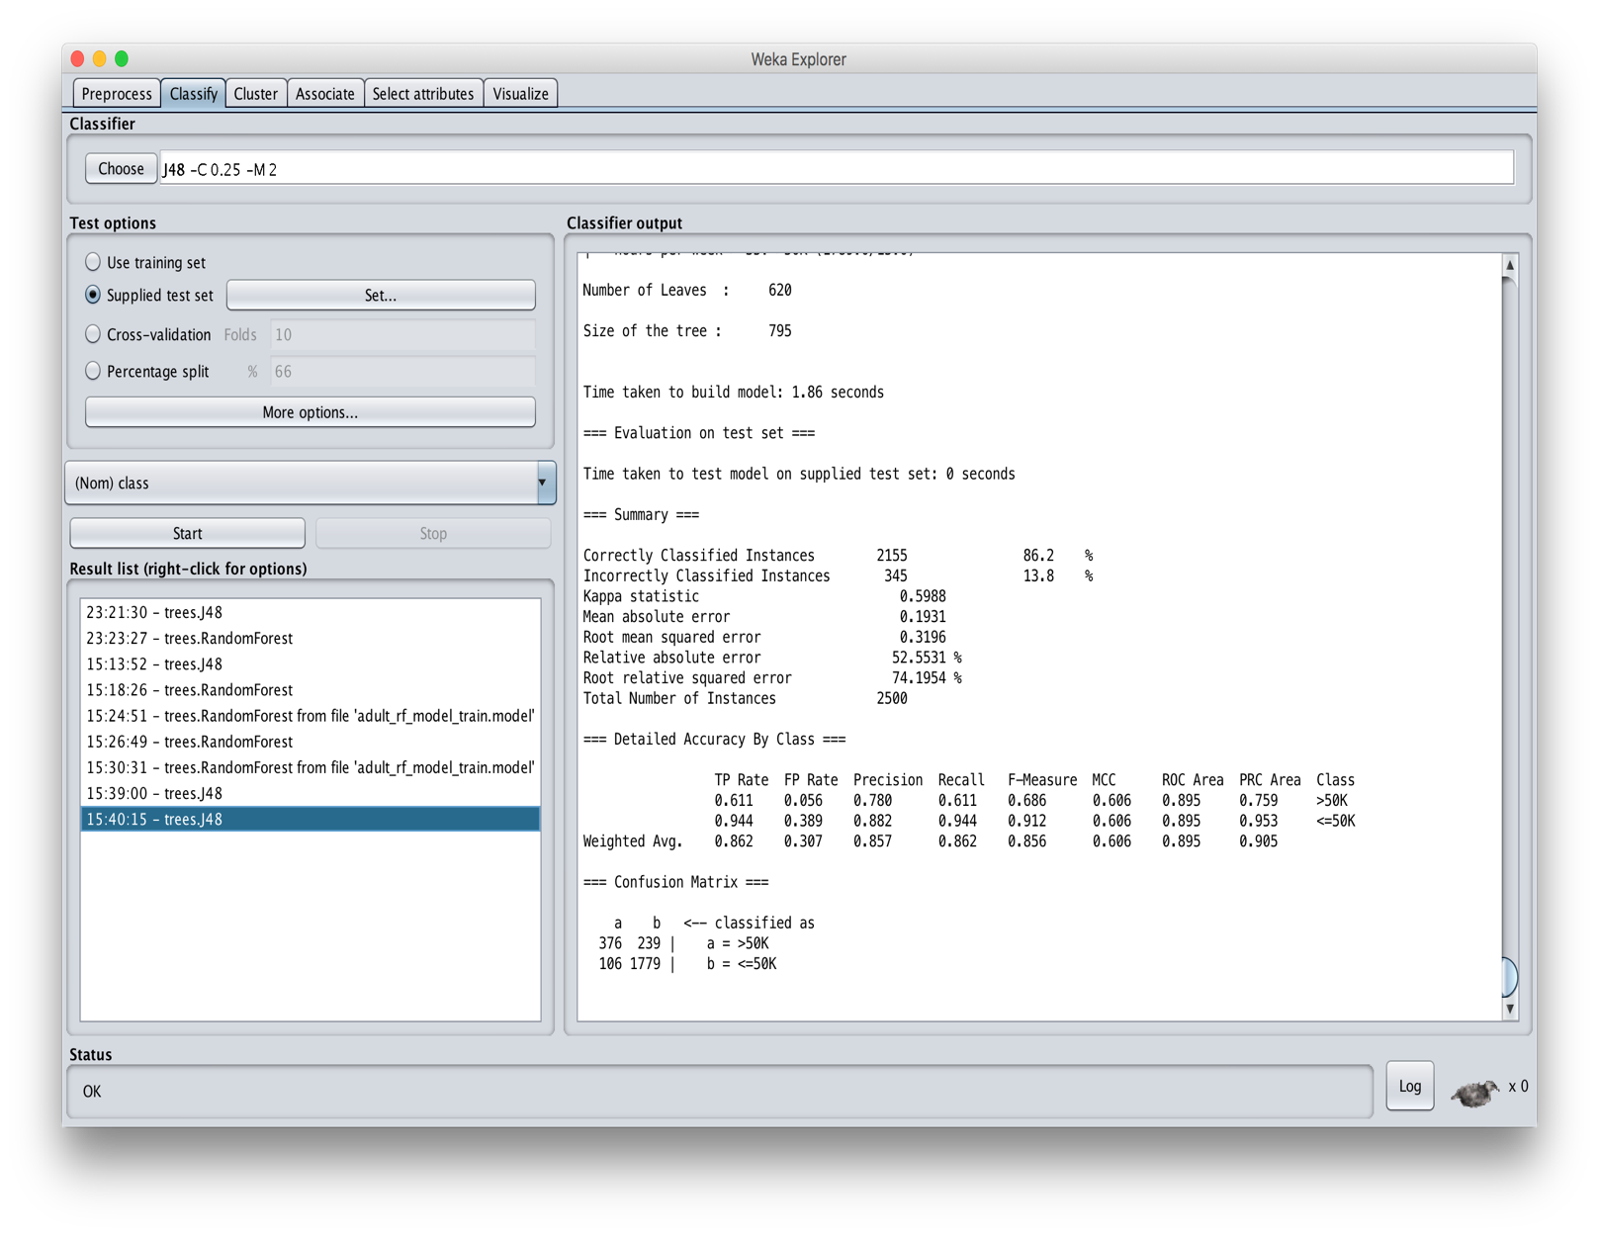
F = 0.856

Slide 24
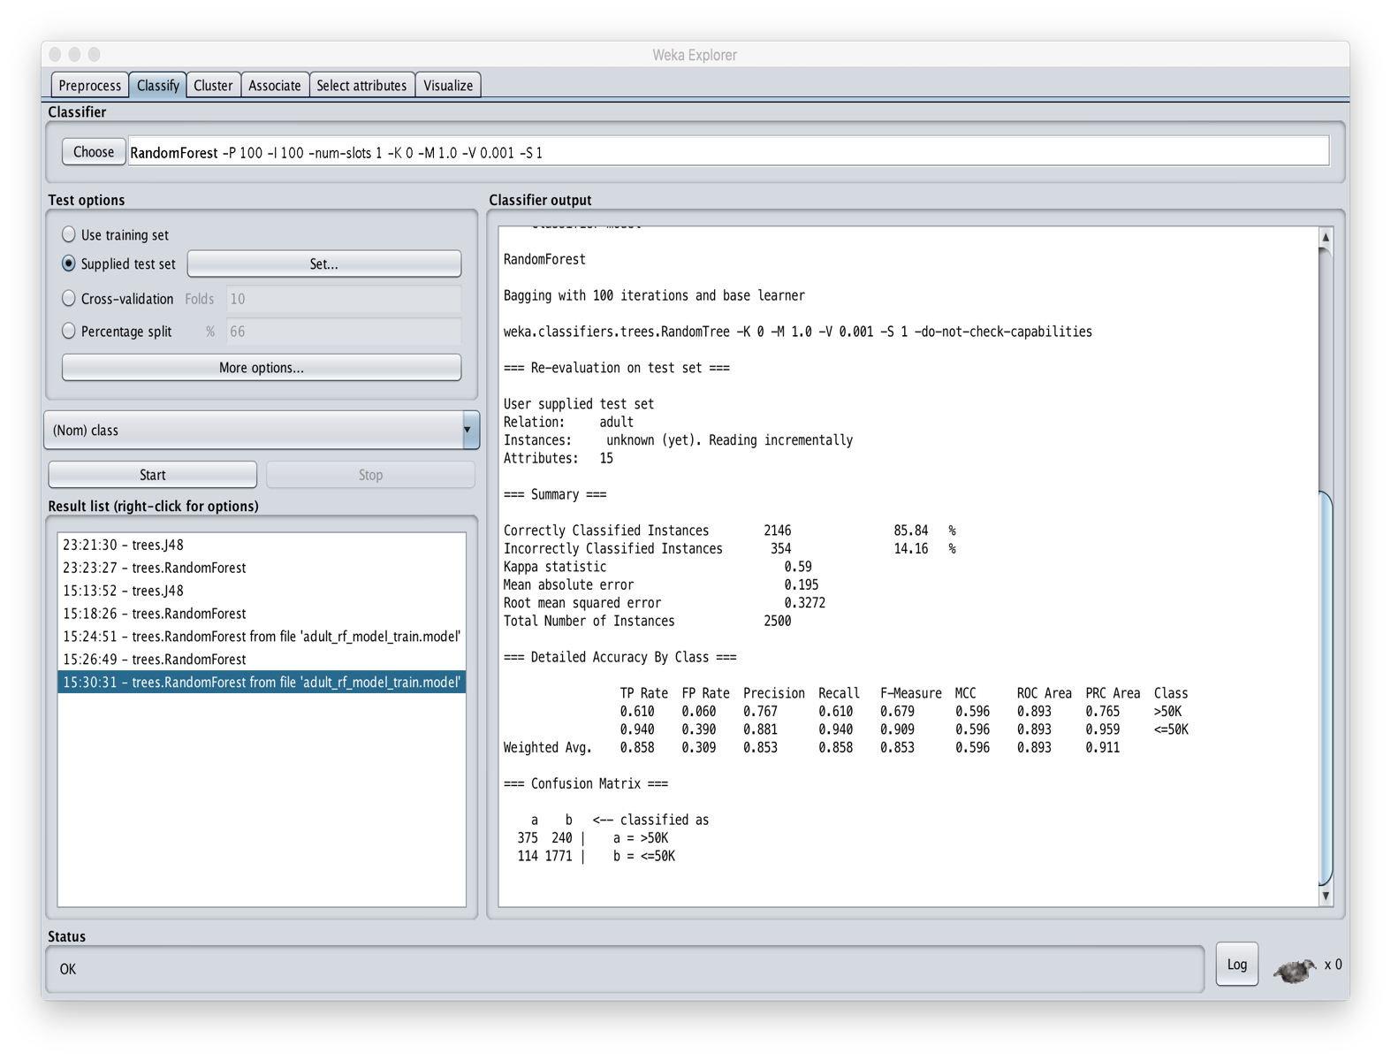
F = 0.853

Slide 25
Conclusions
Bagging helps, especially if training data adequate, but not as large as it should be
  With lots of data, overfitting less of a problem, so bagging may not help
While we explore it using decision trees, it can be applied to any classifier
  Scikit-learn has a general module for bagging
In general, using any of several ensemble approaches to classification often helpful
Training neural networks uses a different approach (dropout) to control overfittting

Slide 26
Conclusions
Wait, there’s more…
A classification problem can change over time
  E.g.: recognizing a spam message from its content and metadata
We showed that an ensemble approach can detect a change in the nature of spam
  Which tells us its time to retrain with new data
  D. Chinavle, P. Kolari, T. Oates, and T. Finin, Ensembles in Adversarial Classification for Spam, ACM CIKM, 2009. link

Slide 27
Recognizing Concept Drift
Build ensemble of five models to classify
spam comments left on a blog at time T1
Note the relative level of agreement
Detect when one of the models starts to diverge from the others with at time T2
  Time to get new data and retrain
  Examining disagreements can be enlightening
Used temporal data spanning several years to prove effectiveness
  E.g., spam focus shift from viagra to weight loss

