Slide 1

Machine
Learning: Methodology
Chapter 19
14.4

Slide 2

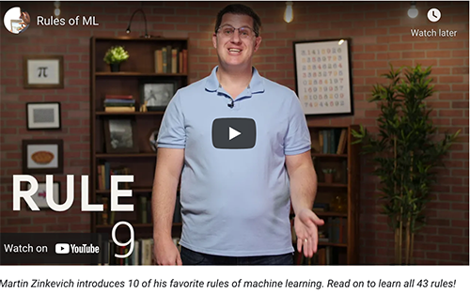
ML is an experimental science
Most ML work has an engineering or experimental flavor
  it’s being used as a tool to solve a problem
Methodology is important
As are approaches for evaluating results
Common to try multiple ML methods, features, and parameters for a problem to find what works best
Google’s Rules of Machine
Learning has more information

Slide 3
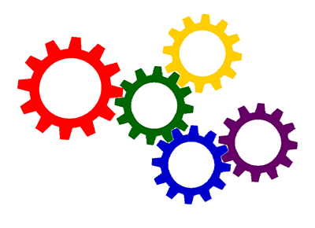
Many moving parts
Solving a problem with machine
learning involves many decisions
Selecting training data and deciding how much is needed
Preprocessing the data, creating new features from it
Selecting a machine learning algorithm
Choosing its parameters
Deciding on a metric to optimize
Running evaluation experiments

Slide 4
Approaches
Different classes of ML algorithms have different kinds of evaluation techniques
  Some are common to most, however
Supervised ML
  We can use our data with the right answers
Unsupervised ML
  Some general metrics exist (e.g., for clusters)
  May need human assessments
Reinforcement learning
  Problem determines good/bad outcomes (e.g., points won in a game)
today

Slide 5

http://archive.ics.uci.edu/ml
233 data sets

Slide 6
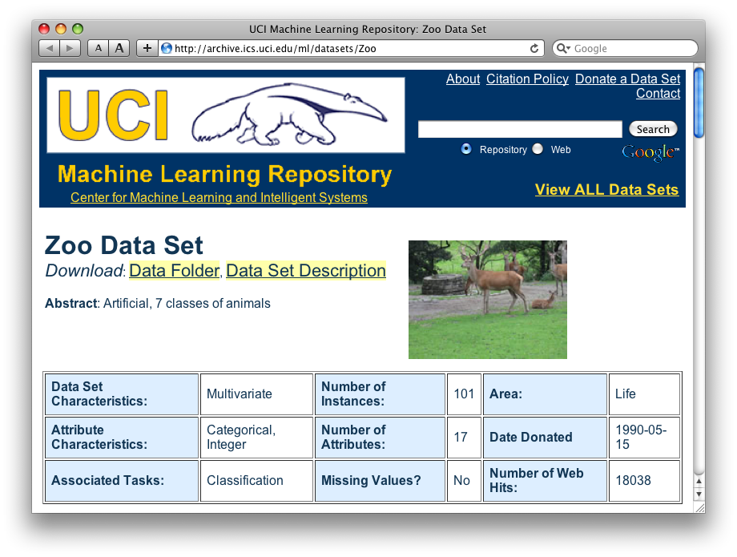
http://archive.ics.uci.edu/ml/datasets/Zoo

Slide 7
Zoo data
animal name: string
hair: Boolean
feathers: Boolean
eggs: Boolean
milk: Boolean
airborne: Boolean
aquatic: Boolean
predator: Boolean
toothed: Boolean
backbone: Boolean
breathes: Boolean
venomous: Boolean
fins: Boolean
legs: {0,2,4,5,6,8}
tail: Boolean
domestic: Boolean
catsize: Boolean
type: {mammal, fish, bird, shellfish, insect, reptile, amphibian}
101 examples
aardvark,1,0,0,1,0,0,1,1,1,1,0,0,4,0,0,1,mammal
antelope,1,0,0,1,0,0,0,1,1,1,0,0,4,1,0,1,mammal
bass,0,0,1,0,0,1,1,1,1,0,0,1,0,1,0,0,fish
bear,1,0,0,1,0,0,1,1,1,1,0,0,4,0,0,1,mammal
boar,1,0,0,1,0,0,1,1,1,1,0,0,4,1,0,1,mammal
buffalo,1,0,0,1,0,0,0,1,1,1,0,0,4,1,0,1,mammal
calf,1,0,0,1,0,0,0,1,1,1,0,0,4,1,1,1,mammal
carp,0,0,1,0,0,1,0,1,1,0,0,1,0,1,1,0,fish
catfish,0,0,1,0,0,1,1,1,1,0,0,1,0,1,0,0,fish
cavy,1,0,0,1,0,0,0,1,1,1,0,0,4,0,1,0,mammal
cheetah,1,0,0,1,0,0,1,1,1,1,0,0,4,1,0,1,mammal
chicken,0,1,1,0,1,0,0,0,1,1,0,0,2,1,1,0,bird
chub,0,0,1,0,0,1,1,1,1,0,0,1,0,1,0,0,fish
clam,0,0,1,0,0,0,1,0,0,0,0,0,0,0,0,0,shellfish
crab,0,0,1,0,0,1,1,0,0,0,0,0,4,0,0,0,shellfish
…

Slide 8
Zoo example
aima-python> python
>>> from learning import *
>>> zoo
<DataSet(zoo): 101 examples, 18 attributes>
>>> dt = DecisionTreeLearner()
>>> dt.train(zoo)
>>> dt.predict(['shark',0,0,1,0,0,1,1,1,1,0,0,1,0,1,0,0])
'fish'
>>> dt.predict(['shark',0,0,0,0,0,1,1,1,1,0,0,1,0,1,0,0])
'mammal’

Slide 9
Evaluation methodology (1)
Standard methodology:
  1. Collect large set of examples with correct classifications (aka ground truth data)
  2. Randomly divide collection into two disjoint sets: training & test (e.g., via a 90-10% split)
  3. Train a model using your algorithm on the training set giving hypothesis H
  4. Measure performance of the model (and H) on the held-out test set

Slide 10
Accuracy: a simple metric
What measure of performance can we use?
It depends on the kind of task, e.g.,
  Classification (e.g., which species of iris)
  Information retrieval (find relevant documents)
One of the simplest is accuracy
  Fraction of the answers that are correct
Doesn't weigh different kinds of errors differently (e.g., false positive vs. false negatives)

Slide 11
Evaluation methodology (2)
Important: keep training and test sets disjoint!
Study efficiency & robustness of algorithm: repeat steps 2-4 for different training sets & training set sizes
On modifying algorithm or its parameters, restart with step 1 to avoid evolving algorithm to work well on just this collection

Slide 12
Better evaluation methodology
Common variation on methodology:
  1. Collect set of examples with correct classifications
  2. Randomly divide it into two disjoint sets: development & test; further divide development into devtrain & devtest
  3. Apply ML to devtrain, giving hypothesis H
  4. Measure performance of H w.r.t.
  devtest data
  5. Modify approach, repeat 3-4 as needed
  6. Final test on test data
Ground truth data
DEV
TEST
devtrain
devtest

Slide 13
Evaluation methodology (4)
Common variation on methodology:
  1. Collect set of examples with correct classifications
  2. Randomly divide it into two disjoint sets: development & test; further divide development into devtrain & devtest
  3. Apply ML to devtrain, giving hypothesis H
  4. Measure performance of H w.r.t.
  devtest data
  5. Modify approach, repeat 3-4 as needed
  6. Final test on test data
Only devtest data used for evalua-tion during system development
When all development has ended, test data used for final evaluation
Ensures final trained system not influenced by test data
If more development needed, get new dataset!
Ground truth data
DEV
TEST
devtrain
devtest

Slide 14
Zoo evaluation
train_and_test(learner, data, start, end) uses data[start:end] for test and rest for train
Hold out 10 data items for test; train on the other 91; show the accuracy on the test data
Doing this four times for different test subsets shows accuracy from 80% to 100%
What’s the true accuracy of our approach?

Slide 15
Zoo evaluation
train_and_test(learner, data, start, end) uses data[start:end] for test and rest for train
  >>> dtl = DecisionTreeLearner
  >>> train_and_test(dtl(), zoo, 0, 10)
  1.0
  >>> train_and_test(dtl(), zoo, 90, 100)
  0.80000000000000004
  >>> train_and_test(dtl(), zoo, 90, 101)
  0.81818181818181823
  >>> train_and_test(dtl(), zoo, 80, 90)
  0.90000000000000002
We might use the average accuracy of the experiments as the overall metric, in this case 0.9

Slide 16
K-fold Cross Validation
Problem: getting ground truth data expensive
Problem: need different test data for each test
Problem: experiments needed to find right feature space & parameters for ML algorithms
Goal: minimize training+test data needed
Idea: split training data into K subsets; use K-1 for training and one for development testing
Repeat K times and average performance
Common K values are 5 and 10

Slide 17
N-fold Cross Validation
AIMA code has a cross_validation function that runs K-fold cross validation
cross_validation(learner, data, K, N) does N iterations, each time randomly selecting 1/K data points for test, leaving rest for train
  >>> cross_validation(dtl(), zoo, 10, 20)
  0.95500000000000007
Very common approach to evaluating model accuracy during development
Best practice: hold out a final test data set

Slide 18
Leave one out validation
AIMA code also has a leave1out function that runs experiments to estimate model accuracy
leave1out(learner, data) does len(data) trials, each using one element for test, rest for train
  >>> leave1out(dtl(), zoo)
  0.97029702970297027
K-fold cross validation can be too pessimistic, since it only trains with 80% or 90% of the data
The leave one out evaluation is an alternative

Slide 19
Fast and slow learners
Some approaches require less training data to reach a given performance level than others
We can think of them as faster learners
Differences can be due to data preprocessing, algorithm choice, and/or parameter settings
Faster is generally better for many reasons (e.g., may want to apply it to many huge datasets)
Learning curve give an intuitive way to assess

Slide 20
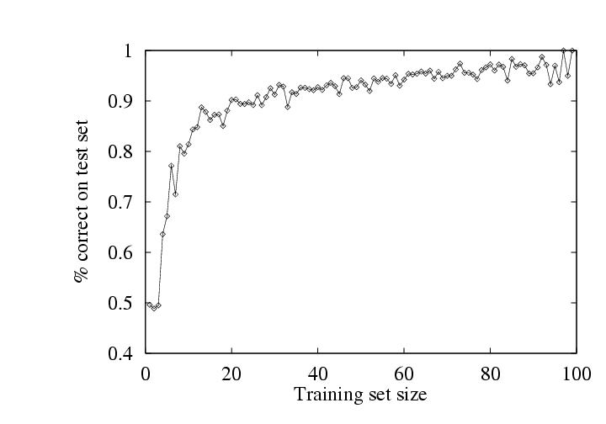
Learning curve (1)
A learning curve shows accuracy on test set as a function of training set size or (for neural networks) running time

Slide 21
Learning curve
When evaluating ML algorithms, steeper learning curves are better
Represent faster learning with less data
System with the red curve is better since it requires less data to achieve a given accuracy
Training set size

Slide 22
Neural network learning curves
For neural networks, the x axis is usually the number of iterations of the training algorithm
System with the red curve is better since it requires fewer iterations and less time to achieve a given accuracy
Number of iterations

Slide 23
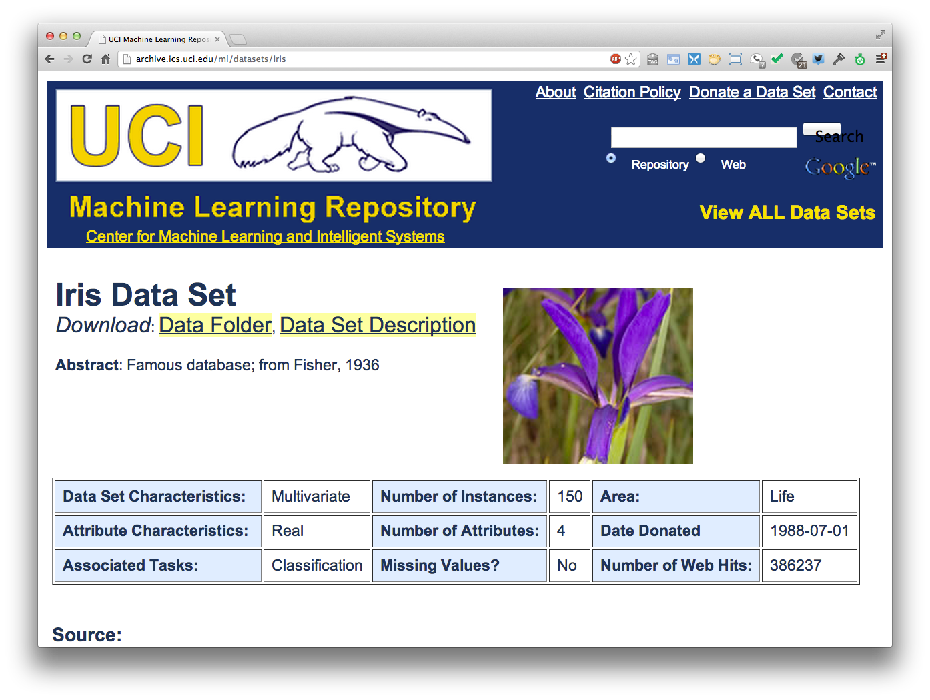
http://archive.ics.uci.edu/ml/datasets/Iris

Slide 24
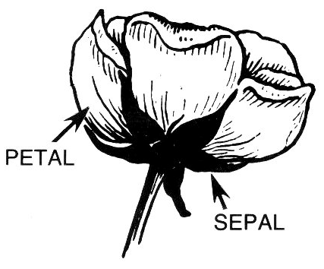
Iris Data
Three classes: Iris Setosa, Iris
Versicolour, Iris Virginica
Four features: sepal length and width, petal length and width
150 data elements (50 of each)
aima-python> more data/iris.csv
5.1,3.5,1.4,0.2,setosa
4.9,3.0,1.4,0.2,setosa
4.7,3.2,1.3,0.2,setosa
4.6,3.1,1.5,0.2,setosa
5.0,3.6,1.4,0.2,setosa
http://code.google.com/p/aima-data/source/browse/trunk/iris.csv

Slide 25
Comparing ML Approaches
Effectiveness of ML algorithms varies depending on problem, data, and features used
You may have intuitions, but run experiments
Average accuracy (% correct) is a standard metric
>>> compare([DecisionTreeLearner, NaiveBayesLearner, NearestNeighborLearner], datasets=[iris, zoo], k=10, trials=5)
iris zoo
DecisionTree 0.86 0.94
NaiveBayes 0.92 0.92
NearestNeighbor 0.85 0.96
Common practice: make best result bold for each experiment, e.g., NaiveBayes worked best for IRIS and NearestNeighbor was best for zoo

Slide 26
Confusion Matrix (1)
A confusion matrix can be a better way to show results for many problems
For binary classifiers it’s simple and related to type I and type II errors (i.e., false positives and false negatives)
We may have different
costs for each error
So, we must understand
their frequencies
actual
Type I
 | C | ~C
C | True positive | False positive
~C | False negative | True negative
predicted
Type II

Slide 27
Confusion Matrix (2)
For multi-way classifiers, a confusion matrix is even more useful
It lets you focus in on where the errors are
actual
 | Cat | Dog | rabbit
Cat | 5 | 3 | 0
Dog | 2 | 3 | 1
Rabbit | 0 | 1 | 9
Consider a system trained to identify an images as a dog, cat, or rabbit
predicted
Correct
Result shows system finds it easy to confuse dogs & cats
Overall accuracy is 17/24 (71%) but for dogs vs. cats it is 8/13 (62%)

Slide 28
Accuracy, Error Rate, Sensitivity, Specificity
P/A | C | ¬C
C | TP | FP | P’
¬C | FN | TN | N’
 | P | N | All
Class Imbalance Problem:
  One class may be rare, e.g. fraud, HIV-positive, ebola
  Significant majority in negative class & rest in positive class
  Sensitivity: True Positive recognition rate
    Sensitivity = TP/TP+FN
  Specificity: True Negative recognition rate
    Specificity = TN/TN+FP
Classifier Accuracy, or recogni-tion rate: percentage of test set tuples are correctly classified
  Accuracy = (TP + TN)/All
Error rate: 1 – accuracy, or
  Error rate = (FP + FN)/All

Slide 29
On Sensitivity and Specificity
High sensitivity: few false negatives
sensitivity=1 => TP=P => you correctly identify all positives, but
may include many negatives
High specificity: few false positives
  specificity=1 => TN=N => you correctly identify all negatives
  but may include many positives
TSA security scenario:
  Scanners set for high sensitivity & low specificity (e.g., trigger on keys) reducing risk of missing dangerous objects
Web search scenario:
  Set for high specificity so first page has nearly all relevant documents

Slide 30
COVID-19 Sensitivity & Specificity
COVID-19: test sensitivity and specificity both 0.99 (i.e., 99% accuracy)
Assume 1% of population infected (pos)
Test 10,000 people where 100 pos, 9900 neg
  99 + 99 will test positive (half right, half wrong)
  01 + 9801 will test negative (virtually all correct)
Dr. Birx, April 2020: “I want to be very clear to the American people, none of our tests are 100% sensitive and specific. What do I mean by that? None of our tests that we use in medicine and diagnose 100% of the people who are positive, and correctly diagnose 100% of the people who are negative"

Slide 31
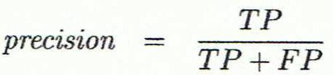
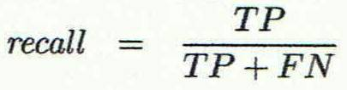
Precision and Recall
Information retrieval uses similar measures, precision & recall, to characterize retrieval effectiveness
  Precision: % of items classifier labels as positive that are actually positive
  Recall: % of positive items classifier labels as positive

Slide 32
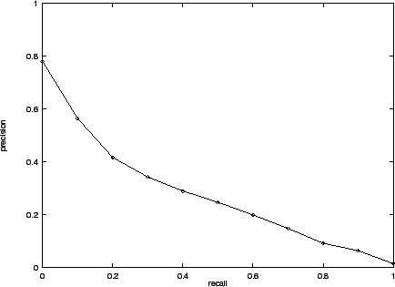
Precision and Recall
In general, increasing one causes other to decrease
Get recall=1 by marking every item as positive
Get highest precision by marking only one item positive, the one you are most certain of
We usually want some
balance of precision
and recall
Studying the
precision-recall
curve is informative

Slide 33
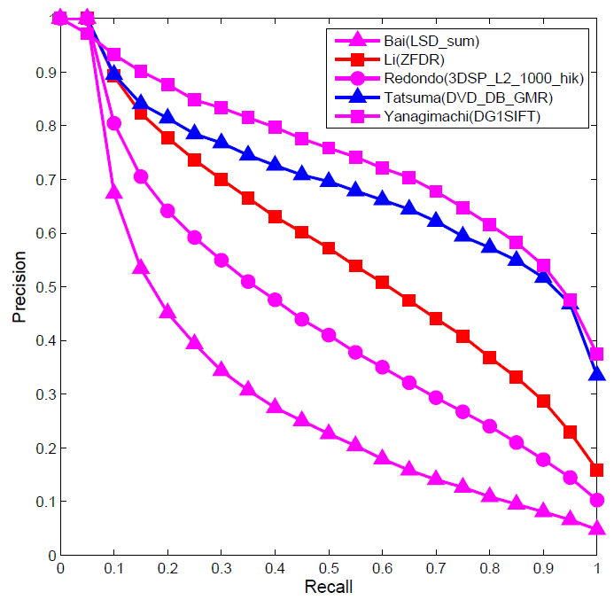
Precision and Recall Curves
If one system’s curve is always above the other, it’s better

Slide 34

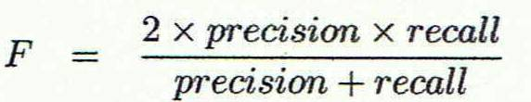
F1 measure
We often want a single measure to compare two systems to decide which is best overall
F1 measure combines both into a useful single metric
It’s the harmonic mean of precision & recall

Slide 35
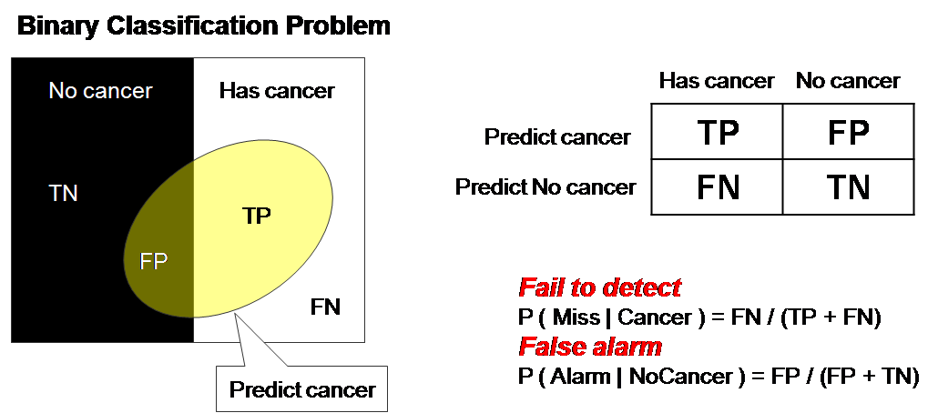
ROC Curve (1)
ROC = Receiver operating characteristic
Notes:
The ROC curve was first developed by electrical engineers and radar engineers during World War II for detecting enemy objects in battlefields and was soon introduced to psychology to account for perceptual detection of stimuli.

Slide 36
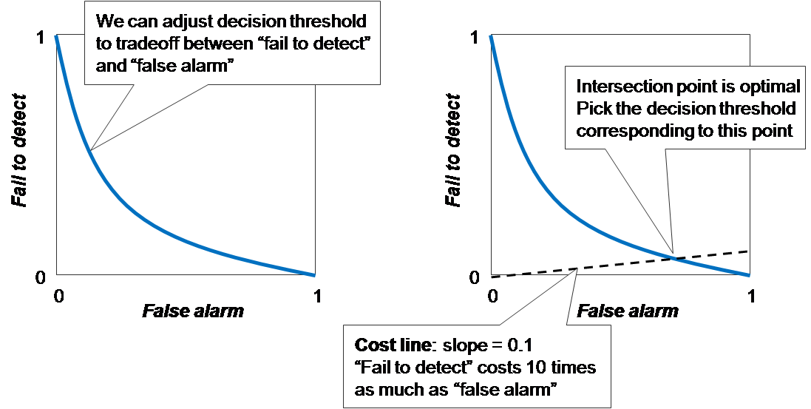
ROC Curve (2)
There is always a tradeoff between the false negative rate and the false positive rate

Slide 37
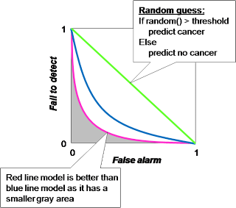
ROC Curve (3)
"Random guess" is worst prediction model and used as a baseline. The decision threshold of random guess is number in 0..1 in order to determine between positive and negative prediction.

Slide 38
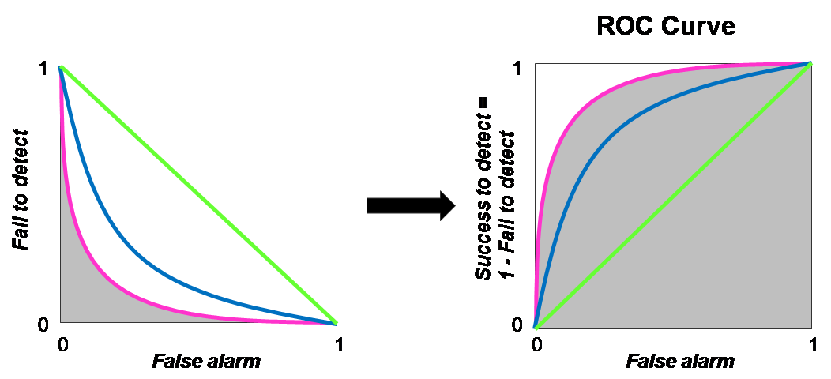
ROC Curve (4)
ROC Curve transforms the y-axis from "fail to detect" to 1 - "fail to detect”, i.e., "success to detect”

Slide 39
Precision at N
Ranking tasks return a set of results ordered from best to worst
  E.g., documents about “barack obama”
  Best knowledge graph type for “Barack Obama”
Learning to rank systems do this using a variety of algorithms (including SVM)
Precision at K is the fraction of top K answers that are correct

Slide 40
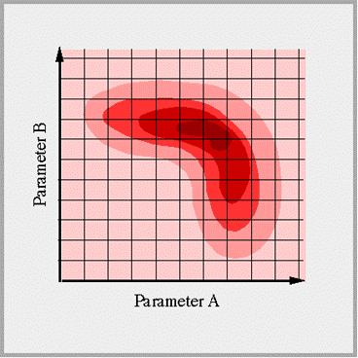
Grid search
ML algorithms tend to have many
parameters
How can we effectively find the best setting for all of them?
A grid search takes a list of possible values for each of a set of parameters parameters
…and tests each combination, to get a metric (e.g., accuracy, F1)
See this scikit learn colab example

Slide 41
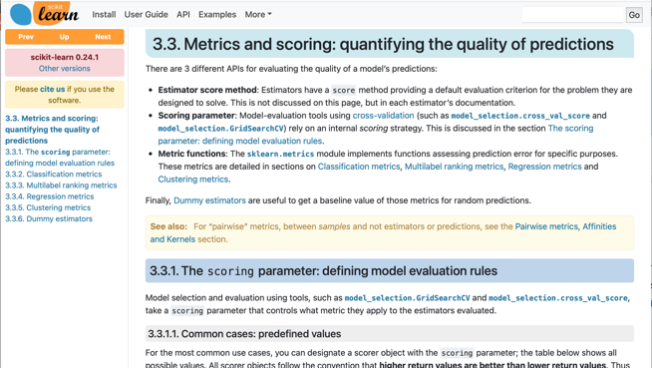
Model evaluation in scikit learn
scikit.metrics’s evaluation
module supports most of
its models in a uniform way
It has functions that make it easy to
  Split the data into train and test subsets
  Do cross validation
  Get various metrics
  Do a grid search for a set of parameters and their possible values
See our colab notebooks for examples

Slide 42
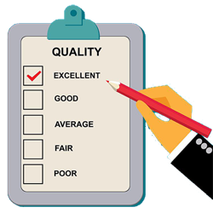
Summary
Evaluating the results of a ML system
is very important!
Part of the development process to decide
  What parameters maximize performance?
  Is one system better?
  Do we need more data?
  Do we need different data?
  etc.
Many ML algorithms have specialized evaluation techniques
There is a lot more to the topic

