Slide 1
Python Tools for Machine Learning
14.3

Slide 2
Motivation
Machine learning involves working with data
  analyzing, manipulating, transforming, …
More often than not, it’s numeric or has a natural numeric representation
Natural language text is an exception, but this too can have a numeric representation
A common data model is as a N-dimensional matrix or tensor
These are supported in Python via libraries

Slide 3
Motivation
Python is a great language, but slow compared to Java, C, and many others
Python packages are available to represent, manipulate and visualize matrices
We’ll briefly review NumPy and SciPy
  Needed to create or access datasets for ML training, evaluation and results
And touch on pandas (data analysis and manipulation) and matplotlib (visualization)

Slide 4
What is Numpy?
NumPy supports features needed for ML
  Typed N-dimensional arrays (matrices/tensors)
  Fast numerical computations (matrix math)
  High-level math functions
Python does numerical computations slowly and lacks an efficient matrix representation
1000 x 1000 matrix multiply
  Python triple loop takes > 10 minutes!
  Numpy takes ~0.03 seconds
NumPy is mostly written in C

Slide 5

NumPy Arrays Can Represent …
Structured lists of numbers
Vectors
Matrices
Images
Tensors
Convolutional Neural Networks
$$\left[\begin{matrix}p_{x} \\ p_{y} \\ p_{z}\end{matrix}\right]$$
$$\left[\begin{matrix}a_{11} & ⋯ & a_{1n} \\ ⋮ & ⋱ & ⋮ \\ a_{m1} & ⋯ & a_{mn}\end{matrix}\right]$$

Slide 6

NumPy Arrays Can Represent …
Structured lists of numbers
Vectors
Matrices
Images
Tensors
Convolutional Neural Networks

Slide 7
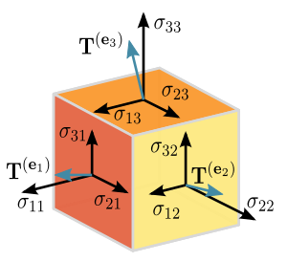
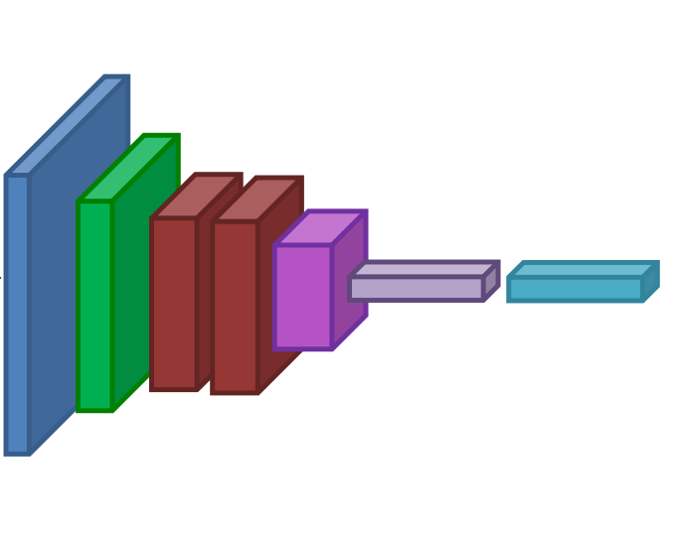
NumPy Arrays Can Represent …
Structured lists of numbers
Vectors
Matrices
Images
Tensors
Convolutional Neural Networks

Slide 8
NumPy Arrays, Basic Properties
>>> import numpy as np
>>> a=np.array([[1,2,3],[4,5,6]],dtype=np.float32)
>>> print(a.ndim, a.shape, a.dtype)
(2, 3) float32
>> print(a)
[[1. 2. 3.]
[4. 5. 6.]]
NumPy Arrays:
Can have any number of dimensions, even zero (a scalar)
Are typed: np.uint8, np.int64, np.float32, np.float64
Are dense: each array element exists and has same type

Slide 9
NumPy Array Indexing, Slicing
a[0,0] # top-left element
a[0,-1] # first row, last column
a[0,:] # first row, all columns
a[:,0] # first column, all rows
a[0:2,0:2] # 1st 2 rows, 1st 2 columns
Notes:
  Zero-indexing
  Multi-dimensional indices are comma-separated)
  Python notation for slicing

Slide 10
Operations on NumPy Arrays
>>> A = np.array([[1, 1], ... [0, 1]])
>>> B = np.array([[2, 0], ... [3, 4]])
>>> A * B # elementwise product array([[2, 0], [0, 4]]) >>> A @ B # matrix product array([[5, 4], [3, 4]]) >>> A.dot(B) # another matrix product array([[5, 4], [3, 4]])

Slide 11
SciPy
SciPy builds on the NumPy array object
Adds additional mathematical functions and sparse arrays
Sparse array: one where most elements = 0
  Efficient representation only explicitly encodes the non-zero values
  Access to a missing element returns 0

Slide 12
SciPy sparse array use case
NumPy and SciPy arrays are numeric
We can represent a document’s content by a vector of features
Each feature is a possible word (aka term)
A feature’s value might be any of:
  TF term frequency: the number of times a term occurs in the document;
  TF-IDF term frequency normalized by IDF (inverse document frequency) to favor uncommon words
  and may be normalized by document length as well

Slide 13
SciPy sparse array use case
Only model 50k most frequent words found in a document collection, ignoring others
Assign each unique word an index (e.g., dog:137)
  Build python dict w from vocabulary, so w[‘dog’]=137
The sentence “the dog chased the cat”
  Would be a numPy vector of length 50,000
  Or a sciPy sparse vector of length 4
An 800-word news article may only have 100 unique words; The Hobbit has 6,592

Slide 14

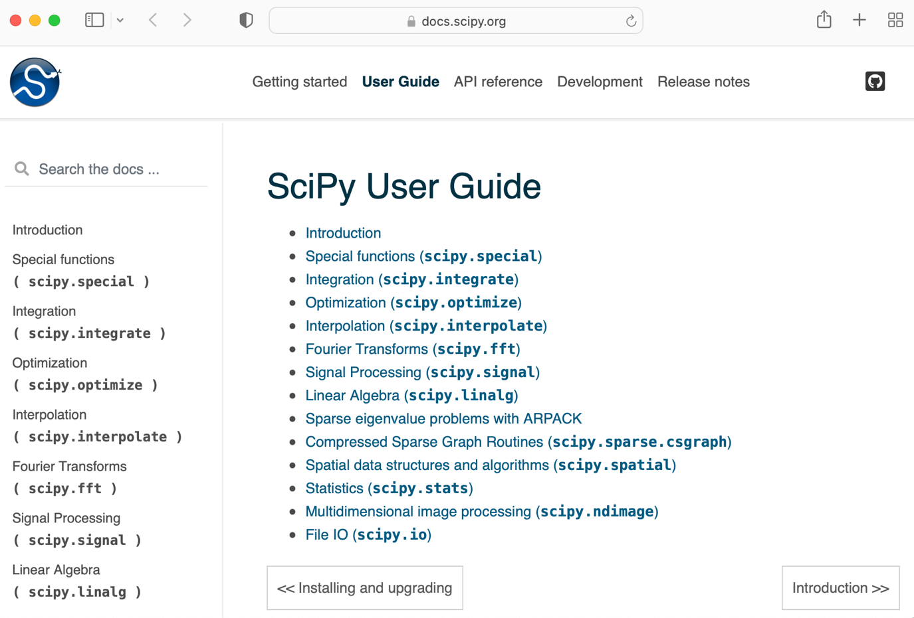
SciPy User Guide

Slide 15
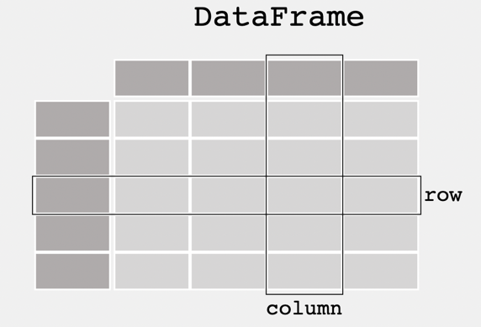
Pandas
pandas is a “fast, powerful, flexible and easy to use open source data analysis and manipulation tool” for Python
It can load and represent tabular data from a spreadsheet or database into a DataFrame object
The data needn’t be numeric
Row and column headers can
be recognized
If you convert non-numeric
values to numbers, you can
convert to a numpy array

Slide 16
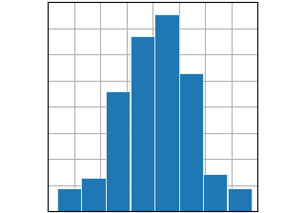
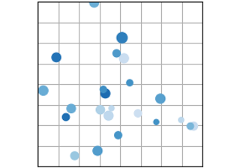
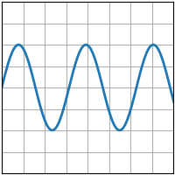
Matplotlib
Comprehensive Python library for
creating static, animated & interactive visualizations
Works well in Python notebooks
Supports many kinds of plots
See the Matplotlib tutorials for more
information

