Slide 1
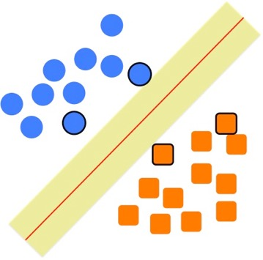
Support Vector Machines
Some slides borrowed from Andrew Moore’s slides on SVMs.

Slide 2
Support Vector Machines
Popular ML technique for classification tasks
Became popular in late 90s (Vapnik 1995; 1998) but Invented in the late 70s (Vapnik, 1979)
Controls complexity and overfitting, so works well on a wide range of practical problems
Can handle high dimensional vector spaces, which makes feature selection less critical
Fast and memory efficient implementations, e.g., svm_light
Not always best solution, especially for problems with small vector spaces

Slide 3
Linear Classifiers
α
x
f
y^{est}
f(x,w,b) = sign(w. x - b)
denotes +1
denotes -1
How would you classify this data?

Slide 4
Linear Classifiers
α
x
f
y^{est}
f(x,w,b) = sign(w. x - b)
denotes +1
denotes -1
How would you classify this data?
Draw a line separating the positive and negative examples
Use that to classify new points

Slide 5
Linear Classifiers
α
x
f
y^{est}
f(x,w,b) = sign(w. x - b)
denotes +1
denotes -1
How would you classify this data?
Here’s another line separating positive and negative examples
Maybe we should use this one?
Notes:
q

Slide 6
Linear Classifiers
α
x
f
y^{est}
f(x,w,b) = sign(w. x - b)
denotes +1
denotes -1
How would you classify this data?
Yet another line separating positive and negative examples
Maybe we should use this one?

Slide 7
Linear Classifiers
α
x
f
y^{est}
f(x,w,b) = sign(w. x - b)
denotes +1
denotes -1
Any of these would be fine..
..but which is best?

Slide 8
Classifier Margin
α
x
f
y^{est}
f(x,w,b) = sign(w. x - b)
denotes +1
denotes -1
A linear classifier’s margin is width that boundary could be increased by before hitting a datapoint

Slide 9
Maximum Margin
α
x
f
y^{est}
f(x,w,b) = sign(w. x - b)
denotes +1
denotes -1
Maximum margin linear classifier is the linear classifier with the largest margin
The simplest kind of SVM, called an LSVM
Linear SVM

Slide 10
Maximum Margin
α
x
f
y^{est}
f(x,w,b) = sign(w. x - b)
denotes +1
denotes -1
Maximum margin linear classifier is the linear classifier with the largest margin
The simplest kind of SVM, called an LSVM
Support Vectors are the data points that margin pushes up against
Linear SVM

Slide 11
Why Maximum Margin?
Intuitively this feels safest
Small errors in boundary location unlikely to cause misclassification
LOOCV* is easy since model is immune to removal of non-support-vector datapoints
Empirically it works very very well
f(x,w,b) = sign(w. x - b)
denotes +1
denotes -1
The maximum margin linear classifier is the linear classifier with the, um, maximum margin.
This is the simplest kind of SVM (Called an LSVM)
Support Vectors are those datapoints that the margin pushes up against
*LOOCV = leave one out cross validation

Slide 12
Specifying a line and margin
Plus-Plane
Classifier Boundary
“Predict Class = +1” zone
Minus-Plane
“Predict Class = -1” zone
How do we represent this mathematically?
…in m input dimensions?

Slide 13
Specifying a line and margin
Plus-Plane
Classifier Boundary
“Predict Class = +1” zone
Minus-Plane
wx+b=1
“Predict Class = -1” zone
wx+b=0
wx+b=-1
Plus-plane = { x : w . x + b = +1 }
Minus-plane = { x : w . x + b = -1 }
Classify as.. | +1 | if | w . x + b >= 1
 | -1 | if | w . x + b <= -1
 | Universe explodes | if | -1 < w . x + b < 1

Slide 14
Learning the Maximum Margin Classifier
x⁺
M = Margin Width =
“Predict Class = +1” zone
x⁻
wx+b=1
“Predict Class = -1” zone
wx+b=0
wx+b=-1
Given a guess of w and b we can
Compute whether all data points in the correct half-planes
Compute the width of the margin
Write a program to search the space of ws and bs to find widest margin matching all the datapoints.
How? -- Gradient descent? Simulated Annealing? Matrix Inversion? EM? Newton’s Method?

Slide 15
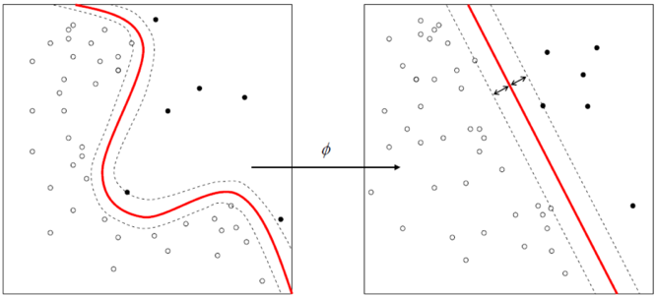
Learning SVMs
Trick #1: Find points that would be closest to optimal separating plane (“support vectors”) and work directly from those instances
Trick #2: Represent as a quadratic optimization problem, and use quadratic programming techniques
Trick #3 (“kernel trick”):
Instead of using raw features, represent data in a high-dimensional feature space constructed from a set of basis functions (e.g., polynomial and Gaussian combinations of the base features)
Find separating plane/SVM in that space
Voila: A nonlinear classifier!

Slide 16
Soft margin classification
What if data from two classes not linearly separable?
Allow a fat decision margin to make a few mistakes
Some points, outliers or noisy examples, are inside or on wrong side of the margin
Each outlier incurs a cost based on distance to hyperplane

Slide 17
Kernel trick
What if data from two classes not linearly separable?
Project data onto a higher dimensional space where it becomes linearly separable
Many SVMs can take an argument, a kernel, that does the transformation of the data
Deciding what kernel function to use is done through experimentation

Slide 18
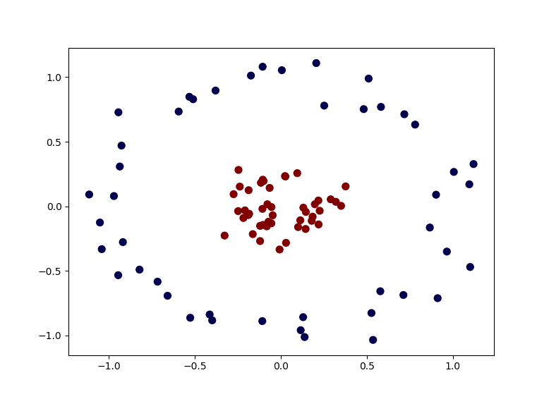
Kernel Trick example
Can’t separate the blue & red points with a line
Figure from S. Bhattacharyya

Slide 19
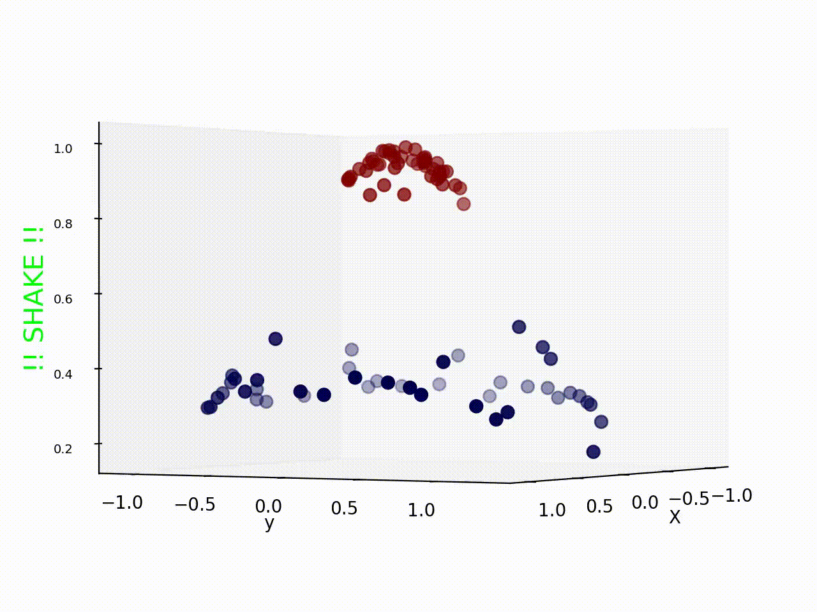
Use a different kernel
Applying a kernel can transform data to make it more nearly linearly separable
E.g., use polar coordinates or map to three dimensions

Slide 20
SVM Performance
SVMs can handle very large features spaces (e.g., 100K features!)
Relatively fast
Anecdotally they work very well indeed
Example: They are among the best-known classifier on a well-studied hand-written-character recognition benchmark

Slide 21
100k features?
SVM used for simple binary text classification, e.g., classify a text document as
expressing sentiment (positive, negative) or political learning (republican, democrat)
Typically use each word in fixed vocabulary of 25-100k words as a feature/dimension
value is TF-IDF number -- frequency of the word in the document relative to all documents
Product reviews might have ~200 unique words, social media posts only < 20 unique words
SVMs typically use sparce matrices for efficiency

Slide 22
Binary vs. multi classification
SVMs only do binary classification ☹
E.g.: can’t classify an iris into one of three species
Note: common for many ML classifiers
Two approaches to multiclass classification: OVA and OVO
Consider Zoo dataset, which classifies animals into one of 7 classes based on 17 attributes
Classes: mammal, bird, reptile, fish, amphibian, insect, invertebrate
Attributes: hair, feathers, eggs, milk, aquatic, toothed, fins, …

Slide 23
OVA or one-vs-all classification
OVA or one-vs-all: turn n-way classification into n binary classification tasks
Also know as one-vs-rest
For zoo problem, train and run 7 binary classifiers:
mammal vs. not-mammal
fish vs. not-fish
bird vs. not-bird, …
Pick the one that gives the highest score
For an SVM this could be measured the one with the widest margin

Slide 24
OVO or one vs one classification
OVO or one vs one: turn n-way classes into N*(N-1)/2 one-vs-one classifiers
mammal vs. bird, mammal vs. reptile …
bird vs. reptile, bird vs. fish, …
fish vs. amphibian, fish vs. insect, …
Use resulting scores to choose the classification that wins the most 1x1 pairings

Slide 25
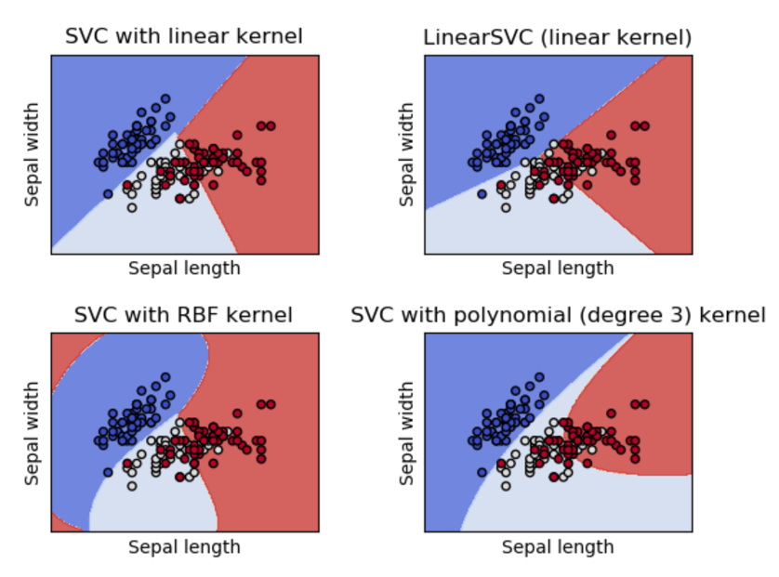
SVMs in scikit-learn
Scikit-learn has three SVM classifiers: SVC, NuSVC, and LinearSVC
Data can be either in dense numpy arrays or sparse scipy arrays
All directly support multi-way classifica-tion, SVC and NuSCV using OvO and LinearSVC using OvA
This colab jupyter notebook gets an accuracy of 97% using OvO with scikit.svm.SVC

Slide 26
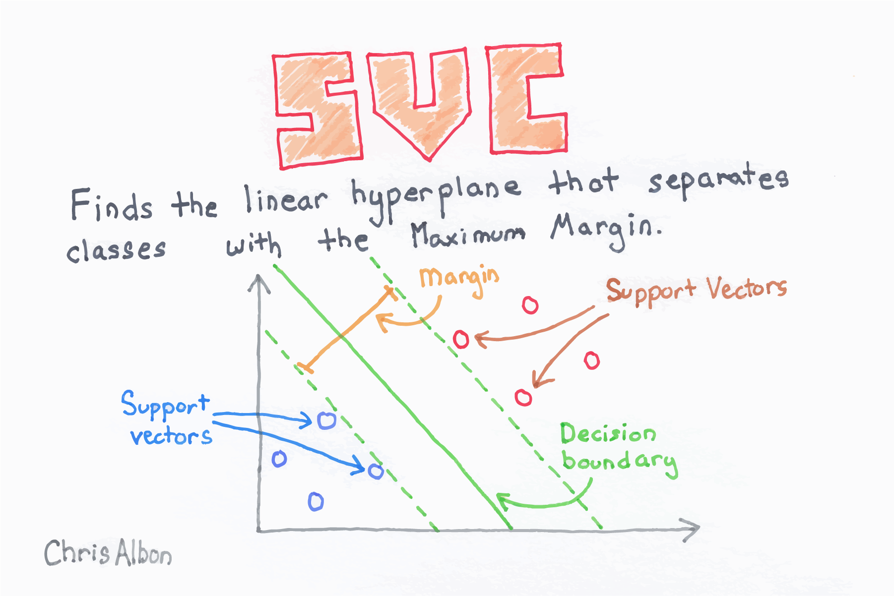

Slide 27
SVM Summary
SVM is a good classification technique for problems with a large feature space
Relatively fast to train and apply the model
The kernel trick can help make some problems more-nearly linearly separable
Their binary nature makes then a poorer fit for multi-way classification

