Slide 1
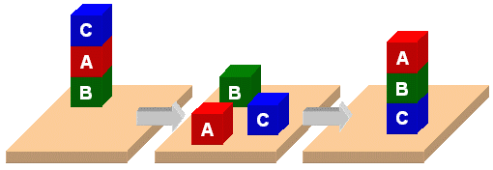
PDDL and the
Blocks World

Slide 2
Knowledge for Planning
We’ll describe PDDL, a standard for representing planning problems
We’ll look at the classic blocks world in PDDL via:
  BW: a domain file
  Several problem files
We’ll use planning.domains to demonstrate solving the problems
And then show simple extensions to the domain by adding predicates and constants

Slide 3
PDDL
Planning Domain Description Language
Based on STRIPS with various extensions
First defined by Drew McDermott (Yale) et al.
  Classic spec: PDDL 1.2; good reference guide
Used in biennial International Planning Competition (IPC) series (1998-2022)
Many planners use it as a standard input
Latest version is 3.1 and newer variants exist

Slide 4
PDDL is still widely used
After 24 years, PDDL still used in many planning systems and domains as a standard for input and output
Its representation was updated, e.g., adding
  fluents (facts that change over time)
  preferences (aka soft constraints)
New variants support multiple agents, ontologies, and more
It still retains is traditional Lisp syntax

Slide 5
PDDL Representation
Task specified via two files: domain file and problem file
  Both use a logic-oriented notation with Lisp syntax
Domain file defines a domain via requirements, predicates, constants, and actions
  Used for many different problem files
Problem file: defines problem by describing its domain, specific objects, initial state, and goal state
Planner: domain + problem ➔ a plan

Slide 6

Blocks Word
Domain File
(define (domain BW)
(:requirements :strips)
(:constants red green blue yellow small large)
(:predicates (on ?x ?y) (on-table ?x) (color ?x ?y) … (clear ?x))
(:action pick-up
:parameters (?obj1)
:precondition (and (clear ?obj1) (on-table ?obj1)
(arm-empty))
:effect (and (not (on-table ?obj1))
(not (clear ?obj1))
(not (arm-empty))
(holding ?obj1)))
… more actions ...)

Slide 7
Blocks Word
Problem File
(define (problem 00)
(:domain BW)
(:objects A B C)
(:init (arm-empty)
(ontable A)
(on B A)
(on C B)
(clear C))
(:goal (and (on A B)
(on B C)
(ontable C)))
C
A
B
B
A
C

Slide 8
What’s a Plan?
For simple planning problems…
A planner takes a problem that identifies the problem domain (e.g. BW)
And produces an ordered set of actions with references to objects in the problem
Which when executed in order achieves the goal

Slide 9
Planner: Domain + Problem => Plan
(define (problem 00)
(:domain BW)
(:objects A B C)
(:init (arm-empty)
(on B A)
(on C B)
(clear C))
(:goal (and (on A B)
(on B C))))
C
A
B
B
A
C
Begin plan
1 (unstack c b)
2 (put-down c)
3 (unstack b a)
4 (stack b c)
5 (pick-up a)
6 (stack a b)
End plan
domain + problem ➔ planner ➔

Slide 10
bw.pddl 1
(define (domain bw)
(:requirements :strips)
(:predicates
(on ?x ?y) ; object ?x is on ?object ?y
(on-table ?x) ; ?x is directly on the table
(clear ?x) ; ?x has nothing on it
(arm-empty) ; robot isn't holding anything
(holding ?x)) ; robot is holding ?x
;; 4 actions to manipulate objects: pickup, putdown, stack, unstack
… actions in next four slides …
Allows basic add and
delete effects in actions
List all the predicates
with their arguments
% starts a one-
line comment
Variables begin
with a ?

Slide 11
bw.pddl 2
(:action pick-up
:parameters (?ob)
:precondition
(and (clear ?ob)
(on-table ?ob)
(arm-empty))
:effect
(and (not (on-table ?ob))
(not (clear ?ob))
(not (arm-empty))
(holding ?ob)))
Variable for the argument
of a pick-up action
These three statements
must be True before we
can do a pick-up action
After doing a pick-up
action, these become
True
Adding (not ?X) removes
?X if it’s in the KB.

Slide 12
bw.pddl 3
(:action put-down
:parameters (?ob)
:precondition (holding ?ob)
:effect
(and (not (holding ?ob))
(clear ?ob)
(arm-empty)
(on-table ?ob)))
(:action stack
:parameters (?ob1 ?ob2)
:precondition (and (holding ?ob) (clear ?ob2))
:effect
(and (not (holding ?ob))
(not (clear ?ob2))
(clear ?ob)
(arm-empty)
(on ?ob ?ob2)))
put-down means put the
thing you’re holding on
the table
stack means put the
thing you are holding on
another object

Slide 13
bw.pddl 5
unstack means take the
first arg off the second
arg
(:action unstack
:parameters (?ob1 ?ob2)
:precondition
(and (on ?ob1 ?ob2)
(clear ?ob1)
(arm-empty))
:effect
(and (holding ?ob1)
(clear ?ob2)
(not (clear ?ob1))
(not (arm-empty))
(not (on ?ob1 ?ob2)))
) ; this closes the domain definition
First arg can’t have
anything on it & the
robot can’t be holding
anything
Updates to KB
describing new state of
the world

Slide 14
p03.pddl
;; The arm is empty and there is a stack of three blocks: C is on B which is on A
;; which is on the table. The goal is to reverse the stack, i.e., have A on B and B
;; on C. No need to mention C is on the table, since domain constraints will enforce it.
(define (problem p03)
(:domain bw)
(:objects A B C)
(:init (arm-empty)
(on-table A)
(on B A)
(on C B)
(clear C))
(:goal (and (on A B)
(on B C))))
C
A
B
B
A
C

Slide 15
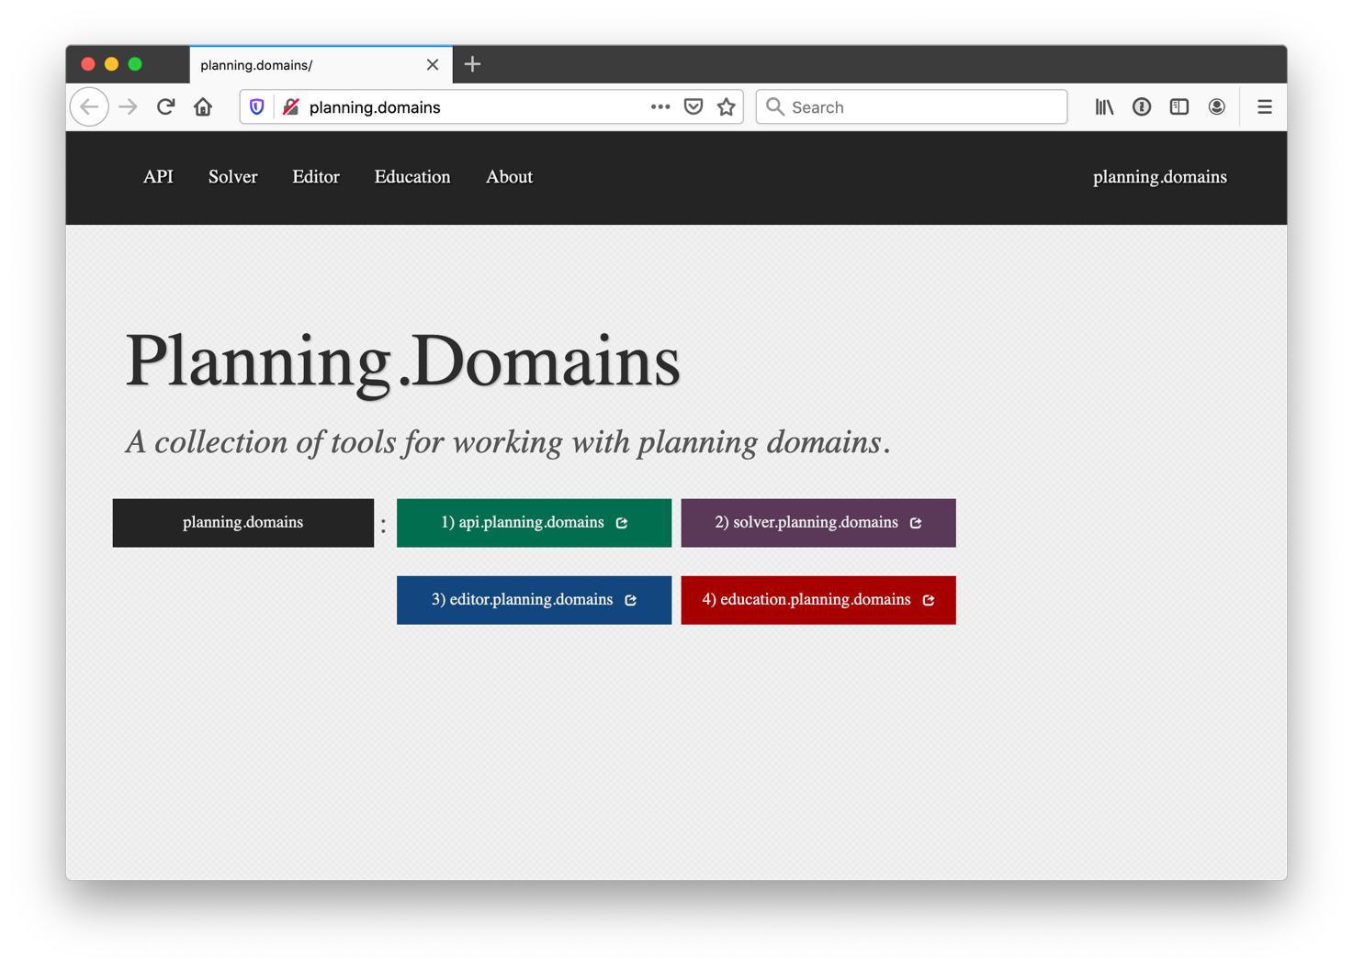
http://planning.domains/
Open the PDDL editor,
upload our domain and
problem files, and run
the solver.

Slide 16
Planning.domains
Open source environment for providing planning services using PDDL (GitHub)
Default planner is ff (aka, fastForward)
  very successful forward-chaining heuristic search planner producing sequential plans
  Can be configured to work with other planners
Use interactively or call via web-based API
We’ve used it for to extend blocks world domain in homework

Slide 17
Online Demonstration
Using planning.domains and files in the planning directory of our 2022 code and data repo
bw.pddl
p01.pddl
p02.pddl …
Air Cargo
  ac_domain.pddl
  Ac_p0.pddl

Slide 18
Fin

