Slide 1
9.3.2
First-Order
Logic (FOL)
part 2

Slide 2
Overview
We’ll first give some examples of how to translate between FOL and English
Then look at modelling family relations in FOL
And finally touch on a few other topics

Slide 3
Translating English to FOL
Every gardener likes the sun
    ∀x gardener(x) → likes(x, Sun)
All purple mushrooms are poisonous
    ∀x (mushroom(x) ∧ purple(x)) → poisonous(x)
No purple mushroom is poisonous (two ways)
  ¬∃x purple(x) ∧ mushroom(x) ∧ poisonous(x)
  ∀x (mushroom(x) ∧ purple(x)) → ¬poisonous(x)

Slide 4
English to FOL: Counting
Use = predicate to identify different individuals
There are at least two purple mushrooms
  ∃x ∃y mushroom(x) ∧ purple(x) ∧ mushroom(y) ∧ purple(y) ∧ ¬(x=y)
This says that there exisit an x and a y such that
  “x is a purple mushroom” and
  “y is a purple mushroom” and
  “x and y are not the same objects”

Slide 5
English to FOL: Counting
There are exactly two purple mushrooms
  ∃x ∃y mushroom(x) ∧ purple(x) ∧ mushroom(y) ∧ purple(y) ∧ ¬(x=y) ∧
  ∀z (mushroom(z) ∧ purple(z)) → ((x=z) ∨ (y=z))
This says that
  “x is a purple mushroom” and
  “y is a purple mushroom” and
  “x and y are not the same objects”
  If there’s a purple mushroom z, then either z=x or z=y
Saying there are 802 different Pokemon is hard!
  Direct use of FOL is not for everything!

Slide 6
Translating English to FOL
What do these mean?
You can fool some of the people all of the time
    ∃x ∀t person(x) ∧ time(t) → can-fool(x, t)
    ∀t ∃x person(x) ∧ time(t) → can-fool(x, t)
You can fool all of the people some of the time
    ∃t ∀x time(t) ∧ person(x) → can-fool(x, t)
    ∀x ∃t person(x) ∧ time(t) → can-fool(x, t)

Slide 7
Translating English to FOL
What do these mean?
  Both English statements are ambiguous
You can fool some of the people all of the time
    #1 There is a nonempty subset of people so easily fooled that you can fool that subset every time*
    #2 For any given time, there is a non-empty subset at that time that you can fool
You can fool all of the people some of the time
    #1 There are one or more times when it’s possible to fool everyone*
    #2 Each individual can be fooled at some point in time
* Most common interpretation, I think

Slide 8
To represent these in logic we need some terms
person(x): True iff x is a person
time(t): True iff t is a point in time
canFool(x, t): True iff x can be fooled at time t
Note: iff = if and only if = ↔

Slide 9
Translating English to FOL
You can fool some of the people all of the time
    #1 There is a nonempty group of people so easily fooled that you can fool that group every time*
    ≡ There’s (at least) one person you can fool every time
    ∃x ∀t person(x) ∧ time(t) → canFool(x, t)
    #2 For any given time, there is a non-empty group at that time that you can fool
    ≡ For every time, there’s a person at that time that you can fool
    ∀t ∃x person(x) ∧ time(t) → canFool(x, t)
* Most common interpretation, I think

Slide 10
Translating English to FOL
You can fool all of the people some of the time
    #1 There’s at least one time when you can fool everyone*
    ∃t ∀x time(t) ∧ person(x) → canFool(x, t)
    #2 Everybody can be fooled at some point in time
    ∀x ∃t person(x) ∧ time(t) → canFool(x, t)
* Most common interpretation, I think

Slide 11
Limits of classical logic
Note that there’s no easy, natural way to talk about a few, many, most, almost all …
This is natural in human languages
  There are many people you can fool most of the time
  There are a few people you can fool almost every time
We also can’t have exceptions
  All birds can fly, except for penguins, ostriches and a few other species
There are non-classical logic systems that can handles these problems

Slide 12
Representation Design
Many options for representing even a simple fact, e.g., something’s color as red, green or blue, e.g.:
  green(kermit)
  color(kermit, green)
  hasProperty(kermit, color, green)
Choice can influence how easy it is to use
Last option of representing properties & relations as triples used by modern knowledge graphs
  Easy to ask: What color is Kermit? What are Kermit’s properties?, What green things are there? What properties are there? What thinks Tell me everything you know, …

Slide 13

Simple genealogy KB in FOL
Design a knowledge base using FOL that
Has facts of immediate family relations, e.g., spouses, parents, etc.
Defines more complex relations (ancestors, relatives)
Detect inconsistencies, e.g., a person is her own parent
Infers relations, e.g., grandparent from parent
Answers queries about relationships between people

Slide 14
How do we approach this?
Design an initial ontology of types, e.g.
  person, animal, man, woman, …
Types form a taxonomy or lattice*, e.g.
  person(X) <=> man(X) ∨ woman(Y)
  man(X) <=> person(X) ∧ male(X)
  woman(X) <=> person(X) ∧ female(X)
  female(X) <=> ~ male(X)
Make assertions about
individuals, e.g.
  man(donaldTrump)
  woman(melaniaTrump)
thing
animal
female
male
person
woman
man
mt
dt
* In a lattice, objects can have multiple immediate types

Slide 15
Extend with relations and constraints
Simple two argument relations, e.g.
  spouse, has_child, has_parent
Add general constraints to relations, e.g.
  spouse(X,Y) => ~ (X = Y)
  spouse(X,Y) => person(X) ∧ person(Y)
  spouse(X,Y) => (man(X) ∧ woman(Y)) ∨
  (woman(X) ∧ man(Y))*
Add FOL sentences for inference, e.g.
  spouse(X,Y) ⬄ spouse(Y,X)
Add instance data
  e.g., spouse(djt, mt)
* Note this constraint is a traditional one than no longer holds

Slide 16
Example: A simple genealogy KB in FOL
Predicates:
  parent(X, Y), child(X, Y), father(X, Y), daughter(X, Y), etc.
  spouse(X, Y), husband(X, Y), wife(X,Y)
  ancestor(X, Y), descendant(X, Y)
  male(X), female(Y)
  relative(X, Y)
Facts:
  husband(joe, mary), son(fred, joe)
  spouse(john, nancy), male(john), son(mark, nancy)
  father(jack, nancy), daughter(linda, jack)
  daughter(liz, linda)
  etc.

Slide 17
Example Axioms
(∀X,y) parent(X, Y) ↔ child (Y, X)
(∀X,Y) father(X, Y) ↔ parent(X, Y) ∧ male(X)
(∀X,Y) mother(X, Y) ↔ parent(X, Y) ∧ female(X)
(∀X,Y) daughter(X, Y) ↔ child(X, Y) ∧ female(X)
(∀X,Y) son(X, Y) ↔ child(X, Y) ∧ male(X)
(∀X,Y) husband(X, Y) ↔ spouse(X, Y) ∧ male(X)
(∀X,Y) spouse(X, Y) ↔ spouse(Y, X)
…

Slide 18
Axioms, definitions and theorems
Axioms: facts and rules that capture (important) facts & concepts in a domain; used to prove theorems
  Mathematicians dislike unnecessary (dependent) axioms, i.e., ones that can be derived from others
  Dependent axioms can make reasoning faster, however
  Choosing a good set of axioms is a design problem
A definition of a predicate is of the form “p(X) ↔ …” and can be decomposed into two parts
  Necessary description: “p(X) → …”
  Sufficient description “p(X) ← …”
  Some concepts have definitions (e.g., triangle) and some don’t (e.g., person)
Notes:
Like person(x)

Slide 19
More on definitions
Example: define father(x, Y) by parent(X, Y) & male(X)
parent(X, Y) is a necessary (but not sufficient) description of father(X, Y)
  father(X, Y) → parent(X, Y)
parent(X, Y) ^ male(X) ^ age(X, 35) is a sufficient (but not necessary) description of father(X, Y):
    father(X, Y) ← parent(X, Y) ^ male(X) ^ age(X, 35)
parent(X, Y) ^ male(X) is a necessary and sufficient description of father(X, Y)
  parent(X, Y) ^ male(X) ↔ father(X, Y)
Necessary and sufficient descriptions are definitions

Slide 20
Another way to look at necessary and sufficient
S(x) is a necessary condition of P(x)
P(x)
S(x)
# all Ps are Ss
(∀x) P(x) => S(x)
S(x) is a sufficient condition of P(x)
S(x)
P(x)
# all Ps are Ss
(∀x) P(x) <= S(x)
S(x) is a necessary and sufficient condition of P(x)
P(x)
S(x)
# all Ps are Ss
# all Ss are Ps
(∀x) P(x) <=> S(x)
Necessary and sufficient descriptions are definitions

Slide 21
Higher-order logic
FOL only lets us quantify over variables, and variables can only range over objects
HOL allows us to quantify over relations, e.g.
  “two functions are equal iff they produce the same value for all arguments”
  ∀f ∀g (f = g) ↔ (∀x f(x) = g(x))
E.g.: (quantify over predicates)
  ∀r transitive( r ) → (∀xyz) r(x,y) ∧ r(y,z) → r(x,z))
More expressive, but reasoning is undecide-able, in general

Slide 22
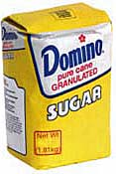
Expressing uniqueness
Often want to say that there is a single, unique object that satisfies a condition
There exists a unique x such that king(x) is true
  ∃x king(x) ∧ ∀y (king(y) → x=y)
  ∃x king(x) ∧ ¬∃y (king(y) ∧ x≠y)
  ∃! x king(x)
Every country has exactly one ruler
  ∀c country(c) → ∃! r ruler(c,r)
Iota operator: ι x P(x) means “the unique x such that p(x) is true”
  The unique ruler of Freedonia is dead
  dead(ι x ruler(freedonia,x))
syntactic
sugar

Slide 23

Examples of FOL in use
Semantics of W3C’s Semantic Web stack (RDF, RDFS, OWL) is defined in FOL
OWL Full is equivalent to FOL
Other OWL profiles support a subset of FOL and are more efficient
FOL oriented knowledge representation systems have many user-friendly tools
E.g.: Protégé for creating, editing and exploring OWL ontologies

Slide 24


Examples of FOL in use
Many practical approaches embrace the approach that “some data is better than none”
The semantics of schema.org is only defined in natural language text
Wikidata’s knowledge graph has a rich schema
  Many constraint/logical violations are flagged with warnings
  However, not all, see this Wikidata query that finds people who are their own grandfather

Slide 25

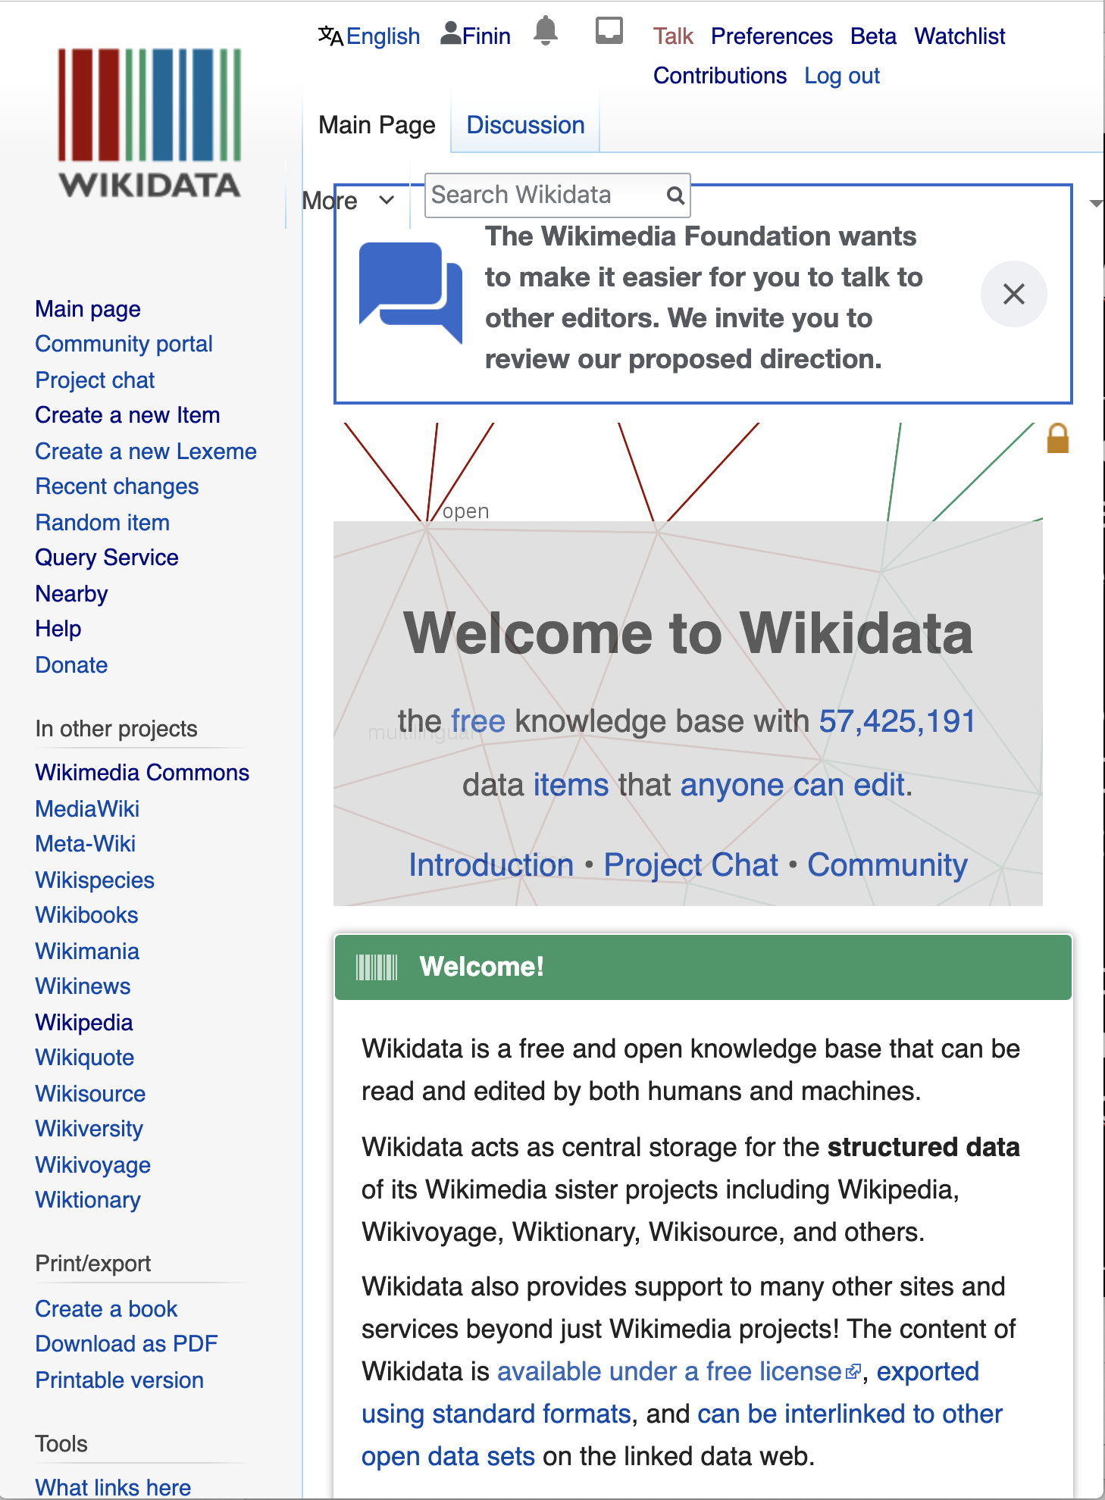
Wikidata
“collaboratively edited structured dataset used by Wikimedia sister projects and others”
Goal: consolidate knowable facts for use in the 200+ Wikipedia sites and other Wikimedia resources (e.g., in Infoboxes)
Integrates Wikimedia sites & links entities to ~7K external identifier systems (e.g., GeoNames ID)
Used by Google’s Knowledge Graph, digital assistants (Siri, Alexa), Wikipedia Infoboxes, etc.

Slide 26
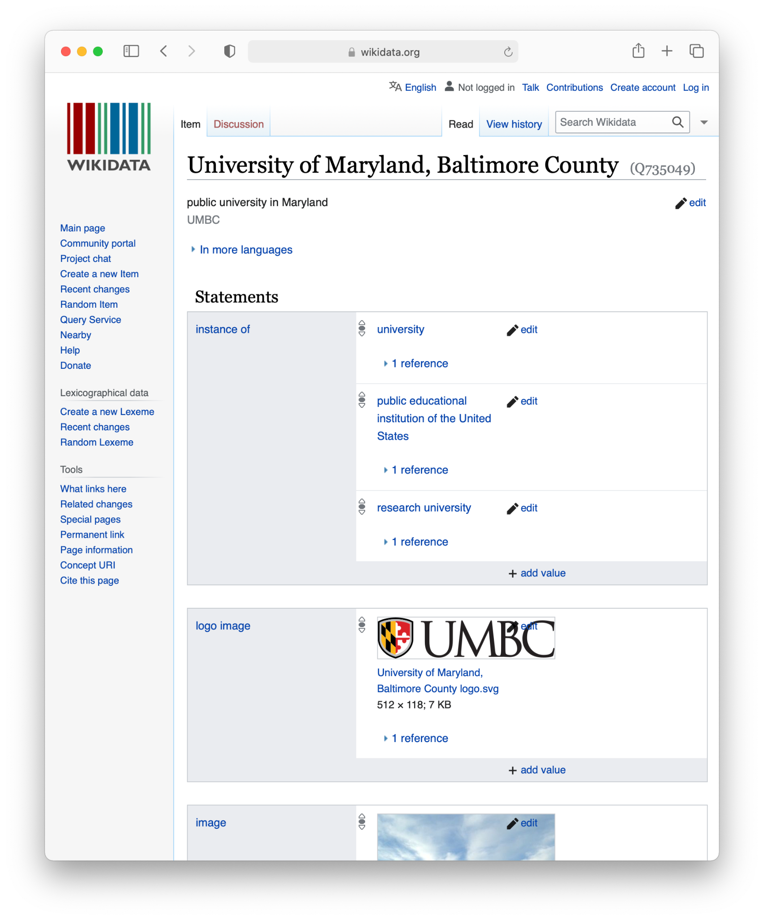
Wikidata knowledge graph
Community knowledge graph with ~1B statements about ~100M items
Fine-grained ontology has
~2M types & ~9K properties
Multilingual: all text values tagged with language id
Has both a human and query interface
Many community tools for editing, search, visualization, update
Wikidata web interface for the UMBC entity, Q735049

Slide 27
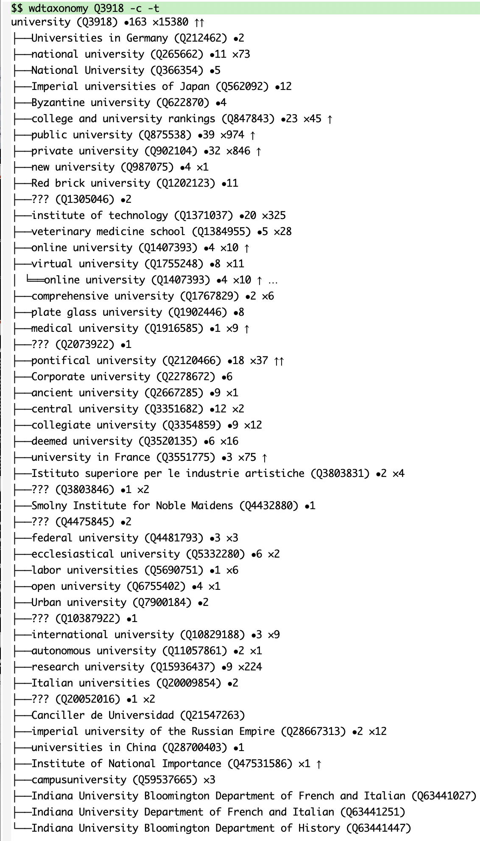
Huge Ontology
How can we understand an ontology with more than two million types?
wdtaxonomy is a useful tool for exploring the ontology
Given a type (e.g, Q3918, university) you can quickly see
  Subtypes or supertypes (immediate or inferred),
  Number of instances (immediate or inferred),
  Direct instances
  Number Wikimedia sites it’s in
Implemented in javascript with a command line script

Slide 28
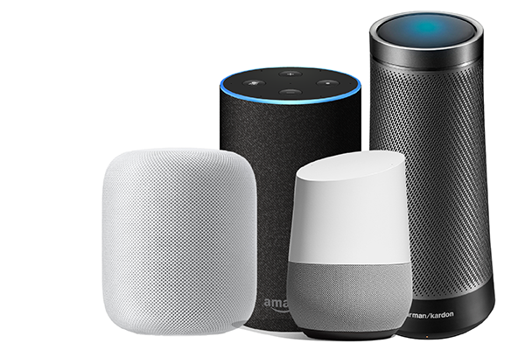
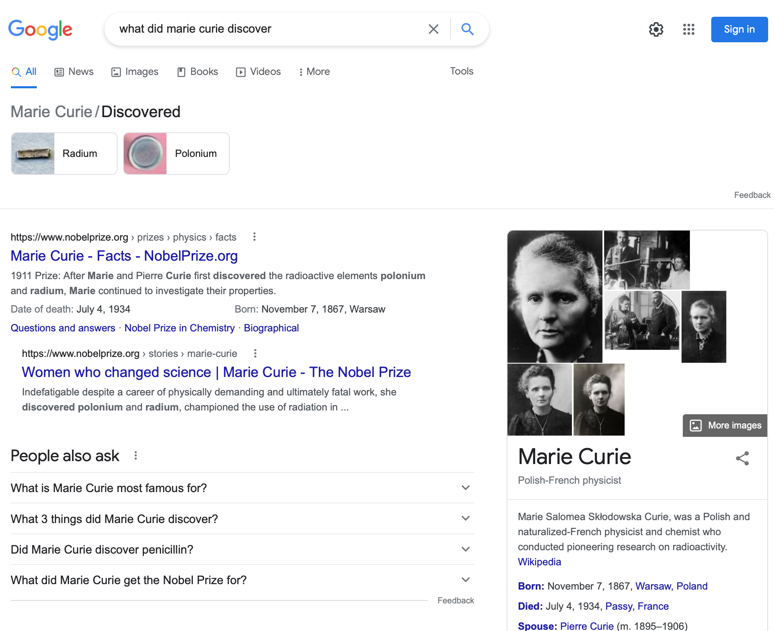
Virtual assistants and Infoboxes
Web search engines and virtual assistants like
Alexa use custom knowledge graphs to
  help understand queries and content of web pages & documents
  Answer questions
  Show infoboxes
Wikidata shares roots
with these
All draw on the similar
knowledge, like the
~300 Wikipedia &
Wikimedia sites

Slide 29
Virtual assistants & search engines
question
answer
Infobox

Slide 30
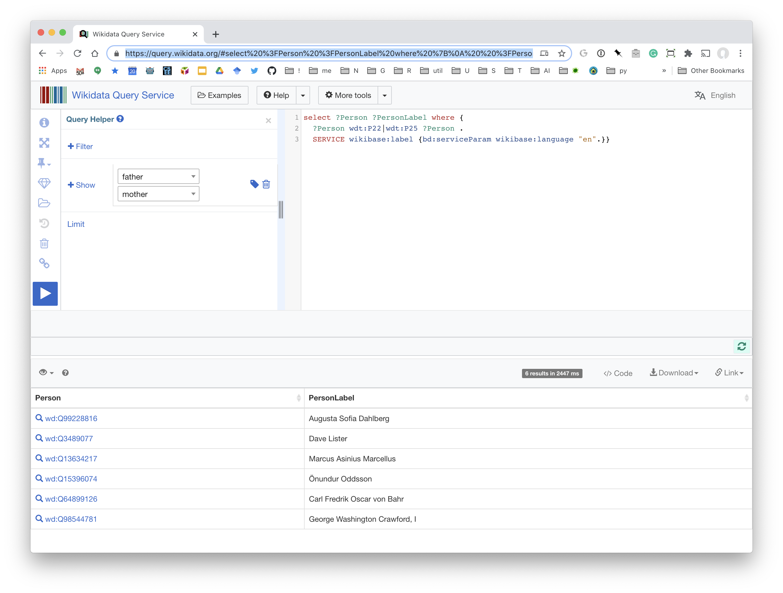
people who are their own mother or father
people who are their own grandparent

Slide 31
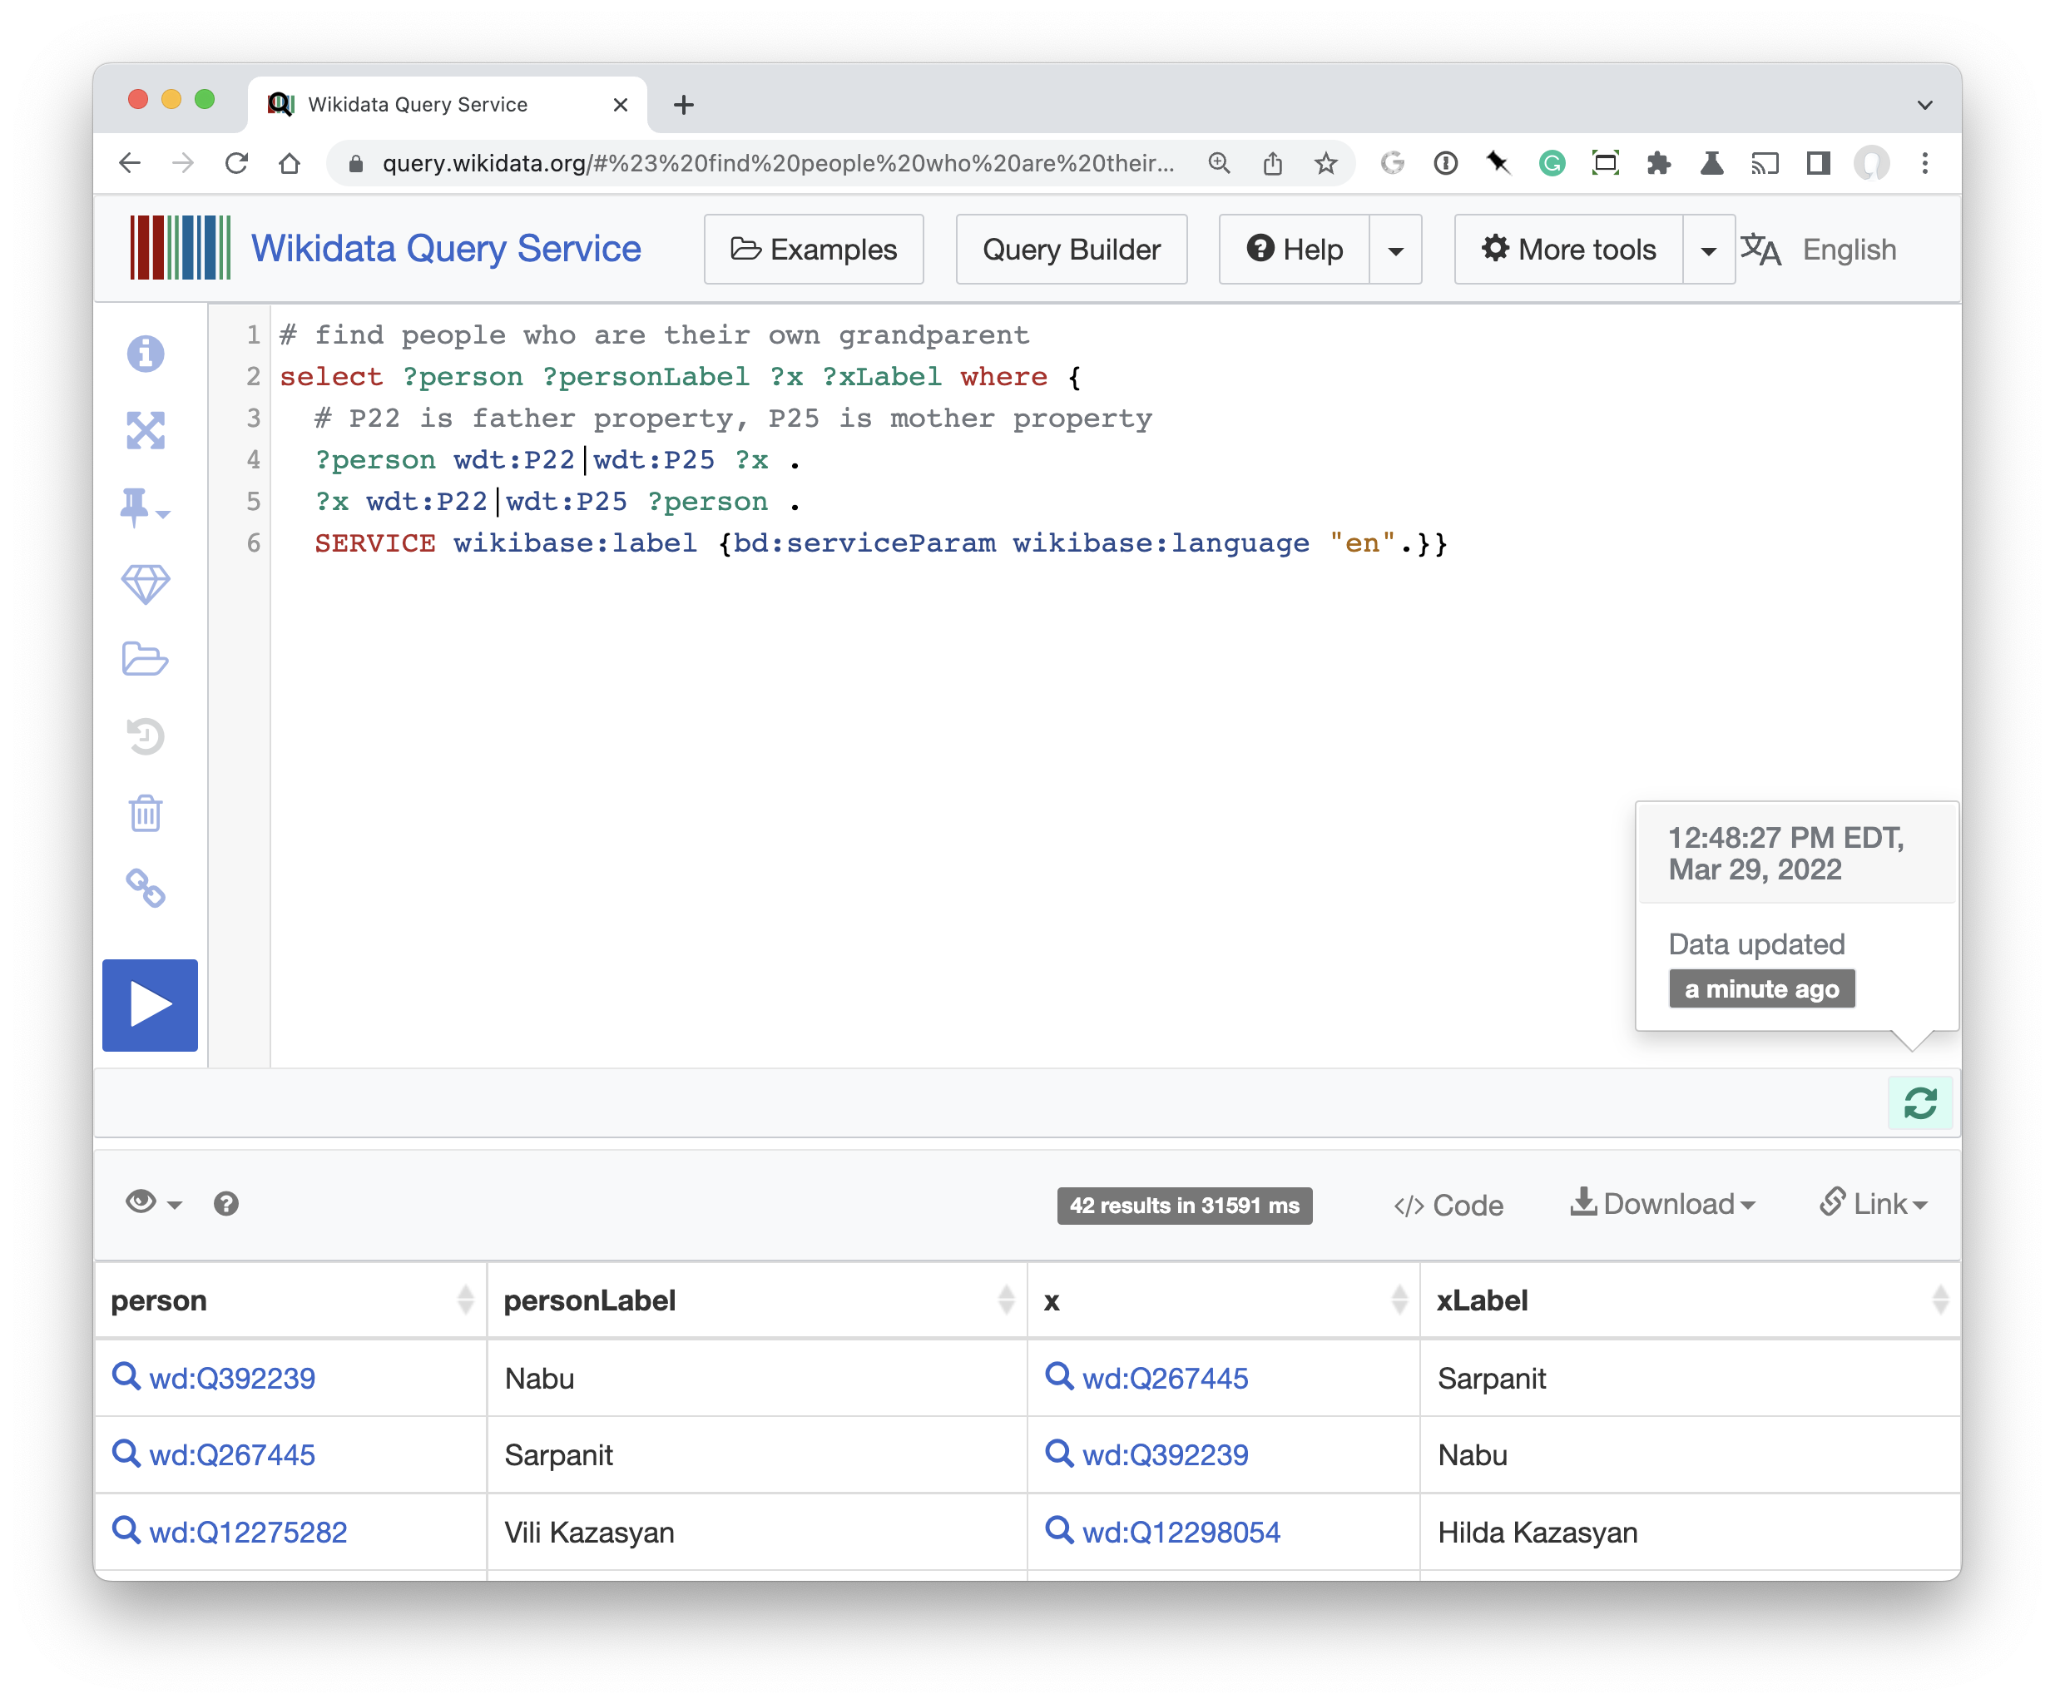
people who are their own grandparent
21 pairs of people on Wikidata are a parent of one of their parents
This is out of ~1M people
This can cause problems for logic reasoners
See I’m My Own Grandpa

Slide 32
FOL Summary
First order logic (FOL) introduces predicates, functions and quantifiers
More expressive, but reasoning more complex
  Reasoning in propositional logic is NP hard, FOL is semi-decidable
Common AI knowledge representation language
  Other KR languages (e.g., OWL) are often defined by mapping them to FOL
FOL variables range over objects
  HOL variables range over functions, predicates or sentences
Some practical systems avoid enforcing rigid FOL constraints due to having noisy data

Slide 33
Fin

