Slide 1
First-Order Logic (FOL) part 1
9.3.1

Slide 2
FOL Overview
First Order logic (FOL) is a powerful knowledge representation (KR) system
Used in AI systems in various ways, e.g., to
Directly represent & reason about concepts & objects
Formally specify meaning of KR systems (e.g., OWL)
For programming languages (e.g., Prolog) and rule-based systems
Make semantic database systems (Datalog) and Knowledge graphs (Wikidata, Schema.org)
Provide features useful in neural network deep learning systems

Slide 3
First-order logic
First-order logic (FOL) models the world in terms of
Objects, which are things with individual identities
Properties of objects that distinguish them from others
Relations that hold among sets of objects
Functions, a subset of relations where there is only one “value” for any given “input”
Examples:
Objects: students, lectures, companies, cars ...
Relations: isa, hasBrother, biggerThan, outside, hasPart, color, occursAfter, owns, visits, precedes, ...
Properties: blue, oval, even, large, ...
Functions: hasFather, hasSSN, ...

Slide 4
User provides
Constant symbols representing individuals in world
BarackObama, Green, John, 3, “John Smith”
Predicate symbols map individuals to truth values
greater(5,3)
green(Grass)
color(Grass, Green)
hasProperty(Grass, Color, Green)
Function symbols map individuals to individuals
hasFather(SashaObama) = BarackObama
colorOf(Sky) = Blue
How to represent properties and relations depends on our goals

Slide 5
What do these mean?
We must indicate what these mean in ways humans will understand
i.e., map to their own internal representations
May be done via a combination of
Choosing good names for formal terms, e.g., calling a concept HumanBeing instead of Q5
Comments in the definition #human being
Descriptions and examples in documentation
Reference to other representations , e.g., sameAs Q5 in Wikidata and Person in schema.org
Give examples like Donald Trump and Luke Skywalker to help distinguish concepts of real and fictional person

Slide 6
FOL Provides
Notations
differ, of course!
Variable symbols
e.g., X, Y, ?x, ?foo, ?number
Connectives
Same as propositional logic: not (¬), and (∧), or (∨), implies (→), iff (↔), equivalence (≡), …
Quantifiers
Universal ∀x or (Ax)
Existential ∃x or (Ex)

Slide 7
Sentences: built from terms and atoms
term (denoting an individual): constant or vari-able symbol, or n-place function of n terms, e.g.:
Constants: john, umbc
Variables: X, Y, Z
Functions: mother_of(john), phone(mother(x))
Ground terms have no variables in them
Ground: john, father_of(father_of(john))
Not Ground: father_of(X)
Syntax varies, e.g., variables start with a “?” or a capital letter, or are identified by quantifiers

Slide 8
Sentences: built from terms and atoms
atomic sentences (which are either true or false) are n-place predicates of n terms, e.g.:
green(kermit)
between(philadelphia, baltimore, dc)
loves(X, mother(X))
complex sentences formed from atomic ones connected by the standard logical connectives with quantifiers if there are variables, e.g.:
loves(mary, john) ∨ loves(mary, bill)
∀x loves(mary, x)

Slide 9
What do atomic sentences mean?
Unary predicates often used to encode a type
muppet(Kermit): kermit is a kind of muppet
green(kermit): kermit is a kind of green thing
integer(X): x is a kind of integer
Non-unary predicates typically encode relations or properties
Loves(john, mary)
Greater_than(2, 1)
Between(newYork, philadelphia, baltimore)
hasName(john, “John Smith”)

Slide 10
Ontology
Designing a logic representation is like design- ing a model in an object-oriented language
Ontology: a “formal naming and definition of the types, properties, and relations of entities for a domain of discourse”
E.g.: schema.org ontology used to put semantic data on Web pages to help search engines
Here’s the semantic markup Google sees on our site
It’s encoded as JSON, but the model is logic

Slide 11
Sentences: built from terms and atoms
quantified sentences adds quantifiers ∀ and ∃
∀x loves(x, mother(x))
∃x number(x) ∧ greater(x, 100), prime(x)
well-formed formula (wff): a sentence with no free variables or where all variables are bound by a universal or existential quantifier
In (∀x)P(x, y) x is bound & y is free so it’s not a wff

Slide 12
Quantifiers: ∀ and ∃
Universal quantification
(∀x)P(X) means P holds for all values of X in the domain associated with variable¹
E.g., (∀X) dolphin(X) → mammal(X) “all dolphins are mammals”
Existential quantification
(∃x)P(X) means P holds for some value of X in domain associated with variable
E.g., (∃X) mammal(X) ∧ lays_eggs(X) “There is a mammal that lays eggs”
This lets us make statements about an object without identifying it
¹ a variable’s domain is often not explicitly stated and is assumed by the context

Slide 13
Universal Quantifier: ∀
Universal quantifiers typically used with implies to form rules:
Logic: ∀X student(X) → smart(X)
Means: All students are smart
Universal quantification rarely used without implies:
Logic: ∀X student(X) ∧ smart(X)
Means: Everything is a student and is smart
What about this, though:
Logic: ∀X alive(X) ∨ dead(X)
Means: everything is either alive or dead
Notes:
P -> Q = ~P v Q
Ex student(x) -> smart(x) = Ex ~student(x) v smart(x)
“there is something that is not a student or smart”

Slide 14
Universal Quantifier: ∀
What about this, though:
Logic: ∀X alive(X) ∨ dead(X)
Means: everything is either alive or dead
Can be rewritten using a standard tautology
A ∨ B ≡ ~A → B
Giving both of these (since A∨B ≡ B∨A)
∀X ~alive(X) → dead(X)
∀X alive(X) → ~dead(X)
Notes:
P -> Q = ~P v Q
Ex student(x) -> smart(x) = Ex ~student(x) v smart(x)
“there is something that is not a student or smart”

Slide 15
Existential Quantifier: ∃
Existential quantifiers usually used with and to specify a list of properties about an individual
Logic: (∃ X) student(X) ∧ smart(X)
Meaning: There is a student who is smart
Common mistake: represent this in FOL as:
Logic: (∃ X) student(X) → smart(X)
Meaning: ?
Notes:
P -> Q = ~P v Q
Ex student(x) -> smart(x) = Ex ~student(x) v smart(x)
“there is something that is not a student or smart”

Slide 16
Existential Quantifier: ∃
Existential quantifiers usually used with and to specify a list of properties about an individual
Logic: (∃ X) student(X) ∧ smart(X)
Meaning: There is a student who is smart
Common mistake: represent this in FOL as:
Logic: (∃ X) student(X) → smart(X)
P → Q = ~P v Q
∃ X student(X) → smart(X) = ∃ X ~student(X) v smart(X)
Meaning: There’s something that is either not a student or is smart
Notes:
P -> Q = ~P v Q
Ex student(x) -> smart(x) = Ex ~student(x) v smart(x)
“there is something that is not a student or smart”

Slide 17
Quantifier Scope
FOL sentences have structure, like programs
In particular, variables in a sentence have a scope
Suppose we want to say “everyone who is alive loves someone”
(∀X) alive(X) → (∃ Y) loves(X, Y)
Here’s how we scope the variables
(∀X) alive(X) → (∃Y) loves(X, Y)
Scope of x
Scope of y

Slide 18
Quantifier Scope
Switching order of two universal quantifiers does not change the meaning
(∀X)(∀Y)P(X,Y) ↔ (∀Y)(∀X) P(X,Y)
Dogs hate cats (i.e., all dogs hate all cats)
You can switch order of existential quantifiers
(∃X)(∃Y)P(X,Y) ↔ (∃Y)(∃X) P(X,Y)
A cat killed a dog
Switching order of universal and existential quantifiers does change meaning:
Everyone likes someone: (∀X)(∃Y) likes(X,Y)
Someone is liked by everyone: (∃Y)(∀X) likes(X,Y)

Slide 19
Procedural example 1
def verify1():
# Everyone likes someone: (∀x)(∃y) likes(x,y)
for p1 in people():
foundLike = False
for p2 in people():
if likes(p1, p2):
foundLike = True
break
if not foundLike:
print(p1, ‘does not like anyone ☹’)
return False
return True
Every person has at
least one individual that
they like

Slide 20
Procedural example 2
def verify2():
# Someone is liked by everyone: (∃y)(∀x) likes(x,y)
for p2 in people():
foundHater = False
for p1 in people():
if not likes(p1, p2):
foundHater = True
break
if not foundHater
print(p2, ‘is liked by everyone ☺’)
return True
return False
There is a person who is
liked by every person in the universe

Slide 21
Connections between ∀ and ∃
We can relate sentences involving ∀ and ∃ using extensions to De Morgan’s laws:
(∀x) P(x) ↔ ¬(∃x) ¬ P(x)
¬(∀x) P(x) ↔ (∃x) ¬P(x)
(∃ x) P(x) ↔ ¬ (∀ x) ¬P(x)
(∃x) P(x) ↔ ¬(∀x) ¬P(x)
Examples
All dogs don’t like cats ↔ No dog likes cats
Not all dogs bark ↔ There is a dog that doesn’t bark
All dogs sleep ↔ There is no dog that doesn’t sleep
There is a dog that talks ↔ Not all dogs can’t talk

Slide 22
Notational differences
Different symbols for and, or, not, implies, ...
∀ ∃ ⇒ ⇔ ∧ ∨ ¬ • ⊃
p v (q ^ r)
p + (q * r)
Different syntax for variables vs. constants, predicates vs. functions, etc.

Slide 23
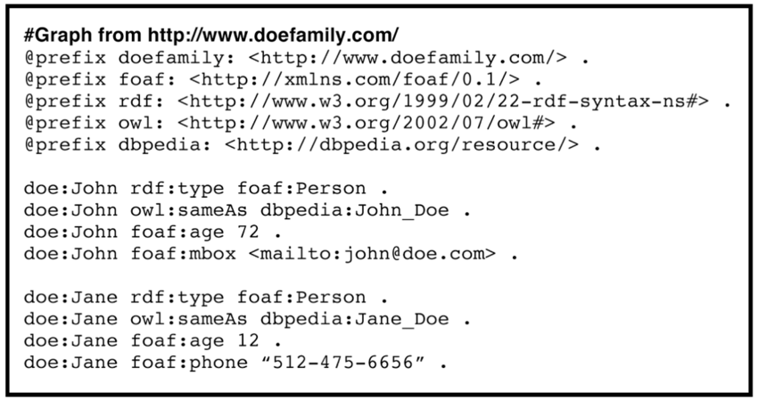
Notational differences
Typical logic notation
∀x ∃y furry(x) ∧ meows(x) ∧ has(x, y), claw(y) ⇒ cat(x)
Prolog
cat(X) :- furry(X), meows (X), has(X, Y), claw(Y).
Lisp notations
(forall ?x (implies (and (furry ?x) (meows ?x)
(has ?x ?y) (claw ?y))
(cat ?x)))
Python code
e.g., AIMA python, logic.ipynb
Knowledge graph triples
e.g., in RDF/OWL

Slide 24
Fin

