Slide 1
Axelrod exploring the iterated prisoner’s dilemma
Notes:
1

Slide 2
Axelrod-Python
https://github.com/Axelrod-Python
  Explore strategies for the Prisoners dilemma game
  Over 100 strategies from literature and original ones
  Run round robin tournaments with options
  Population dynamics (i.e., evolution)
Easy to install
  pip install axelrod
Also includes notebooks
Documentation

Slide 3
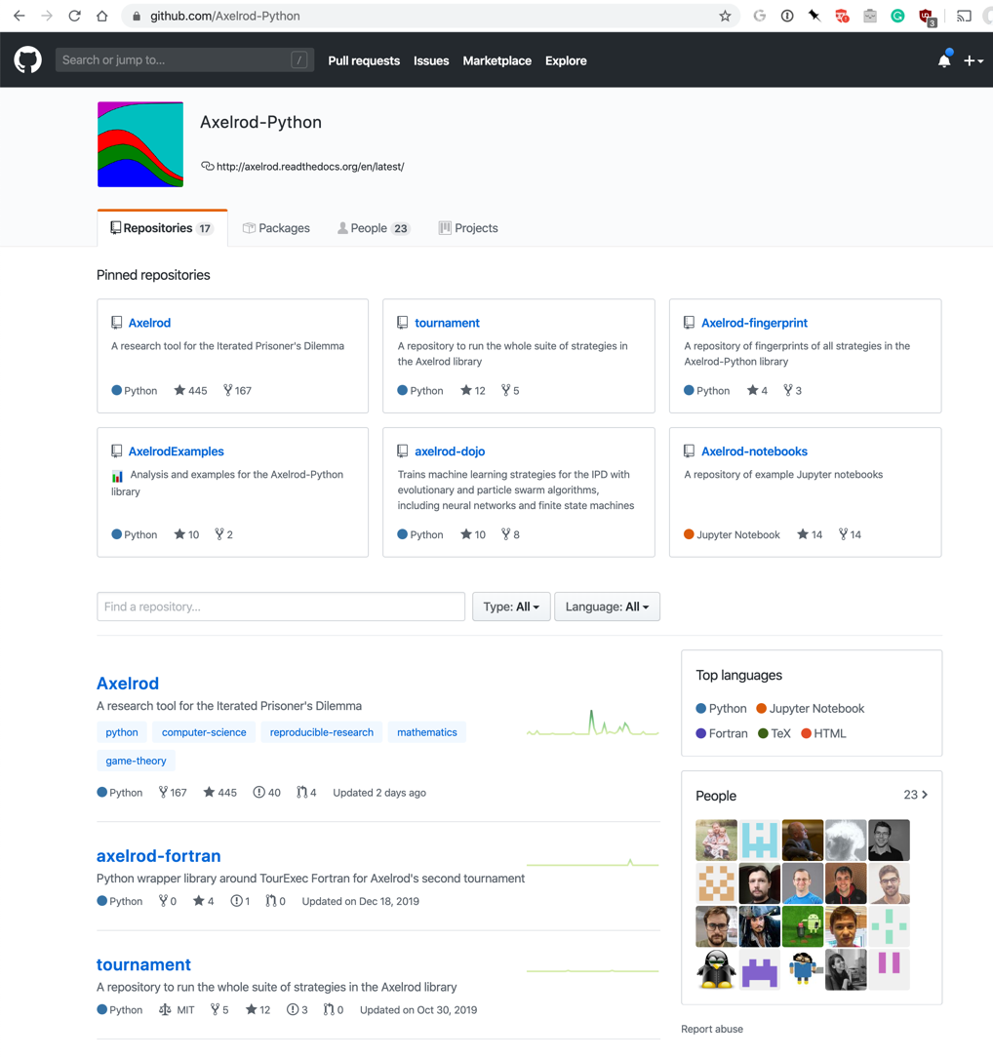
https://github.com/Axelrod-Python

Slide 4
Axelrod Players
A player like TitForTat is a subclass of a Player class
Every player subclass has a set of fixed properties (e.g., how many interactions it remembers)
A subclass has instances with unique IDs
Instances interact with “opponents”, who are instances of a player subtype
Each instance maintains a history of its interactions with each opponent it encounters
Its strategy for an encounter may depend on this

Slide 5
TitForTat
class TitForTat(Player):
name = "Tit For Tat"
classifier = {
"memory_depth": 1,
"stochastic": False,
"inspects_source": False,
"manipulates_source": False,
…}
def strategy(self, opponent: Player) -> Action:
# First move
if not self.history:
return C
# React to the opponent's last move
if opponent.history[-1] == D:
return D
return C
Remembers only last interaction with a given player
Note use of type hints, added in 3.5

Slide 6
TitFor2Tats
class TitFor2Tats(Player):
"""player starts by cooperating and then defects only after 2defects by opponent”””
name = "Tit For 2 Tats"
classifier = {
"memory_depth": 2,
"stochastic": False,
"inspects_source": False,
"manipulates_source": False,
…}
@staticmethod
def strategy(opponent: Player) -> Action:
return D if opponent.history[-2:] == [D, D] else C
Remembers last2 interactions with a given player
Cooperates unless this opponent defected last two times

Slide 7
Bulley
class TitFor2Tats(Player):
""" player that behaves opposite to Tit For Tat, including first move”””
name = "Tit For 2 Tats"
classifier = {
"memory_depth": 2,
"stochastic": False,
"inspects_source": False,
"manipulates_source": False,
…}
@staticmethod
def strategy(opponent: Player) -> Action:
return C if opponent.history[-1:] == [D] else D

Slide 8
Predefined Player Strategies
There are 24 variations on the basic Tit For Tat strategy
And more than 100 other player strategies
See an index here with brief descriptions and links to the Python source code

