Slide 1
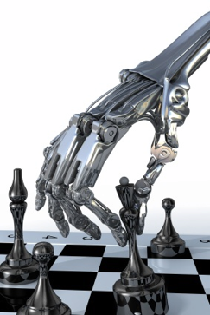
More on Games
Chapter 5.4-5.7
Some material adopted from notes by Charles R. Dyer, University of Wisconsin-Madison

Slide 2
Overview
Stochastic games
Other issues
AlphaGo Zero
General game playing

Slide 3
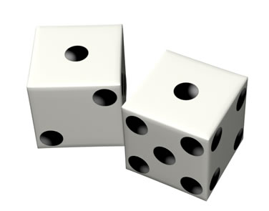
Stochastic Games
In real life, unpredictable external events can put us into unforeseen situations
Many games introduce unpredictability through a random element, such as the throwing of dice
These offer simple scenarios for problem solving with adversaries and uncertainty

Slide 4
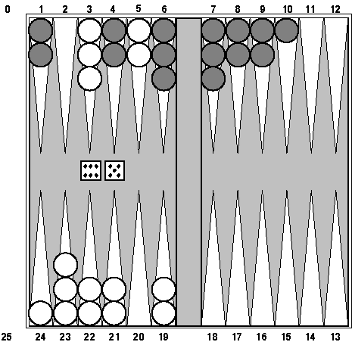
Example: Backgammon
Popular two-player game with uncertainty
Players roll dice to determine what moves can be made
White has just rolled 5 & 6, giving four legal moves:
  5-10, 5-11
  5-11, 19-24
  5-10, 10-16
  5-11, 11-16
Good for exploring decision making in adversarial prob-lems involving skill and luck

Slide 5
Why can’t we use MiniMax?
Before player chooses a move, she rolls dice and only then knows what moves are possible
Immediate outcome of each move also known
But she does not know what moves she or her opponent will have available in the future
Need to adapt MiniMax to handle this
Requires using probabilities and expected values

Slide 6
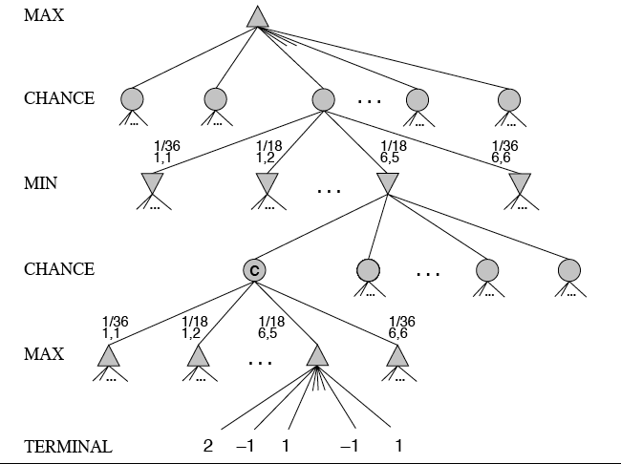
MiniMax trees with Chance Nodes

Slide 7
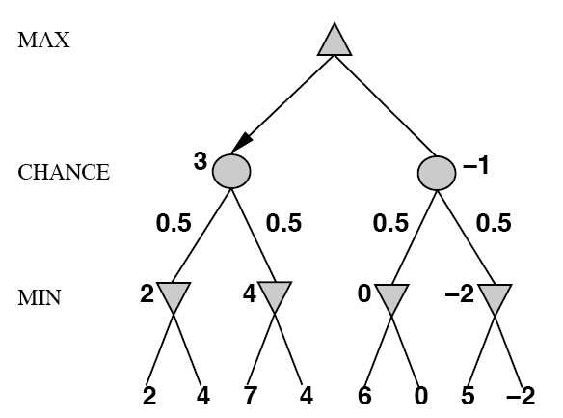
Understanding the notation
Max’s move 1
Max’s move 2
Min flips coin
Outcome probability
Min knows two possible moves
Apply static evaluator here
Board state includes chance outcome determining available moves

Slide 8
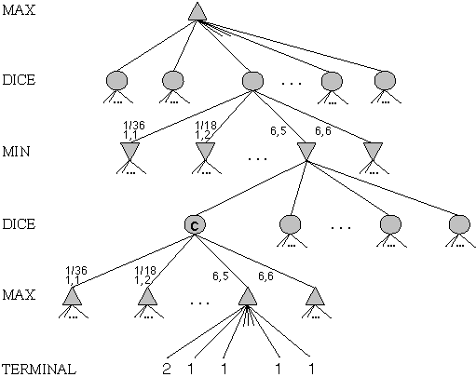
Game trees with chance nodes
Chance nodes (circles) represent random events
For random event with N outcomes, chance node has N children, each with a probability
2 dice: 21 distinct outcomes
Use minimax to compute values
for MAX and MIN nodes
Use expected values for
chance nodes
Chance nodes over max node:
expectimax(C) = ∑_{i}(P(d_{i})*maxval(i))
Chance nodes over min node:
expectimin(C) = ∑_{i}(P(d_{i})*minval(i))
Min
Rolls
Max
Rolls

Slide 9
Impact on lookahead
Dice rolls increase branching factor
  There are 21 possible rolls with two dice
Backgammon: ~20 legal moves for given roll
  ~6K with 1-1 roll (get to roll again!)
At depth 4: 20 * (21 * 20)**3 ≈ 1.2B boards
As depth increases, probability of reaching a given node shrinks
  lookahead’s value diminished and alpha-beta pruning is much less effective
TDGammon used depth-2 search + good static evaluator to achieve world-champion level
Notes:
1 1
1 2
1 3
1 4
1 5
1 6
2 2
2 3
2 4
2 5
2 6
3 3
3 4
3 5
3 6
4 4
4 5
4 6
5 5
5 6
6 6
Possible outcomes rolling two dice if they are not considered distinguishable
1 1
1 2
1 3
1 4
1 5
1 6
2 2
2 3
2 4
2 5
2 6
3 3
3 4
3 5
3 6
4 4
4 5
4 6
5 5
5 6
6

Slide 10
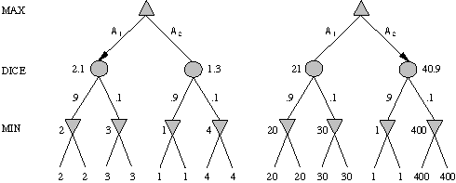
Meaning of the evaluation function
A1 is best move
A2 is best move
2 outcomes: probabilities {.9, .1}
With probabilities & expected values we must be careful about meaning of values returned by static evaluator
Bigger is better and twice as big is twice as good
Relative-order preserving change of static evaluation values doesn’t change minimax decision, but could here
Linear transformations are OK

Slide 11
Games of imperfect information
E.g. card games where opponent's initial hand unknown
  Can calculate probability for each possible deal
  Like having one big dice roll at beginning of game
Possible approach: minimax over each action in each deal; choose action with highest expected value over all deals
Special case: if action optimal for all deals, it's optimal
GIB bridge program, approximates this idea by
  Generating 100 deals consistent with bidding
  Picking action that wins most tricks on average

Slide 12
High-Performance Game Programs
Many programs based on alpha-beta + iterative deepening + extended/singular search + transposition tables + huge databases + …
Chinook searched all checkers configurations with ≤ 8 pieces to create endgame database of 444 billion board configurations
Methods general, but implementations improved via many specifically tuned-up enhancements (e.g., the evaluation functions)

Slide 13
Other Issues
Multi-player games, no alliances
  E.g., many card games, like Hearts
Multi-player games with alliances
  Further complicated if alliances are fluid and can change during the game
  E.g., Risk
  More on this when we discuss game theory
  Good model for a social animal like humans, where we must balance cooperation and competition

Slide 14

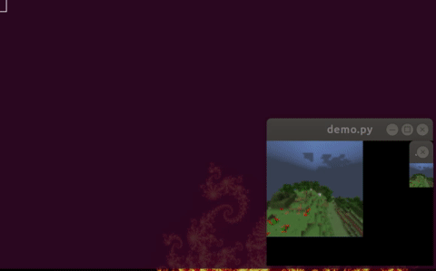
AI and video Games
Many games include agents run by
the game program as
  Adversaries, in first person shooter games
  Collaborators, in a virtual reality game
  E.g.: AI bots in Fortnite Chapter 2
Some games used as AI/ML challenges or learning environments
  MineRL: train bots to play Minecraft
  MarioAI: train bots for Super Mario Bros
  Facebook Nethack Learning Environment
  for reinforcement learning

Slide 15
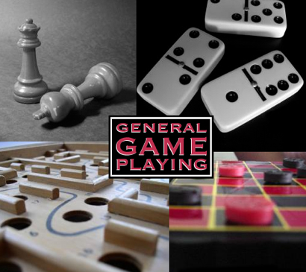
General Game Playing
General Game Playing is an idea
developed by Prof. Michael
Genesereth of Stanford
See his site for more information
Idea: don’t develop specialized systems to play specific games (e.g., Checkers) well
Goal: design AI programs to be able to play more than one game successfully
Work from a description of a novel game

Slide 16
General Game Playing
Stanford’s GGP is a Web-based system
Complete, logical specification of many different games in terms of:
    relational descriptions of states
    legal moves and their effects
    goal relations and their payoffs
Management of matches between automated players and of competitions involving many players and games

Slide 17
GGP
Input: logical description of a game in a custom game description language
  Game bots must
    Learn how to play legally from description
    Play well using general problem-solving strategies
    Improve using general machine learning techniques
Regular completions 2005-2016, $10K prize
Java General Game Playing Base Package

Slide 18
Tic-Tac-Toe in GDL
(role xplayer)
(role oplayer)
;; Initial State
(init (cell 1 1 b))
(init (cell 1 2 b))
...
(init (control xplayer))
;; Dynamic Components
(<= (next (cell ?m ?n x))
(does xplayer (mark ?m ?n))
(true (cell ?m ?n b)))
(<= (next (cell ?m ?n o))
(does oplayer (mark ?m ?n))
(true (cell ?m ?n b)))
…
...
(<= (next (control xplayer))
(true (control oplayer)))
(<= (legal ?w (mark ?x ?y))
(true (cell ?x ?y b))
(true (control ?w)))
(<= (legal xplayer noop)
(true (control oplayer)))
(<= (legal oplayer noop)
(true (control xplayer)))
...
(<= (goal xplayer 100) (line x))
...
(<= (goal oplayer 0) (line x))
...
See ggp-base repository: http://bit.ly/RB49q5

Slide 19
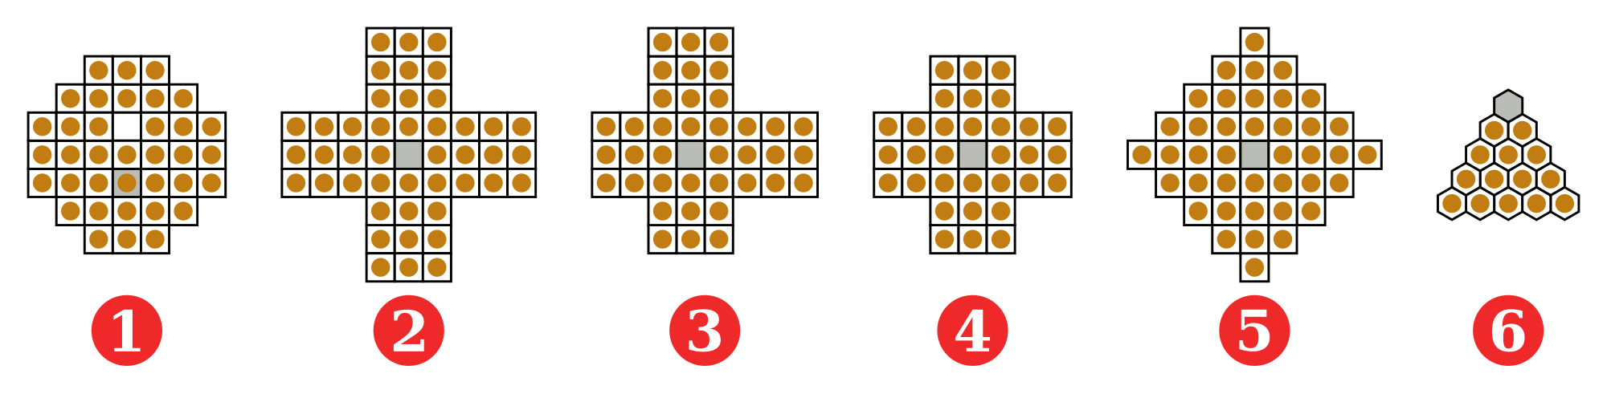
GGP Peg
Jumping
Game
; http://games.stanford.edu/gamemaster/games-debug/peg.kif
(init (hole a c3 peg))
(init (hole a c4 peg))
…
(init (hole d c4 empty))
…
(<= (next (pegs ?x)) (does jumper (jump ?sr ?sc ?dr ?dc)) (true (pegs ?y))
(succ ?x ?y)) (<= (next (hole ?sr ?sc empty)) (does jumper (jump ?sr ?sc ?dr ?dc)))
…
(<= (legal jumper (jump ?sr ?sc ?dr ?dc)) (true (hole ?sr ?sc peg))
(true (hole ?dr ?dc empty)) (middle ?sr ?sc ?or ?oc ?dr ?dc) (true (hole ?or ?oc peg)))
…
(<= (goal jumper 100) (true (hole a c3 empty)) (true (hole a c4 empty))
(true (hole a c5 empty))
…
(succ s1 s2)
(succ s2 s3)
…

Slide 20
A example of General Intelligence
Artificial General Intelligence describes research that aims to create machines capable of general intelligent action
Harkens back to early visions of AI, like McCarthy’s Advise Taker
  See Programs with Common Sense (1959)
A response to frustration with narrow specialists, often seen as “hacks”
  See On Chomsky and the Two Cultures
  of Statistical Learning

Slide 21
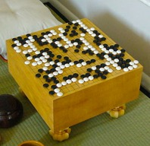
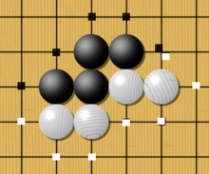
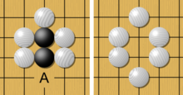
Go - the game
Played on 19x19 board; black vs. white stones
Huge state space O(b^{d}): chess:~35⁸⁰, go: ~250¹⁵⁰
Rule: Stones on board must have an adjacent open point ("liberty") or be part of connected group with a liberty. Groups of stones losing their last liberty are removed from the board.
liberties
capture

Slide 22
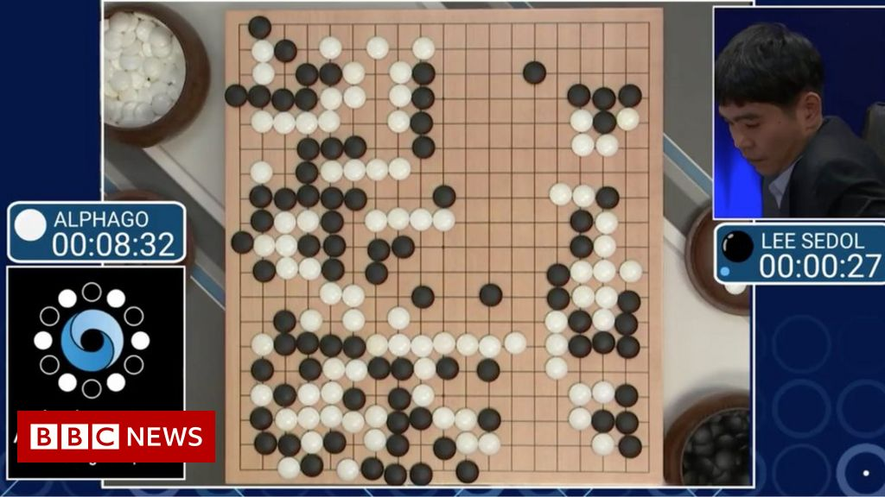

Slide 23
AlphaGO
Developed by Google’s DeepMind
Beat top-ranked human grandmasters in 2016
Used Monte Carlo tree search over game tree
  expands search tree via random sampling of search space
Science Breakthrough of the year runner-up
  Mastering the game of Go with deep neural networks and tree search, Silver et al., Nature, 529:484–489, 2016
Match with grandmaster Lee Sedol in 2016 was subject of award-winning 2017 AlphaGo

Slide 24
AlphaGo implementation
Trained deep neural networks (13 layers) to learn static evaluation function and policy function to determine the best next move
Performs Monte Carlo game search
  explore state space like minimax
  random "rollouts"
  simulate probable plays by opponent according to policy function

Slide 25
AlphaGo implementation
Hardware: 1920 CPUs, 28O GPUs
Neural networks trained in two phases over 4-6 weeks
Phase 1: supervised learning from database of 30 million moves in games between two good human players
Phase 2: play against versions of self using reinforcement learning to improve performance

Slide 26
Perspective on Games: Con and Pro
“Chess is the Drosophila of artificial intelligence. However, computer chess has developed much as genetics might have if the geneticists had concentrated their efforts starting in 1910 on breeding racing Drosophila. We would have some science, but mainly we would have very fast fruit flies.” John McCarthy, Stanford
“Saying Deep Blue doesn’t really think about chess is like saying an airplane doesn't really fly because it doesn't flap its wings.”
Drew McDermott, Yale

Slide 27
Why study games?
Interesting, hard problems that require minimal “initial structure”
Clear criteria for success
A way to study problems involving {hostile, adversarial, competing} agents and the uncertainty of interacting with the natural world
People have used them to assess intelligence
Fun, good, easy to understand, PR potential
Games often define very large search spaces
  chess 35¹⁰⁰ nodes in search tree, 10⁴⁰ legal states

