Slide 1
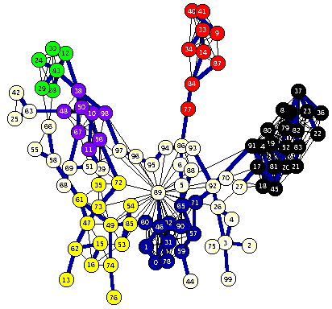
CSP in
Python

Slide 2
Overview
Python-constraint is a good package for solving CSP problems in Python
Installing it
Using it
Examples in
  Magic Squares
  Map coloring
  Sudoku puzzles
  HW?: Battleships

Slide 3
Installation
On your own computer
  pip install python-constraint
  sudo pip install python-constraint
Install locally on gl
  pip3 install –user python-constraints
Install locally on UMBC Jupyter hub server by executing this once in a notebook
  !pip install –user python-constraints
Clone source from github
  https://github.com/python-constraint

Slide 4
Simple Example
variable name
>>> from constraint import *
>>> p = Problem()
>>> p.addVariable("a", [1,2,3])
>>> p.addVariable("b", [4,5,6])
>>> p.getSolutions()
[{'a': 3, 'b': 6}, {'a': 3, 'b': 5}, {'a': 3, 'b': 4},
{'a': 2, 'b': 6}, {'a': 2, 'b': 5}, {'a': 2, 'b': 4},
{'a': 1, 'b': 6}, {'a': 1, 'b': 5}, {'a': 1, 'b': 4}]
>>> p.addConstraint(lambda x,y: 2*x==y, (’a’,’b'))
>>> p.getSolutions()
[{'a': 3, 'b': 6}, {'a': 2, 'b': 4}]
domain
9 solutions (instantiations)
two variables
constraint function

Slide 5
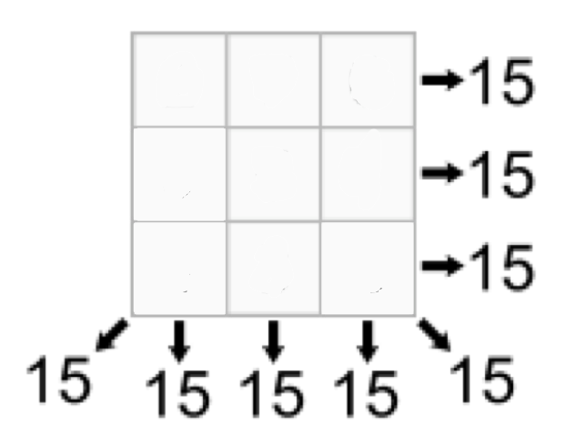
Magic Square
An NxN array of integers where all rows, columns and diagonals sum to the same number
Given N (e.g., 3) and magic sum (e.g., 15), find cell values
What are the
  Variables & their domains
  Constraints

Slide 6
Magic Square
An NxN array of integers where
all rows, columns and diagonals
sum to the same number
Given N (e.g., 3) & magic sum
(e.g., 15), find cell values
What are the
  Variables [0..8] & their domains [1..9]
  Constraints
0
1
2
3
4
5
6
7
8
All variables have different values
v0+v1+v2 ==15, v0+v3+v6 == 15, …

Slide 7
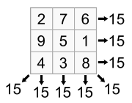
Magic Square
An NxN array of integers where all rows, columns and diagonals sum to the same number
Given N (e.g., 3) and the magic sum (e.g., 15) find the cell values
What are the
  Variables & their domains
  Constraints

Slide 8
3x3 Magic Square
numbers as variables: 0..8
domain of each is 1..10
from constraint import *
p = Problem()
p.addVariables(range(9), range(1,10))
p.addConstraint(AllDifferentConstraint(), range(9))
p.addConstraint(ExactSumConstraint(15), [0,4,8])
p.addConstraint(ExactSumConstraint(15), [2,4,6])
for row in range(3):
p.addConstraint(ExactSumConstraint(15),
[row*3+i for i in range(3)])
for col in range(3):
p.addConstraint(ExactSumConstraint(15),
[col+3*i for i in range(3)])
built-in constraint functions
variables involved with constraint

Slide 9
3x3 Magic Square
sols = p.getSolutions()
print sols
for s in sols:
print
for row in range(3):
for col in range(3):
print s[row*3+col],
print

Slide 10
3x3 Magic Square
> python ms3.py
[{0:6,1:7,2:2,…8:4}, {0:6,1:…}, …]
6 7 2
1 5 9
8 3 4
6 1 8
7 5 3
2 9 4
… six more solutions …

Slide 11
Constraints
FunctionConstraint(f, v)
Arguments:
  F: a function of N (N>0) arguments
  V: a list of N variables
Function can be defined & referenced by name or defined locally via lambda expressions
  p.addConstraint(lambda x,y:x==2*y,[11,22])
  def dblfn(x,y): return x == 2*y
  P.addConstraint(dblfn, [11,22])

Slide 12
Constraints
Constraints on a set of variables:
  AllDifferentConstraint()
  AllEqualConstraint()
  MaxSumConstraint()
  ExactSumConstraint()
  MinSumConstraint()
Examples:
  p.addConstraint(ExactSumConstraint(100),[11,…19])
  p.addConstraint(AllDifferentConstraint(),[11,…19])

Slide 13
Constraints
Constraints on a set of possible values
  InSetConstraint()
  NotInSetConstraint()
  SomeInSetConstraint()
  SomeNotInSetConstraint()

Slide 14
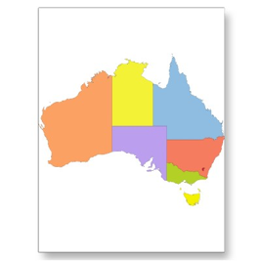
Map Coloring
For map coloring, each country is a variable and the domains are the set of available colors
Constraints: countries sharing a boarder can’t have the same color
A simple python string can encode
  Strings to use as variables for the countries
  Counties sharing a border
"SA:WA NT Q NSW V; NT:WA Q; NSW: Q V; T:”
  “sharing a border” is symmetric, so only mention it once

Slide 15
Map Coloring
def color(map, colors=['red','green','blue']):
(vars, adjoins) = parse_map(map)
p = Problem()
p.addVariables(vars, colors)
for (v1, v2) in adjoins:
p.addConstraint(lambda x,y: x!=y, [v1, v2])
solution = p.getSolution()
if solution:
for v in vars:
print "%s:%s " % (v, solution[v]),
print
else:
print 'No solution found :-(’
austrailia = "SA:WA NT Q NSW V; NT:WA Q; NSW: Q V; T:"

Slide 16
Map Coloring
australia = 'SA:WA NT Q NSW V; NT:WA Q; NSW: Q V; T:’
def parse_map(neighbors):
adjoins = []
regions = set()
specs = [spec.split(':') for spec in neighbors.split(';')]
for (A, Aneighbors) in specs:
A = A.strip();
regions.add(A)
for B in Aneighbors.split():
regions.add(B)
adjoins.append([A,B])
return (list(regions), adjoins)

Slide 17
Sudoku
def sudoku(initValue):
p = Problem()
# Define a variable for each cell: 11,12,13...21,22,23...98,99
for i in range(1, 10) :
p.addVariables(range(i*10+1, i*10+10), range(1, 10))
# Each row has different values
for i in range(1, 10) :
p.addConstraint(AllDifferentConstraint(), range(i*10+1, i*10+10))
# Each colum has different values
for i in range(1, 10) :
p.addConstraint(AllDifferentConstraint(), range(10+i, 100+i, 10))
# Each 3x3 box has different values
p.addConstraint(AllDifferentConstraint(), [11,12,13,21,22,23,31,32,33])
p.addConstraint(AllDifferentConstraint(), [41,42,43,51,52,53,61,62,63])
p.addConstraint(AllDifferentConstraint(), [71,72,73,81,82,83,91,92,93])
p.addConstraint(AllDifferentConstraint(), [14,15,16,24,25,26,34,35,36])
p.addConstraint(AllDifferentConstraint(), [44,45,46,54,55,56,64,65,66])
p.addConstraint(AllDifferentConstraint(), [74,75,76,84,85,86,94,95,96])
p.addConstraint(AllDifferentConstraint(), [17,18,19,27,28,29,37,38,39])
p.addConstraint(AllDifferentConstraint(), [47,48,49,57,58,59,67,68,69])
p.addConstraint(AllDifferentConstraint(), [77,78,79,87,88,89,97,98,99])
# add unary constraints for cells with initial non-zero values
for i in range(1, 10) :
for j in range(1, 10):
value = initValue[i-1][j-1]
if value: p.addConstraint(lambda var, val=value: var == val, (i*10+j,))
return p.getSolution()

Slide 18
Sudoku Input
easy = [[0,9,0,7,0,0,8,6,0],
[0,3,1,0,0,5,0,2,0],
[8,0,6,0,0,0,0,0,0],
[0,0,7,0,5,0,0,0,6],
[0,0,0,3,0,7,0,0,0],
[5,0,0,0,1,0,7,0,0],
[0,0,0,0,0,0,1,0,9],
[0,2,0,6,0,0,0,5,0],
[0,5,4,0,0,8,0,7,0]]

Slide 19
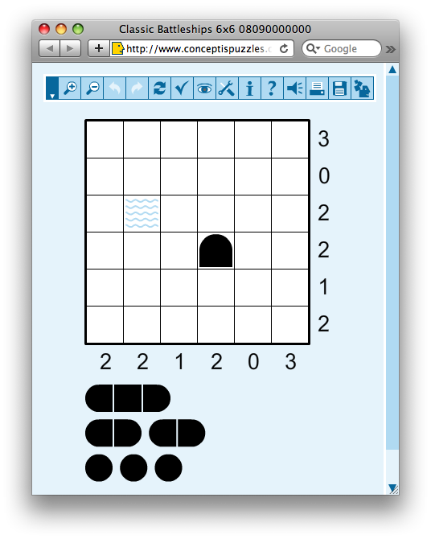
Battleship Puzzle
NxN grid
Each cell occupied by water or part of a ship
Given
  Ships of varying lengths
  Row and column sums of number of ship cells
  Hints for some cells
What are
  variables and domains
  constraints

Slide 20
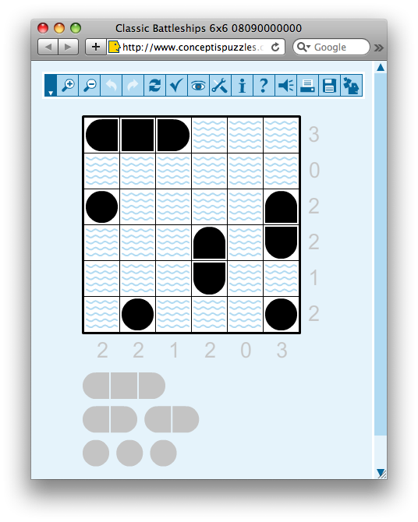
Battleship Puzzle
NxN grid
Each cell occupied by water or part of a ship
Given
  Ships of varying lengths
  Row and column sums of number of ship cells
  Hints for some cells
What are
  variables and domains
  constraints

Slide 21
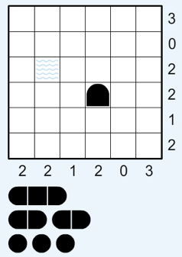
Battleship puzzle
Resources
  http://www.conceptispuzzles.com/
  http://wikipedia.org/wiki/Battleship_(puzzle)
Barbara M. Smith, Constraint Programming Models for Solitaire Battleships, 2006
  http://bit.ly/cspBs

Slide 22
A HW Problem ?
Write a CSP program to solve 6x6 battleships with 3 subs, 2 destroyers and 1 carrier
Given row and column sums and several hints
Hints: for a location, specify one of {water, top, bottom, left, right, middle, circle}

