Slide 1

Informed
Search
Chapter 4 (b)
Some material adopted from notes by Charles R. Dyer, University of Wisconsin-Madison

Slide 2
Today’s class: local search
Iterative improvement methods (aka local search) move from potential solution to potential solution until a goal is reached
Examples include hill climbing, simulated annealing, local beam search, genetic algorithms
Online search interleaves searching and acting

Slide 3
When local search may win
Local search may be good when
You don’t know a goal, but can recognize one when you see it
You only want to find a goal and don’t need to keep track of the sequence of actions that reached it
You don’t care about finding the shortest solution
You do care about find a solution quickly

Slide 4
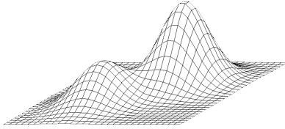
Hill Climbing
Extended current path with successor that’s closer to solution than end of current path
If goal is to get to the top of a hill, then always take a step that leads you up
Simple hill climbing: take any upward step
Steepest ascent hill climbing: consider all possible steps, take one that goes up most
No memory required

Slide 5
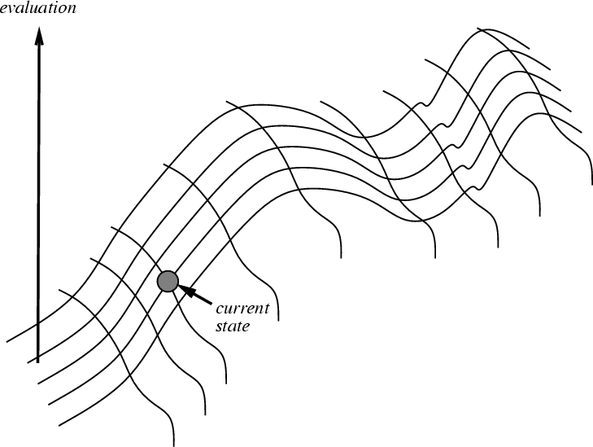
Hill climbing on a surface of states
Height defined by an evaluation function that takes a state & returns a number

Slide 6
Hill climbing for search
For informed search and many other problems (e.g., neural network training) we want to find a global minimum
  Search evaluation function: measure of how far the current state is from a goal
It’s an easy change to make in the algorithm, or we can just negate the evaluation function
We still call it hill climbing though

Slide 7

Hill-climbing search
If there’s successor s for current state n such that
  h(s) < h(n) and h(s) <= h(t) for all successors t
then move from n to s; otherwise, halt at n
  i.e.: Look one step ahead to decide if a successor is better than current state; if so, move to best successor
Like greedy search, but doesn’t allow backtracking or jumping to alternative path since it has no memory
Like beam search with a beam width of 1 (i.e., maximum size of the nodes list is 1)
Not complete since search may terminate at a local minima, plateau or ridge

Slide 8
Hill climbing example
2
8
3
1
2
3
start
1
6
4
h = -4
goal
8
4
h = 0
7
5
7
6
5
-5
-5
-2
2
8
3
1
2
3
1
4
h = -3
8
4
h = -1
7
6
5
7
6
5
-3
-4
2
3
2
3
1
8
4
1
8
4
h = -2
7
6
5
7
6
5
h = -3
-4
f(n) = -(number of tiles out of place)

Slide 9
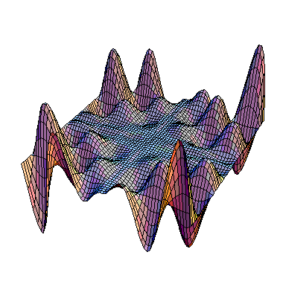
Exploring the Landscape
local maximum
Local Maxima: peaks not highest point in space
Plateaus: broad flat region giving search no guidance (use random walk)
Ridges: flat like plateaus, but with drop-offs to sides; steps to North, East, South and West may go down, but step to NW may go up
plateau
ridge
Image from: http://classes.yale.edu/fractals/CA/GA/Fitness/Fitness.html

Slide 10
Drawbacks of hill climbing
Problems: local maxima, plateaus, ridges
Possible remedies:
  Random restart: keep restarting search from random locations until a goal is found
    may require an estimate – how low can we go
  Problem reformulation: reformulate search space to eliminate these problematic features
Some problem spaces are great for hill climbing and others are terrible

Slide 11
Example of a local optimum
2
5
-4
1
7
4
start
8
6
3
goal
1
2
5
1
2
5
1
2
3
7
4
7
4
-4
8
4
0
8
6
3
8
6
3
7
6
5
-3
1
2
5
8
7
4
-4
6
3

Slide 12
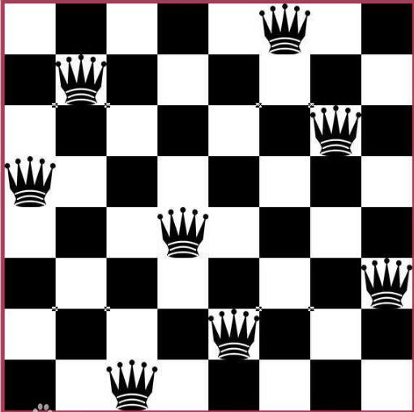
Hill Climbing and 8 Queens
Randomly put one queen in each column
Goal state: no two queens attack one another
Actions: moving any queen to a different row
Each state thus has 65 successors
Heuristic h: # of pairs attacking one another
Current state: h= 17
h=0 => solution
Can be extended to a N-queens problem for an NxN board

Slide 13
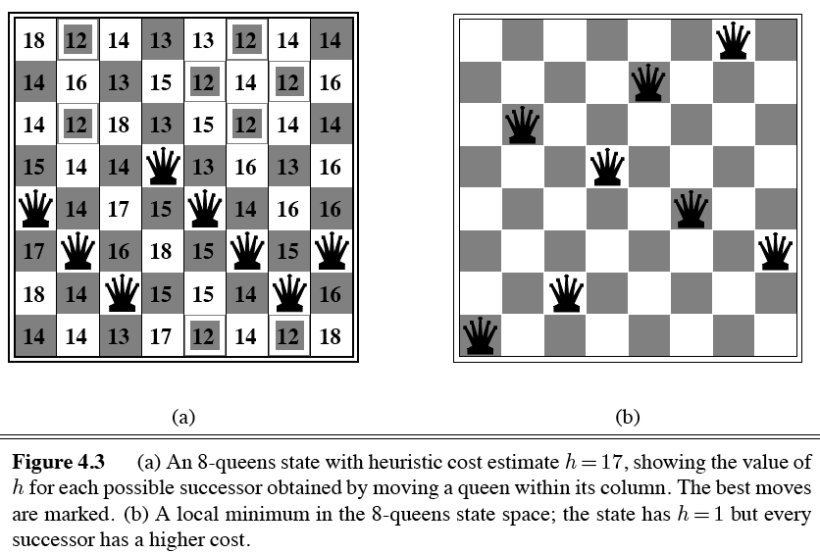
Hill Climbing and 8 Queens

Slide 14

argmax and argmin
The argmax and argmin concept is common in many AI and machine learning algorithms
See argmax on Wikipedia (argmin is similar)
Argmax_{x} f(x) finds value of x for which f(x) is largest
Argmin_{x} f(x) finds value of x for which f(x) is smallest
Computing this generally requires some search

Slide 15
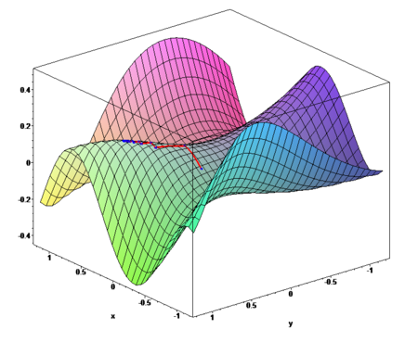
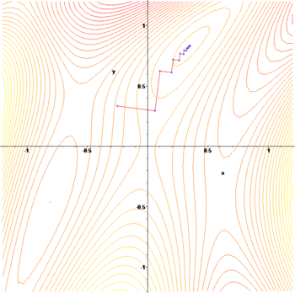
Gradient ascent or descent
Images from http://en.wikipedia.org/wiki/Gradient_descent
Gradient descent procedure for finding the arg_{x} min f(x)
  choose initial x₀ randomly
  Repeat x_{i+1} ← x_{i} – η f '(x_{i})
  until the sequence x₀, x₁, …, x_{i}, x_{i+1} converges
Step size proportional to f '(x_{i}), i.e., 1st derivative or slope;
  Steeper slope => bigger step
Often used in machine learning algorithms
  Cheaper to compute than Newton’s method

Slide 16
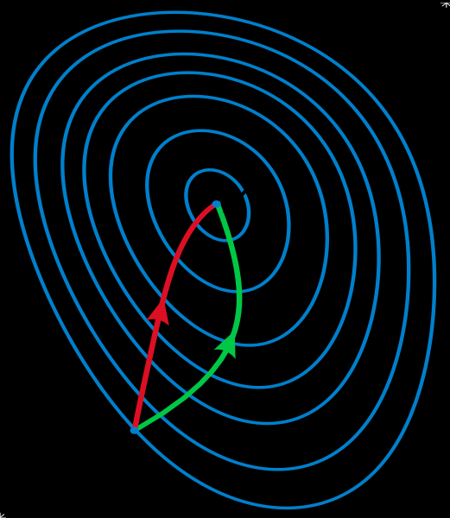
Gradient methods vs. Newton’s method
A reminder of Newton’s method from Calculus:
    x_{i+1} ← x_{i} – η f '(x_{i}) / f ''(x_{i})
Newton’s method uses 2nd order information (e.g., 2nd derivative) to take a faster route to a minimum
Second-order info. is more expensive to compute, but converges quicker
See gradient descent
Contour lines of a function
Gradient descent (green)
Newton’s method (red)
Image from http://en.wikipedia.org/wiki/Newton's_method_in_optimization

Slide 17
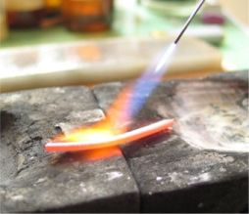
Annealing
In metallurgy, annealing is a technique
involving heating & controlled cooling of a material to increase size of its crystals & reduce defects
Heat causes atoms to become unstuck from initial positions (local minima of internal energy) and wander randomly through states of higher energy
Slow cooling gives them more chances of finding configurations with lower internal energy than initial one

Slide 18
Simulated annealing (SA)
SA exploits analogy between how metal cools and freezes into a minimum-energy crystalline structure & search for a minimum/maximum in a general system
SA can avoid becoming trapped at local minima
SA uses random search accepting changes decreasing objective function f and some that increase it
SA uses a control parameter T, which by analogy with the original application, is known as the system temperature
T starts out high and gradually decreases toward 0

Slide 19
SA intuitions
Combines hill climbing (for efficiency) with random walk (for completeness)
Analogy: getting a ping-pong ball into the deepest depression in a bumpy surface
  Shake the surface to get the ball out of local minima
  Don’t shake too hard to dislodge it from global minimum
Simulated annealing:
  Start shaking hard (high temperature) and gradually reduce shaking intensity (lower temperature)
  Escape local minima by allowing some “bad” moves
  But gradually reduce their size and frequency

Slide 20
Simulated annealing
“bad” move from A to B accepted with prob.
        -(f(B)-f(A)/T)
        e
The higher the temperature, the more likely it is that a bad move can be made
As T tends to zero, probability tends to zero, and SA becomes more like hill climbing
If T lowered slowly enough, SA is complete and admissible
Finding the proper rate to lower is still an issue

Slide 21
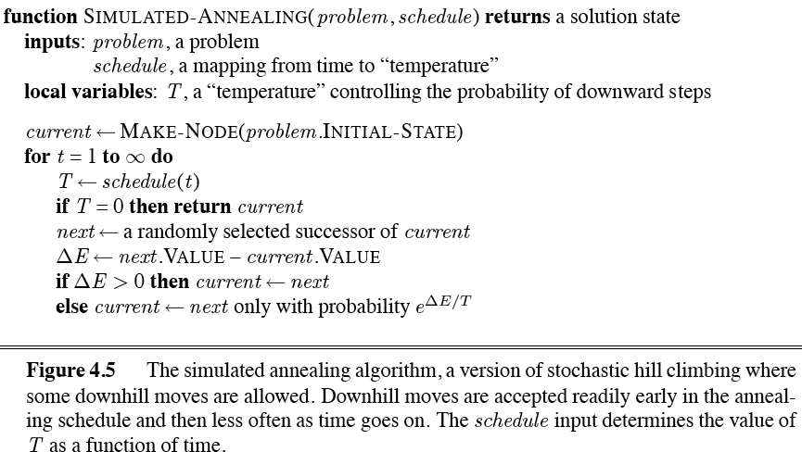
Simulated annealing algorithm

Slide 22
Local beam search
Basic idea
  Begin with k random states
  Generate all successors of these states
  Keep the k best states generated by them
Provides a simple, efficient way to share some knowledge across a set of searches
Stochastic beam search is a variation:
  Probability of keeping a state is a function of its heuristic value

Slide 23
Genetic algorithms (GA)
Search technique inspired by evolution
Similar to stochastic beam search
Start with initial population of k random states
New states generated by mutating a single state or reproducing (combining) two parent states, selected according to their fitness
Encoding used for genome of an individual strongly affects the behavior of search

Slide 24
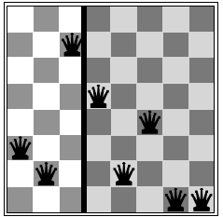
Ma and Pa solutions

Slide 25
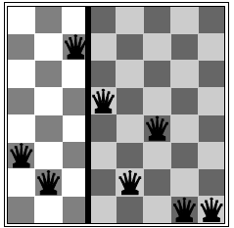
8 Queens problem
Represent state by a
string of 8 digits in {1..8}
S = ‘32752411’
Fitness function = # of
non-attacking pairs
F(S_{solution}) = 8*7/2 = 28
F(S₁) = 24
State S₁

Slide 26
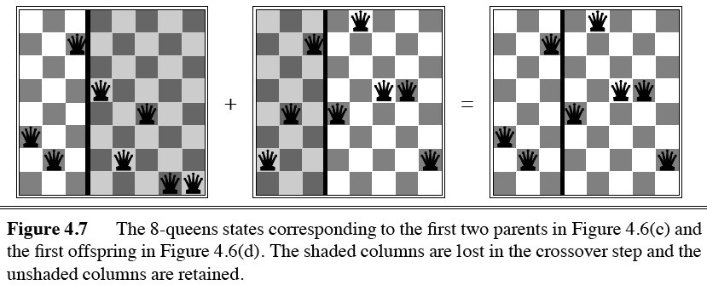
Genetic algorithms
Ma
Pa
Offspring

Slide 27
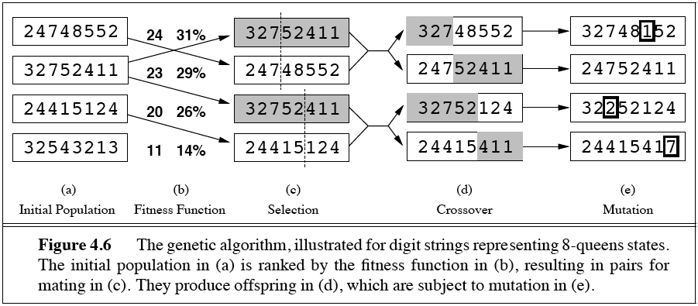
Genetic algorithms
Fitness function: number of non-attacking pairs of queens (min=0, max=(8 × 7)/2 = 28)
Probability of mating is a function of fitness score
Random cross-over point for a mating pair chosen
Resulting offspring subject to a random mutation with probability

Slide 28
Genetic algorithms
Fitness function: number of non-attacking pairs of queens (min=0, max=(8 × 7)/2 = 28)
Probability of mating is a function of fitness score
Random cross-over point for a mating pair chosen
Resulting offspring subject to a random mutation with probability

Slide 29
Genetic algorithms
Fitness function: number of non-attacking pairs of queens (min=0, max=(8 × 7)/2 = 28)
Probability of mating is a function of fitness score
Random cross-over point for a mating pair chosen
Resulting offspring subject to a random mutation with probability

Slide 30
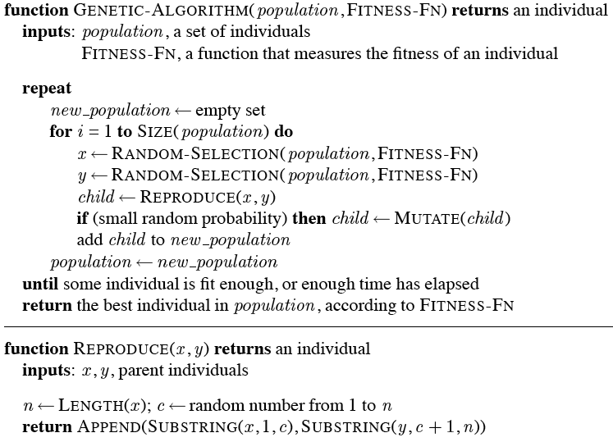
GA pseudo-code

Slide 31
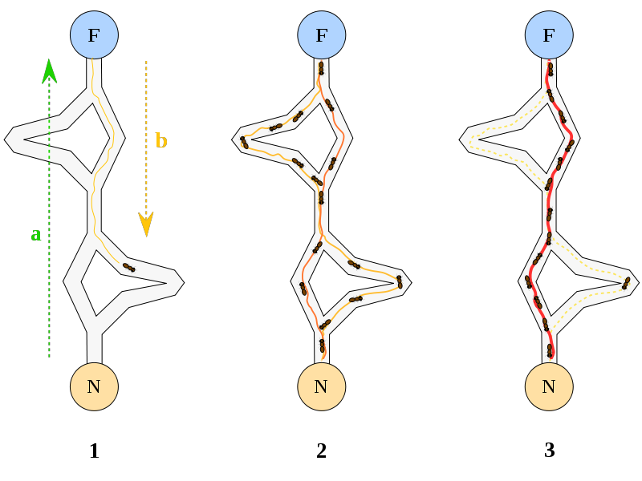
Ant Colony Optimization
A probabilistic search technique for problems reducible to finding good paths through graphs
Inspiration
Ants leave nest
Wander, discover food
Return to nest, pre-ferring shorter paths
Leave pheromone trail
Shortest path is reinforced
An example of agents communicating through their environment

Slide 32
Taboo search
Problem: Hill climbing can get stuck on local maxima
Solution: Maintain a list of k previously visited states, and prevent the search from revisiting them
An example of a metaheuristic

Slide 33
Online search
Nothing to do with Web search!
Involves interleave computation AND action
  search some, act some, repeat
Exploration: Can’t be sure of action out-comes; must perform them to know result
More realistic approach for many problems
Relatively easy if actions are reversible (ONLINE-DFS-AGENT)
LRTA* (Learning Real-Time A*): Update h(s) (in state table) based on experience

Slide 34
Other topics
Search in continuous spaces
  Different math
Search with uncertain actions
  Must model the probabilities of an actions results
Search with partial observations
  Acquiring knowledge as a result of search

Slide 35
Summary: Informed search
Hill-climbing algorithms keep only a single state in memory, but can get stuck on local optima
Simulated annealing escapes local optima, and is complete and optimal given a “long enough” cooling schedule
Genetic algorithms can search a large space by modeling biological evolution
Online search algorithms are useful in state spaces with partial/no information

