Slide 1

P8.py

Slide 2
8 puzzle in python
Look at a simple implementation of an eight puzzle solver in python
p8.py
Solve using A* with three different heuristics
  NIL: h = 1
  OOP: h = # of tiles out of place
  MHD: h = sum of manhatten distance between each tile’s current & goal positions
All three are admissible

Slide 3
What must we model?
A state
Goal test
Actions
Result of doing action in state
Heuristic function

Slide 4
Representing states and actions
Represent state as string of nine characters with blank as *
  E.g.: s = '1234*5678'
Position of blank in state S is
> s.index('*')
4
1 | 2 | 3
4 | * | 5
6 | 7 | 8
Represent an action as one of four possible ways to move the blank:
  up down right left

Slide 5
Legal Actions
def actions8(s): # returns list of legal actions in state s
action_table = {
0:['down', 'right'],
1:['down', 'left', 'right'],
2:['down', 'left'],
3:['up', 'down', 'right'],
4:['up', 'down', 'left', 'right'],
5:['up', 'down', 'left'],
6:['up', 'right'],
7:['up', 'left', 'right'],
8:['up', 'left'] }
return action_table[s.index('*')]
0 | 1 | 2
3 | 4 | 5
6 | 7 | 8
Function maps a position to a list of possible moves for a tile in that position

Slide 6
Result of action A on state S
def result8(S, A):
blank = S.index('*') # blank position
if A == 'up':
swap = blank - 3
return S[0:swap] + '*' + S[swap+1:blank] + S[swap] + S[blank+1:]
elif A == 'down':
swap = blank + 3
return S[0:blank] + S[swap] + S[blank+1:swap] + '*' + S[swap+1:]
elif A == 'left':
swap = blank - 1
return S[0:swap] + '*' + S[swap] + S[blank+1:]
elif A == 'right':
swap = blank + 1
return S[0:blank] + S[swap] + '*' + S[swap+1:]
raise ValueError('Unrecognized action: ' + A)

Slide 7
Heuristic functions
class P8_h1(P8):
""" Eight puzzle using a heuristic function that counts number
of tiles out of place"””
name = 'Out of Place Heuristic (OOP)’
def h(self, node):
""”OOP 8 puzzle heuristic: number of tiles 'out of place'
between a node's state and the goal"""
mismatches = 0
for (t1, t2) in zip(node.state, self.goal):
if t1 != t2: mismatches =+ 1
return mismatches

Slide 8
Path_cost method
Since path cost is just the number of steps, we can use the default version define in Problem
def path_cost(self, c, state1, action, state2):
"""Return cost of a solution path that arrives at state2 from
state1 via action, assuming cost c to get up to state1. If problem
is such that the path doesn't matter, this function will only look at
state2. If the path does matter, it will consider c and maybe state1
and action. The default method costs 1 for every step in the path."""
return c + 1

Slide 9
How can we test this?
Need solvable test problems that aren’t too hard
  Recall that the state space has two disjoint sets!
Idea: take a random walk of N steps from the goal
  Resulting state is solvable in ≤ N moves
  Ensure random walk has no loops for a good test
What metrics can we use to compare heuristics?
  # of states generated, # of states expanded, effective branching factor (efb), and run time

Slide 10
Example
Generate tests of different distances from *12345678
  15 steps: 4*3275681 => *12345678
  19 steps: 4258361*7 => *12345678
Solve using three heuristics, collect data
heuristic used | solution length | states generated | successors computed | effective branching fac. | runtime in seconds
NIL | 15 | 14,386 | 5,173 | 1.77 | 5.47145
OOP | 15 | 761 | 283 | 1.46 | 0.02097
MHD | 15 | 87 | 31 | 1.26 | 0.00086
NIL | 19 | 78,872 | 28,567 | 1.72 | 159.1051
OOP | 19 | 3,906 | 1,457 | 1.47 | 0.4217
MHD | 19 | 499 | 185 | 1.32 | 0.1238

Slide 11
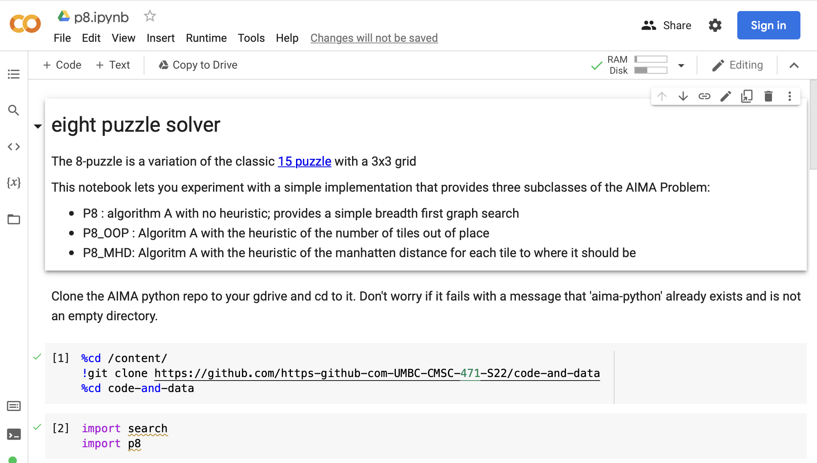
P8 Problem on Colab
See our collection of AI notebooks on Colab and the code and data in our repo
P8.ipynb which uses p8.py and search.py

Slide 12
Example
(python3.8) search_examples> python p8.py
142*35678 => *12345678 (5 steps from start)
heur. steps depth states succs EBF seconds
NIL 5 3 26 9 2.08 0.00023
OOP 5 3 12 4 1.59 0.00010
MHD 5 3 10 3 1.44 0.00013
25*148367 => *12345678 (10 steps from start)
heur. steps depth states succs EBF seconds
NIL 10 10 1166 420 1.83 0.04605
OOP 10 10 30 12 1.28 0.00031
MHD 10 10 25 10 1.26 0.00036
4*3275681 => *12345678 (15 steps from start)
heur. steps depth states succs EBF seconds
NIL 15 15 14386 5173 1.77 5.47145
OOP 15 15 761 283 1.46 0.02097
MHD 15 15 87 31 1.26 0.00115
64375182* => *12345678 (18 steps from start)
heur. steps depth states succs EBF seconds
NIL 18 18 48230 17402 1.72 60.17903
OOP 18 18 1775 659 1.43 0.11732
MHD 18 18 58 22 1.19 0.00086
4258361*7 => *12345678 (19 steps from start)
heur. steps depth states succs EBF seconds
NIL 19 19 78873 28567 1.72 159.10511
OOP 19 19 3906 1457 1.47 0.42174
MHD 19 19 499 185 1.32 0.01238

