Slide 1
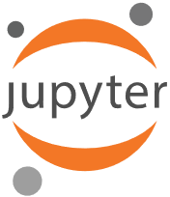
Python & Notebooks for AI

Slide 2
Why Python
Python has become the most popular programming language today by some metrics
It’s a great higher-level programming language
Easy to learn and use
Many interesting and powerful features
Large library of modules; easy to install
Drawbacks: slow (interpreted); few built-in datatypes (no arrays!), poor multiprocessing,…
Overcome by new modules implementing efficient data structures in C (e.g., Numpy)

Slide 3
Why Python for AI?
AI is currently undergoing a Cambrian explosion
New ideas appear every month and must be evaluated and explored rapidly to maintain an advantage or even keep up
Applies to companies, researchers, students
Python is great for rapid development
New neural network packages (e.g., TensorFlow, PyTorch) use efficient C modules for expensive computing parts, visualization, etc.

Slide 4
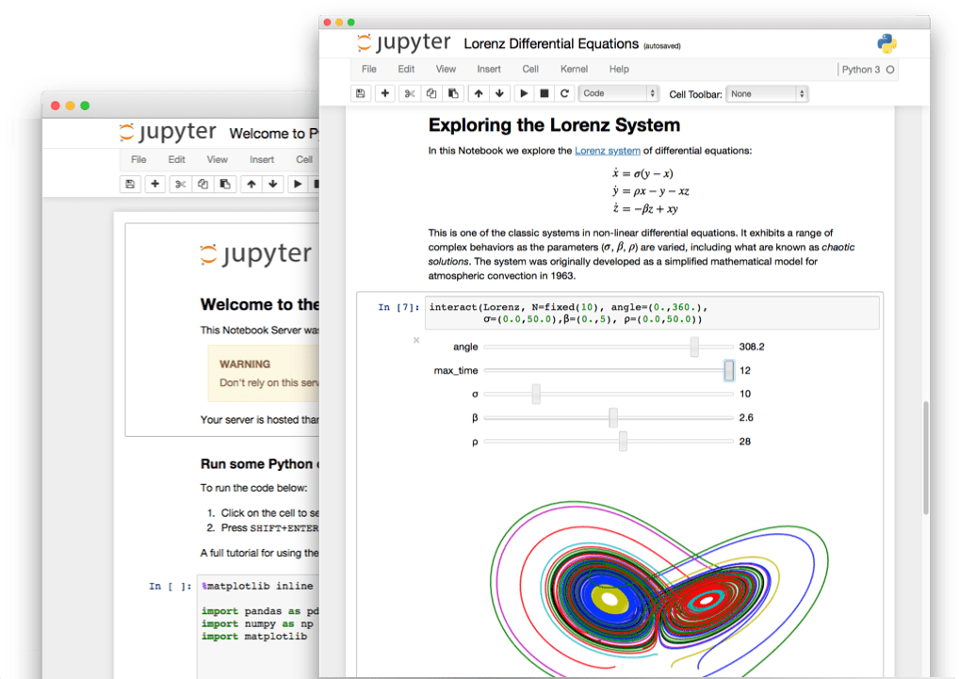
Jupyter Notebooks
Current Python notebook software, replacing iPython
Open source, browser- based application to create and share interactive documents with
Live Python code (also R, Julia, Scala, Bash, …)
Visualizations
Narrative Text
Also has a console window and file mover

Slide 5
Many ways to use…
Install on your computer
Pip install jupyter; cd to working directory; execute command “jupyter notebook”; visit browser
In your browser, access UMBC’s remote Jupyter server, https://jupyter.rs.umbc.edu/
Requires authorization and then logging in
Access Google’s free Colab server at https://colab.research.google.com/
Powerful, harder to work with your local files
Binder https://jupyter.org/binder is another free remote service

Slide 6
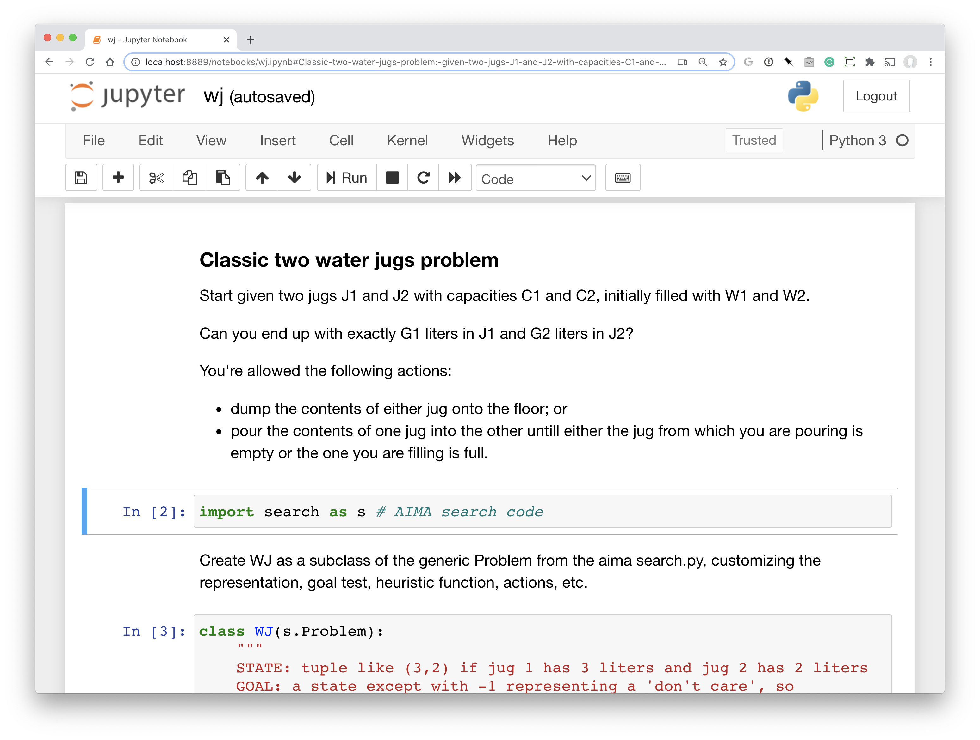
Let’s try it
Example: code to solve water jug problems with two jugs

