Slide 1

Uninformed Search
Some material adopted from notes by Charles R. Dyer, University of Wisconsin-Madison

Slide 2
Today’s topics
Goal-based agents
Representing states and actions
Example problems
Generic state-space search algorithm
Specific algorithms
  Breadth-first search
  Depth-first search
  Uniform cost search
  Depth-first iterative deepening
Example problems revisited

Slide 3
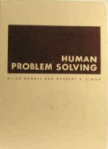
Big Idea
Allen Newell and Herb Simon developed
the problem space principle as an AI
approach in the late 60s/early 70s
"The rational activity in which people engage to solve a problem can be described in terms of (1) a set of states of knowledge, (2) operators for changing one state into another, (3) constraints on applying operators, and (4) control knowledge for deciding which operator to apply next."
Newell A & Simon H A. Human problem solving.
Englewood Cliffs, NJ: Prentice-Hall. 1972.

Slide 4
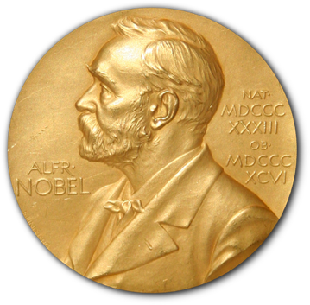
BTW
Herb Simon was a polymath who
contributed to economics, cognitive
science, management, computer science and many other fields
He was awarded a Nobel Prize in 1978 “for his pioneering research into the decision-making process within economic organizations”
He is the only computer scientist to have won a Nobel Prize, although it was for his work in economics

Slide 5
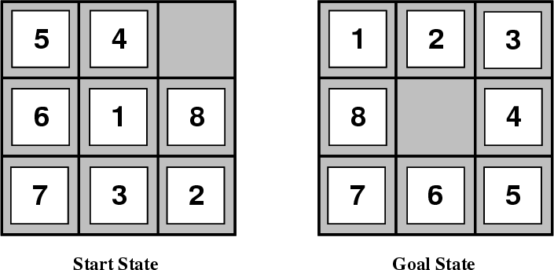
Example: 8-Puzzle
Given an initial configuration of 8 numbered tiles on a 3x3 board, move the tiles to produce a desired goal configuration

Slide 6
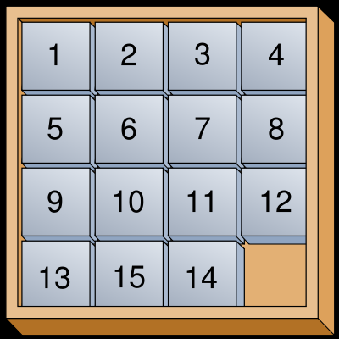
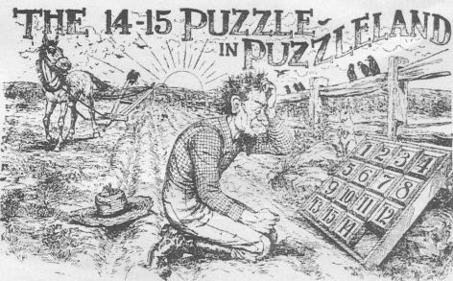
15 puzzle
Popularized, but not invented, by Sam Loyd
He offered $1000 to all who could solve it in 1896
He sold many puzzles
Its states form two
disjoint spaces
There was no path to solution from initial
state he gave!
Sam Loyd's 1914 illustration of the unsolvable variation

Slide 7
Simpler: 3-Puzzle
3
1
2
2
1
3
start
goal
3
3
2
3
2
3
2
2
1
2
1
1
1
1
3
start
1
2
2
2
3
1
3
1
3
goal

Slide 8

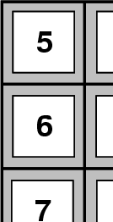
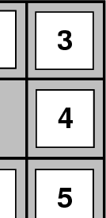
Building goal-based agents
We must answer the following questions
  How do we represent the state of the “world”?
  What is the goal and how can we recognize it?
  What are the possible actions?
  What relevant information do we encoded to describe states, actions and their effects and thereby solve the problem?
initial state
goal state

Slide 9
Characteristics of 8-puzzle ?
 | Fully observable? | Deterministic? | Episodic? | Static? | Discrete? | Single agent?
8-puzzle

Slide 10
Characteristics of 8-puzzle
 | Fully observable? | Deterministic? | Episodic? | Static? | Discrete? | Single agent?
8-puzzle | Yes | Yes | Yes | Yes | Yes | Yes
This is typical of the problems worked on in the 60s and 70s
And the algorithms for solving them a state-space search approach

Slide 11
Representing states
State of an 8-puzzle?

Slide 12
Representing states
State of an 8-puzzle?
A 3x3 array of integer in {0..8}
No integer appears twice
0 represents the empty space
In Python, we might implement this using a nine-character string: “540681732”
And write functions to map the 2D coordinates to a sting index

Slide 13

What’s the goal to be achieved?
Describe situation we want to achieve, a set of properties that we want to hold, etc.
Defining a goal test function that when applied to a state returns True or False
For our problem:
  def isGoal(state):
  # return True iff state is a goal
  return state == “123405678”

Slide 14

What are the actions?
Primitive actions for changing the state
  In a deterministic world: no uncertainty in an action’s effects (simple model)
Given action and description of current world state, action completely specifies
  Whether action can be applied to the current world (i.e., is it applicable and legal?) and
  What state results after action is performed in the current world (i.e., no need for history information to compute the next state)

Slide 15
Representing actions
Actions ideally considered as discrete events that occur at an instant of time
Example, in a planning context
  If state:inClass and perform action:goHome, then next state is state:atHome
  There’s no time where you’re neither in class nor at home (i.e., in the state of “going home”)

Slide 16
Representing actions
Actions for 8-puzzle?

Slide 17
Representing actions
Actions for 8-puzzle?
Number of actions/operators depends on the representation used in describing a state
  Specify 4 potential moves for each of the 8 tiles, resulting in a total of 4*8=32 actions
  Or, specify four potential moves for “blank” square and we only need 4 actions
A good representational can simplify a problem!

Slide 18

Representing states
Size of a problem usually described in terms of possible number of states
Examples*
  Tic-Tac-Toe has about 3⁹ states (19,683≈2*10⁴)
  Checkers has about 10⁴⁰ states
  Rubik’s Cube has about 10¹⁹ states
  Chess has about 10¹²⁰ states in a typical game
  Go has 2*10¹⁷⁰
State space size ≈ solution difficulty
* these are rough upper-bounds, of course

Slide 19
Representing states
Our estimates were loose upper bounds
How many possible, legal states does tic-tac-toe really have?
Simple upper bound: 9 board cells, each of which can be empty, O, or X: so 3⁹ or 19,683
Only 593 states remain after eliminating
  impossible states
  Rotations and reflections
X
X
X
X

Slide 20

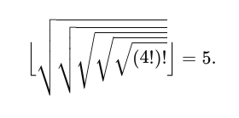
Can Problem spaces be infinite?
Yes, examples include theorem proving and this simple example from Knuth (1964)
Starting with the number 4, a sequence of square root, floor, and factorial operations can reach any desired positive integer
To get to 5 from 4, do
floor(sqrt (sqrt (sqrt (sqrt (sqrt (fact (fact 4)))))))

Slide 21
Infinitely hard to solve?
No
But you must be more careful in searching a space that may be infinite
Some approaches (e.g., breadth first search) may be better than others (e.g., depth first search)
  Depth first search can get lost exploring an infinite subspace

Slide 22
Some example problems
Toy problems and microworlds
  8-Puzzle
  Missionaries and Cannibals
  Cryptarithmetic
  Remove 5 Sticks
  Water Jug Problem
Real-world problems
We’ll look at a few

Slide 23
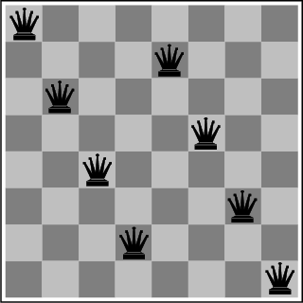
The 8-Queens Puzzle
Place eight queens on a chessboard such that no queen attacks any other
We can generalize the problem to a NxN chessboard
What are the states, goal test, actions?
Is this a solution?

Slide 24
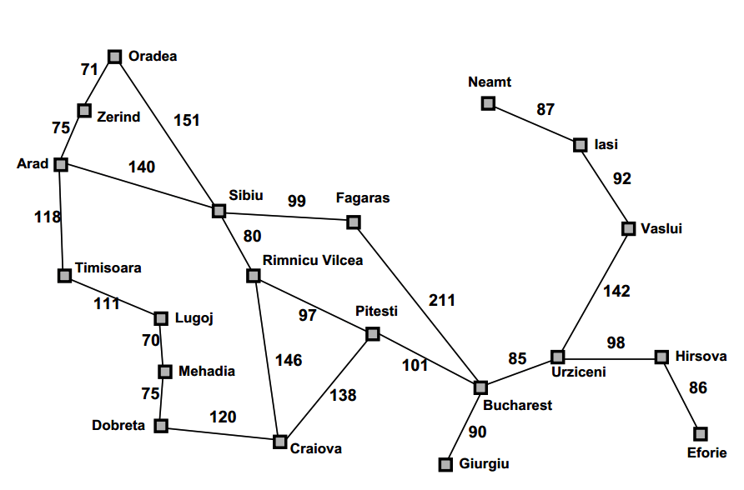
Route Planning
Find a route from Arad to Bucharest
distance from
Neamt to Iasi
A simplified map of major roads in Romania used in our text

Slide 25
Remove 5 Sticks
Given this configuration of sticks, remove exactly five sticks so that the remaining ones form exactly three squares
Other tasks:
Remove 4 sticks and leave 4 squares
Remove 3 sticks and leave 4 squares
Remove 4 sticks and leave 3 squares

Slide 26
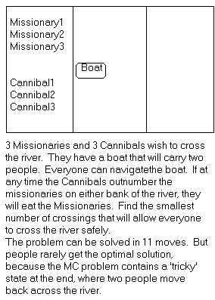
Missionaries and Cannibals
There are 3 missionaries, 3 canni-bals, and 1 boat that can carry up to two people on one side of a river
  Goal: Move all the missionaries and cannibals across the river
  Constraint: Missionaries can’t be out-numbered by cannibals on either side of river, or the missionaries are killed
  State: configuration of missionaries and cannibals and boat on each side of river
  Operators: Move boat containing some set of occupants across the river (in either direction) to the other side
What are the states, goal test, actions?

Slide 27
Missionaries and Cannibals Solution
Near side Far side
0 Initial setup: MMMCCC B -
1 Two cannibals cross over: MMMC B CC
2 One comes back: MMMCC B C
3 Two cannibals go over again: MMM B CCC
4 One comes back: MMMC B CC
5 Two missionaries cross: MC B MMCC
6 A missionary & cannibal return: MMCC B MC
7 Two missionaries cross again: CC B MMMC
8 A cannibal returns: CCC B MMM
9 Two cannibals cross: C B MMMCC
10 One returns: CC B MMMC
11 And brings over the third: - B MMMCCC

Slide 28
Cryptarithmetic
Find an assignment of digits (0..9) to letters so that a given arithmetic expression is true. Examples:
SEND + MORE = MONEY and
    FORTY Solution: 29786
    + TEN 850
    + TEN 850
    ----- -----
    SIXTY 31486
    F=2, O=9, R=7, etc.
The solution is NOT a sequence of actions that transforms the initial state into the goal state
Solution is a node with an assignment of digits to each of the distinct letters in the given problem
What are the states, goal test, actions?

Slide 29
Some more real-world problems
Touring (traveling salesman)
Logistics
VLSI layout
Robot navigation
Theorem proving
Learning

Slide 30
Knowledge representation issues
What’s in a state?
  Is boat color relevant to solving the M&C problem? Is sunspot activity relevant to predicting the stock market? This a hard problem that’s usually left to a person.
The right level of abstraction to describe the world
  Too fine-grained and we’ll “miss the forest for the trees.” Too coarse-grained and we’ll miss critical details for solving the problem.
Number of states depends on the representation and abstraction level. E.g., for Remove-5-Sticks
  Represent individual sticks, there are 17-choose-5 possible ways of removing 5 sticks
  Represent the “squares” defined by 4 sticks, there are 6 squares initially and we must remove 3 squares, so only 6-choose-3 ways of removing 3 squares

Slide 31


Water Jug Problem
Two jugs J1 & J2 with capacity C1 & C2
Initially J1 has W1 water and J2 has W2 water
  e.g.: full 5-gallon jug and empty 2-gallon jug
Possible actions:
  Pour from jug X to jug Y until X empty or Y full
  Empty jug X onto the floor
Goal: J1 has G1 water and J2 G2
  G1 or G2 can be -1 to represent any amount
E.g.: initially full jugs with capacities 3 and 1 liters, goal is to have 1 liter in each

Slide 32
So…
🤔
How can we represent the states?
What’s an initial state; how to recognize goal states
What are the actions; how to tell which can be done in a given state; what’s the resulting state
How do we search for a solution from an initial state any goal state
What is a solution, e.g.:
  The goal state achieved, or
  The path (i.e., sequence of actions) taking us from the initial state to a goal state?

Slide 33
Search in a state space
Basic idea:
  Create representation of initial state
  Try all possible actions & connect states that result
  Recursively apply process to the new states until we find a solution or are left with dead ends
We need to keep track of the connections between states and might use a
  Tree data structure or
  Graph data structure
A graph structure is best in general…

Slide 34


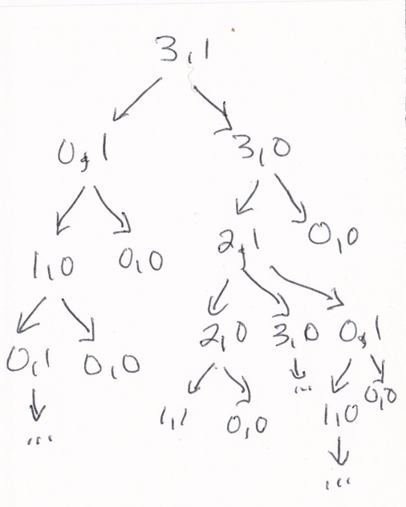
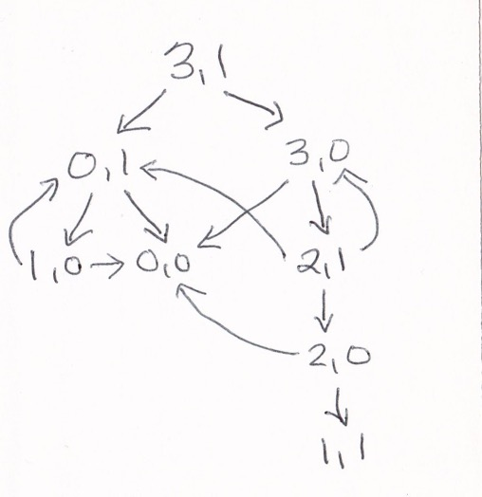
Search in a state space
Consider a water jug problem with a 3-liter and 1-liter jug, an initial state of (3,1) and a goal stage of (1,1)
Tree model of space
Graph model of space
graph model avoids redundancy and loops and is usually preferred

Slide 35
Formalizing state space search
A state space is a graph (V, E) where V is a set of nodes and E is a set of arcs, and each arc is directed from a node to another node
Nodes: data structures with state description and other info, e.g., node’s parent, name of action that generated it from parent, etc.
Arcs: instances of actions, head is a state, tail is the state that results from action, label on arc is action’s name or id

Slide 36
Formalizing search in a state space
Each arc has fixed, positive cost associated with it corresponding to the action cost
  Simple case: all costs are 1
Each node has a set of successor nodes produced by trying all legal actions that can be applied at node’s state
  Expanding a node = generating its successor nodes and adding them and their associated arcs to the graph
One or more nodes are marked as start nodes
A goal test is applied to a state to determine if its associated node is a goal node

Slide 37
Example: Water Jug Problem
5
2
Two jugs J1 and J2 with capacity C1 and C2
Initially J1 has W1 water and J2 has W2 water
  e.g.: a full 5-gallon jug and an empty 2-gallon jug
Possible actions:
  Pour from jug X to jug Y until X empty or Y full
  Empty jug X onto the floor
Goal: J1 has G1 water and J2 G2
  G1 or G0 can be -1 to represent any amount

Slide 38

This is not a toy problem!
Clip from the 1995 film Die Hard with a Vengeance

Slide 39
Example: Water Jug Problem
5
2
Given full 5-gal. jug and empty 2-gal. jug, fill 2-gal jug with one gallon
State representation?
  General state?
  Initial state?
  Goal state?
Possible actions?
  Condition?
  Resulting state?
Action table
Name | Cond. | Transition | Effect
Empty5 |  | (x,y)→(0,y) | Empty 5G jug
Empty2 |  | (x,y)→(x,0) | Empty 2G jug
2to5 | x ≤ 3 | (x,2)→(x+2,0) | Pour 2G into 5G
5to2 | x ≥ 2 | (x,0)→(x-2,2) | Pour 5G into 2G
5to2part | y < 2 | (1,y)→(0,y+1) | Pour partial 5G into 2G

Slide 40
Example: Water Jug Problem
5
2
Given full 5-gal. jug and empty 2-gal. jug, fill 2-gal jug with one gallon
State = (x,y), where x is water in jug 1; y is water in jug 2
Initial State = (5,0)
Goal State = (-1,1), where -1 means any amount
Action table
Name | Cond. | Transition | Effect
dump1 | x>0 | (x,y)→(0,y) | Empty Jug 1
dump2 | y>0 | (x,y)→(x,0) | Empty Jug 2
pour_1_2 | x>0 & y<C2 | (x,y)→(x-D,y+D) D = min(x,C2-y) | Pour from Jug 1 to Jug 2
pour_2_1 | y>0 & X<C1 | (x,y)→(x+D,y-D) D = min(y,C1-x) | Pour from Jug 2 to Jug 1

Slide 41
Water jug state space
5, 2
5, 1
5, 0
Empty5
4, 2
4, 1
4, 0
Empty2
3, 2
3, 1
3, 0
2to5
2, 2
2, 1
2, 0
5to2
1, 2
1, 1
1, 0
5to2part
0, 2
0, 1
0, 0

Slide 42
Water jug solution
5, 2
5, 1
5, 0
4, 2
4, 1
4, 0
3, 2
3, 1
3, 0
2, 2
2, 1
2, 0
1, 2
1, 1
1, 0
0, 2
0, 1
0, 0

Slide 43
Class Exercise
Representing a 2x2 Sudoku puzzle as a search space
Fill in the grid so that every row, every column, and every 2x2 box contains the digits 1 through 4
  What are the states?
  What are the actions?
  What are the constraints
  on actions?
  What is the description
  of the goal state?
 | 3
 |  |  | 1
3
 |  | 2

Slide 44
Formalizing search
Solution: sequence of actions associated with a path from a start node to a goal node
Solution cost: sum of the arc costs on the solution path
  If all arcs have same (unit) cost, then solution cost is length of solution (number of steps)
  Algorithms generally require that arc costs cannot be negative (why?)

Slide 45
Formalizing search
State-space search: searching through state space for solution by making explicit a portion of an implicit state-space graph to find a goal node
  Can’t materializing whole space for large problems
  Initially V={S}, where S is the start node, E={}
  On expanding S, its successor nodes are generated and added to V and associated arcs added to E
  Process continues until a goal node is found
Nodes represent a partial solution path (+ cost of partial solution path) from S to the node
  From a node there may be many possible paths (and thus solutions) with this partial path as a prefix

Slide 46
State-space search algorithm
;; problem describes the start state, operators, goal test, and operator costs
;; queueing-function is a comparator function that ranks two states
;; general-search returns either a goal node or failure
function general-search (problem, QUEUEING-FUNCTION)
nodes = MAKE-QUEUE(MAKE-NODE(problem.INITIAL-STATE))
loop
if EMPTY(nodes) then return "failure"
node = REMOVE-FRONT(nodes)
if problem.GOAL-TEST(node.STATE) succeeds
then return node
nodes = QUEUEING-FUNCTION(nodes, EXPAND(node,
problem.OPERATORS))
end
;; Note: The goal test is NOT done when nodes are generated
;; Note: This algorithm does not detect loops

Slide 47
Key procedures to be defined
EXPAND
  Generate a node’s successor nodes, adding them to the graph if not already there
GOAL-TEST
  Test if state satisfies all goal conditions
QUEUEING-FUNCTION
  Maintain ranked list of nodes that are candidates for expansion
  Changing definition of the QUEUEING-FUNCTION leads to different search strategies: Which node to expand next

Slide 48
Bookkeeping
Typical node data structure includes:
State at this node
Parent node(s)
Action(s) applied to get to this node
Depth of this node (# of actions on shortest known path from initial state)
Cost of path (sum of action costs on best path from initialstate)

Slide 49
Some issues
Search process constructs a search tree/graph where
  root is initial state and
  leaf nodes are nodes
    not yet expanded (i.e., in list “nodes”) or
    having no successors (i.e., they’re deadends because no operators were applicable and yet they are not goals)
Search tree may be infinite due to loops; even graph may be infinite for some problems
Solution is a path or a node, depending on problem.
  E.g., in cryptarithmetic return a node; in 8-puzzle, a path
Changing definition of the QUEUEING-FUNCTION leads to different search strategies

Slide 50
Informed vs. uninformed search
Uninformed search strategies (blind search)
  Use no information about likely direction of a goal
  Methods: breadth-first, depth-first, depth-limited, uniform-cost, depth-first iterative deepening, bidirectional
Informed search strategies (heuristic search)
  Use information about domain to (try to) (usually) head in the general direction of goal node(s)
  Methods: hill climbing, best-first, greedy search, beam search, algorithm A, algorithm A*
Notes:
Heuristic = “rule of athumb”

Slide 51
Evaluating search strategies
Completeness
  Guarantees finding a solution whenever one exists
Time complexity (worst or average case)
  Usually measured by number of nodes expanded
Space complexity
  Usually measured by maximum size of graph/tree during the search
Optimality (aka Admissibility)
  If a solution is found, is it guaranteed to be an optimal one, i.e., one with minimum cost

Slide 52
Classic uninformed search methods
The four classic uninformed search methods
  Breadth first search (BFS)
  Depth first search (DFS)
  Uniform cost search (generalization of BFS)
  Iterative deepening (blend of DFS and BFS)
To which we can add another technique
  Bi-directional search (hack on BFS)

Slide 53
Example of uninformed search strategies
S
3
8
1
A
B
C
3
15
7
20
5
D
E
G
Consider this search space where S is the start node, G is the goal, and numbers are arc costs
assume graph is not known in advance

Slide 54
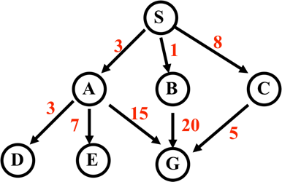
Breadth-First Search
ignore weights on arcs
Expanded node Nodes list (aka Fringe)
{ S⁰ }
S⁰ { A³ B¹ C⁸ }
A³ { B¹ C⁸ D⁶ E¹⁰ G¹⁸ }
B¹ { C⁸ D⁶ E¹⁰ G¹⁸ G²¹ }
C⁸ { D⁶ E¹⁰ G¹⁸ G²¹ G¹³ }
D⁶ { E¹⁰ G¹⁸ G²¹ G¹³ }
E¹⁰ { G¹⁸ G²¹ G¹³ }
G¹⁸ { G²¹ G¹³ }
Typically, don’t check if node is goal until we expand it (why?)
Solution path found is S A G , steps = 2
# nodes expanded (including goal node) = 7
FIFO (queue)
Notation
G¹⁸
G is node; 18 is cost of shortest known path from S

Slide 55
Breadth-First Search (BFS)
- Long time to find solutions with many steps: we must look at all shorter length possibilities first
    Complete tree of depth d where nodes have b children has 1+b+b²+...+b^{d} = (b^{(d+1)}-1)/(b-1) nodes = 0(b^{d})
    Tree with depth 12 & branching 10 > trillion nodes
    If BFS expands 1000 nodes/sec and nodes uses 100 bytes, can take 35 years & uses 111TB of memory!
+ Always finds solution if one exists
+ Solution found is optimal
i.e., guaranteed to be the shortest

Slide 56
Breadth-First Search
Enqueue nodes in FIFO (first-in, first-out) order
Complete
Optimal (i.e., admissible) finds shorted path, which is optimal if all operators have same cost
Exponential time and space complexity, O(b^{d}), where d is depth of solution; b is branching factor (i.e., # of children)
Long time to find long solutions since we explore all shorter length possibilities first

Slide 57
Depth-First Search
Expanded node Nodes list (aka fringe)
{ S⁰ }
S⁰ { A³ B¹ C⁸ }
A³ { D⁶ E¹⁰ G¹⁸ B¹ C⁸ }
D⁶ { E¹⁰ G¹⁸ B¹ C⁸ }
E¹⁰ { G¹⁸ B¹ C⁸ }
G¹⁸ { B¹ C⁸ }
Solution path found is S A G, cost 18
Number of nodes expanded (including goal node) = 5
LIFO (stack)

Slide 58
Depth-First (DFS)
Enqueue nodes on nodes in LIFO (last-in, first-out) order, i.e., use stack data structure to order nodes
May not terminate w/o depth bound, i.e., ending search below fixed depth D (depth-limited search)
Not complete (with or w/o cycle detection, with or w/o a cutoff depth)
Exponential time, O(b^{d}), but linear space, O(bd)
Can find long solutions quickly if lucky (and short solutions slowly if unlucky!)
On reaching dead-end, can only back up one level at a time even if problem occurs because of a bad choice at top of tree

Slide 59
Uniform-Cost Search (UCS)
Enqueue nodes by path cost, i.e., cost of path from start to current node n. Sort nodes by increasing value.
Aka Dijkstra’s Algorithm, similar to Branch and Bound Algorithm from operations research
Complete (*)
Optimal/Admissible (*)
  Depends on goal test being applied when node is removed from nodes list, not when its parent node is expanded & node first generated
Exponential time and space complexity, O(b^{d})

Slide 60
Uniform-Cost Search
Expanded node Nodes list
{ S⁰ }
S⁰ { B¹ A³ C⁸ }
B¹ { A³ C⁸ G²¹ }
A³ { D⁶ C⁸ E¹⁰ G¹⁸ G²¹ }
D⁶ { C⁸ E¹⁰ G¹⁸ G²¹ }
C⁸ { E¹⁰ G¹³ G¹⁸ G²¹ }
E¹⁰ { G¹³ G¹⁸ G²¹ }
G¹³ { G¹⁸ G²¹ }
Solution path found is S C G, cost 13
Number of nodes expanded (including goal node) = 7
priority queue

Slide 61
Depth-First Iterative Deepening (DFID)
Do DFS to depth 0, then (if no solution) DFS to depth 1, etc.
Often used with a tree search
Complete
Optimal/Admissible if all operators have unit cost, else finds shortest solution (like BFS)
Time complexity a bit worse than BFS or DFS
  Nodes near top of search tree generated many times, but since almost all nodes are near bottom, worst case time complexity still exponential, O(b^{d})
Space complexity linear, like DFS

Slide 62
Depth-First Iterative Deepening (DFID)
If branching factor is b and solution is at depth d, then nodes at depth d are generated once, nodes at depth d-1 are generated twice, etc.
  Hence b^{d} + 2b^{(d-1)} + ... + db <= b^{d} / (1 - 1/b)² = O(b^{d}).
  If b=4, worst case is 1.78 * 4^{d}, i.e., 78% more nodes searched than exist at depth d (in worst case)
Linear space complexity, O(bd), like DFS
Has advantages of BFS (completeness) and DFS (i.e., limited space, finds longer paths quickly)
Preferred for large state spaces where solution depth is unknown

Slide 63
How they perform
Depth-First Search:
  4 Expanded nodes: S A D E G
  Solution found: S A G (cost 18)
Breadth-First Search:
  7 Expanded nodes: S A B C D E G
  Solution found: S A G (cost 18)
Uniform-Cost Search:
  7 Expanded nodes: S A D B C E G
  Solution found: S C G (cost 13)
  Only uninformed search that worries about costs
Iterative-Deepening Search:
  10 nodes expanded: S S A B C S A D E G
  Solution found: S A G (cost 18)

Slide 64
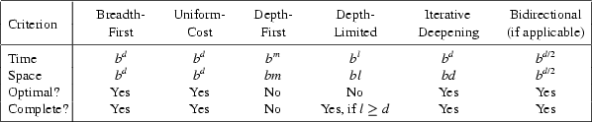
Comparing Search Strategies

Slide 65
Searching Backward from Goal
Usually, a successor function is reversible
  i.e., can generate a node’s predecessors in graph
If we know a single goal (rather than a goal’s properties), we could search backward to the initial state
It might be more efficient
  Depends on whether the graph fans in or fans out

Slide 66
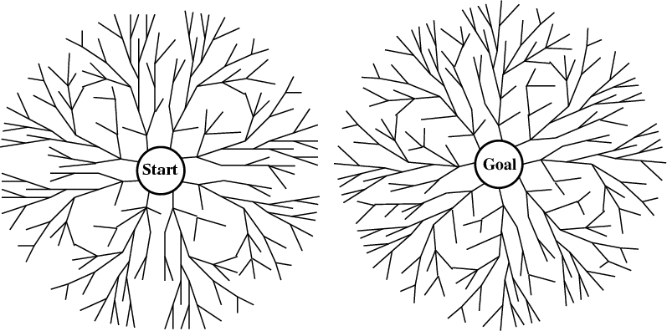
Bi-directional search
Alternate searching from the start state toward the goal and from the goal state toward the start
Stop when the frontiers intersect
Works well only when there are unique start & goal states
Requires ability to generate “predecessor” states
Can (sometimes) lead to finding a solution more quickly

Slide 67
Some simple improvements
In increasing order of effectiveness w.r.t. reducing state space size and with increasing computational costs:
  1. Never return to state you just came from
  2. Never create paths with cycles in them
  3. Never generate a state that was ever created before
Net effect depends on frequency of loops in state space

Slide 68
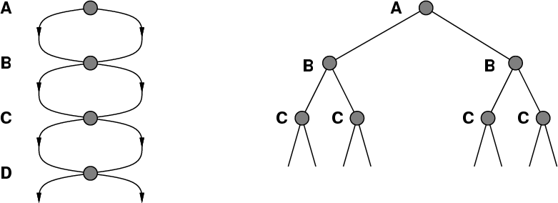
A State Space that Generates an
Exponentially Growing Search Space

Slide 69
Holy Grail Search
Expanded node Nodes list
{ S⁰ }
S⁰ {C⁸ A³ B¹ }
C⁸ { G¹³ A³ B¹ }
G¹³ { A³ B¹ }
Solution path found is S C G, cost 13 (optimal)
Number of nodes expanded (including goal node) = 3
(as few as possible!)
If only we knew where we were headed…

Slide 70
Summary
Search in a problem space is at the heart of many AI systems
Formalizing the search in terms of states, actions, and goals is key
The simple “uninformed” algorithms we examined can be augmented to heuristics to improve them in various ways
But for some problems, a simple algorithm is best

