Slide 1
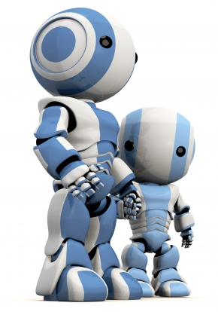
Intelligent Agents
Chapter 2

Slide 2
Agents and AI
Much of our text is organized around the concept of autonomous agents
It defines an agent as
anything that can be viewed as perceiving its environment through sensors and acting upon that environment through actuators
Not all AI problems or tasks need or fit this concept, but it’s quite general
We’ll explore the concept today

Slide 3
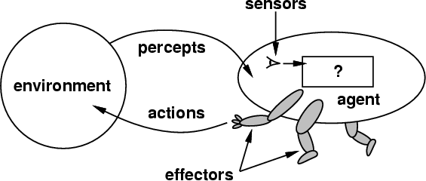
How do you design an intelligent agent?
Intelligent agents perceive environment via sensors and act rationally on them with their effectors
Discrete agents receive percepts one at a time, and map them to a sequence of discrete actions
General properties
Reactive to the environment
Pro-active or goal-directed
Interacts with other agents through communication or via the environment
Autonomous

Slide 4
sensors/percepts and effectors/actions ?
Humans have
Sensors: Eyes (vision), ears (hearing), skin (touch), tongue (gustation), nose (olfaction), neuromuscular system (proprioception)
Percepts: things that are perceived
lowest level: electrical signals from these sensors
After processing: objects in visual field (location, textures, colors, …), auditory streams (pitch, loudness, direction), …
Effectors: limbs, digits, eyes, tongue, …
Actions: lift finger, turn left, walk, run, carry an object, …
Note: percepts and actions need to be carefully defined, possibly at different levels of abstraction

Slide 5
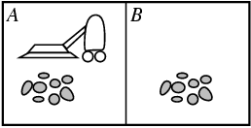
Example: simple vacuum agent
Agent / Robot
iRobot Corporation
Percepts: location and contents, e.g., [A, Dirty]
Actions: Left, Right, Suck, NoOp
Founder Rodney Brooks (MIT)

Slide 6
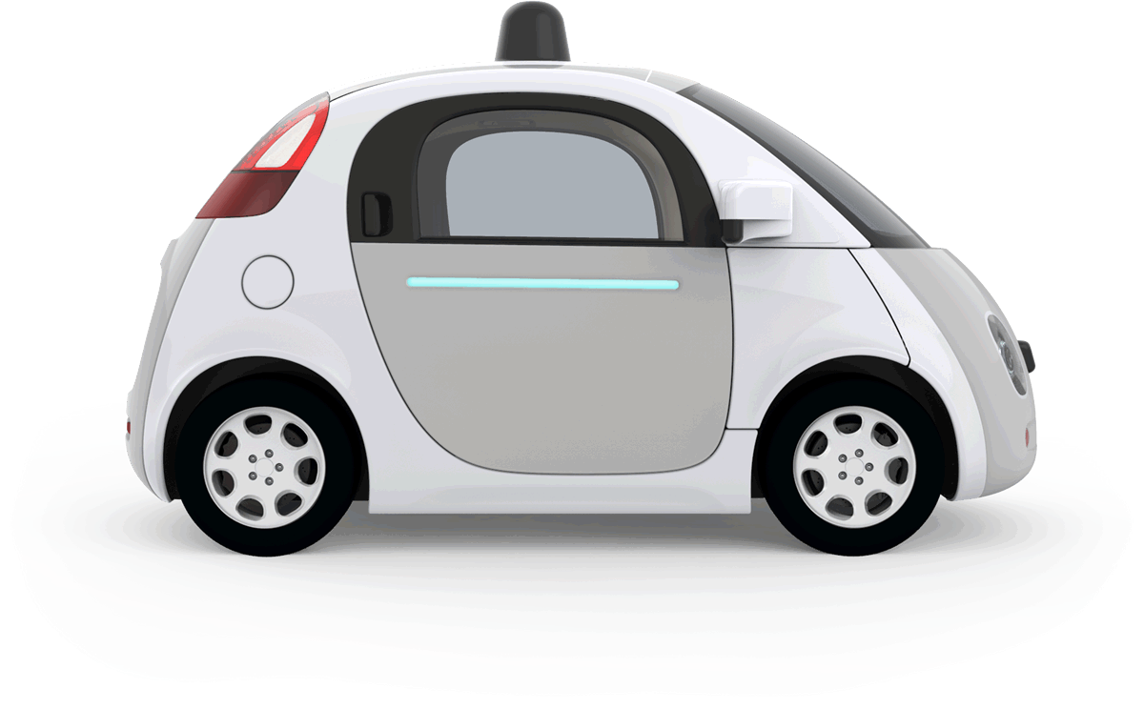
Example: autonomous taxi
Percepts: Video, sonar, speedometer, odometer, engine sensors, keyboard input, microphone, GPS, …
Actions: Steer, accelerate, brake, horn, speak, …
Goals: Maintain safety, reach destination, maximize profits (fuel, tire wear), obey laws, provide passenger comfort, …
Environment: U.S. urban streets, freeways, traffic, pedestrians, weather, customers, …
Different aspects of driving may require different types of agent programs!

Slide 7
Rationality
Ideal rational agents should, for each input, act to maximize expected performance measure based on
(1) percept sequence, and
(2) built-in and acquired knowledge
Rationality → Need a performance measure to say how well a task has been achieved
Types of performance measures: false alarm (false positive) & false dismissal (false negative) rates, speed, resources required, effect on environment, money earned, …
Notes:
False positives and negative typically occur in classification systems.
A airport TSA checkpoint wants to classify a bag as containing something dangerous or not.
False positive: we thought the bad was dangerous, but its not
False negative: we thought the bag wads not dangerous, but it was!
Consider measuring the performance of a airport TSA check point: its more important to minimize false negatives than false positives
When choosing a mate, it might be reversed

Slide 8
Omniscience and learning
Rational agents aren’t expected to know everything
But to use what they do know effectively
Rationality includes information gathering -- If you don’t know something that might be useful, find out!
Rationality also can exploit learning – making generalization from past experience to fill in missing information

Slide 9
Autonomy
A system is autonomous to extent that its behavior is determined by its experience
A system isn’t autonomous if guided by its designer according to a priori decisions
An autonomous agent can always say “no”
To be effective, agents must have:
Enough built-in knowledge to perform minimally
Ability to learn, to maintain or improve its performance

Slide 10
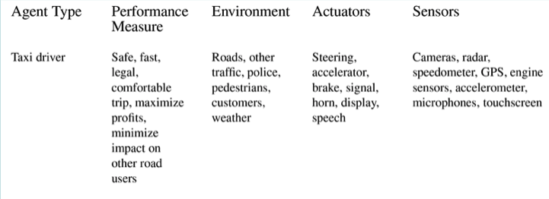
PEAS model: Taxi Agent
Performance, Environment, Actuators, Sensors
Example of an autonomous taxi

Slide 11
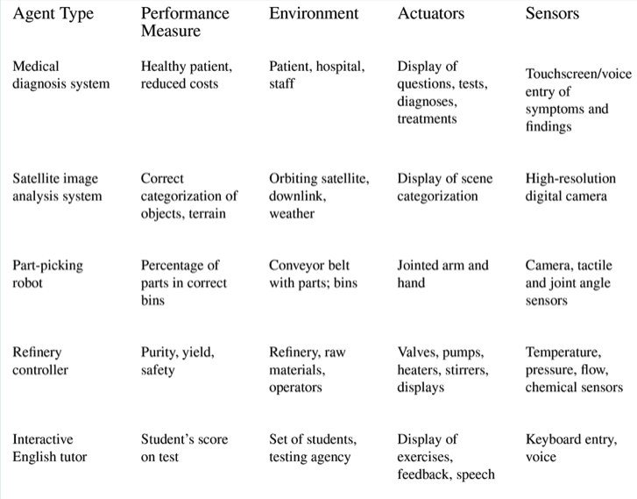
PEAS model: Other Agents
Note: agents need not be physical: 3 of the 5 are not

Slide 12
Some agent types
(0) Table-driven agents
Use percept sequence/action table to find next action. Implemented by a lookup table
(1) Simple reflex agents
Based on condition-action rules, stateless devices with no memory of past world states
(2) Agents with memory
have represent states and keep track of past world states
(3) Agents with goals
Have a state and goal information describing desirable situations; can take future events into consideration
(4) Utility-based agents
base decisions on utility theory in order to act rationally
(5) Learning agents
base decisions on models learned and updated through experience
simple
complex

Slide 13
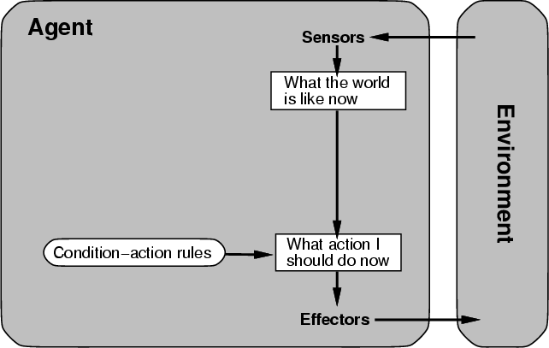
(0/1) Table-driven/reflex agent architecture
Use percept sequence/action table to find the next action. Implemented by a (large) lookup table

Slide 14
(0) Table-driven agents
Table lookup of percept-action pairs mapping from every possible perceived state to optimal action for it
Problems:
Table may be too big to generate and to store (e.g., chess has about 10¹²⁰ states)
No knowledge of non-perceptual parts of the current state (e.g., desirability of states)
Not adaptive to changes in the environment; entire table must be updated if changes occur
Looping: Can’t make actions conditional on previous actions/states

Slide 15
(1) Simple reflex agents
Rule-based reasoning maps percepts to optimal action; each rule handles collection of perceived states (aka reactive agents)
Problems remain
Usually too big to generate and to store
No knowledge of non-perceptual parts of state
Not adaptive to changes in environment; collection of rules must be updated if changes occur
Can’t condition actions on previous state
Difficult to engineer if number of rules large due to conflicts

Slide 16
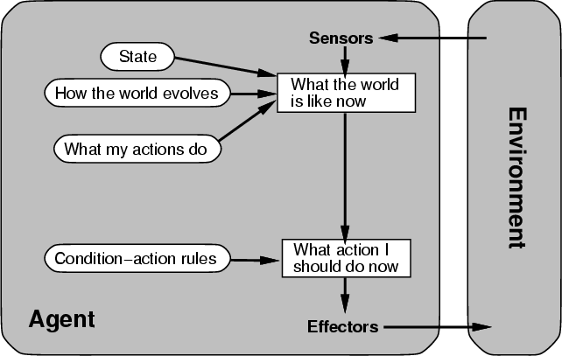
(2) Architecture for an agent with memory
internal state keeps track of past states of the world

Slide 17
(2) Agents with memory
Encode internal state of world to remember past as modeled by earlier percepts
Sensors often don’t give entire world state at each input, so environment captured over time
State can encode different "world states" that generate the same immediate percept
Requires representing change in the world
Might represent just latest state, but then can’t reason about hypothetical courses of action

Slide 18
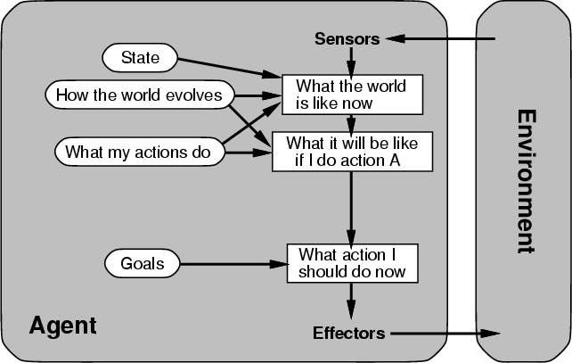
(3) Architecture for goal-based agent
state and goal information describe desirable situations allowing agent to take future events into consideration

Slide 19
(3) Goal-based agents
Deliberative instead of reactive
Choose actions to achieve a goal
Goal: description of a desirable situation
Keeping track of current state often not enough; add goals to decide which situations are good
Achieving goal may require an action sequence
Model action consequences: “what if I do...?”
Use planning algorithms to produce action sequences

Slide 20
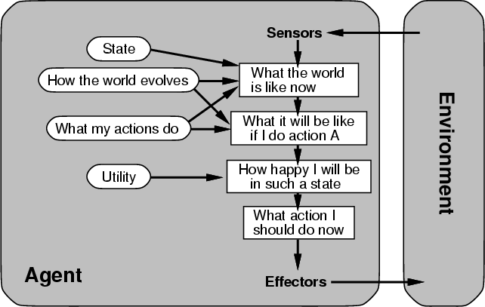
(4) complete utility-based agent
base decisions on utility theory in order to act rationally

Slide 21
(4) Utility-based agents
For multiple possible alternatives, how to decide which is best?
Goals give distinction between good/bad states, but often need a measure for degree
Utility function U: State→Reals gives measure of success/happiness for given state
Allows decisions comparing choices between conflicting goals and likelihood of success and importance of goal (if achievement uncertain)

Slide 22
(5) Learning agent
“Quick turn is not safe”
No quick turn
Road conditions, etc
Takes percepts
and selects actions
Try out the brakes on
different road surfaces
More complicated when agent must learn utility information, e.g., via reinforcement learning based on action payoff

Slide 23
Problem Environments
Characteristics of the problem environment have a big impact on an agent’s requirements
Consider developing an agent to
Solve a crossword puzzle, vs.
Drive a taxi
Identifying some general problem characteristics helps us understand it and possible approaches to solving it

Slide 24
Properties of Environments (1)
Fully/Partially observable
Agent’s sensors give complete state of environment needed to choose action: environment is fully observable
Such environments are convenient, freeing agents from keeping track of the environment’s changes
Deterministic/Stochastic
Environment is deterministic if next state is completely determined by current state and agent’s action
Stochastic (i.e., non-deterministic) environments have multiple, unpredictable outcomes
In fully observable, deterministic environments agents need not deal with uncertainty

Slide 25
Properties of Environments (2)
Episodic/Sequential
In episodic environments subsequent episodes don’t depend on actions in previous episodes
In sequential environments agent engages in a series of connected episodes
Episodic environments don’t require agent to plan ahead
Static/Dynamic
Static environments don’t change as agent is thinking
The passage of time as agent deliberates is irrelevant
The agent needn’t observe world during deliberation

Slide 26
Properties of Environments (3)
Discrete/Continuous
If number of distinct percepts and actions is limited, environment is discrete, otherwise it’s continuous
Single agent/Multiagent
In environments with other agents, agent must consider strategic, game-theoretic aspects, for either cooperative or competitive agents
Most engineering environments don’t have multiagent properties, whereas most social and economic systems get their complexity from interactions of (more or less) rational agents

Slide 27
Characteristics of environments
 | Fully observable? | Deterministic? | Episodic? | Static? | Discrete? | Single agent?
Solitaire
Backgammon
Taxi driving
Internet shopping
Medical diagnosis
A Yes in a cell means that aspect is simpler; a No more complex

Slide 28
Characteristics of environments
 | Fully observable | Deterministic | Episodic | Static | Discrete? | Single agent?
Solitaire | No | Yes | Yes | Yes | Yes | Yes
Backgammon
Taxi driving
Internet shopping
Medical diagnosis
A Yes in a cell means that aspect is simpler; a No more complex

Slide 29
Characteristics of environments
 | Fully observable? | Deterministic? | Episodic? | Static? | Discrete? | Single agent?
Solitaire | No | Yes | Yes | Yes | Yes | Yes
Backgammon | Yes | No | ? | Yes | Yes | No
Taxi driving
Internet shopping
Medical diagnosis
A Yes in a cell means that aspect is simpler; a No more complex

Slide 30
Characteristics of environments
 | Fully observable? | Deterministic? | Episodic? | Static? | Discrete? | Single agent?
Solitaire | No | Yes | Yes | Yes | Yes | Yes
Backgammon | Yes | No | ? | Yes | Yes | No
Taxi driving | No | No | No? | No | No | No
Internet shopping
Medical diagnosis
A Yes in a cell means that aspect is simpler; a No more complex

Slide 31
Characteristics of environments
 | Fully observable? | Deterministic? | Episodic? | Static? | Discrete? | Single agent?
Solitaire | No | Yes | Yes | Yes | Yes | Yes
Backgammon | Yes | No | ? | Yes | Yes | No
Taxi driving | No | No | No? | No | No | No
Internet shopping | No | No | No | No | Yes | No
Medical diagnosis
A Yes in a cell means that aspect is simpler; a No more complex

Slide 32
Characteristics of environments
→ Lots of real-world domains fall into the hardest case!
 | Fully observable? | Deterministic? | Episodic? | Static? | Discrete? | Single agent?
Solitaire | No | Yes | Yes | Yes | Yes | Yes
Backgammon | Yes | No | ? | Yes | Yes | No
Taxi driving | No | No | No? | No | No | No
Internet shopping | No | No | No | No | Yes | No
Medical diagnosis | No | No | No | No | No | Yes
A Yes in a cell means that aspect is simpler; a No more complex

Slide 33
Summary
Agents perceive and act in an environment, have an architecture and are implemented by an agent program
Ideal agents choses actions to maximize their expected performance, given percept sequence so far
Autonomous agents use own experience rather than built-in knowledge of environ-ment by designer

Slide 34
Summary
Agent programs map percepts to actions and update their internal state
Reflex agents respond immediately to percepts
Goal-based agents act to achieve their goal(s)
Utility-based agents maximize their utility function
Representing knowledge is important for good agent design
Challenging environments are partially observable, stochastic, sequential, dynamic, and continuous and contain multiple agents

Slide 35
Summary
Not all AI problems a good fit for or require a full agent model, e.g., playing solitaire
Nor are many AI tasks you might need to solve:
Classify movie reviews as negative, neutral or positive
Locate faces of people in an image
Use an efficient theorem prover
Learn preferred thermostat settings for each hour of each day of a week

