Slide 1
What is AI?
CMSC 471 Introduction
Tim Finin, finin@umbc.edu

Slide 2
What is AI?
Q. What is artificial intelligence?
A. It is the science and engineering of making intelligent machines, especially intelligent computer programs. It is related to the similar task of using computers to understand human intelligence, but AI does not have to confine itself to methods that are biologically observable.
John McCarthy
http://www-formal.stanford.edu/jmc/whatisai/

Slide 3
Ok, so what is intelligence?
Q. Yes, but what is intelligence?
A. Intelligence is the computational part of the ability to achieve goals in the world. Varying kinds and degrees of intelligence occur in people, many animals and some machines.
http://www-formal.stanford.edu/jmc/whatisai/

Slide 4

Big questions
Can machines think?
Must/should they think like humans do?
Can they learn from their experience?
Can they have common sense?
If so, how? If not, why not?
What does this say about human beings?
What does this say about the mind?

Slide 5
A little bit of
AI history

Slide 6
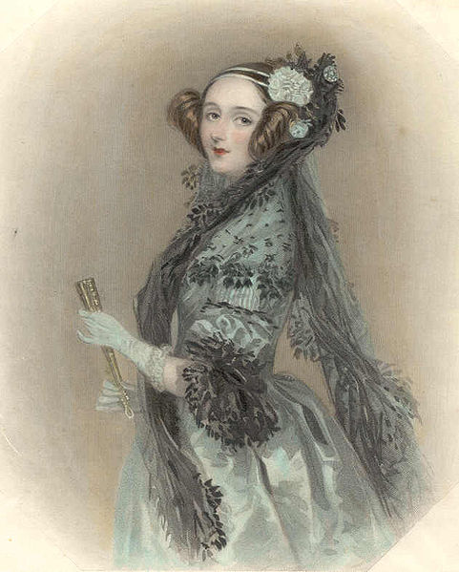
Ada Lovelace
Babbage thought his machine was just
a number cruncher
Ada Lovelace saw that numbers can represent other entities, enabling machines to reason about anything
But she wrote: “The Analytical Engine has no pretentions whatever to originate anything. It can do whatever we know how to order it to perform.”

Slide 7
AI prehistory and early years
George Boole invented propositional logic (1847)
Karel Capek coined term robot in play R.U.R. (1921)
John von Neumann: minimax (1928)
Norbert Wiener founded field of cybernetics (1940s)
Neural networks (40s & 50s) among the earliest theories of how we might reproduce intelligence
Isaac Asimov I, Robot (1950) Laws of Robotics
Turing test proposed in 1950 & debated ever since
Early work on Chess by Alan Turing, 1950

Slide 8
AI prehistory and early years
Logic Theorist and GPS, 1950s, early symbolic AI; focus on search, learning, knowledge representation
Marvin Minsky: neural nets (1951), AI founder, blocks world, Society of Mind
John McCarthy Lisp (1958), coined AI (1957)
Allen Newell, Herbert Simon: GPS (1957), AI founders
Noam Chomsky: analytical approach to language (1950s)
Dartmouth summer conference (1956) established AI as a discipline

Slide 9
1956 Dartmouth AI Project
We propose that a 2-month, 10-man study of artificial intelligence be carried out during the summer of 1956 at Dartmouth College in Hanover, New Hampshire. The study is to proceed on the basis of the conjecture that every aspect of learning or any other feature of intelligence can in principle be so precisely described that a machine can be made to simulate it. An attempt will be made to find how to make machines use language, form abstractions and concepts, solve kinds of problems now reserved for humans, and improve themselves. We think that a significant advance can be made in one or more of these problems if a carefully selected group of scientists work on it together for a summer.
http://www-formal.stanford.edu/jmc/history/dartmouth/dartmouth.html

Slide 10
1956 Dartmouth AI Project
We propose that a 2-month, 10-man study of artificial intelligence be carried out during the summer of 1956 at Dartmouth College in Hanover, New Hampshire. The study is to proceed on the basis of the conjecture that every aspect of learning or any other feature of intelligence can in principle be so precisely described that a machine can be made to simulate it. An attempt will be made to find how to make machines use language, form abstractions and concepts, solve kinds of problems now reserved for humans, and improve themselves. We think that a significant advance can be made in one or more of these problems if a carefully selected group of scientists work on it together for a summer.
http://www-formal.stanford.edu/jmc/history/dartmouth/dartmouth.html
Notes:
We’ve always tended to be over-optimistic about building AI systems!

Slide 11
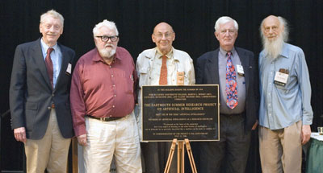
1956 Dartmouth AI Project
Five of the attendees of the 1956 Dartmouth Summer Research Project on AI reunited in 2006: Trenchard More, John McCarthy, Marvin Minsky, Oliver Selfridge, and Ray Solomonoff. Missing: Arthur Samuel, Herbert Simon, Allen Newell, Nathaniel Rochester and Claude Shannon.

Slide 12
Recent AI History
AI has had it’s ups and downs
  50-60 up, 70s down, 80s up, 90s down, 00s up then down, 10s up, 20s up, …
  Like the stock market, the overall trend is up
Hot topics today?
  Neural networks again: deep learning
  Machine learning, datamining
  Exploiting big data
  Autonomous vehicles, robotics
  Text mining, natural language understanding, speech
  Computer vision

Slide 13
Why AI?
1 Engineering: get machines to do useful things
  e.g., understand spoken natural language, recognize individual people
  in visual scenes, autonomous vehicles, better cybersecurity, …
2 Cognitive Science: model and understand how natural minds and mental phenomena work
  e.g., visual perception, memory, learning, language, decision making, …
3 Philosophy: explore basic, interesting and important philosophical questions
  e.g., mind-body problem, what’s consciousness, free will, …
Notes:
Obviously, 1 drives the interest and is why organizations want to invest in it

Slide 14
Possible AI approaches
Like humans
Well
Think
Act

Slide 15
Possible approaches
Like humans
Well
Rational
agents
Think
GPS
Act
Heuristic
systems
Eliza

Slide 16
Possible approaches
Like humans
Well
Rational
agents
Think
GPS
AI tends to work mostly in this area
Act
Heuristic
systems
Eliza

Slide 17
Think well
Like humans
Well
Think
GPS
Rational
agents
Act
Eliza
Heuristic
systems
Develop formal models of
knowledge representation, reasoning, learning, memory, problem solving, that can be rendered in algorithms
Often an emphasis on a systems that are provably correct, and guarantee finding an optimal solution

Slide 18
Act well
Like humans
Well
Think
GPS
Rational
agents
For a given set of inputs, generate output that’s not necessarily correct
but gets job done
Heuristic: rule of thumb, strategy, trick or simplification which drastically limits search for solutions in large problem spaces
Heuristics don’t guarantee optimal solutions or even any solution at all: all that can be said for a useful heuristic is that it offers solutions which are good enough most of the time
  Feigenbaum and Feldman, 1963, p. 6
Act
Eliza
Heuristic
systems

Slide 19
Think like humans
Like humans
Well
Think
GPS
Rational
agents
Cognitive science approach
Focus not just on behavior & I/O but also look at reasoning process
Computational model should reflect “how” results were obtained
Provides new language for expressing cognitive theories & new mechanisms for evaluating them
GPS (General Problem Solver): Goal not just to produce humanlike behavior, but to produce a sequence of steps of reasoning process that was similar to those followed by a person
Act
Eliza
Heuristic
systems

Slide 20
Act like humans
Like humans
Well
Think
Rational
agents
Behaviorist approach
Not interested in how you
get results, just similarity to
what human results are
Exemplified by the Turing Test (Alan Turing, 1950)
Has applications in interactive enter- tainment (e.g., computer games, CGI), virtual worlds and in modeling human intentions
GPS
Act
Eliza
Heuristic
systems

Slide 21
Turing Test¹
Three rooms: person, computer,
interrogator
Interrogator communicates with others via a ‘teleprinter’
Interrogator tries to distinguish person and machine
Machine tries to fool interrogator into believing it is the person
Person acts naturally
If machine succeeds, we conclude it can think
¹ Turing, Alan (October 1950), "Computing Machinery and Intelligence", Mind. (236): 433–460.

Slide 22
Eliza
ELIZA: program simulating a psychotherapist interacting with a patient by Joeseph Weizenbaum (MIT), ~1966, FORTRAN
First script was DOCTOR
  Simple collection of syntactic patterns not unlike regular expressions
  Patterns had associated replies that might include bits of the input after simple transforms (my → your)
Weizenbaum was shocked at reactions:
  Psychiatrists thought it had potential
  People unequivocally anthropomorphized Eliza
  Many thought it solved the language understanding problem

Slide 23
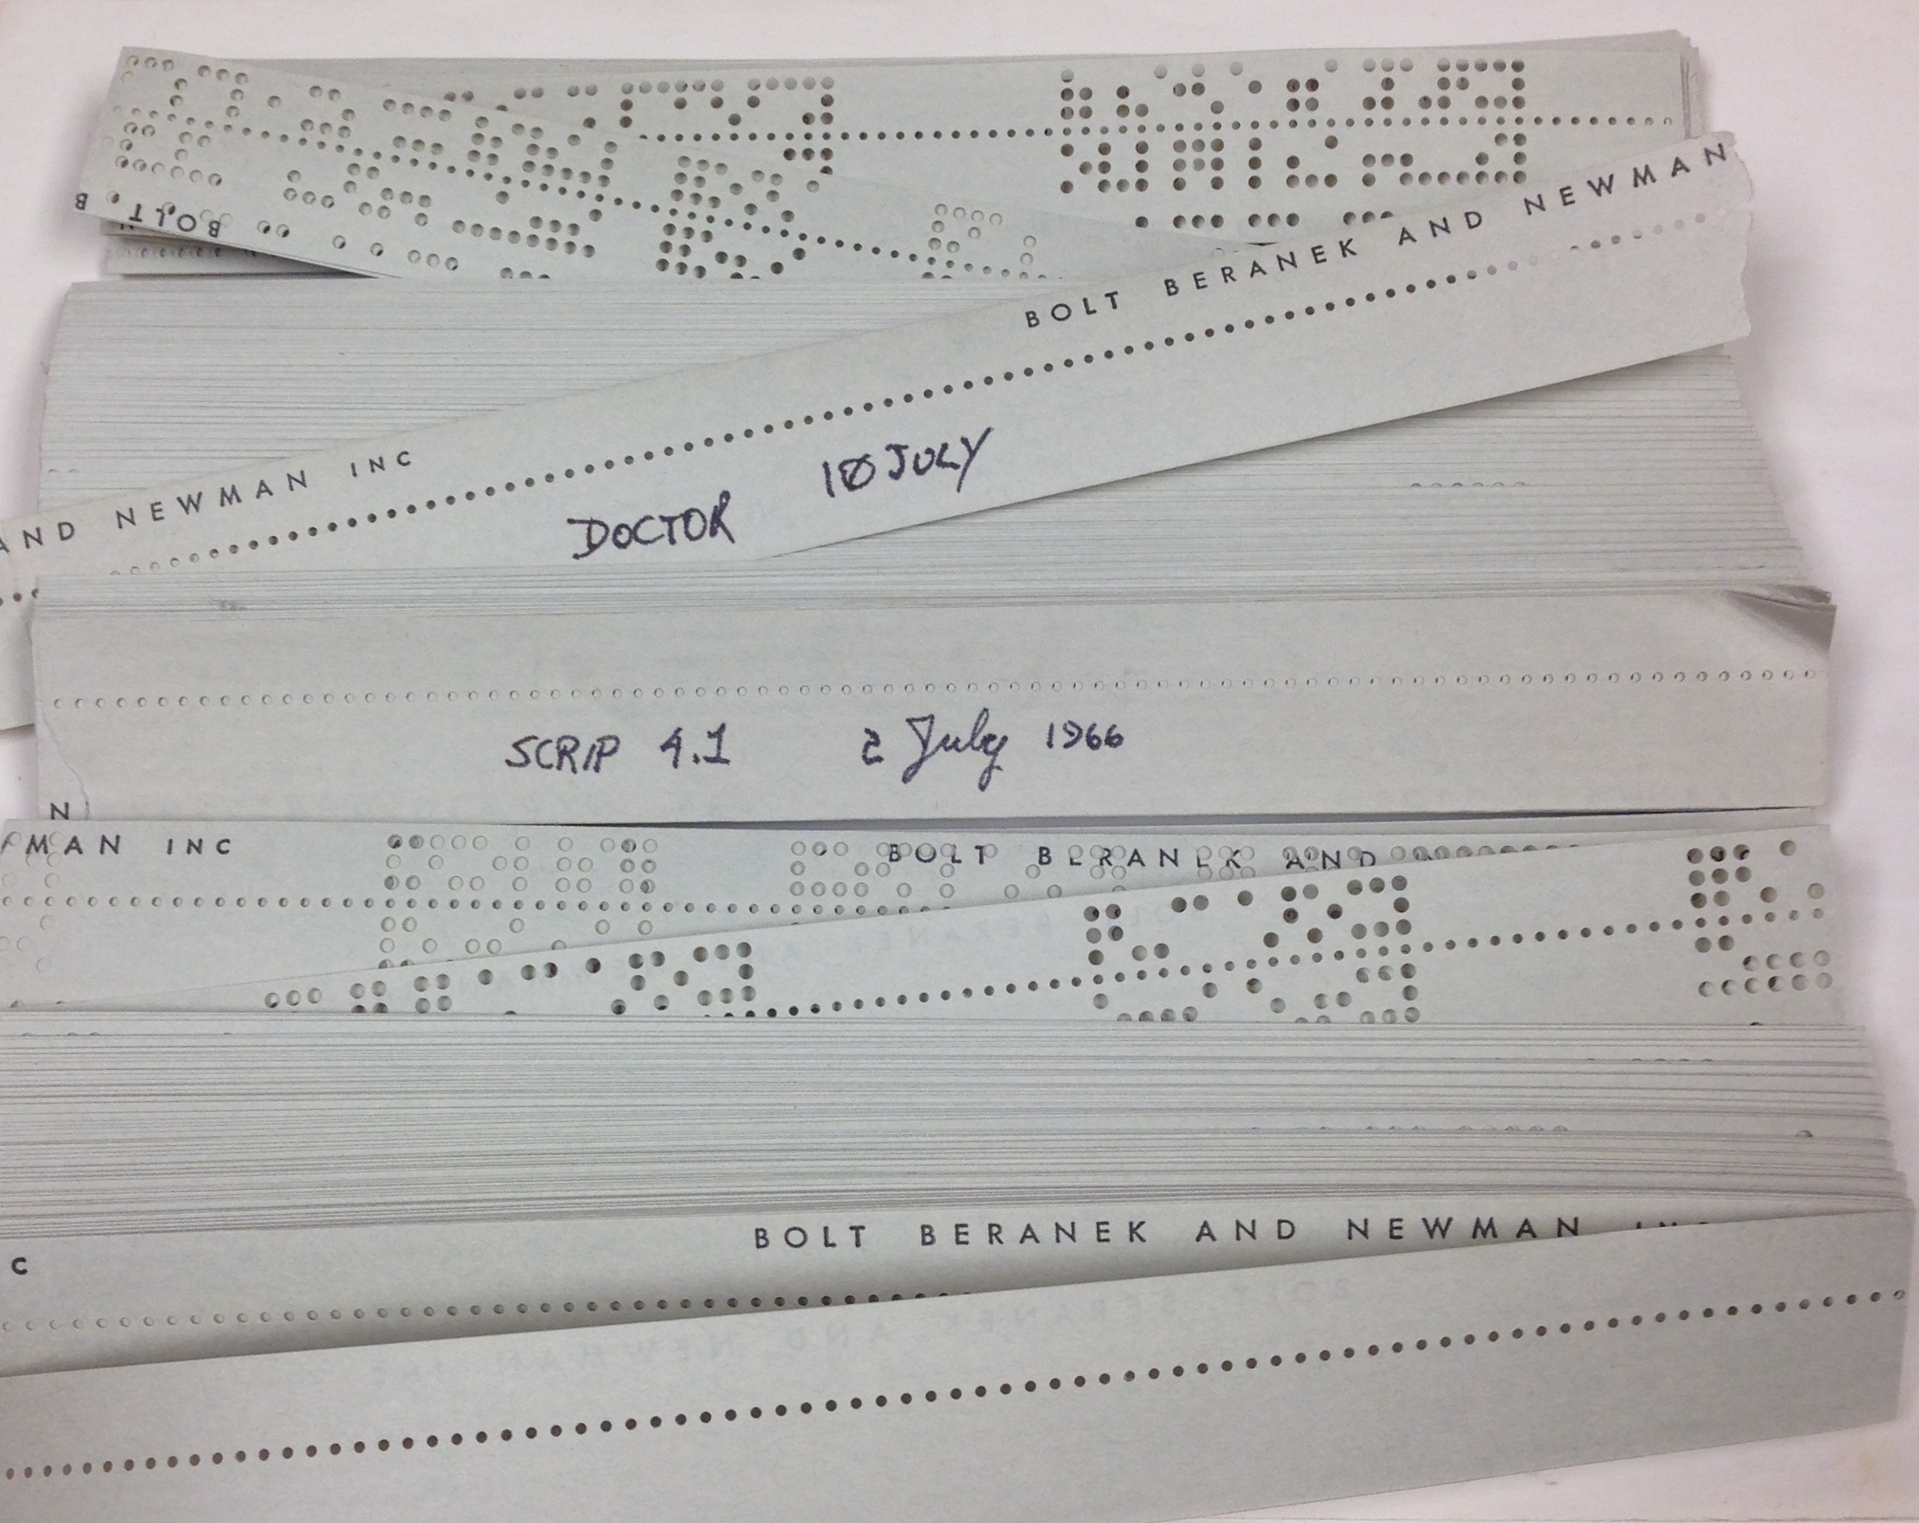
It lives!
Amazingly, a1966 version was recently found and restored, see http://elizagen.org/
In 2021, the original ELIZA source code was discovered in MIT’s Weizenbaum archives.

Slide 24
Eliza
I am the psychotherapist. Please, describe your problems. Each time you are finished talking, type RET twice.
i'm having a hard time with my students
Why do you say that?
well, they keep asking me for money
Maybe your plans have something to do with this.
what plans?
Is it because of your life that you say what plans?
No, it's because I didn't know what you were talking about
Is it because you didn't know what I was talking about that you came to me?
no, it's because i wanted to see if you could pass the turing test
Does it bother you that you wanted to see if I could really pass the turing test?
…..
How do you reconcile problems at school?
This is a waste of time. Good bye
My secretary will send you a bill.
This is a transcript of a conversation with an Eliza-like program found in Emacs
Try typing
  Meta-x doctor
in your favorite Emacs

Slide 25
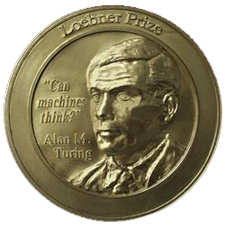
The Loebner contest
Modern version of Turing Test, held
annually with a $100K cash prize
Hugh Loebner was once director of UMBC Academic Computing Services (now DoIT)
Restricted topic (removed in ‘95) & limited time
Participants: humans, computers and judges
Scoring rank from least to most human
  Highest median rank wins $2000
  If better than a human, win $100K (Not yet)
Results: 2016, 2017, 2018, 2019

Slide 26
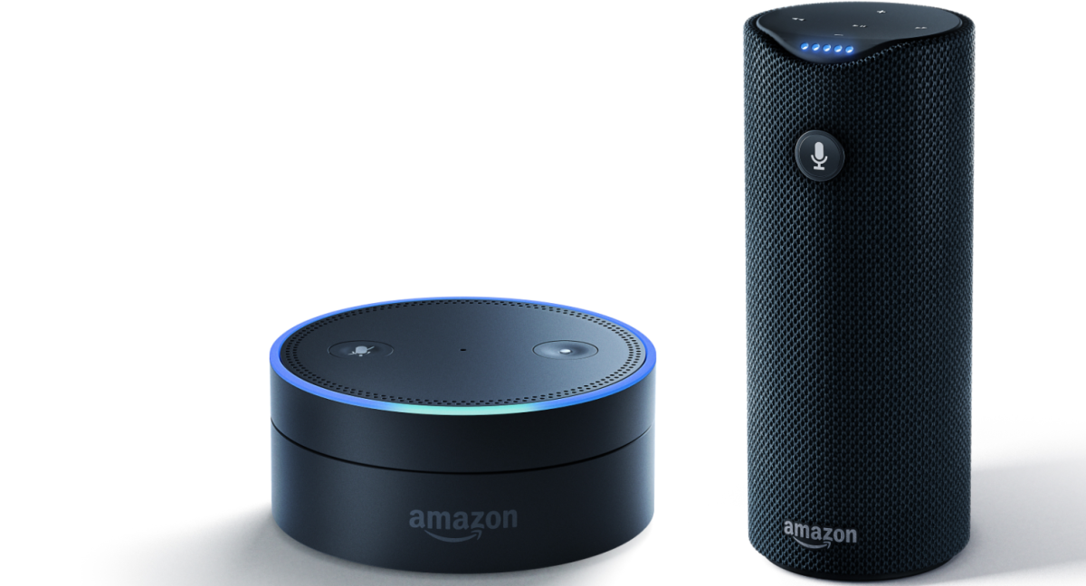
Is it relevant to AI?
Most AI researchers believe that the Loebner contest is not relevant to AI
However, techniques used by some are similar to those that are driving many useful chat bot applications
  These are supported, however, by
  sophisticated speech to text and text to
  speech systems
  And varying degrees of language
  understanding and machine
  learning

Slide 27
What’s easy and what’s hard?
Easy: many high-level tasks usually associated with “intelligence” in people
    E.g., symbolic integration, proving theorems, playing chess, medical diagnosis
Hard: tasks many animals can do
    walking around without running into things
    catching prey and avoiding predators
    Interpreting sensory info. (e.g., visual, aural, …)
    modeling internal states of other from behavior
    working as a team (e.g., with pack animals)
Is there a fundamental difference between these?

Slide 28
What can AI systems do?
Computer vision: face recognition from a large set
Robotics: autonomous (mostly) automobile
Natural language processing: useful machine translation and simple fact extraction
Expert systems: medical diagnosis in narrow domains
Spoken language systems: e.g., Google Now, Siri, Cortana
Planning and scheduling: Hubble Telescope experiments
Learning: text categorization into ~1000 topics
User modeling: Bayesian reasoning in Windows help (the infamous paper clip…)
Games: Grand Master level in chess (world champion), checkers,…

Slide 29
What can’t AI systems do well yet?
Understand natural language robustly (e.g., read and understand articles in a newspaper)
Surf the web and find interesting knowledge
Interpret an arbitrary visual scene
Learn a natural language
Play Go well
Construct plans in dynamic real-time domains
Refocus attention in complex environments
Perform life-long learning
Exhibit true autonomy and intelligence!

Slide 30
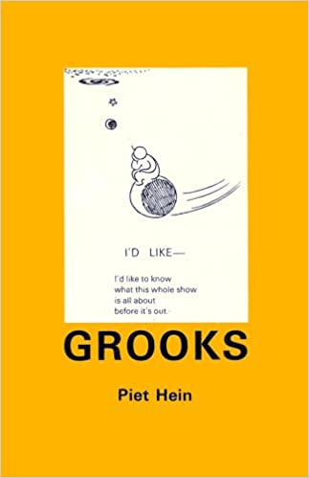
T.T.T.
Put up in a place
where it's easy to see
the cryptic admonishment
T. T. T.
When you feel how depressingly
slowly you climb,
it's well to remember that
Things Take Time.
Piet Hein

Slide 31
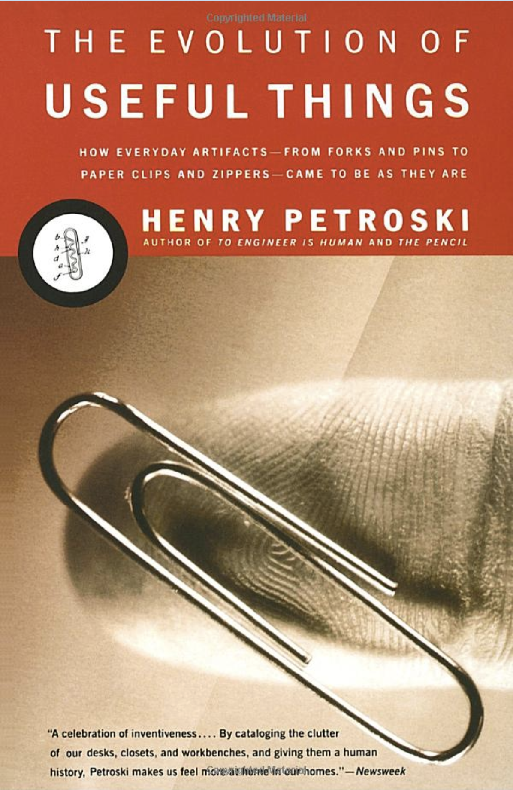
T.T.T: things take time
Prior to the 1890’s, papers were held together with straight pens
The development of “spring steel” allowed the invention of the paper clip in 1899
It took about 25 years (!) for the evolution of the modern “gem paperclip”, considered to be optimal for general use
The Evolution of Useful Things: How Every-day Artifacts-From Forks and Pins to Paper Clips and Zippers-Came to be as They are

Slide 32
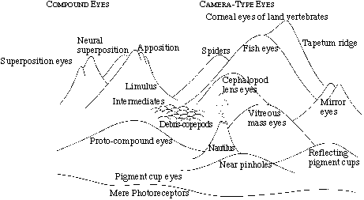
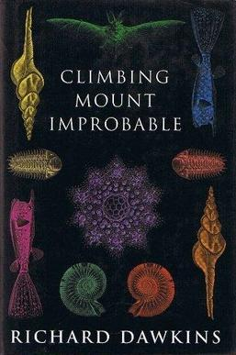
Climbing
Mount
Improbable
“The sheer height of the peak doesn't matter, so long as you don't try to scale it in a single bound. Locate the mildly sloping path and, if you have unlimited time, the ascent is only as formidable as the next step”
-- Richard Dawkins, Climbing Mount Improbable, 1996
Notes:
Mount Improbable rears up from the plain, lofting its peaks dizzily to the rarefied sky. The towering, vertical cliffs of Mount Improbable can never, it seems, be climbed Dwarfed like insects, thwarted mountaineers crawl and scrabble along the foot, gazing hopelessly at the sheer, unattainable heights. They shake their tiny, baffled heads and declare the brooding summit forever unscalable.
Our mountaineers are too ambitious. So intent are they on the perpendicular drama of the cliffs, they do not think to look round the other side of the mountain. There they would find not vertical cliffs and echoing canyons but gently inclined grassy meadows, graded steadily and easily towards the distant uplands. Occasionally the gradual ascent is punctuated by a small, rocky crag, but you can usually find a detour that is not too steep for a fit hill-walker in stout shoes and with time to spare. The sheer height of the peak doesn't matter, so long as you don't try to scale it in a single bound. Locate the mildly sloping path and, if you have unlimited time, the ascent is only as formidable as the next step.

