Slide 1
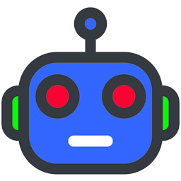
CMSC 471
Introduction to
Artificial Intelligence
Course Overview
Spring 2022

Slide 2
Today’s Class
Course overview
Introduction
  Brief history of AI
  What is AI? (and why is it so interesting?)
  What’s the state of AI now?

Slide 3
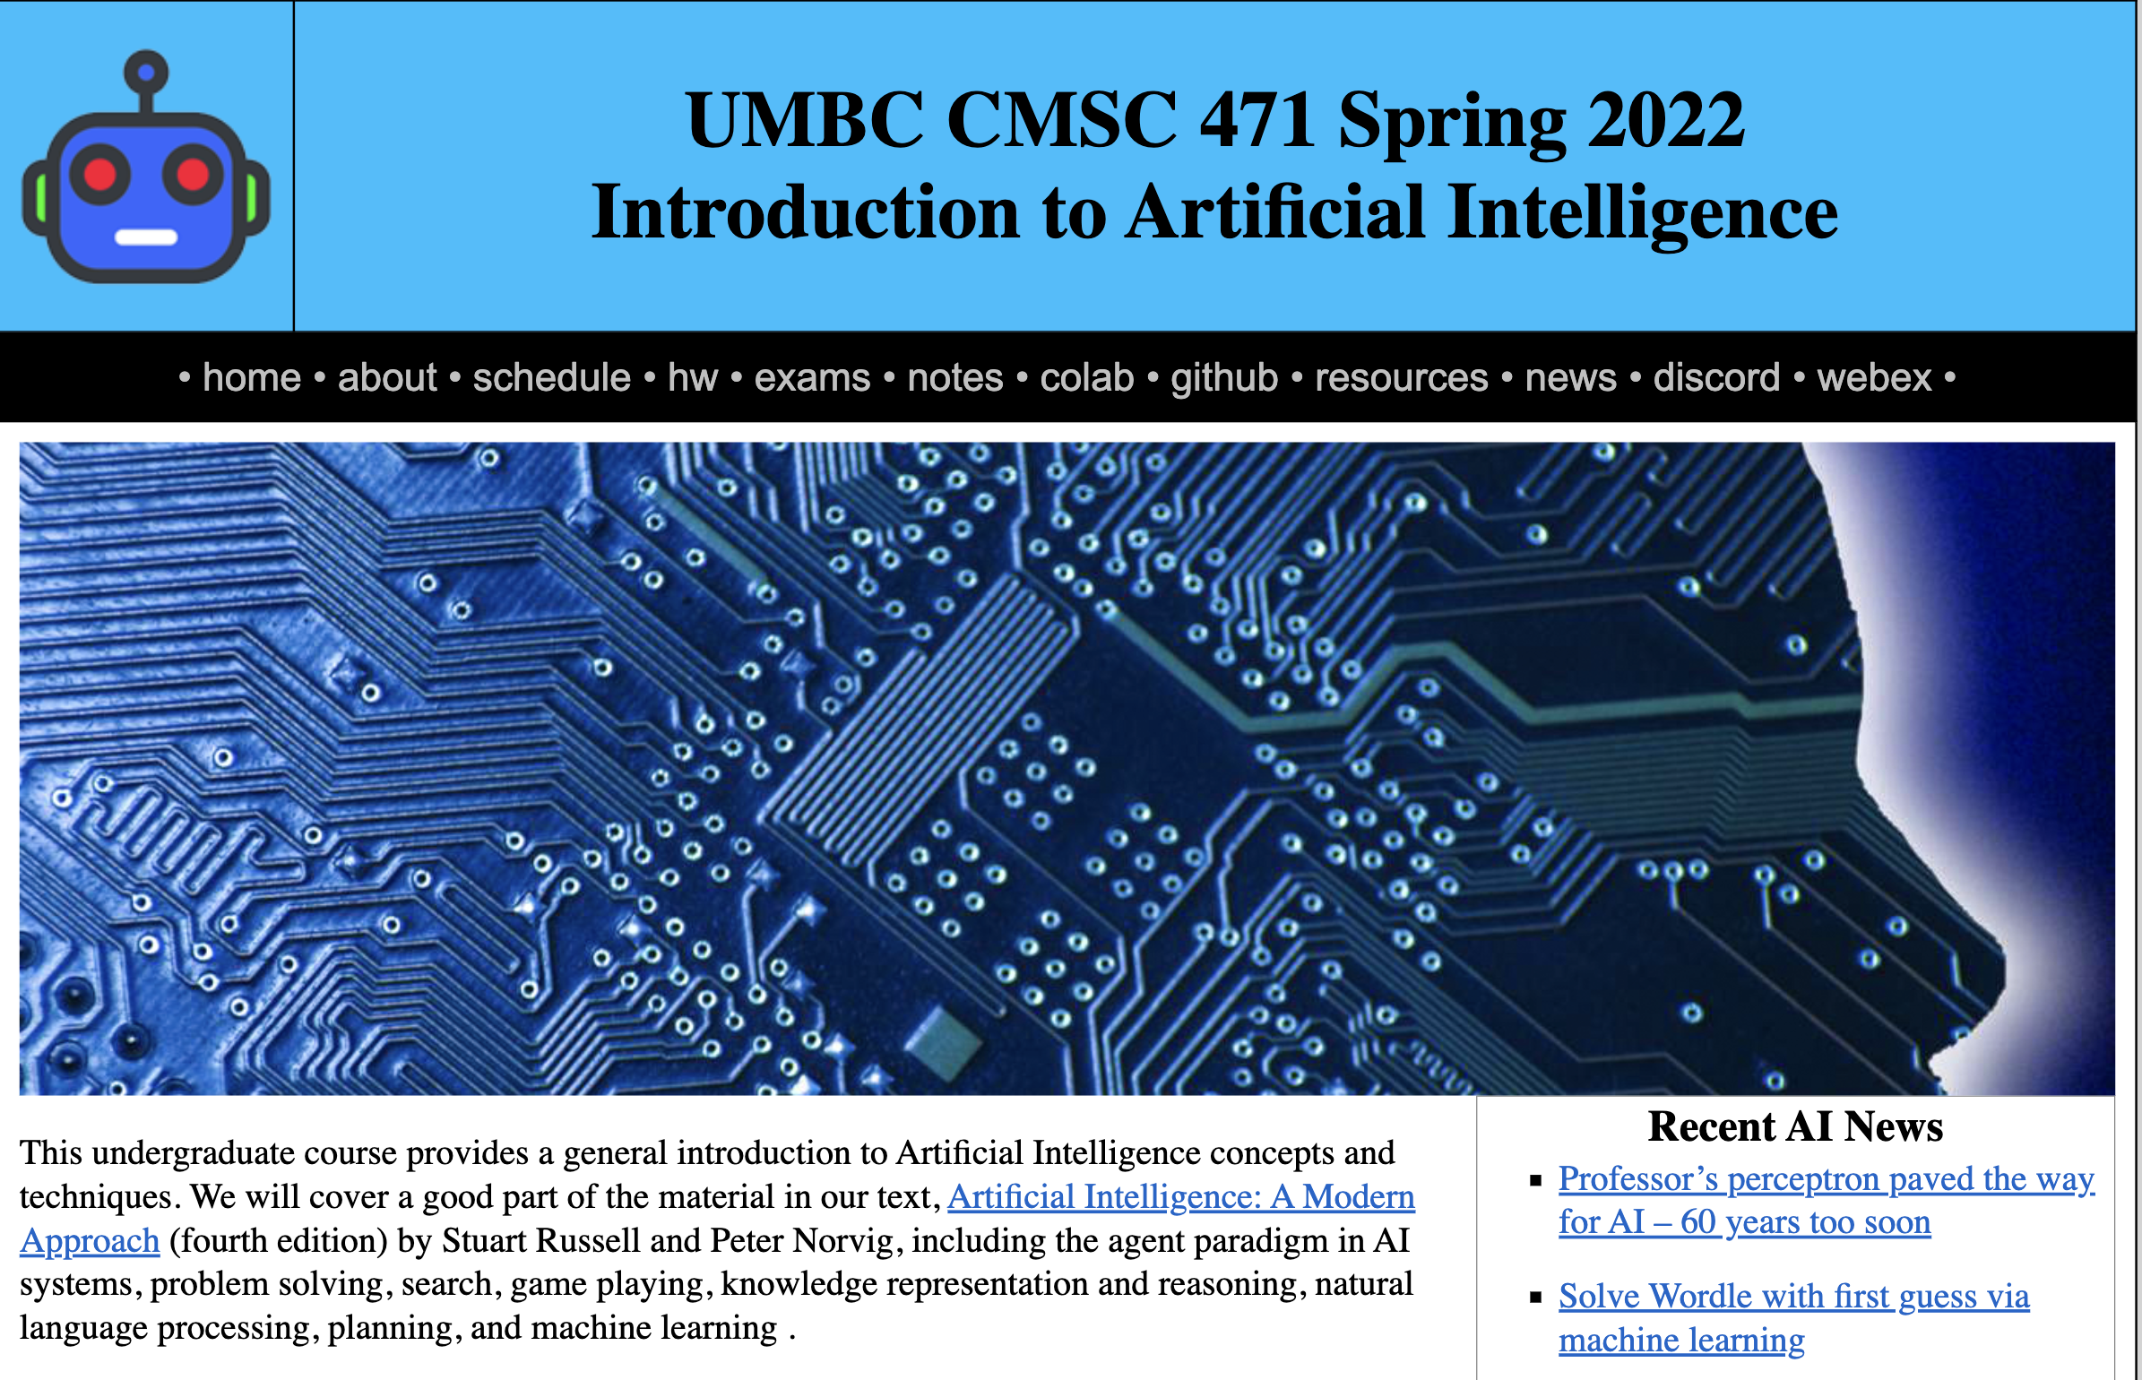
https://bit.ly/471s22

Slide 4
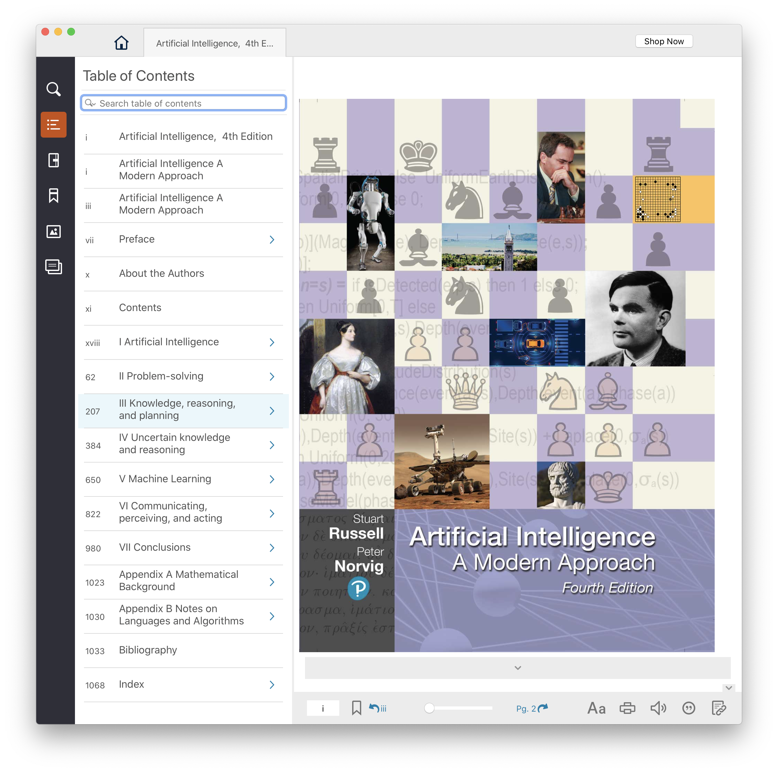
Text, CMI
4th edition of AIMA (2020) has lots of new material since the 2009 3rd edition
UMBC CMI program charges
$35 for a digital version, $160
on Amazon for hardcopy
Access on Blackboard or down- load to computer/phone
Opt-out of CMI via Blackboard

Slide 5
Homework and grading policies
~Six short homework assignments (mix of written and programming)
  One-time extensions of up to a week may be granted if requested in advance
  Last-minute requests for extensions probably will not be granted
Do the reading before each class!

Slide 6
Programming
Programming assignments in Python
  We’ll use Python 3 in the notes and examples
We’ll use GitHub to share code, Jupyter notebooks, and for HW submission
  You’ll need to install some Python packages
Some assignments may require other systems
  E.g., C5 decision tree software, Weka Machine learning environments

Slide 7
Exams and Quizes
We may have periodic short quizzes (0-10%)
  On Blackboard every other week or so, mostly to motivate you to keep up with the reading and classes
Midterm exam (15-20%)
  In person or on Blackboard, March 17?
Final exam (25-30%)
  In person or on Blackboard, mid-May
  Comprehensive with an emphasis on last half of material (e.g., 30/70 split)
Homework (45-50%)

Slide 8
Instructor availability
Professor Tim Finin, finin@umbc.edu
  Office hour: Wed 10-11 on Webex and/or in person by arrangement (329 ITE)
Ask general questions on Discord first
  We’ll try to respond within 24 hours
TA: Prajna Bhandary, prajnab1@umbc.edu, ITE334
If needed, we may try holding help session on Discord

