Slide 1
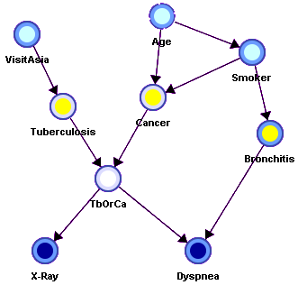
Reasoning with Bayesian
Belief Networks
bbn.pptx

Slide 2
Overview
Bayesian Belief Networks (BBNs) can reason with networks of propositions and associated probabilities
BBNs encode causal associations between facts and events the propositions represent
Useful for many AI problems
  Diagnosis
  Expert systems
  Planning
  Learning

Slide 3

Judea Pearl
UCLA CS professor
Introduced Bayesian networks in the 1980
Pioneer of probabilistic approach to AI reasoning
First to mathematize causal modeling in empirical sciences
Written many books on the topics, including the popular 2018 Book of Why

Slide 4
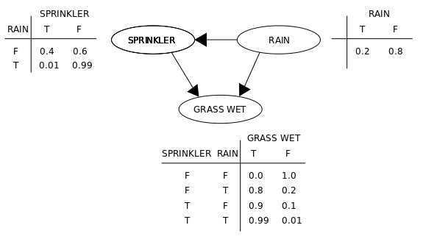
BBN Definition
AKA Bayesian Network, Bayes Net
A graphical model (as a DAG) of probabilistic relationships among a set of random variables
Nodes are variables, links represent direct influence of one variable on another
Nodes have prior
probabilities or
Conditional
Probability
Tables (CPTs)
source

Slide 5
Recall Bayes Rule
Note symmetry: can compute probability of a hypothesis given its evidence as well as probability of evidence given hypothesis

Slide 6
Simple Bayesian Network
Smoking
Cancer

Slide 7
Simple Bayesian Network
Smoking
Cancer
Nodes
represent
variables
Smoking variable represents person’s degree of smoking and has three possible values (no, light, heavy)
Cancer variable represents person’s cancer diagnosis and has three possible values (none, benign, malignant)

Slide 8
Simple Bayesian Network
Smoking
Cancer
tl;dr: smoking effects cancer
Smoking behavior effects the probability of cancer outcome
Smoking behavior considered evidence for whether a person is likely to have cancer or not
Directed links represent
“causal” relations

Slide 9
Simple Bayesian Network
Smoking
Cancer
Prior probability of S
P(
S=no)
0.80
Nodes without in-links have prior probabilities
P(
S=light)
0.15
P(
S=heavy)
0.05
Joint distribution of S and C
Smoking=
no
light
heavy
Nodes with in-links have joint probability distributions
C=none
0.96
0.88
0.60
C=benign
0.03
0.08
0.25
C=malignant
0.01
0.04
0.15

Slide 10
More Complex Bayesian Network
Age
Gender
Exposure
to Toxics
Smoking
Cancer
Serum
Calcium
Lung
Tumor

Slide 11
More Complex Bayesian Network
Nodes
represent
variables
Age
Gender
Exposure
to Toxics
Smoking
Does gender cause smoking?
Influence might be a better term
Links represent immediate“causal” relations
Cancer
Serum
Calcium
Lung
Tumor

Slide 12
More Complex Bayesian Network
Age
Gender
Exposure
to Toxics
Smoking
condition
Cancer
Serum
Calcium
Lung
Tumor

Slide 13
More Complex Bayesian Network
predispositions
Age
Gender
Exposure
to Toxics
Smoking
Cancer
Serum
Calcium
Lung
Tumor

Slide 14
More Complex Bayesian Network
Age
Gender
Exposure
to Toxics
Smoking
Cancer
observable symptoms
Serum
Calcium
Lung
Tumor

Slide 15
More Complex Bayesian Network
Model has 7 variables
Complete joint probability distribution will have 7 dimensions!
Too much data required ☹
BBN simplifies: a node has a CPT with data on itself & parents in graph
Age
Gender
Can we predict likelihood of lung tumor given values of other 6 variables?
Exposure
to Toxics
Smoking
Cancer
Serum
Calcium
Lung
Tumor

Slide 16
Independence
Age and Gender are
independent.
Age
Gender
P(A,G) = P(G) * P(A)
There is no path between them in the graph
P(A |G) = P(A)
P(G |A) = P(G)
P(A,G) = P(G|A) P(A) = P(G)P(A)
P(A,G) = P(A|G) P(G) = P(A)P(G)

Slide 17
Conditional Independence
Cancer is independent of Age and Gender given Smoking
Age
Gender
Smoking
P(C | A,G,S) = P(C | S)
Cancer
If we know value of smoking, no need to know values of age or gender

Slide 18
Conditional Independence
Cancer is independent of Age and Gender given Smoking
Age
Gender
Smoking
Instead of one big CPT with 4 variables, we have two smaller CPTs with 3 and 2 variables
If all variables binary: 12 models (2³ +2²) rather than 16 (2⁴)
Cancer

Slide 19
Conditional Independence: Naïve Bayes
Serum Calcium and Lung Tumor are dependent
Cancer
Serum Calcium is indepen-dent of Lung Tumor, given Cancer
Serum
Calcium
Lung
Tumor
P(L | SC,C) = P(L|C)
P(SC | L,C) = P(SC|C)
Naïve Bayes assumption: evidence (e.g., symptoms) independent given disease; easy to combine evidence
Notes:
Serum calcium is a blood test to measure the amount of calcium in the blood
Elevated levels of calcium in the blood is associated with some cancers.

Slide 20
Explaining Away
Exposure to Toxics and Smoking are independent
Exposure
to Toxics
Smoking
Exposure to Toxics is dependent on Smoking, given Cancer
Cancer
P(E=heavy | C=malignant) > P(E=heavy | C=malignant, S=heavy)
Explaining away: reasoning pattern where confirma-tion of one cause reduces need to invoke alternatives
Essence of Occam’s Razor (prefer hypothesis with fewest assumptions)
Relies on independence of causes
Notes:
Occam’s Razor : among competing hypotheses, the one with the fewest assumptions should be selected

Slide 21
Conditional Independence
A variable (node) is conditionally independent of its non-descendants given its parents
Age
Gender
Non-Descendants
Exposure
to Toxics
Smoking
Parents
Cancer is independent of Age and Gender given Exposure to Toxics and Smoking.
Cancer
Serum
Calcium
Lung
Tumor
Descendants

Slide 22
Another non-descendant
A variable is conditionally independent of its non-descendants given its parents
Age
Gender
Exposure
to Toxics
Smoking
Diet
Cancer
Cancer is independent of Diet given Exposure to Toxics and Smoking
Serum
Calcium
Lung
Tumor

Slide 23
BBN Construction
The knowledge acquisition process for a BBN involves three steps
  KA1: Choosing appropriate variables
  KA2: Deciding on the network structure
  KA3: Obtaining data for the conditional probability tables

Slide 24
KA1: Choosing variables
Variable values: integers, reals or enumerations
Variable should have collectively exhaustive, mutually exclusive values
Error Occurred
No Error
They should be values, not probabilities
Risk of Smoking
Smoking
Notes:
If ”error occurred” and “No error” are T/F Boolean variables only one is needed
The variable’s values must be finite. They will typically have 2-4 possible values.

Slide 25
Heuristic: Knowable in Principle
Example of good variables
  Weather: {Sunny, Cloudy, Rain, Snow}
  Gasoline: $ per gallon {<1, 1-2, 2-3, 3-4, >4}
  Temperature: { ≥ 100°F , < 100°F}
  User needs help on Excel Charts: {Yes, No}
  User’s personality: {dominant, submissive}

Slide 26
KA2: Structuring
Network structure corresponding
to “causality” is usually good.
Age
Gender
Initially this uses designer’s knowledge and intuitions but can be checked with data
Exposure
to Toxic
Smoking
May be better to add suspected links than to leave out
Cancer
Genetic
Damage
Lung
Tumor
But bigger CPT tables mean
more data collection

Slide 27
KA3: The Numbers
For each variable we have a table of probability of its value for values of its parents
For variables w/o parents, we have prior probabilities
Smoking
Cancer
 | smoking
cancer | no | light | heavy
none | 0.96 | 0.88 | 0.60
benign | 0.03 | 0.08 | 0.25
malignant | 0.01 | 0.04 | 0.15
smoking priors
no | 0.80
light | 0.15
heavy | 0.05

Slide 28
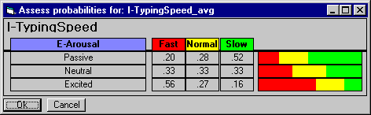
KA3: The numbers
Second decimal usually doesn’t matter
Relative probabilities are important
Zeros and ones are often enough
Order of magnitude is typical: 10⁻⁹ vs 10⁻⁶
Sensitivity analysis can be used to decide accuracy needed

Slide 29
Three kinds of reasoning
BBNs support three main kinds of reasoning:
Predicting conditions given predispositions
Diagnosing conditions given symptoms (and predisposing)
Explaining a condition by one or more predispositions
To which we can add a fourth:
Deciding on an action based on probabilities of the conditions

Slide 30
Predictive Inference
Age
Gender
How likely are elderly males
to get malignant cancer?
Exposure
to Toxics
Smoking
Cancer
P(C=malignant | Age>60, Gender=male)
Serum
Calcium
Lung
Tumor

Slide 31
Predictive and diagnostic combined
Age
Gender
How likely is an elderly male patient with high Serum Calcium to have malignant cancer?
Exposure
to Toxics
Smoking
Cancer
P(C=malignant | Age>60,
Gender= male, Serum Calcium = high)
Serum
Calcium
Lung
Tumor

Slide 32
Explaining away
Age
Gender
If we see a lung tumor, the probability of heavy smoking and of exposure to toxics both go up
Exposure
to Toxics
Smoking
Smoking
Cancer
If we then observe heavy smoking, the probability of exposure to toxics goes back down
Serum
Calcium
Lung
Tumor

Slide 33
Some software tools
Netica: Windows app for working with Bayes-ian belief networks and influence diagrams
  A commercial product, free for small networks
  Includes graphical editor, compiler, inference engine, etc.
  To run in OS X or Linus you need Crossover
Hugin: free demo versions for Linux, Mac, and Windows are available
Various Python packages, e.g., …
Aima-python code in probability4e.py

Slide 34
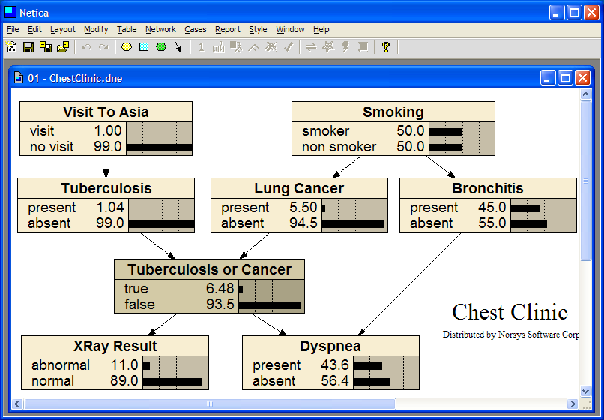
Dyspnea is difficult or labored breathing
Notes:
Dyspnea is medical term for difficult or labored breathing.

Slide 35
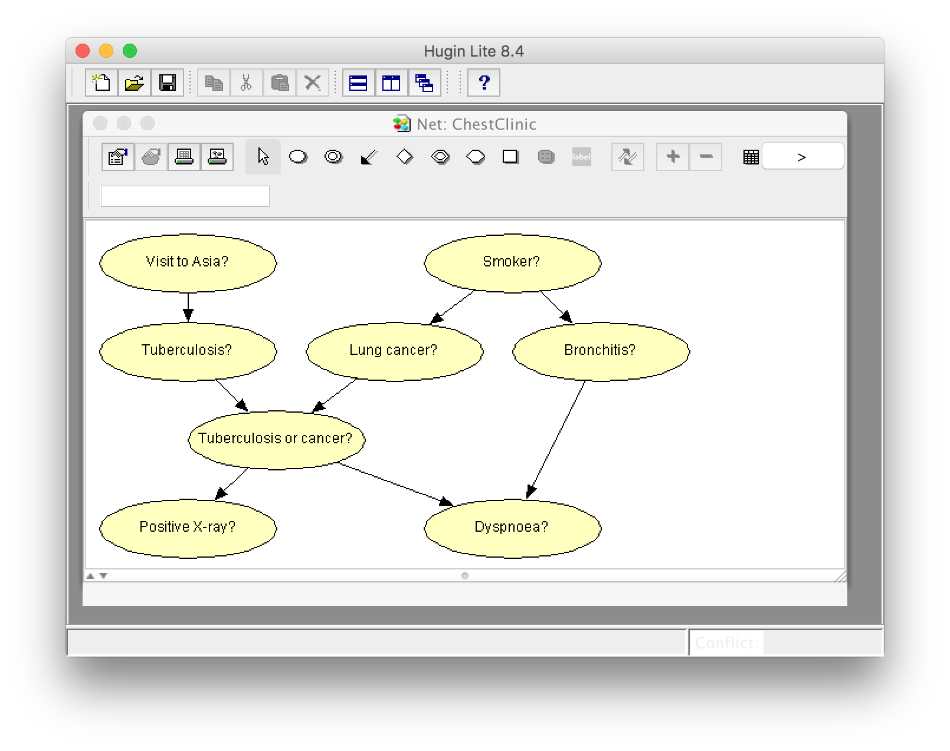
Same BBN model in Hugin app
Notes:
Dyspnoea is also a medical term for difficult or labored breathing.

Slide 36
Decision making
A decision is a medical domain might be a choice of treatment (e.g., radiation or chemotherapy)
Decisions should be made to maximize expected utility
View decision making in terms of
  Beliefs/Uncertainties
  Alternatives/Decisions
  Objectives/Utilities

Slide 37

Decision Problem
Should I have my party
inside or outside?
dry
Regret
in
wet
Relieved
dry
Perfect!
out
wet
Disaster

Slide 38
Value Function
A numerical score over all possible states allows a BBN to be used to make decisions
Using $ for the value helps our intuition

Slide 39
Decision Making with BBNs
Today’s weather forecast might be either sunny, cloudy or rainy
Should you take an umbrella when you leave?
Your decision depends only on the forecast
  The forecast “depends on” the actual weather
Your satisfaction depends on your decision and the weather
  Assign a utility to each of four situations: (rain|no rain) x (umbrella, no umbrella)

Slide 40
Decision Making with BBNs
Extend BBN framework to include two new kinds of nodes: decision and utility
Decision node computes the expected utility of a decision given its parent(s) (e.g., forecast) and a valuation
Utility node computes utility value given its parents, e.g. a decision and weather
    Assign utility to each situations: (rain|no rain) x (umbrella, no umbrella)
    Utility value assigned to each is probably subjective

Slide 41
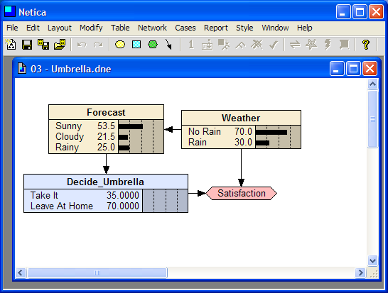

Slide 42
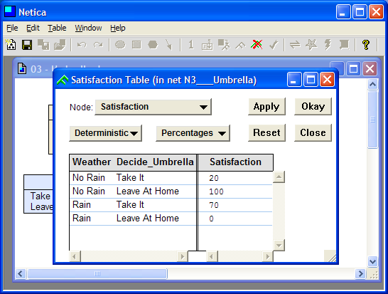

Slide 43
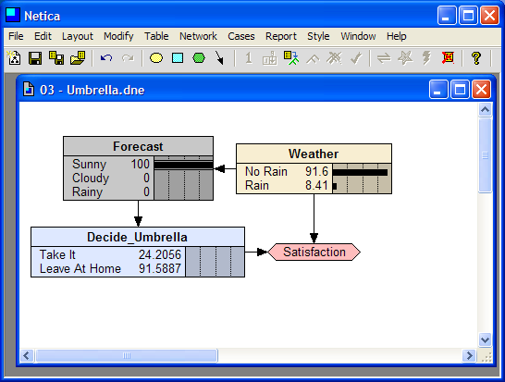

Slide 44
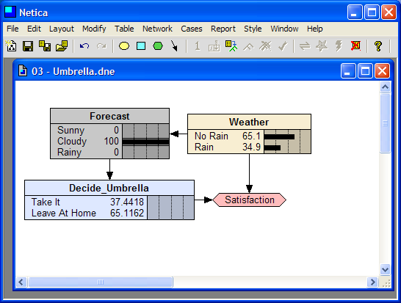

Slide 45
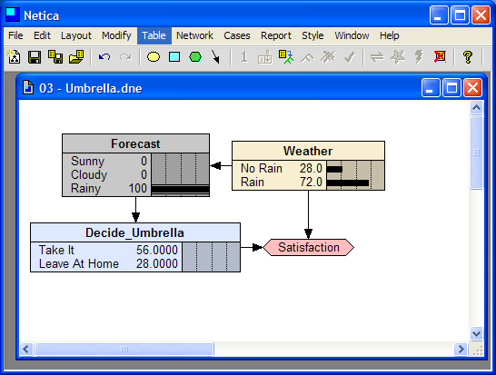

Slide 46
Predispositions or causes

Slide 47
Conditions or diseases

Slide 48
Functional Node

Slide 49
Symptoms or effects
Dyspnea is shortness of breath

