Slide 1
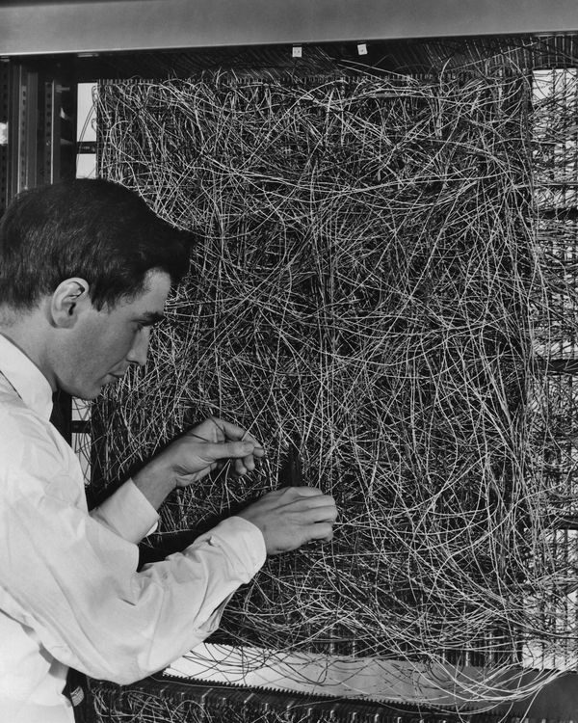
If you think debugging your TensorFlow network is hard...
A man adjusting the random wiring network between the light sensors and association unit of scientist Frank Rosenblatt's Perceptron, or MARK 1 computer, at the Cornell Aeronautical Laboratory, Buffalo, New York, circa 1960. The machine is designed to use a type of artificial neural network, known as a perceptron. (Photo by Frederic Lewis/Archive Photos/Getty Images)

