Slide 1
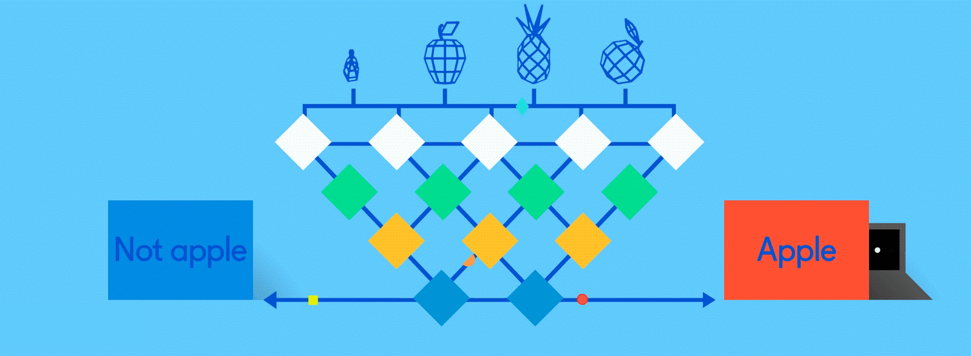
Neural Networks for Machine Learning tensorflow playground

Slide 2
TensorFlow Playground
Great javascript app demonstrating many basic neural network concepts (e.g., MLPs)
Doesn’t use TensorFlow software, but a lightweight js library
Runs in a Web browser
See http://playground.tensorflow.org/
Code also available on GitHub
Try the playground exercises in Google’s machine learning crash course

Slide 3
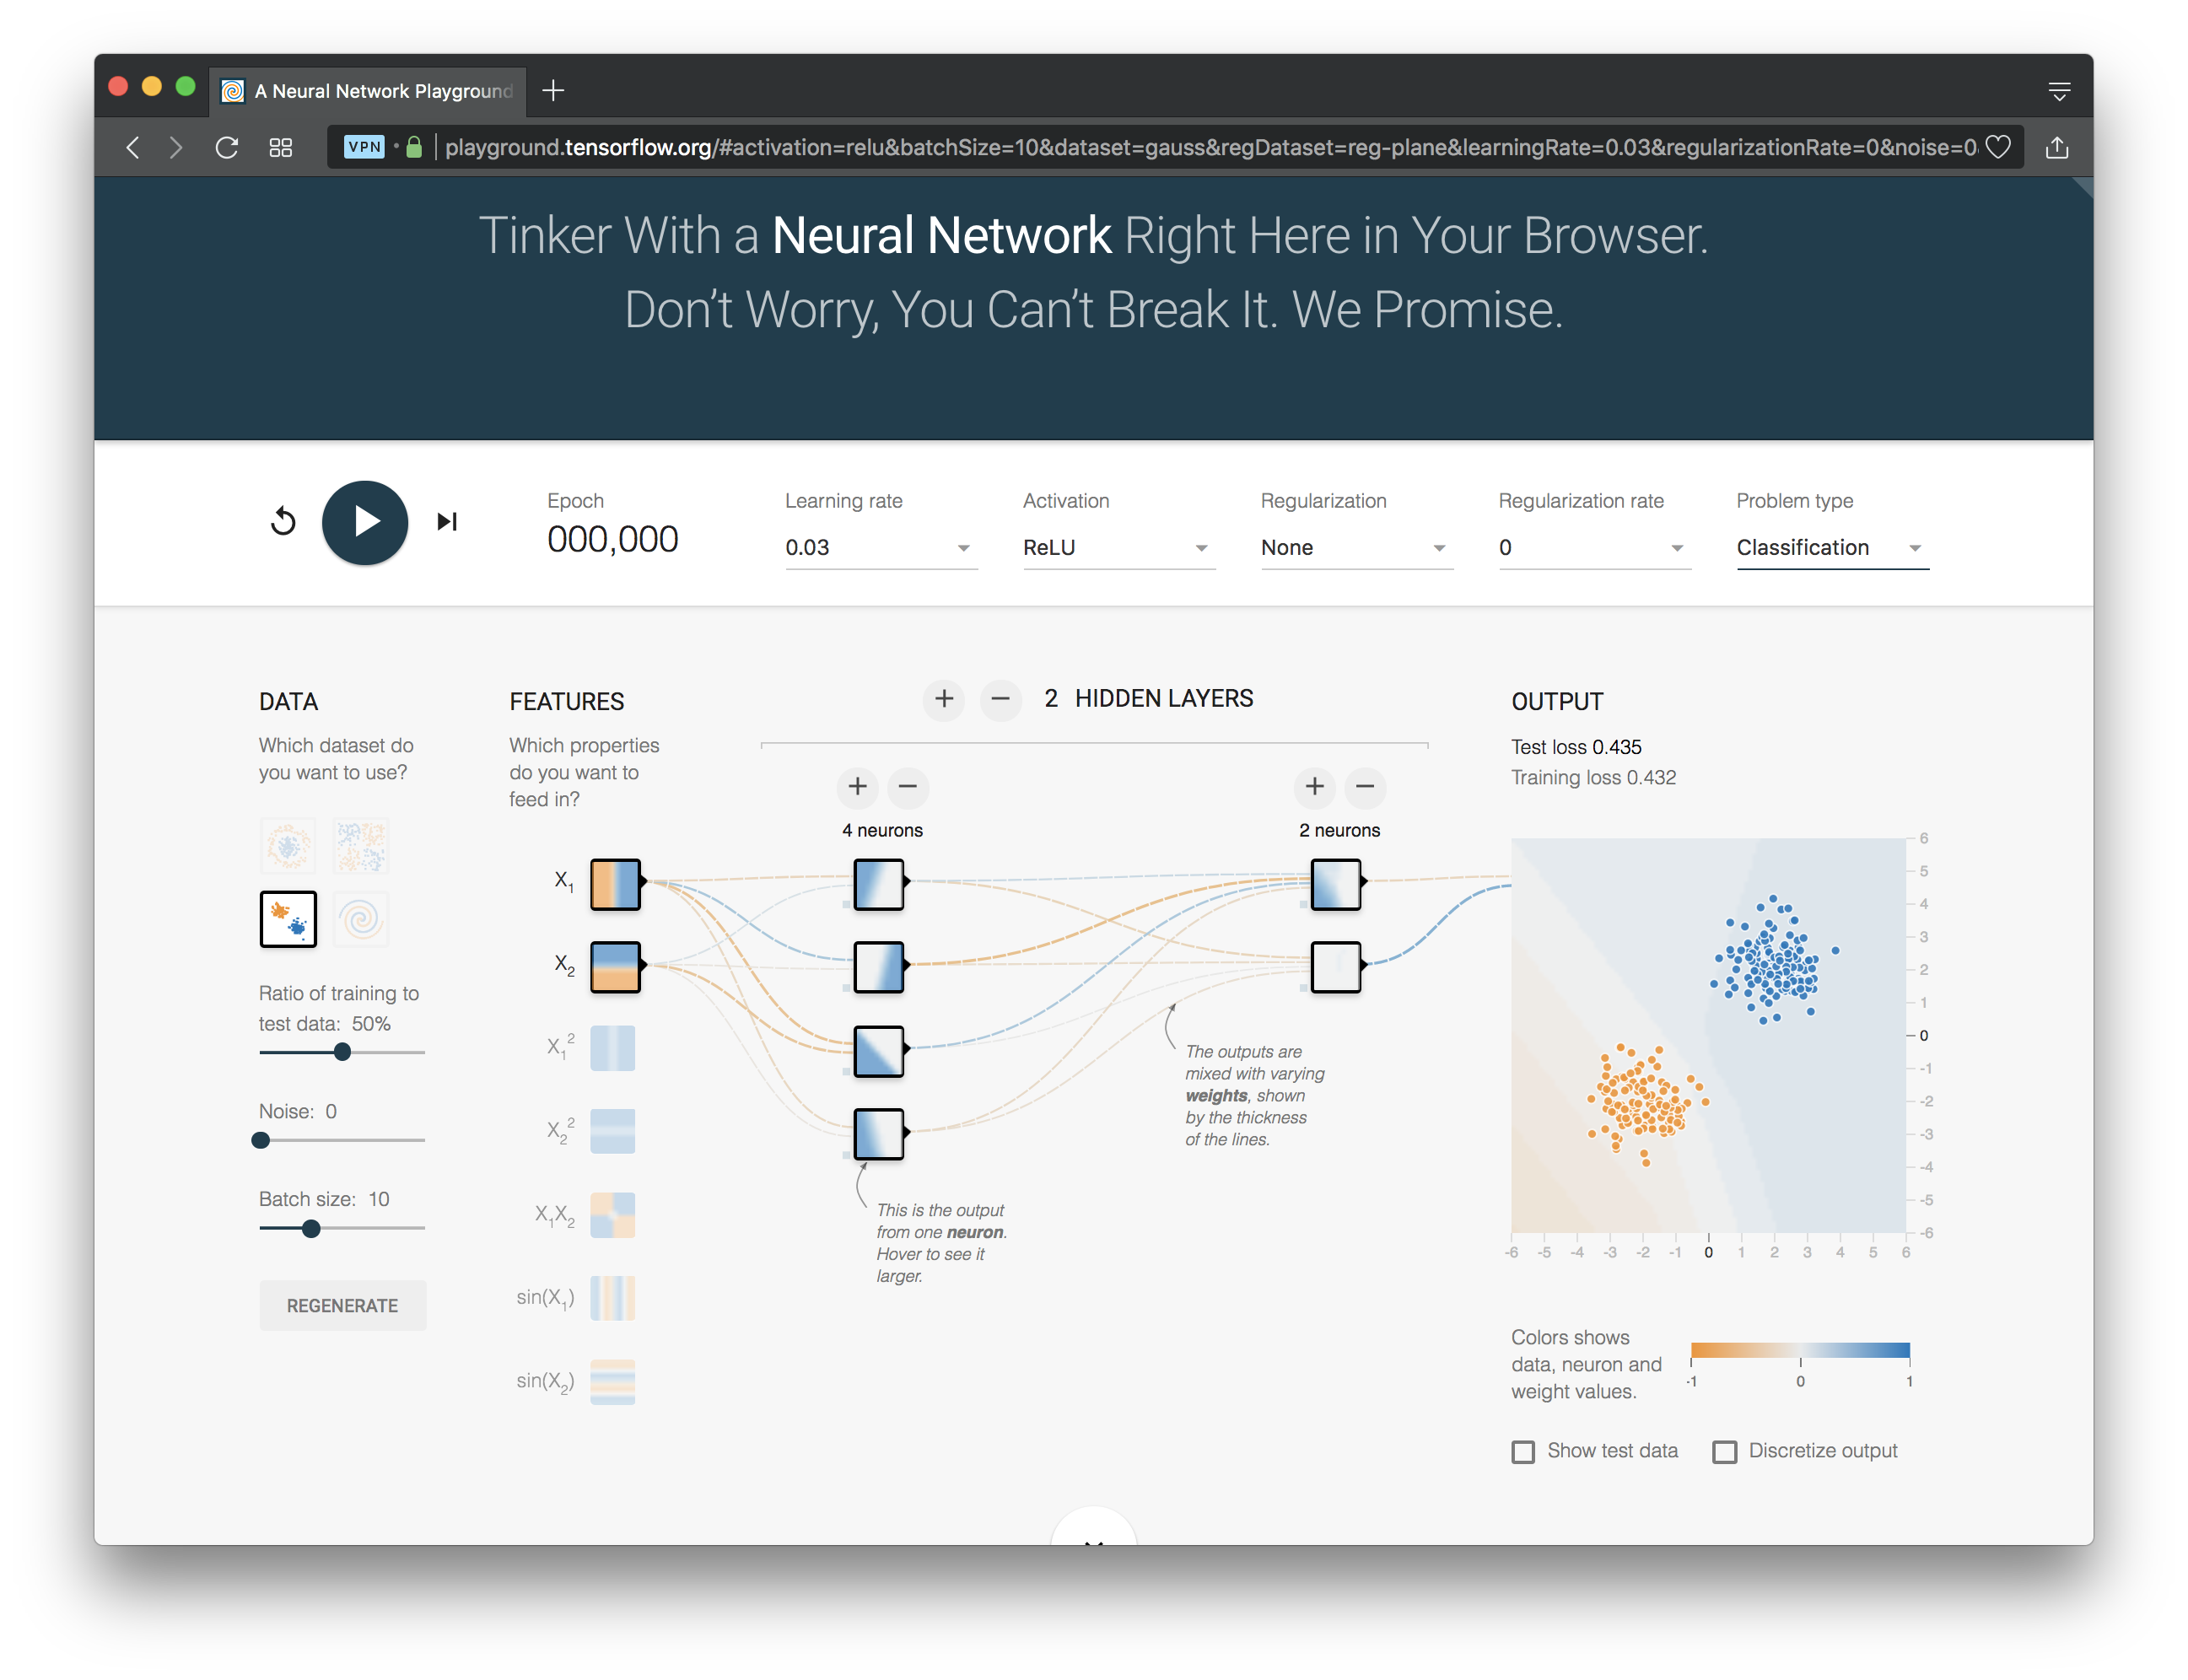
http://playground.tensorflow.org/

Slide 4
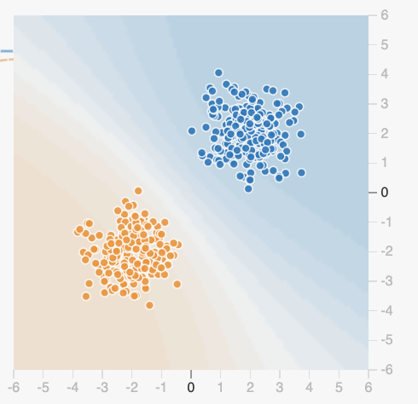
Datasets
Six datasets, each with 500 (x,y)
points on a plane where x and y
between -5 and +5
Points have labels of positive (orange) or negative (blue)
Two possible machine learning tasks:
  Classification: Predict class of test points
  Regression: find function to separate classes
Evaluation: split dataset into training and test, e.g., 70% training, 30% test

Slide 5
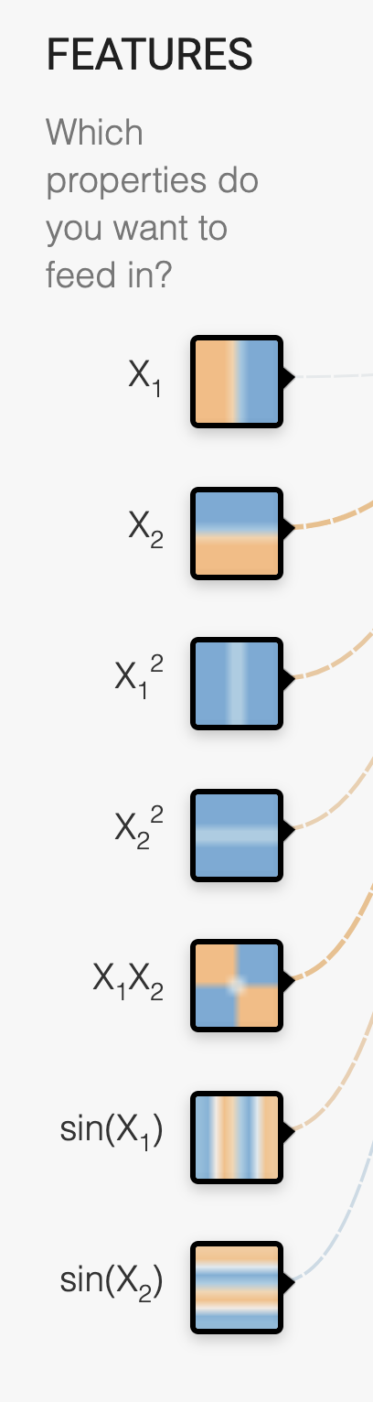
Available Input features
X₁ Point’s x value
X₂ Point’s y value
X₁² Point’s x value squared
X₂² Point’s y value squared
X₁X₂ Product of point’s x & y values
sin(X₁) Sine of point’s x value
sin(X₂) Sine of point’s y value

Slide 6
Designing a neural network
Simple feed forward NNs have a few choices
  What input features to use
  How many hidden layers to have
    How many neurons are in each layer
    How each layer is connected to ones before & after
Complex NNs have more choices
  E.g., CNNs, RNNs, etc.
High-level interfaces (Keras, TensorFlow, PyTorch, …) try to make this easier

Slide 7
http://playground.tensorflow.org/

Slide 8
Training a Neural Network
Neural networks are used for supervised machine learning and need to be trained
The training process is broken done in a series of epochs
  In each epoch, all of the training data is run through the system to adjust the NN parameters
Process ends after a fixed # of epochs or when error rate flattens or starts increasing

Slide 9
Typical
Training
Flow
Divide training data into batches of
instances (e.g., batch size = 10)
For each epoch:
  For each batch:
    Instances run through network, noting difference between predicted and actual value
    Backpropagation used to adjust connection weights
  Stop when training loss flatten out
If test loss is too high, then try
  Adding additional hidden layers
  Adding more features to inputs
  Adjusting hyperparameters (e.g., learning rate)
  Get more training data

Slide 10
Hyperparameters
Parameters whose values are set
before the learning process begins
Basic neural network hyperparameters
  Learning rate (e.g., 0.03)
  Activation function (e.g., ReLU)
  Regularization (e.g., L2)
  Regularization rate (e.g., 0.1)

Slide 11
Learning rate
Gradient descent used in
backpropagation to adjust
weights to minimize the loss function
Learning rate determines how much weights are adjusted each time
If too high, we may miss some or most minima
  Result: erratic performance or never achieving a low loss
If too low, learning will take longer than
necessary

Slide 12
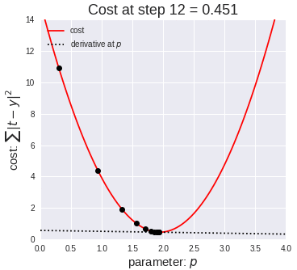
Gradient Descent
Iterative process used in ML to find local minimum in our loss function measuring errors
Moves in direction of
steepest descent
Step size decreases as
steepness lessens to
avoid missing minima
Custom variants for
NNs include adam
optimization

Slide 13
Activation Function
Determines a node’s output given its inputs
The ReLu (rectified linear unit) is simple and a good choice for most networks
Returns zero for negative
values and its input for
positive ones
  f(x) = max(0,x)

Slide 14
Regularization
Parameter to control overfitting,
i.e. when the model does well on training data but poorly on new, unseen data
L2 regularization is the most common
Using dropout is another common way of controlling overfitting in neural networks
  At each training stage, some hidden nodes temporarily removed (dropped out)

Slide 15
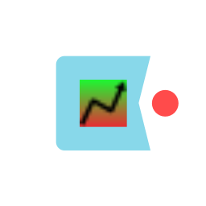
Hyperparameter optimization
How do we find the best settings for these hyperparameters?
Experimentation
  Experiment with a range of different settings (e.g., for learning rate) via multiple runs
  Use a grid search tool, e.g., scikit learn’s
Experience
  Similar problems with similar data will probably benefit from similar settings

Slide 16
http://playground.tensorflow.org/

