Slide 1
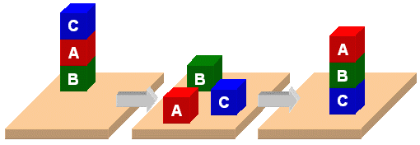
PDDL

Slide 2
PDDL
Planning Domain Description Language
Based on STRIPS with various extensions
First defined by Drew McDermott (Yale) et al.
  Classic spec: PDDL 1.2; good reference guide
Used in biennial International Planning Competition (IPC) series (1998-2020)
Many planners use it as a standard input

Slide 3
PDDL Representation
Task specified via two files: domain file and problem file
  Both use a logic-oriented notation with Lisp syntax
Domain file defines a domain via requirements, predicates, constants, and actions
  Used for many different problem files
Problem file: defines problem by describing its domain, objects, initial state and goal state
Planner: takes a domain and a problem and produces a plan

Slide 4

Blocks Word
Domain File
(define (domain BW)
(:requirements :strips)
(:constants red green blue yellow small large)
(:predicates (on ?x ?y) (on-table ?x) (color ?x ?y) … (clear ?x))
(:action pick-up
:parameters (?obj1)
:precondition (and (clear ?obj1) (on-table ?obj1)
(arm-empty))
:effect (and (not (on-table ?obj1))
(not (clear ?obj1))
(not (arm-empty))
(holding ?obj1)))
… more actions ...)

Slide 5
Blocks Word
Problem File
(define (problem 00)
(:domain BW)
(:objects A B C)
(:init (arm-empty)
(ontable A)
(on B A)
(on C B)
(clear C))
(:goal (and (on A B)
(on B C)
(ontable C)))
C
A
B
B
A
C

Slide 6
Blocks Word
Problem File
(define (problem 00)
(:domain BW)
(:objects A B C)
(:init (arm-empty)
(on B A)
(on C B)
(clear C))
(:goal (and (on A B)
(on B C))))
C
A
B
B
A
C
Begin plan
1 (unstack c b)
2 (put-down c)
3 (unstack b a)
4 (stack b c)
5 (pick-up a)
6 (stack a b)
End plan

Slide 7
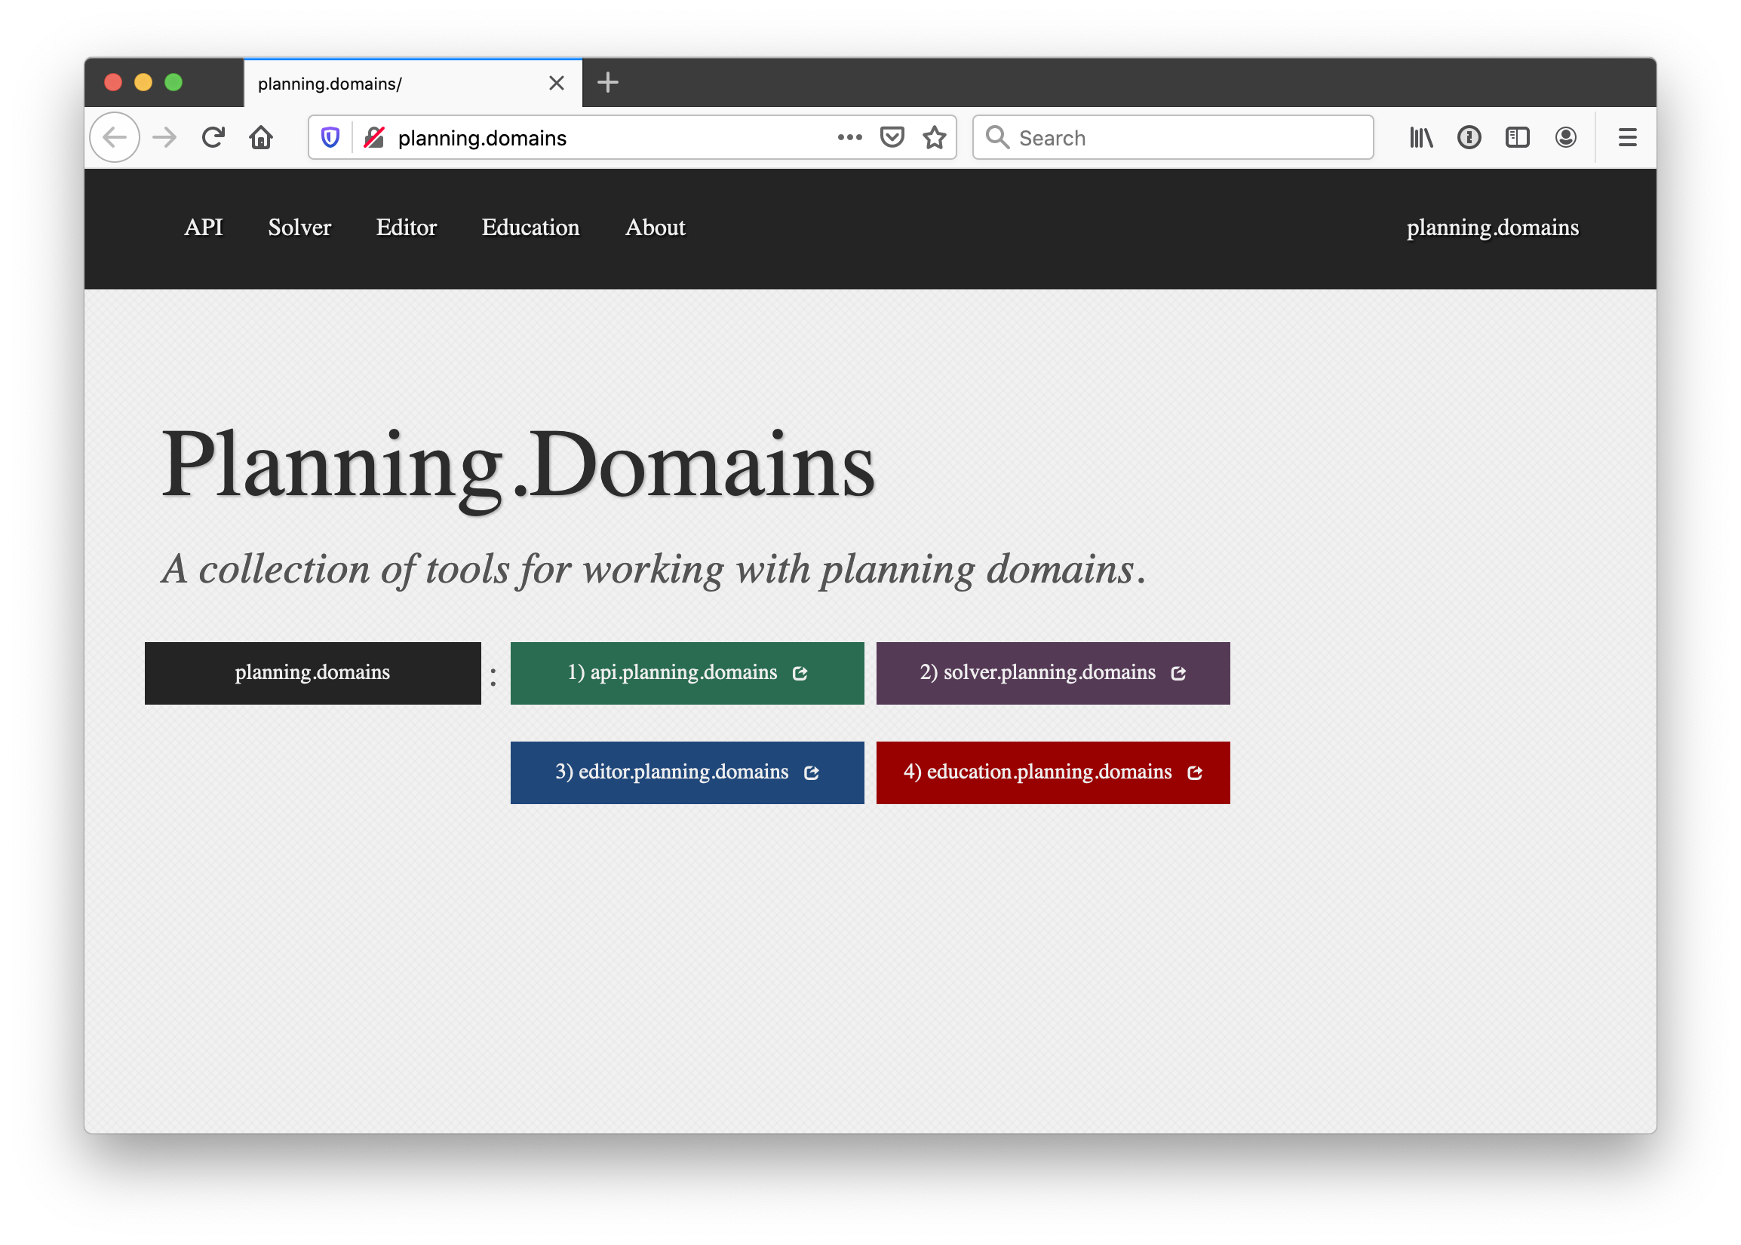
http://planning.domains/

Slide 8
Planning.domains
Open source environment for providing planning services using PDDL (GitHub)
Default planner is ff
  very successful forward-chaining heuristic search planner producing sequential plans
  Can be configured to work with other planners
Use interactively or call via web-based API
Use for HW5 to extend blocks world domain

