Slide 1
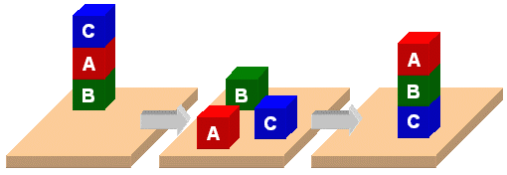
Classic Blocks World

Slide 2
Classic Blocks World
We’ll look at the classic blocks world domain
Starting with
  BW: a domain file
  Several problem files
We’ll use planning.domains to demonstrate solving the problems
And then show simple extensions to the domain by adding predicates and constants

Slide 3
bw.pddl 1
(define (domain bw)
(:requirements :strips)
(:predicates
(on ?x ?y) ; object ?x is on ?object ?y
(on-table ?x) ; ?x is directly on the table
(clear ?x) ; ?x has nothing on it
(arm-empty) ; robot isn't holding anything
(holding ?x)) ; robot is holding ?x
;; 4 actions to manipulate objects: pickup, putdown, stack, unstack
… actions in next four slides …
Allows basic add and
delete effects in actions
List all the predicates
with their arguments
Varialbles begin
with a ?

Slide 4
bw.pddl 2
(:action pick-up
:parameters (?ob)
:precondition
(and (clear ?ob)
(on-table ?ob)
(arm-empty))
:effect
(and (not (on-table ?ob))
(not (clear ?ob))
(not (arm-empty))
(holding ?ob)))
Variable for the argument
of a pick-up action
These three statements
must be True before we
can do a pick-up action
After doing a pick-up
action, these become
True
Adding (not ?X) removes
?X if it’s in the KB and
vice versa

Slide 5
bw.pddl 3
(:action put-down
:parameters (?ob)
:precondition (holding ?ob)
:effect
(and (not (holding ?ob))
(clear ?ob)
(arm-empty)
(on-table ?ob)))
(:action stack
:parameters (?ob1 ?ob2)
:precondition (and (holding ?ob) (clear ?ob2))
:effect
(and (not (holding ?ob))
(not (clear ?ob2))
(clear ?ob)
(arm-empty)
(on ?ob ?ob2)))
put-down means put the
thing you’re holding on
the table
stack means put the
thing you are holding on
another object

Slide 6
bw.pddl 5
unstack means take the
first arg off the second
arg
(:action unstack
:parameters (?ob1 ?ob2)
:precondition
(and (on ?ob1 ?ob2)
(clear ?ob1)
(arm-empty))
:effect
(and (holding ?ob1)
(clear ?ob2)
(not (clear ?ob1))
(not (arm-empty))
(not (on ?ob1 ?ob2)))
) ; this closes the domain definition
First arg can’t have
anything on it & the
robot can’t be holding
anything
Updates to KB
describing new state of
the world

Slide 7
p03.pddl
;; The arm is empty and there is a stack of three blocks: C is on B which is on A
;; which is on the table. The goal is to reverse the stack, i.e., have A on B and B
;; on C. No need to mention C is on the table, since domain constraints will enforce it.
(define (problem p03)
(:domain bw)
(:objects A B C)
(:init (arm-empty)
(on-table A)
(on B A)
(on C B)
(clear C))
(:goal (and (on A B)
(on B C))))
C
A
B
B
A
C

Slide 8
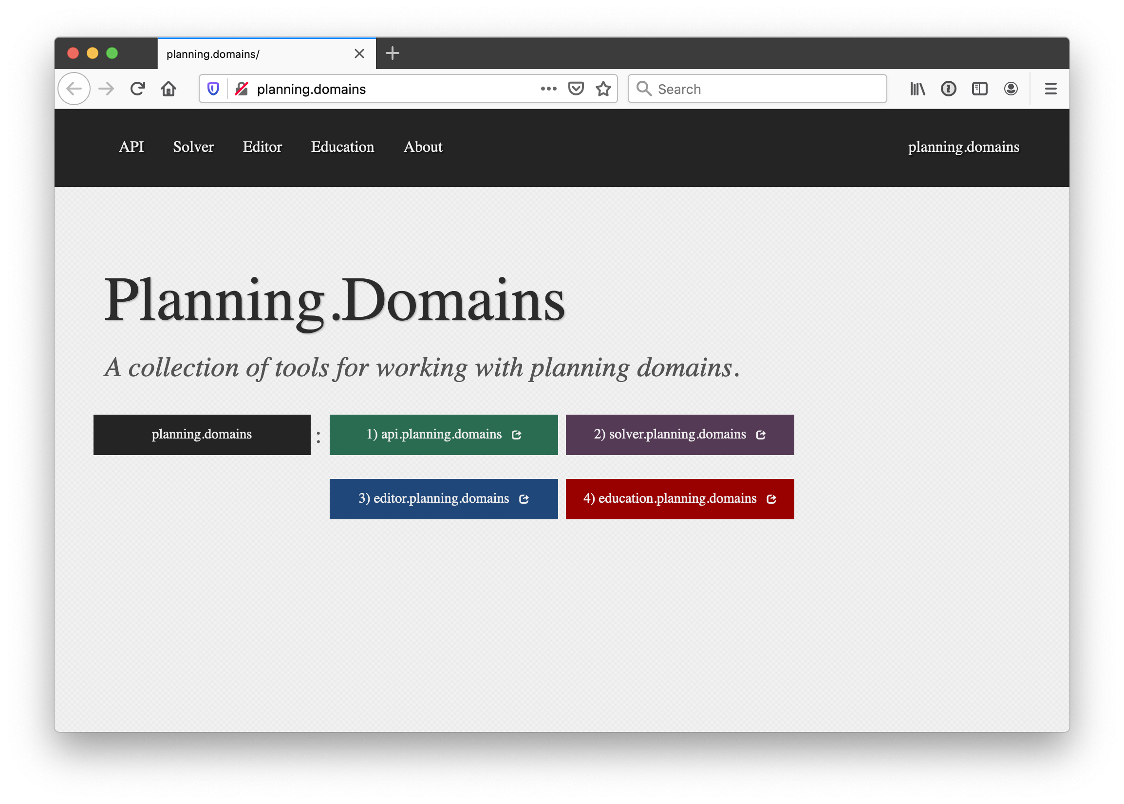
http://planning.domains/
Open the PDDL editor,
upload our domain and
problem files, and run
the solver.

Slide 9
Online Demonstration
Using planning.domains and files in the planning directory of our 2020 671 code repo
Blocks world
bw.pddl
p01.pddl
p02.pddl …
Air Cargo
  ac_domain.pddl
  Ac_p0.pddl

Slide 10
Fin

