Slide 1
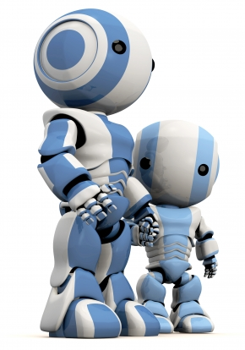
Intelligent Agents
Chapter 2

Slide 2
Agents and AI
Much of our text is organized around the concept of autonomous agents
It defines an agent as
  anything that can be viewed as perceiving its environment through sensors and acting upon that environment through actuators
Not all AI problems or tasks need or fit this concept, but it’s quite general
We’ll explore the concept today

Slide 3
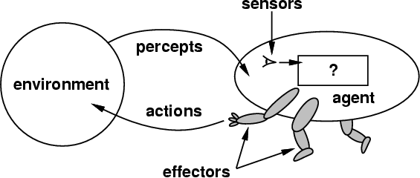
How do you design an intelligent agent?
Intelligent agents perceive environment via sensors and act rationally on them with their effectors
Discrete agents receive percepts one at a time, and map them to a sequence of discrete actions
General properties
  Reactive to the environment
  Pro-active or goal-directed
  Interacts with other
  agents through
  communication or
  via the environment
  Autonomous

Slide 4
sensors/percepts and effectors/actions ?
Humans have
  Sensors: Eyes (vision), ears (hearing), skin (touch), tongue (gustation), nose (olfaction), neuromuscular system (proprioception)
  Percepts: things that are perceived
    lowest level: electrical signals from these sensors
    After processing: objects in visual field (location, textures, colors, …), auditory streams (pitch, loudness, direction), …
  Effectors: limbs, digits, eyes, tongue, …
  Actions: lift finger, turn left, walk, run, carry an object, …
Note: percepts and actions need to be carefully defined, possibly at different levels of abstraction

Slide 5
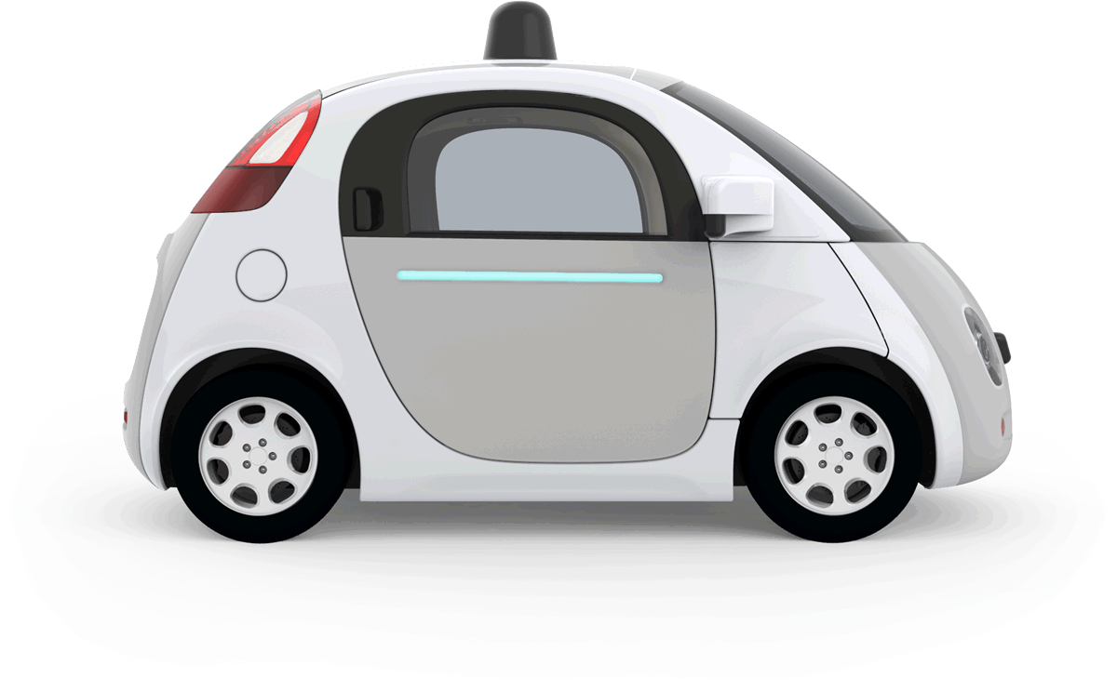
Example: autonomous taxi
Percepts: Video, sonar, speedometer,
odometer, engine sensors, keyboard
input, microphone, GPS, …
Actions: Steer, accelerate, brake, horn, speak, …
Goals: Maintain safety, reach destination, maximize profits (fuel, tire wear), obey laws, provide passenger comfort, …
Environment: U.S. urban streets, freeways, traffic, pedestrians, weather, customers, …
Different aspects of driving may require different types of agent programs!

Slide 6
Rationality
Ideal rational agents should, for each input, act to
maximize expected performance measure based on
    (1) percept sequence, and
    (2) its built-in and acquired knowledge
Rationality → Need a performance measure to say how well a task has been achieved
Types of performance measures: false alarm (false positive) & false dismissal (false negative) rates, speed, resources required, effect on environment, money earned, …
Notes:
Consider measuring the performance of a airport TSA check point: its more important to minimize false negatives than false positives
When choosing a mate, it might be reversed

Slide 7
Omniscience and learning
Rational agents aren’t expected to know everything
But to use what they do know effectively
Rationality includes information gathering -- If you don’t know something that might be useful, find out!
Rationality also can exploit learning – making generalization from past experience to fill in missing information

Slide 8

Autonomy
A system is autonomous to extent that its behavior is determined by its experience
A system isn’t autonomous if guided by its designer according to a priori decisions
An autonomous agent can always say “no”
To survive, agents must have:
  Enough built-in knowledge to survive
  The ability to learn

Slide 9

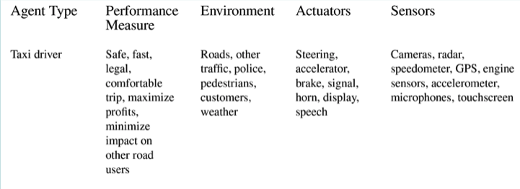
PEAS model: Taxi Agent
Performance, Environment, Actuators, Sensors
Example of an autonomous taxi

Slide 10
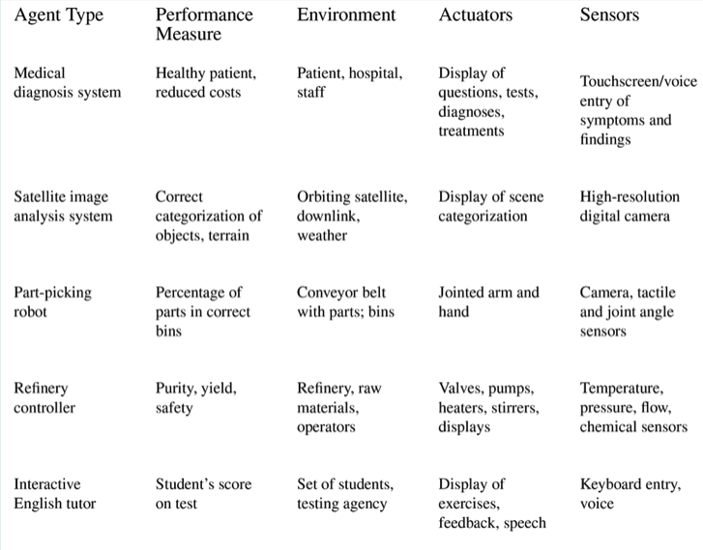
PEAS model: Other Agents
Note that three of the five are not physical agents

Slide 11
Some agent types
(0) Table-driven agents
  Use percept sequence/action table to find next
  action. Implemented by a lookup table
(1) Simple reflex agents
  Based on condition-action rules, stateless devices
  with no memory of past world states
(2) Agents with memory
  have represent states and keep track of past world states
(3) Agents with goals
  Have a state and goal information describing desirable situations; can take future events into consideration
(4) Utility-based agents
  base decisions on utility theory in order to act rationally
simple
complex

Slide 12
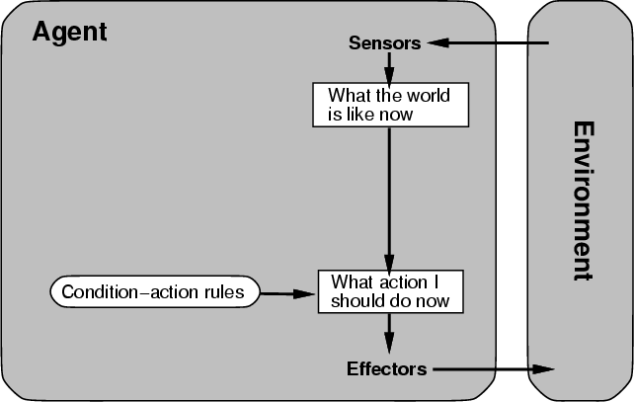
(0/1) Table-driven/reflex agent architecture
  Use percept sequence/action table to find the next action. Implemented by a (large) lookup table

Slide 13
(0) Table-driven agents
Table lookup of percept-action pairs mapping from every possible perceived state to optimal action for it
Problems:
  Table may be too big to generate and to store (e.g., chess has about 10¹²⁰ states)
  No knowledge of non-perceptual parts of the current state (e.g., desirability of states)
  Not adaptive to changes in the environment; entire table must be updated if changes occur
  Looping: Can’t make actions conditional on previous actions/states

Slide 14
(1) Simple reflex agents
Rule-based reasoning maps percepts to optimal action; each rule handles collection of perceived states (aka reactive agents)
Problems remain
  Usually too big to generate and to store
  No knowledge of non-perceptual parts of state
  Not adaptive to changes in environment; collection of rules must be updated if changes occur
  Can’t condition actions on previous state
  Difficult to engineer if number of rules large due to conflicts

Slide 15
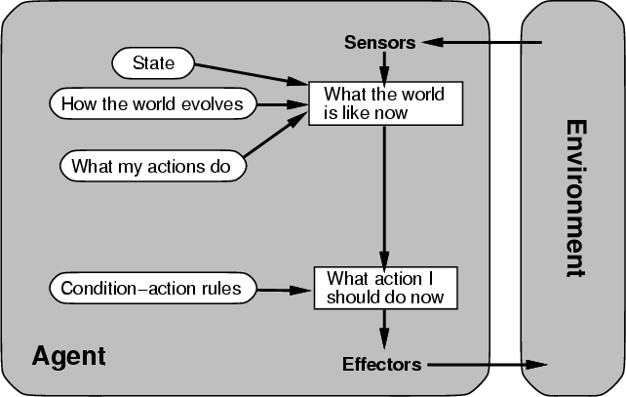
(2) Architecture for an agent with memory
  internal state keeps track of past states of the world

Slide 16
(2) Agents with memory
Encode internal state of world to remember past as modeled by earlier percepts
  Note: sensors don’t usually give entire world state at each input, so environment perception is captured over time
  State used to encode different "world states" that generate the same immediate percept
Requires representing change in the world
  Might represent just latest state, but then can’t reason about hypothetical courses of action

Slide 17
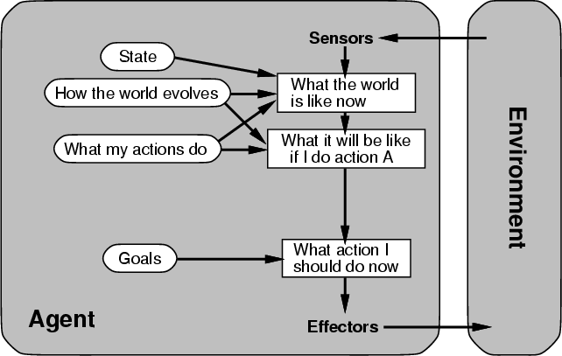
(3) Architecture for goal-based agent
state and goal information describe desirable situations allowing agent to take future events into consideration

Slide 18

(3) Goal-based agents
Deliberative instead of reactive
Choose actions to achieve a goal
Goal: description of a desirable situation
Keeping track of current state often not enough; must add goals to decide which situations are good
Achieving goal may require an action sequence
  Model action consequences: “what happens if I do...?”
  Use planning algorithms to produce action sequences

Slide 19
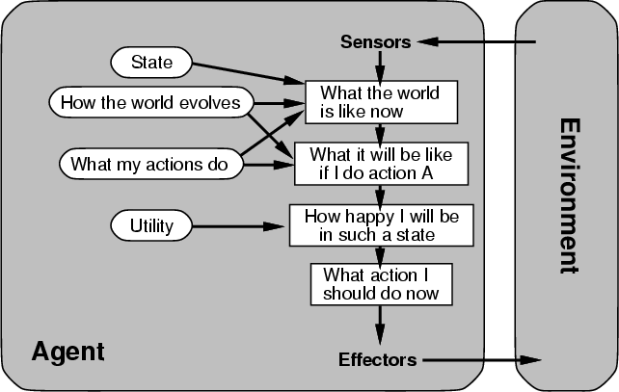
(4) complete utility-based agent
  base decisions on utility theory in order to act rationally

Slide 20
(4) Utility-based agents
For multiple possible alternatives, how to decide which is best?
Goals give a crude distinction between happy and unhappy states, but often need a performance measure for degree
Utility function U: State→Reals gives measure of success/happiness for given state
Allows decisions comparing choices between conflicting goals and likelihood of success and importance of goal (if achievement uncertain)

Slide 21
Problem Environments
Characteristics of the problem environment have a big impact on an agent’s requirements
Consider developing an agent to
  Solve a crossword puzzle, vs.
  Drive a Taxi
We can identify some general characteristics to help us understand the problem and possible approaches to solving it

Slide 22
Properties of Environments (1)
Fully/Partially observable
  Agent’s sensors give complete state of environment needed to choose action: environment is fully observable
  Such environments are convenient, freeing agents from keeping track of the environment’s changes
Deterministic/Stochastic
  Environment is deterministic if next state is completely determined by current state and agent’s action
  Stochastic (i.e., non-deterministic) environments have multiple, unpredictable outcomes
In fully observable, deterministic environments agents need not deal with uncertainty

Slide 23
Properties of Environments (2)
Episodic/Sequential
  In episodic environments subsequent episodes don’t depend on actions in previous episodes
  In sequential environments agent engages in a series of connected episodes
  Episodic environments don’t require agent to plan ahead
Static/Dynamic
  Static environments don’t change as agent is thinking
  The passage of time as agent deliberates is irrelevant
  The agent needn’t observe world during deliberation

Slide 24
Properties of Environments (3)
Discrete/Continuous
  If number of distinct percepts and actions is limited, environment is discrete, otherwise it’s continuous
Single agent/Multiagent
  In environments with other agents, agent must consider strategic, game-theoretic aspects of environment (for either cooperative or competitive agents)
  Most engineering environments don’t have multiagent properties, whereas most social and economic systems get their complexity from interactions of (more or less) rational agents

Slide 25
Characteristics of environments
 | Fully observable? | Deterministic? | Episodic? | Static? | Discrete? | Single agent?
Solitaire
Backgammon
Taxi driving
Internet shopping
Medical diagnosis
A Yes in a cell means that aspect is simpler; a No more complex

Slide 26
Characteristics of environments
 | Fully observable | Deterministic | Episodic | Static | Discrete? | Single agent?
Solitaire | No | Yes | Yes | Yes | Yes | Yes
Backgammon
Taxi driving
Internet shopping
Medical diagnosis
A Yes in a cell means that aspect is simpler; a No more complex

Slide 27
Characteristics of environments
 | Fully observable? | Deterministic? | Episodic? | Static? | Discrete? | Single agent?
Solitaire | No | Yes | Yes | Yes | Yes | Yes
Backgammon | Yes | No | ? | Yes | Yes | No
Taxi driving
Internet shopping
Medical diagnosis
A Yes in a cell means that aspect is simpler; a No more complex

Slide 28
Characteristics of environments
 | Fully observable? | Deterministic? | Episodic? | Static? | Discrete? | Single agent?
Solitaire | No | Yes | Yes | Yes | Yes | Yes
Backgammon | Yes | No | No | Yes | Yes | No
Taxi driving | No | No | No | No | No | No
Internet shopping
Medical diagnosis
A Yes in a cell means that aspect is simpler; a No more complex

Slide 29
Characteristics of environments
 | Fully observable? | Deterministic? | Episodic? | Static? | Discrete? | Single agent?
Solitaire | No | Yes | Yes | Yes | Yes | Yes
Backgammon | Yes | No | No | Yes | Yes | No
Taxi driving | No | No | No | No | No | No
Internet shopping | No | No | No | No | Yes | No
Medical diagnosis
A Yes in a cell means that aspect is simpler; a No more complex

Slide 30
Characteristics of environments
→ Lots of real-world domains fall into the hardest case!
 | Fully observable? | Deterministic? | Episodic? | Static? | Discrete? | Single agent?
Solitaire | No | Yes | Yes | Yes | Yes | Yes
Backgammon | Yes | No | No | Yes | Yes | No
Taxi driving | No | No | No | No | No | No
Internet shopping | No | No | No | No | Yes | No
Medical diagnosis | No | No | No | No | No | Yes
A Yes in a cell means that aspect is simpler; a No more complex

Slide 31
Summary
Agents perceive and act in an environment, have an architecture and are implemented by an agent program
Ideal agents choses actions to maximize their expected performance, given percept sequence so far
Autonomous agents use own experience rather than built-in knowledge of environ-ment by designer

Slide 32
Summary
Agent programs map percepts to actions and update their internal state
  Reflex agents respond immediately to percepts
  Goal-based agents act to achieve their goal(s)
  Utility-based agents maximize their utility function
Representing knowledge is important for good agent design
Most challenging environments are partially observable, stochastic, sequential, dynamic, and continuous and contain multiple agents

Slide 33
Summary
Not all AI problems a good fit for or require an agent agent model, e.g., playing solitaire
Nor are many AI tasks you might need to solve:
  Classify movie reviews as negative, neutral or positive
  Locate faces of people in an image
  Use an efficient theorem prover
  Learn preferred thermostat settings for each hour of each day of a week

