Slide 1

CMSC 471
Introduction to
Artificial Intelligence
Course Overview
Spring 2021
Section 02

Slide 2
Today’s Class
Course overview
Introduction
  Brief history of AI
  What is AI? (and why is it so interesting?)
  What’s the state of AI now?

Slide 3
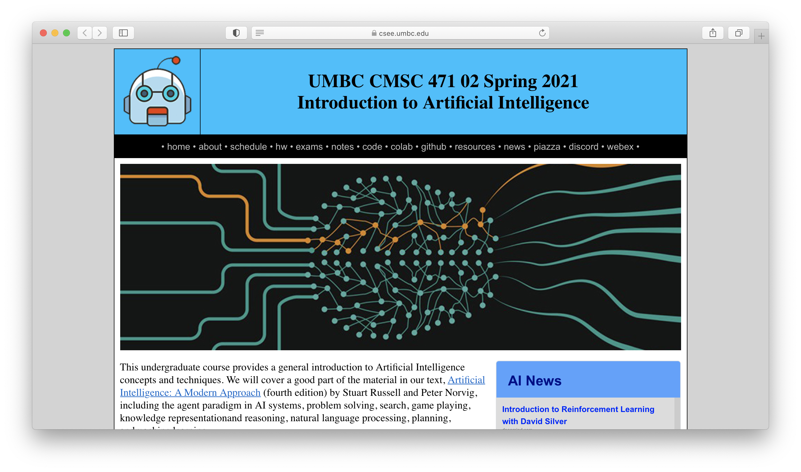
http://bit.ly/471s21

Slide 4
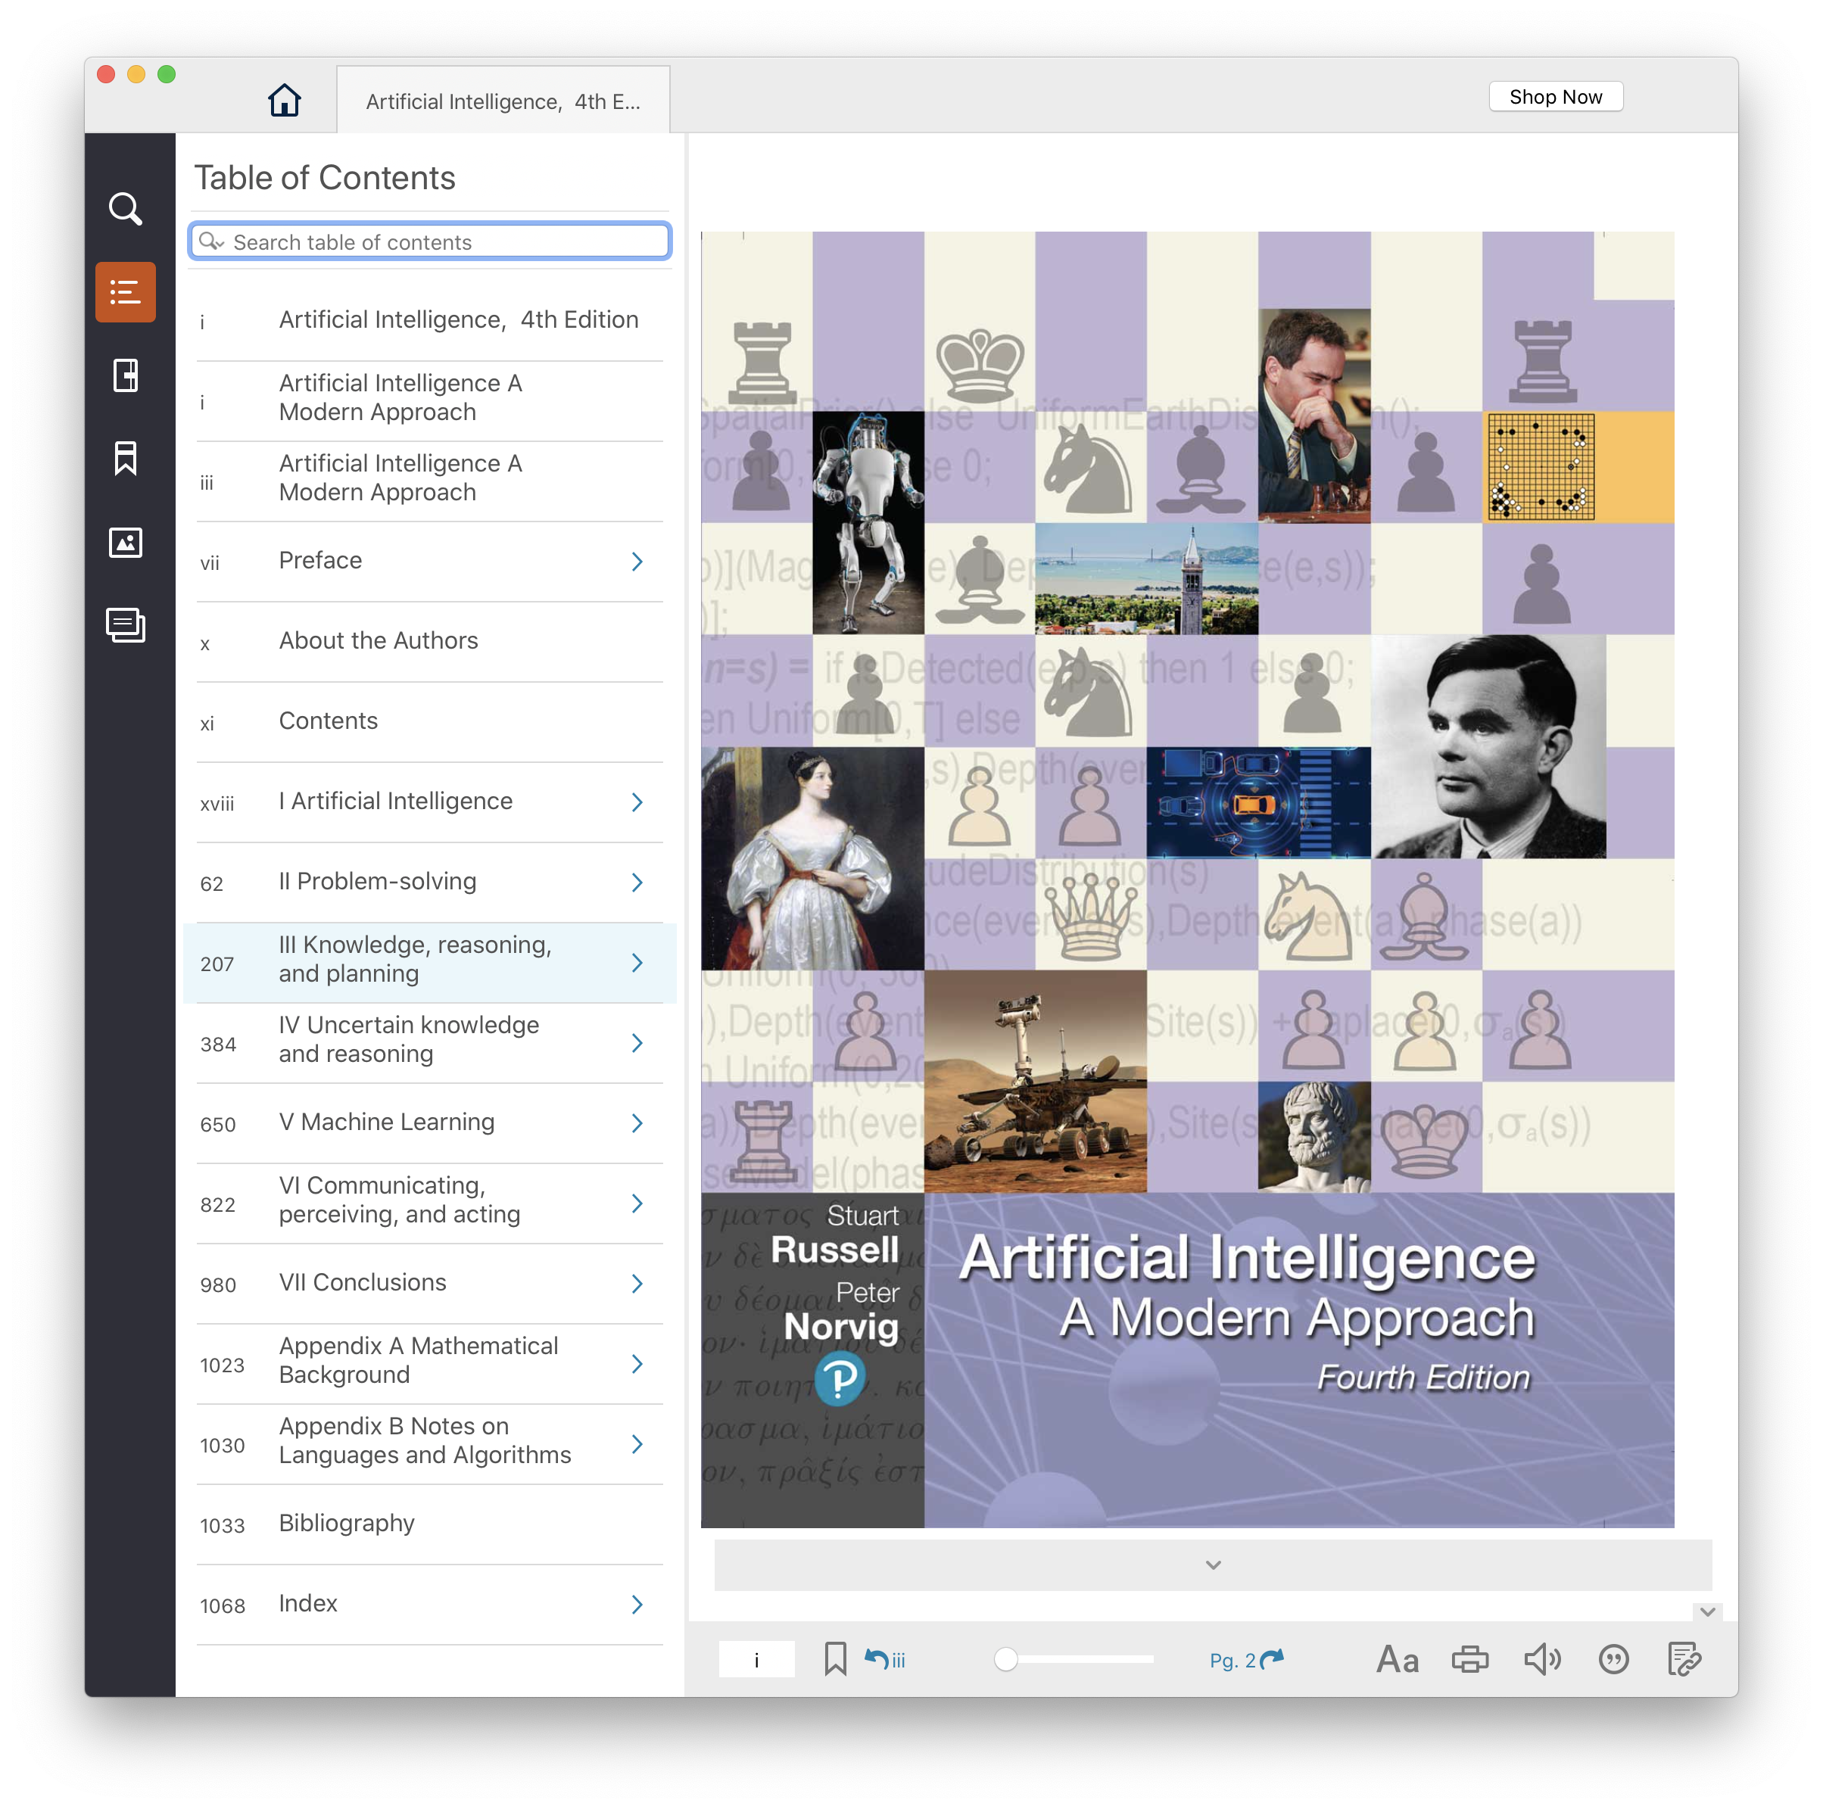
Text, CMI
4th edition of AIMA (2020) has lots of new material since the 2009 3rd edition
UMBC CMI program charges
$44 for a digital version, $160
on Amazon for hardcopy
Access on Blackboard ordown- load epub to computer/phone
Opt-out of CMI via form

Slide 5
Homework and grading policies
Six to eight short homework assignments (mix of written and programming)
  One-time extensions of up to a week may be granted if requested in advance
  Last-minute requests for extensions probably will not be granted
Do the reading before each class!

Slide 6
Programming
Programming assignments in Python
  We’ll use Python 3 in the notes and examples
We’ll use GitHub to share code, Jupyter notebooks and for HW submission
Some assignments may require other systems
  E.g., C5 decision tree learning system, Weka Machine learning environments

Slide 7
Exams and Quizes
Periodic short quizzes (10%)
  On Blackboard every other week or so
Midterm exam (15%)
  On Blackboard, October 10
Final exam (25%)
  On Blackboard, December 15
  Comprehensive with an emphasis on last half of material (e.g., 30/70 split)

Slide 8
Instructor availability
Professor Finin, finin@umbc.edu
  Office hours: Tue/Fri 9-10 on Webex
Direct general questions to Piazza first
  We’ll try to respond within 24 hours
TA: TBD
Grader: TBD
If needed, we may try holding help session on Discord

