Slide 1
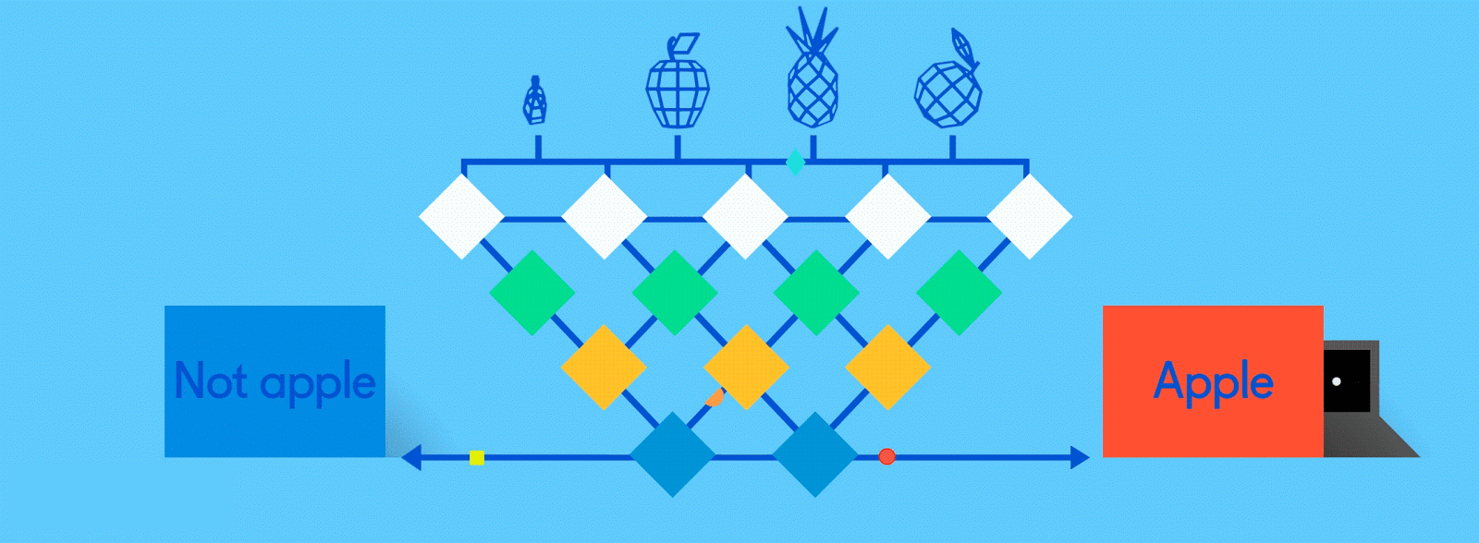
Neural Networks
History

Slide 2
Pitts & McCulloch (1943)
First mathematical model of biological neurons
All Boolean operations can be implemented by these neuron-like nodes
Competitor to Von Neumann model for general purpose computing device
Origin of automata theory

Slide 3
Hebb (1949)
Hebbian rule of learning: increase connection strength between neurons i and j whenever both are activated
Or increase connection strength between nodes i and j whenever both are simultaneously ON or OFF

Slide 4
Early booming (50s – early 60s)
Rosenblatt (1958-1960)
  Perceptron: network of threshold nodes
  for pattern classification; perceptron
  learning rule
  Mark 1 perceptron computer
Widrow and Hoff (1960, 1962)
  Learning rule based on gradient descent (differentiable unit)
Minsky trys to build general purpose machine with Pitts/McCullock units

Slide 5
History: setback in mid 60s – late 70s)
Serious problems with perceptron model (Minsky’s book 1969)
  Single layer perceptrons cannot represent (learn) simple functions such as XOR
  Multi-layer of non-linear units may have greater power but there is no learning rule for such nets
  Scaling problem: connection weights may grow infinitely
  First two problems overcame by latter effort in 80s, but scaling problem persists
Death of Rosenblatt (1964)
Striving of Von Neumann machine and AI

Slide 6
Renewed enthusiasm 80s
New techniques
  Backpropagation for multi-layer feed forward nets (with non-linear, differentiable node functions)
  Thermodynamic models (Hopfield net, Boltzmann machine …)
  Unsupervised learning
Applications: character recognition, speech recognition, text-to-speech, etc.
Traditional approaches face difficult challenges
Caution:
  Don’t underestimate difficulties and limitations
  Poses more problems than solutions

Slide 7
Not with a perceptron ☹
Training examples are not linearly separable for one case: sum=1 iff x1 xor x2

Slide 8
Works well on some problems
Learning curves
Are majority of inputs 1?
Restaurant example: WillWait?

