Slide 1
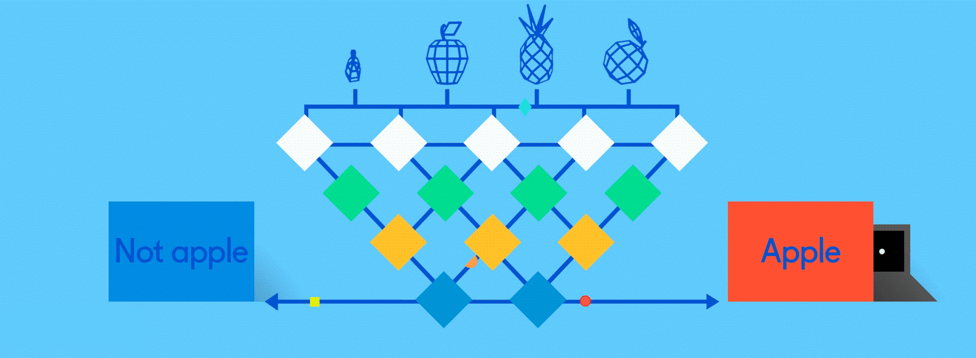
Neural Networks for Machine Learning introduction

Slide 2
Biological neural activity
Neurons have body, axon and many dendrites
  In one of two states: firing and rest
  They fire if total incoming stimulus > threshold
Synapse: thin gap between axon of one neuron and dendrite of another
  Signal exchange

Slide 3
Artificial neural network
Set of nodes with inputs and outputs
Node performs computation via its activation function
Weighted connections between nodes
Connectivity gives network architecture
NN computations depend on connections & weights
Notes:
Set of nodes
Node have inputs and outputs
Nodes performs computation via its activation function
Weighted connections between nodes
Connectivity gives structure/architecture of net
What can be computed by a NN determined by the connections and their weights
Simplified version of networks of neurons in animal nerve systems

Slide 4
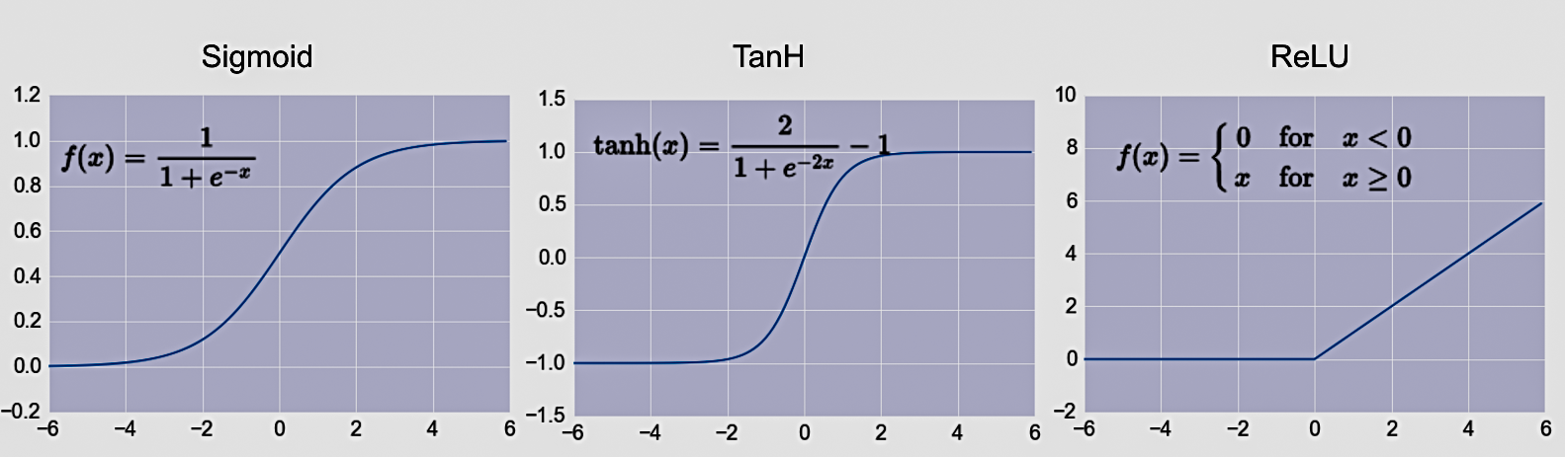
Common Activation Functions
Choice of activation function depends on problem and available computational power

Slide 5
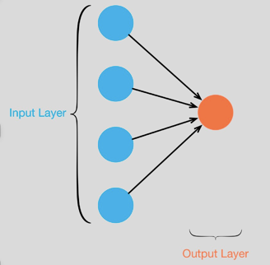
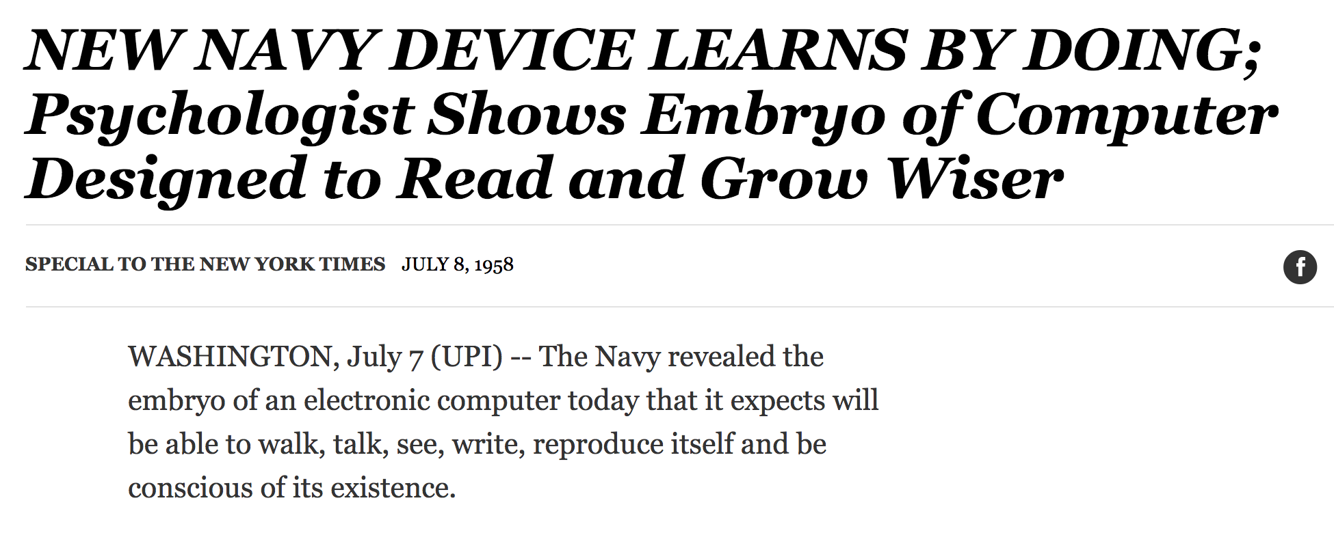
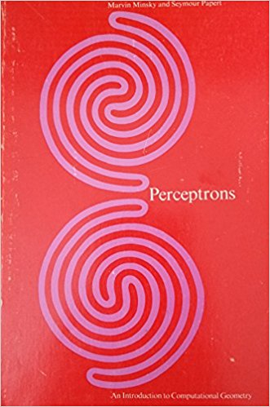
Single Layer Perceptron
Full 1958 NYT article above here
Rosenblatt: it can learn to compute functions by learning weights on inputs from examples
Not all functions ☹️, cf. Perceptrons

Slide 6
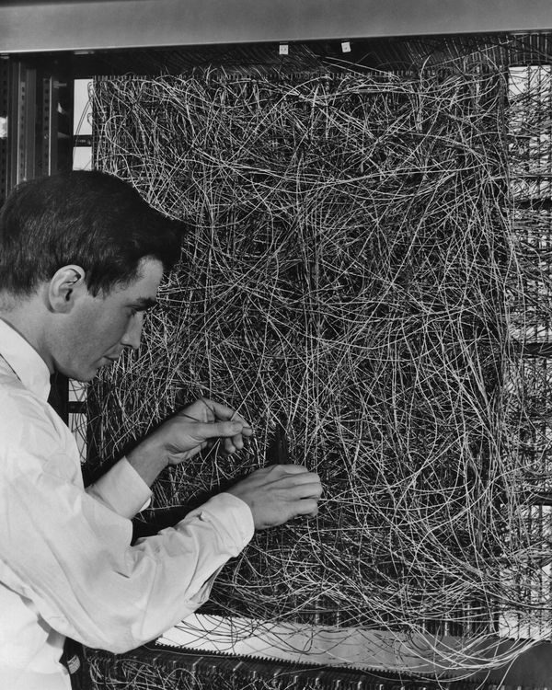
A man adjusting the random wiring network between the light sensors and association unit of scientist Frank Rosenblatt's Perceptron, or MARK 1 computer, at the Cornell Aeronautical Laboratory, Buffalo, New York, circa 1960. The machine is designed to use a type of artificial neural network, known as a perceptron. (Photo by Frederic Lewis/Archive Photos/Getty Images)

Slide 7
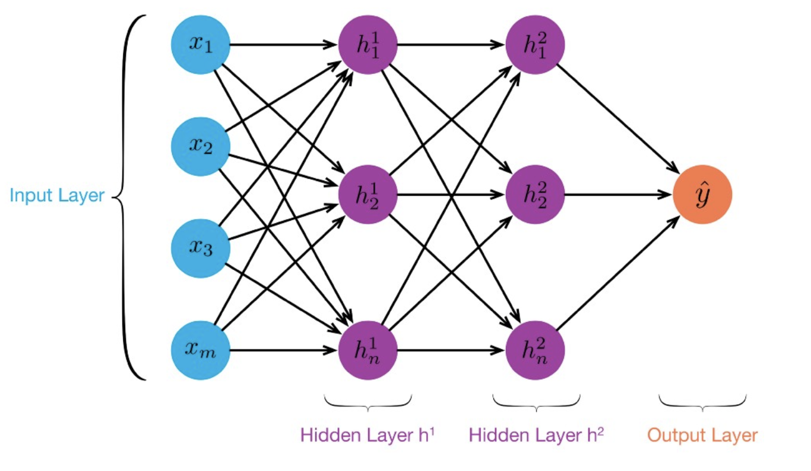
MLP:
Multilayer
Perceptron
≥ 1 “hidden layers” between inputs & output
Can compute non-linear functions
Training: adjust weights slightly to reduce error between output y and target value t; repeat
Introduced in 1980s, still used today

Slide 8
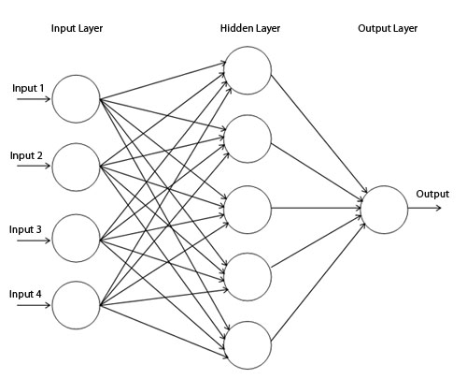
Backpropagation
Forward direction
Calculate network and error
Rumelhart, David E.; Hinton, Geoffrey E.; Williams, Ronald J. (8 October 1986). Learning representations by back-propagating errors. Nature. 323 (6088): 533–536.

Slide 9
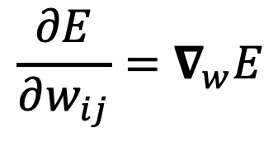
Backpropagation
Backward direction
Backpropagate: from output to input, recursively compute and adjust weights
$$\frac{∂E}{∂w_{ij}}=∇_{w}E$$

Slide 10
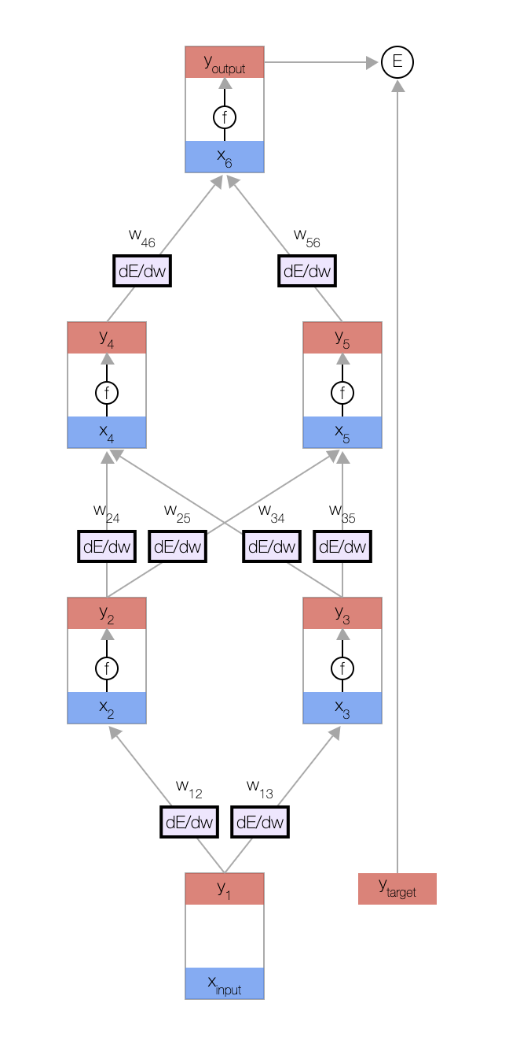
Backprop Explained
A simple animation shows how backprop works
A MLP with one input, two hidden layers and one output
Click on image or go to http://bit.ly/471bpd to view in your browser

Slide 11
Neural Network Architectures
Current focus on large networks with different “architectures” suited for different kinds of tasks
Feedforward Neural Network
CNN: Convolutional Neural Network
RNN: Recurrent Neural Network
LSTM: Long Short Term Memory
GAN: Generative Adversarial Network

Slide 12
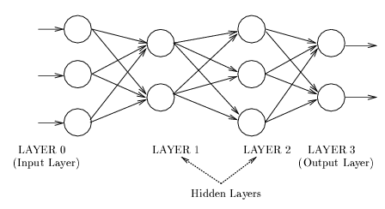
Feedforward Neural Network
Connections allowed from a node in layer i only to nodes in layer i+1
  i.e., no cycles or loops
Simple, widely used architecture.
downstream nodes tend to successively abstract features from preceding layers
http://playground.tensorflow.org/

Slide 13

http://playground.tensorflow.org/

Slide 14
CNN: Convolutional Neural Network
Good for image processing: classification, object recognition, automobile lane tracking, etc.
Classic demo: learn to recognize hand-written digits from MNIST data with 70K examples

Slide 15
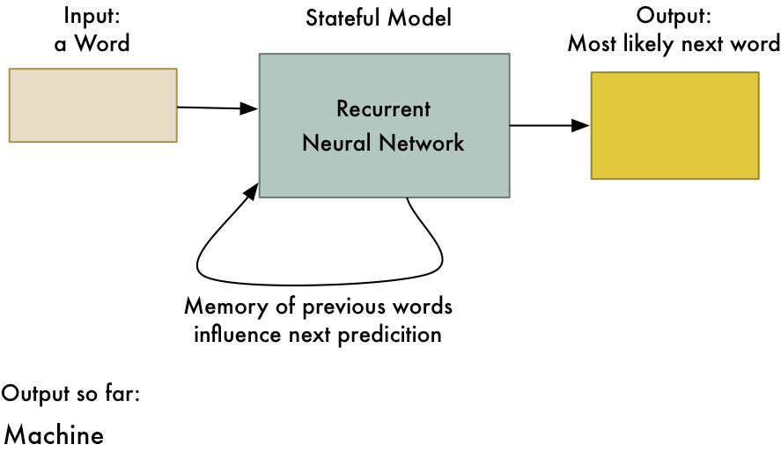
RNN: Recurrent Neural Networks
Good for learning over sequences of data, e.g., a sentence orf words
LSTM (Long Short Term Memory) a popular architecture
gif from Adam Geitgey

Slide 16
Deep Learning Frameworks
Popular open source deep learning frame-works use Python at top-level; C++ in backend
  TensorFlow (via Google)
  PyTorch (via Facebook)
  MxNet (Apache)
  Caffe (Berkeley)
Keras: popular API works with the first two and provides good support at architecture level
Notes:
Demo: MNIST CNN
Demo: RNN sentiment

Slide 17
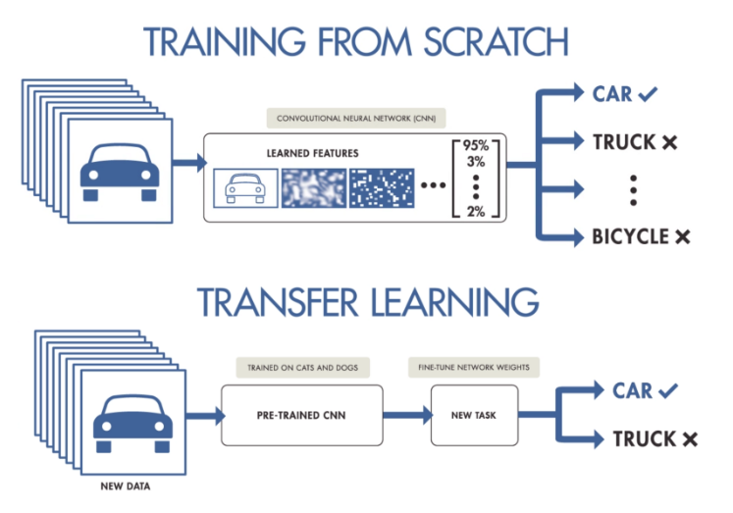
Good at Transfer Learning
Neural networks effective for transfer learning
  Using parts of a model trained on a task as an initial model to train on a different task
Particularly effective for image recognition

Slide 18
Good at Transfer Learning
For images, the initial stages of a model learn high-level visual features (lines, edges) from pixels
Final stages predict task-specific labels
source:http://ruder.io/transfer-learning/

Slide 19
Fine Tuning a NN Model
Special kind of transfer learning
  Start with a pre-trained model
  Replace last output layer with a new one
  Fix all but last layer by marking as trainable:false
Retraining on new task and data very fast
  Only the weights for the last layer are adjusted
Example
  Start: NN to classify animal pix with 100s of categories
  Finetune on new task to classify pix of 15 common pets

Slide 20
Conclusions
Quick introduction to neural networks and deep learning
Learn more by
  Take UMBC’s CMSC 478 machine learning class
  Try scikit-learn’s neural network models
  Explore Google’s Machine Learning Crash Course
  Try Miner/Kasch tutorial on applied deep learning
  Work through examples
and then try your own project idea

