Slide 1
What’s better than a tree?
14.5

Slide 2
Random Forest
Can often improve performance of decision tree classifiers using a set of decision trees (a forest)
Each tree trained on a random subset of training data
Classify a data instance using all trees
Combine answers to make classification
  E.g., vote for most common class

Slide 3
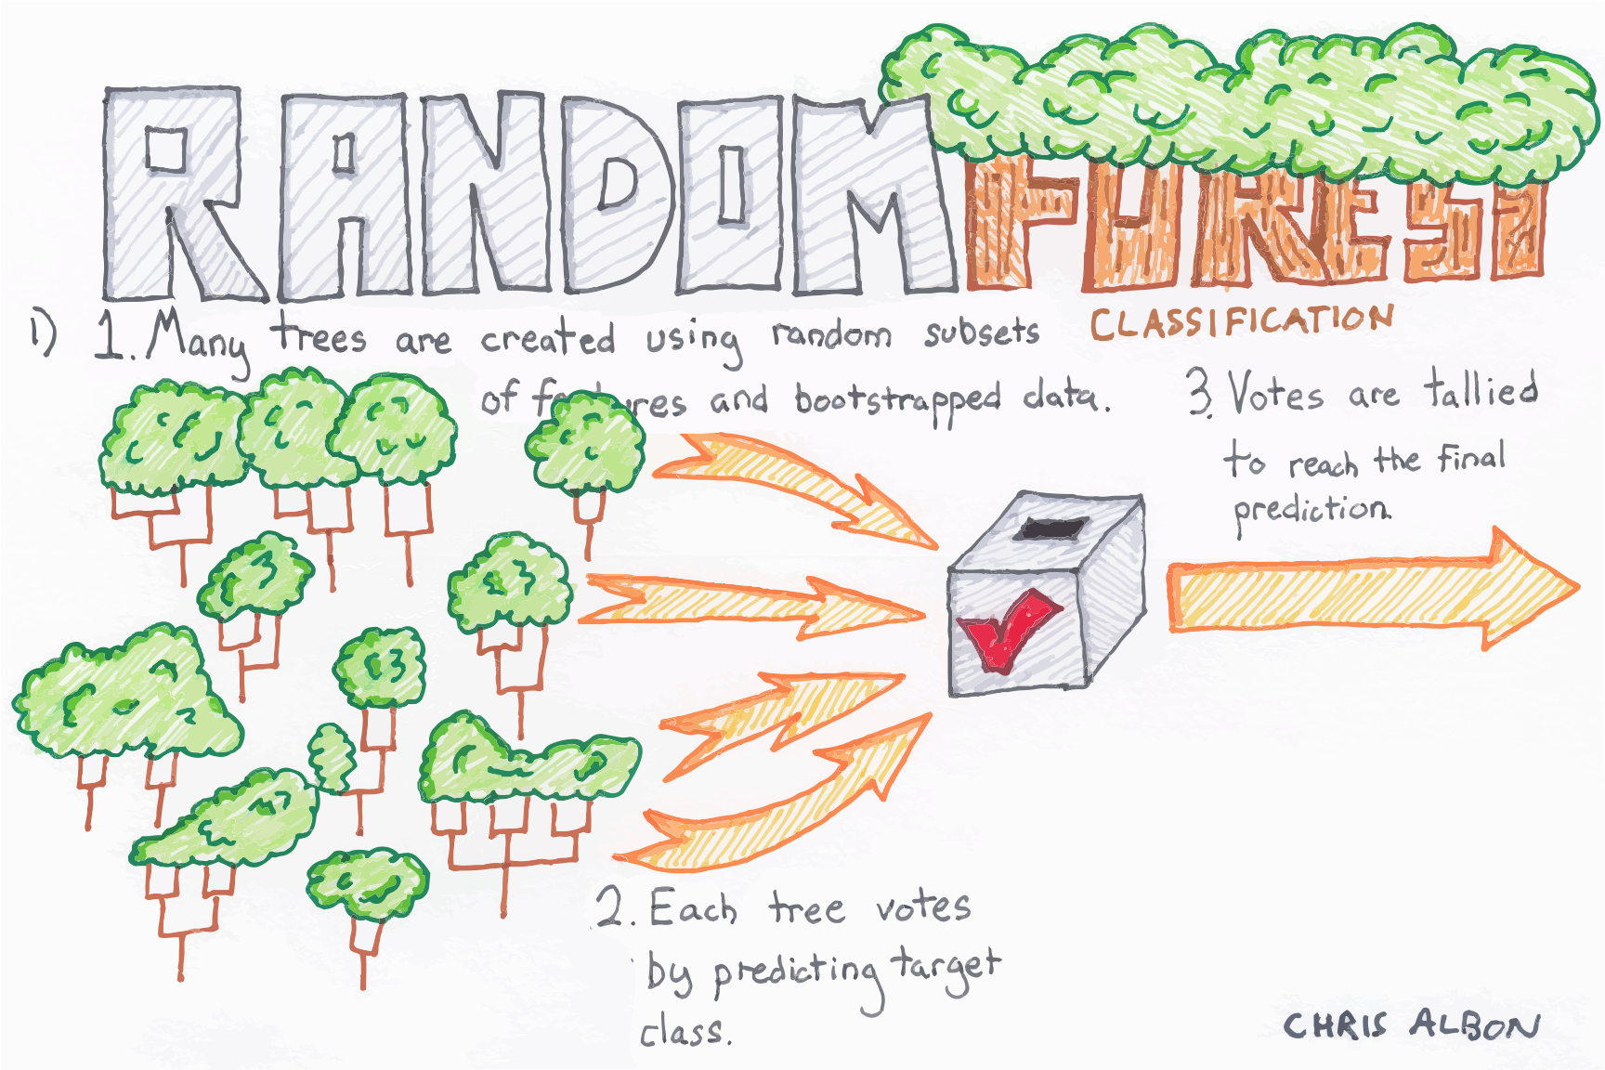

Slide 4
cf. Wisdom of the Crowd
Statistician Francis Galton observed a 1906 contest to guess the weight of an ox at a country fair that 800 people entered. He discovered that their average guess (1,197lb) was very close to the actual weight (1,198lb)
When getting human annotations training data for machine learning, standard practice is get ≥ 3 annotations and take majority vote
cf. abbreviation (short for Latin: confer/conferatur) refer reader to other material to make a comparison

Slide 5
Random Forests Benefits
Decision trees not the strongest modeling approach
Random forests make them much stronger
=> more robust than a single decision tree
  Limit overfitting to given dataset
  Reduce errors due to training data bias
  Stable performance if some noise added to training data

Slide 6
Bagging
Idea can be used on any classifier!
Improve classification by combining classifications of randomly selected training subsets
Bagging = Bootstrap aggregating
  An ensemble meta-algorithm that can improve stability & accuracy of algorithms for statistical classification and regression
Helps avoid overfitting

Slide 7
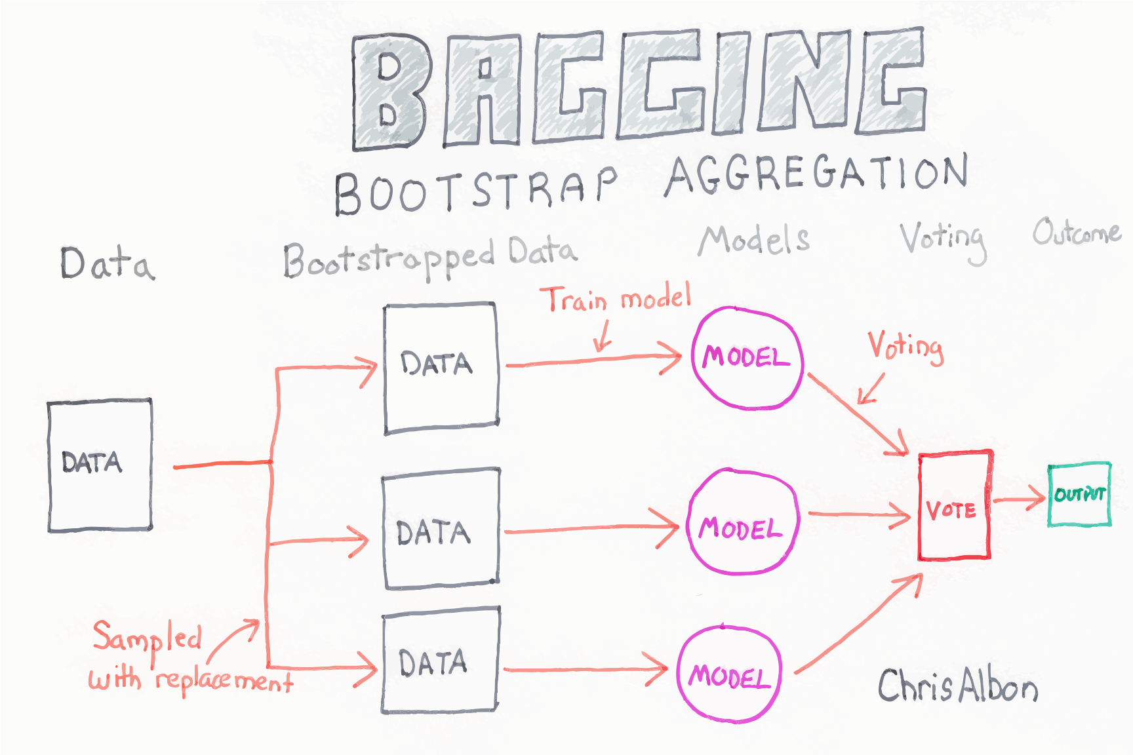

Slide 8
Choosing subsets of training data
Classic bagging: select random subset of training instances with replacement
Pasting: select random subset of training instances
Random Subspaces: use all training instances, but with a random subset of features
Random Patches: random subset of instances and random subset of features
What’s best? YMMV: depends on problem, training data, algorithm

Slide 9
Examples
Two examples using Weka
  UCI Auto mpg prediction dataset
  UCI Adult income prediction dataset
RandomForest improves over J48 for the smaller dataset, but not for the larger
Takeaway: more data is always best

Slide 10
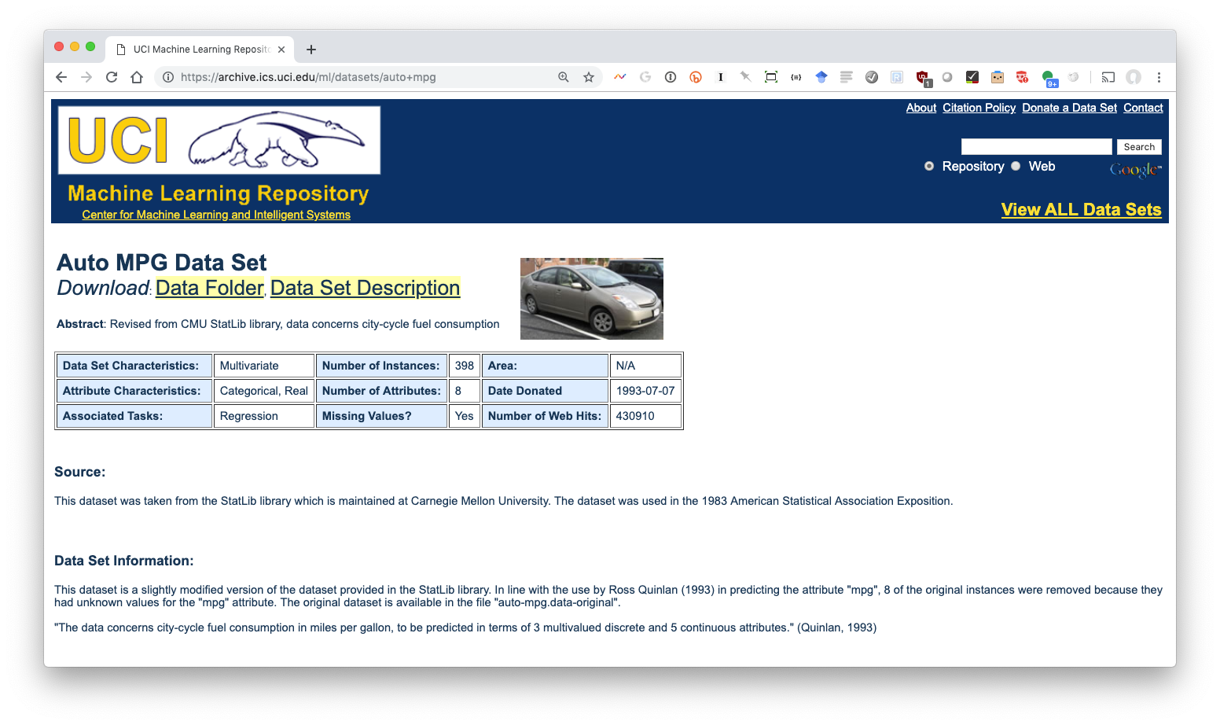
UCI Auto MGP Dataset (1)

Slide 11
UCI Auto MGP Dataset (2)
Data from 1983
398 instances
Predict auto mpg from seven attributes:
  Number of cylinders
  Displacement
  Horsepower
  Weight
  Acceleration
  Model year
  Country of origin

Slide 12
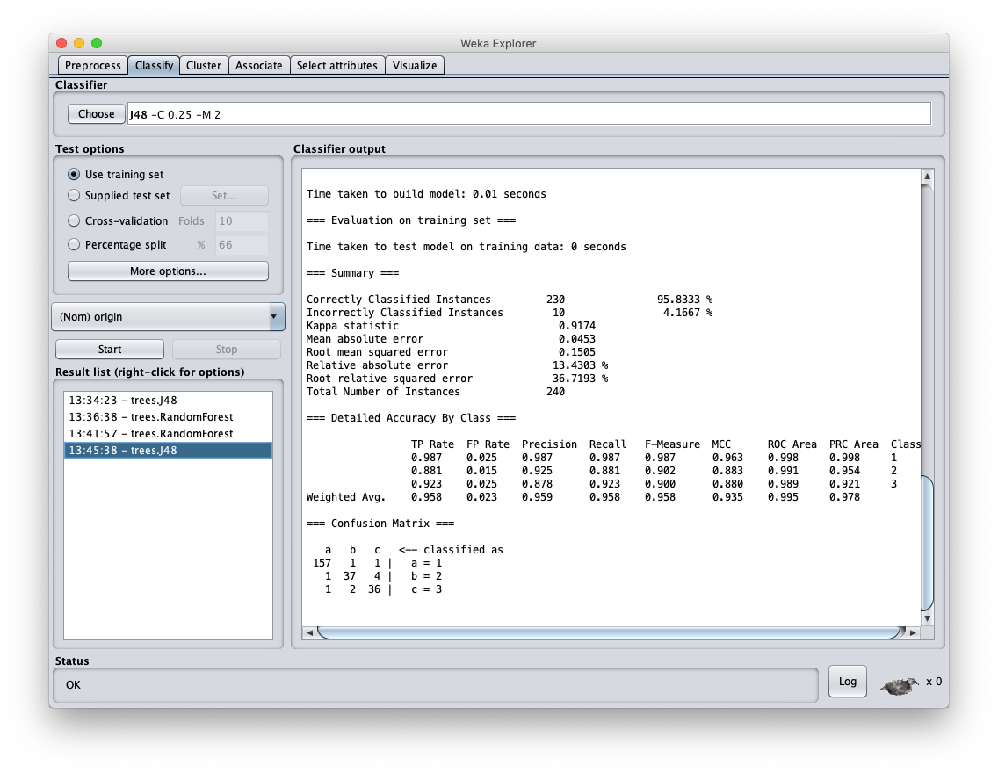

Slide 13
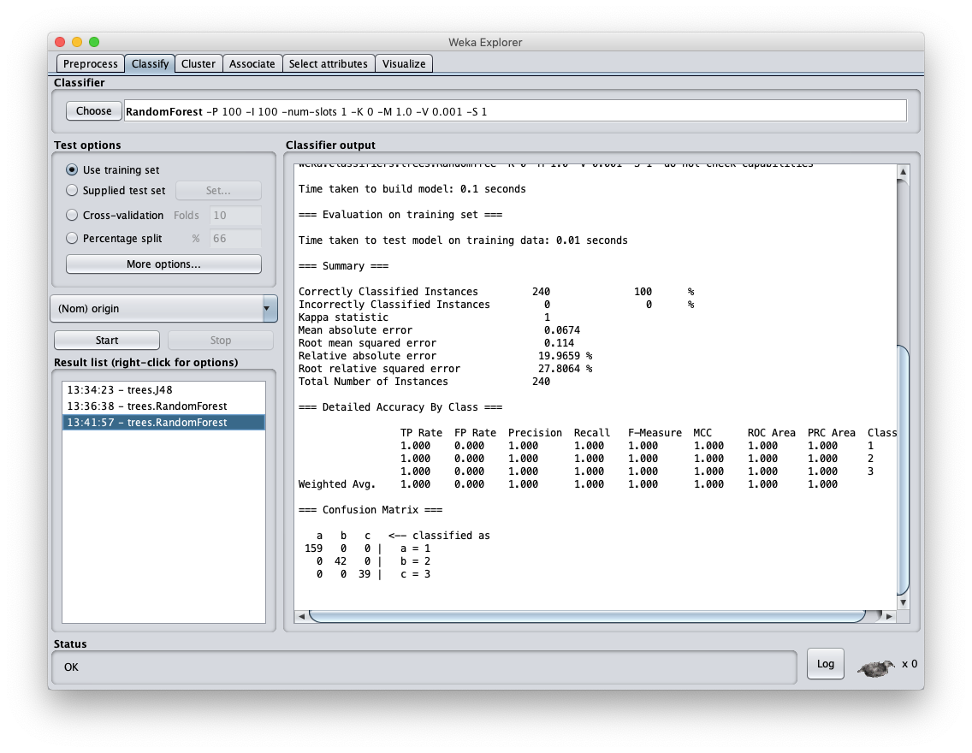

Slide 14
100% … Wait, What ?
Results are too good to be true!
ML results tend to be asymptotic
  asymptotic lines approach a curve but never touch
Closer you get to F1=1.0, the harder it is to improve
What did we do wrong?

Slide 15
Results are too good
Relatively small dataset allows construction of a DT model that does very well
Using Random Forest still improves on it
We trained and tested on the same data!
Very poor methodology since it overfits to this particular training set
This training dataset has a separate test data set
  We can also try 10-fold cross validation

Slide 16
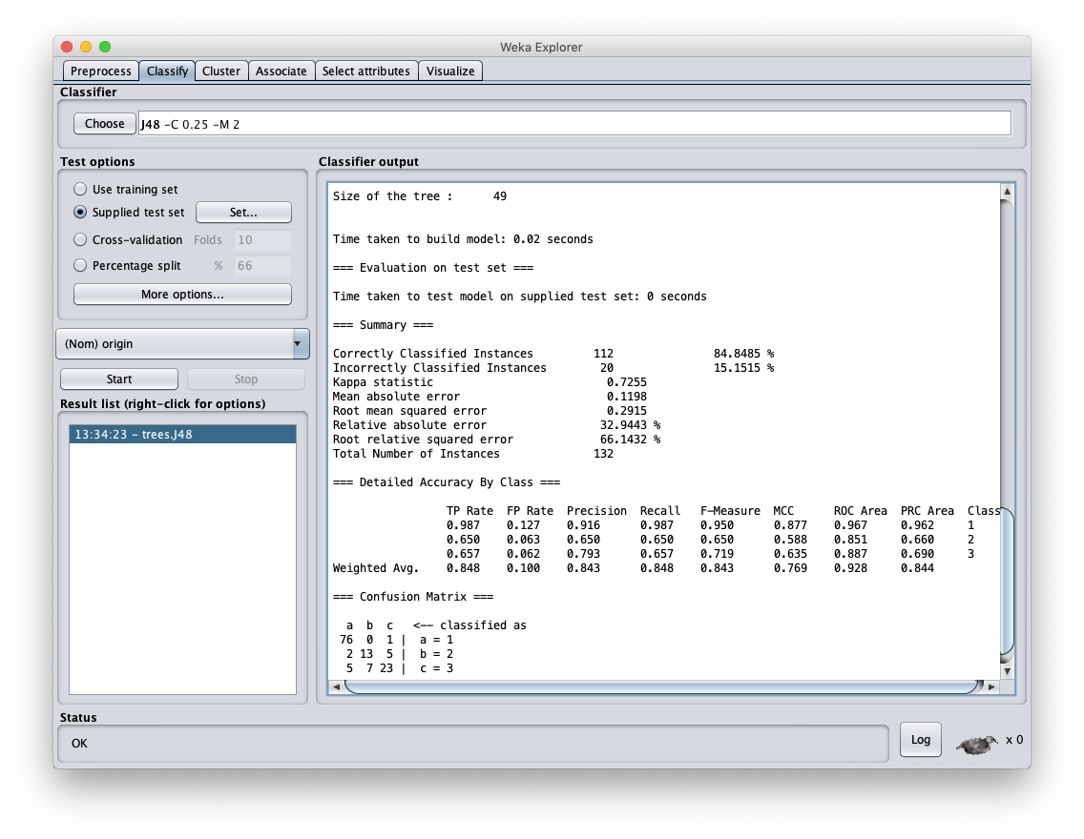

Slide 17
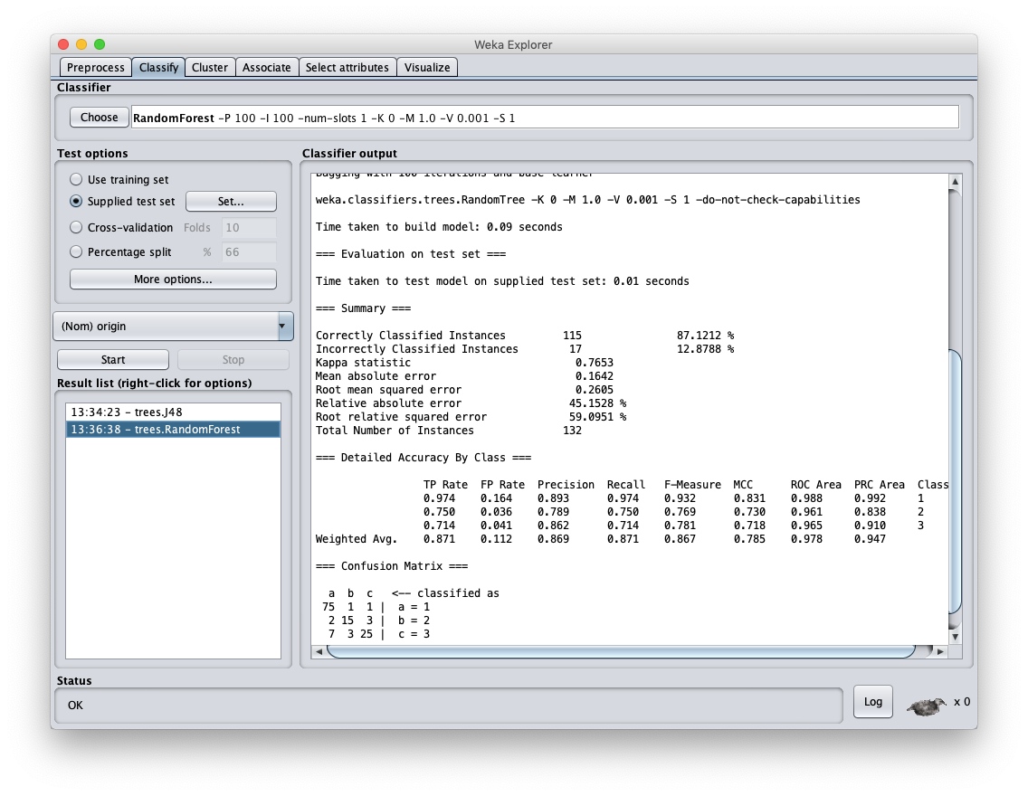

Slide 18
AUTO MPG Results (2)
Using an independent test set shows more realistic balanced F1 score of .843
Using Random Forest raises this to .867
While the increase is not large, it is probably statistically significant
F1 scores this high are difficult to increase dramatically
  Human scores for many tasks are often in this range (i.e. 0.8 – 0.9)

Slide 19
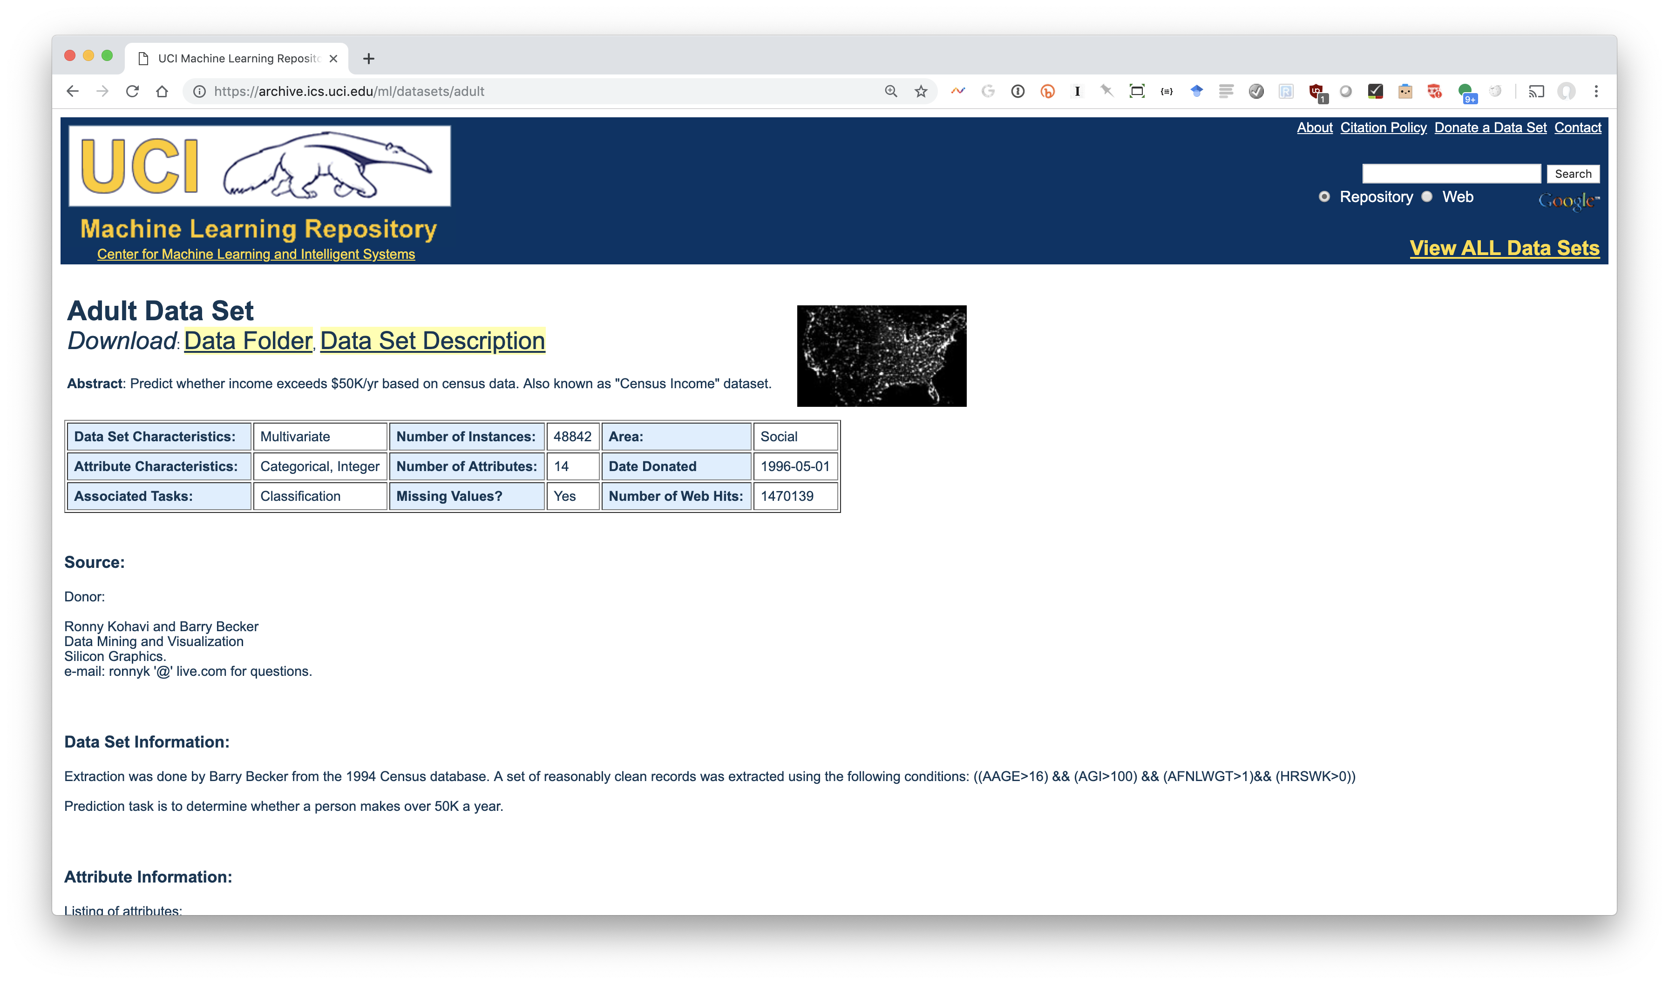
UCI Adult Dataset (1)

Slide 20
UCI Adult Dataset (2)
Data on adults from 1994 census data
Large dataset with 48,842 instances
Predict if person makes over $50K/year
  Equivalent to ~$87K/year today
14 features including age, education, marital status, occupation, race, sex, native country, …
  Mixture of numeric (e.g., age) and nominal (e.g., occupation) values

Slide 21
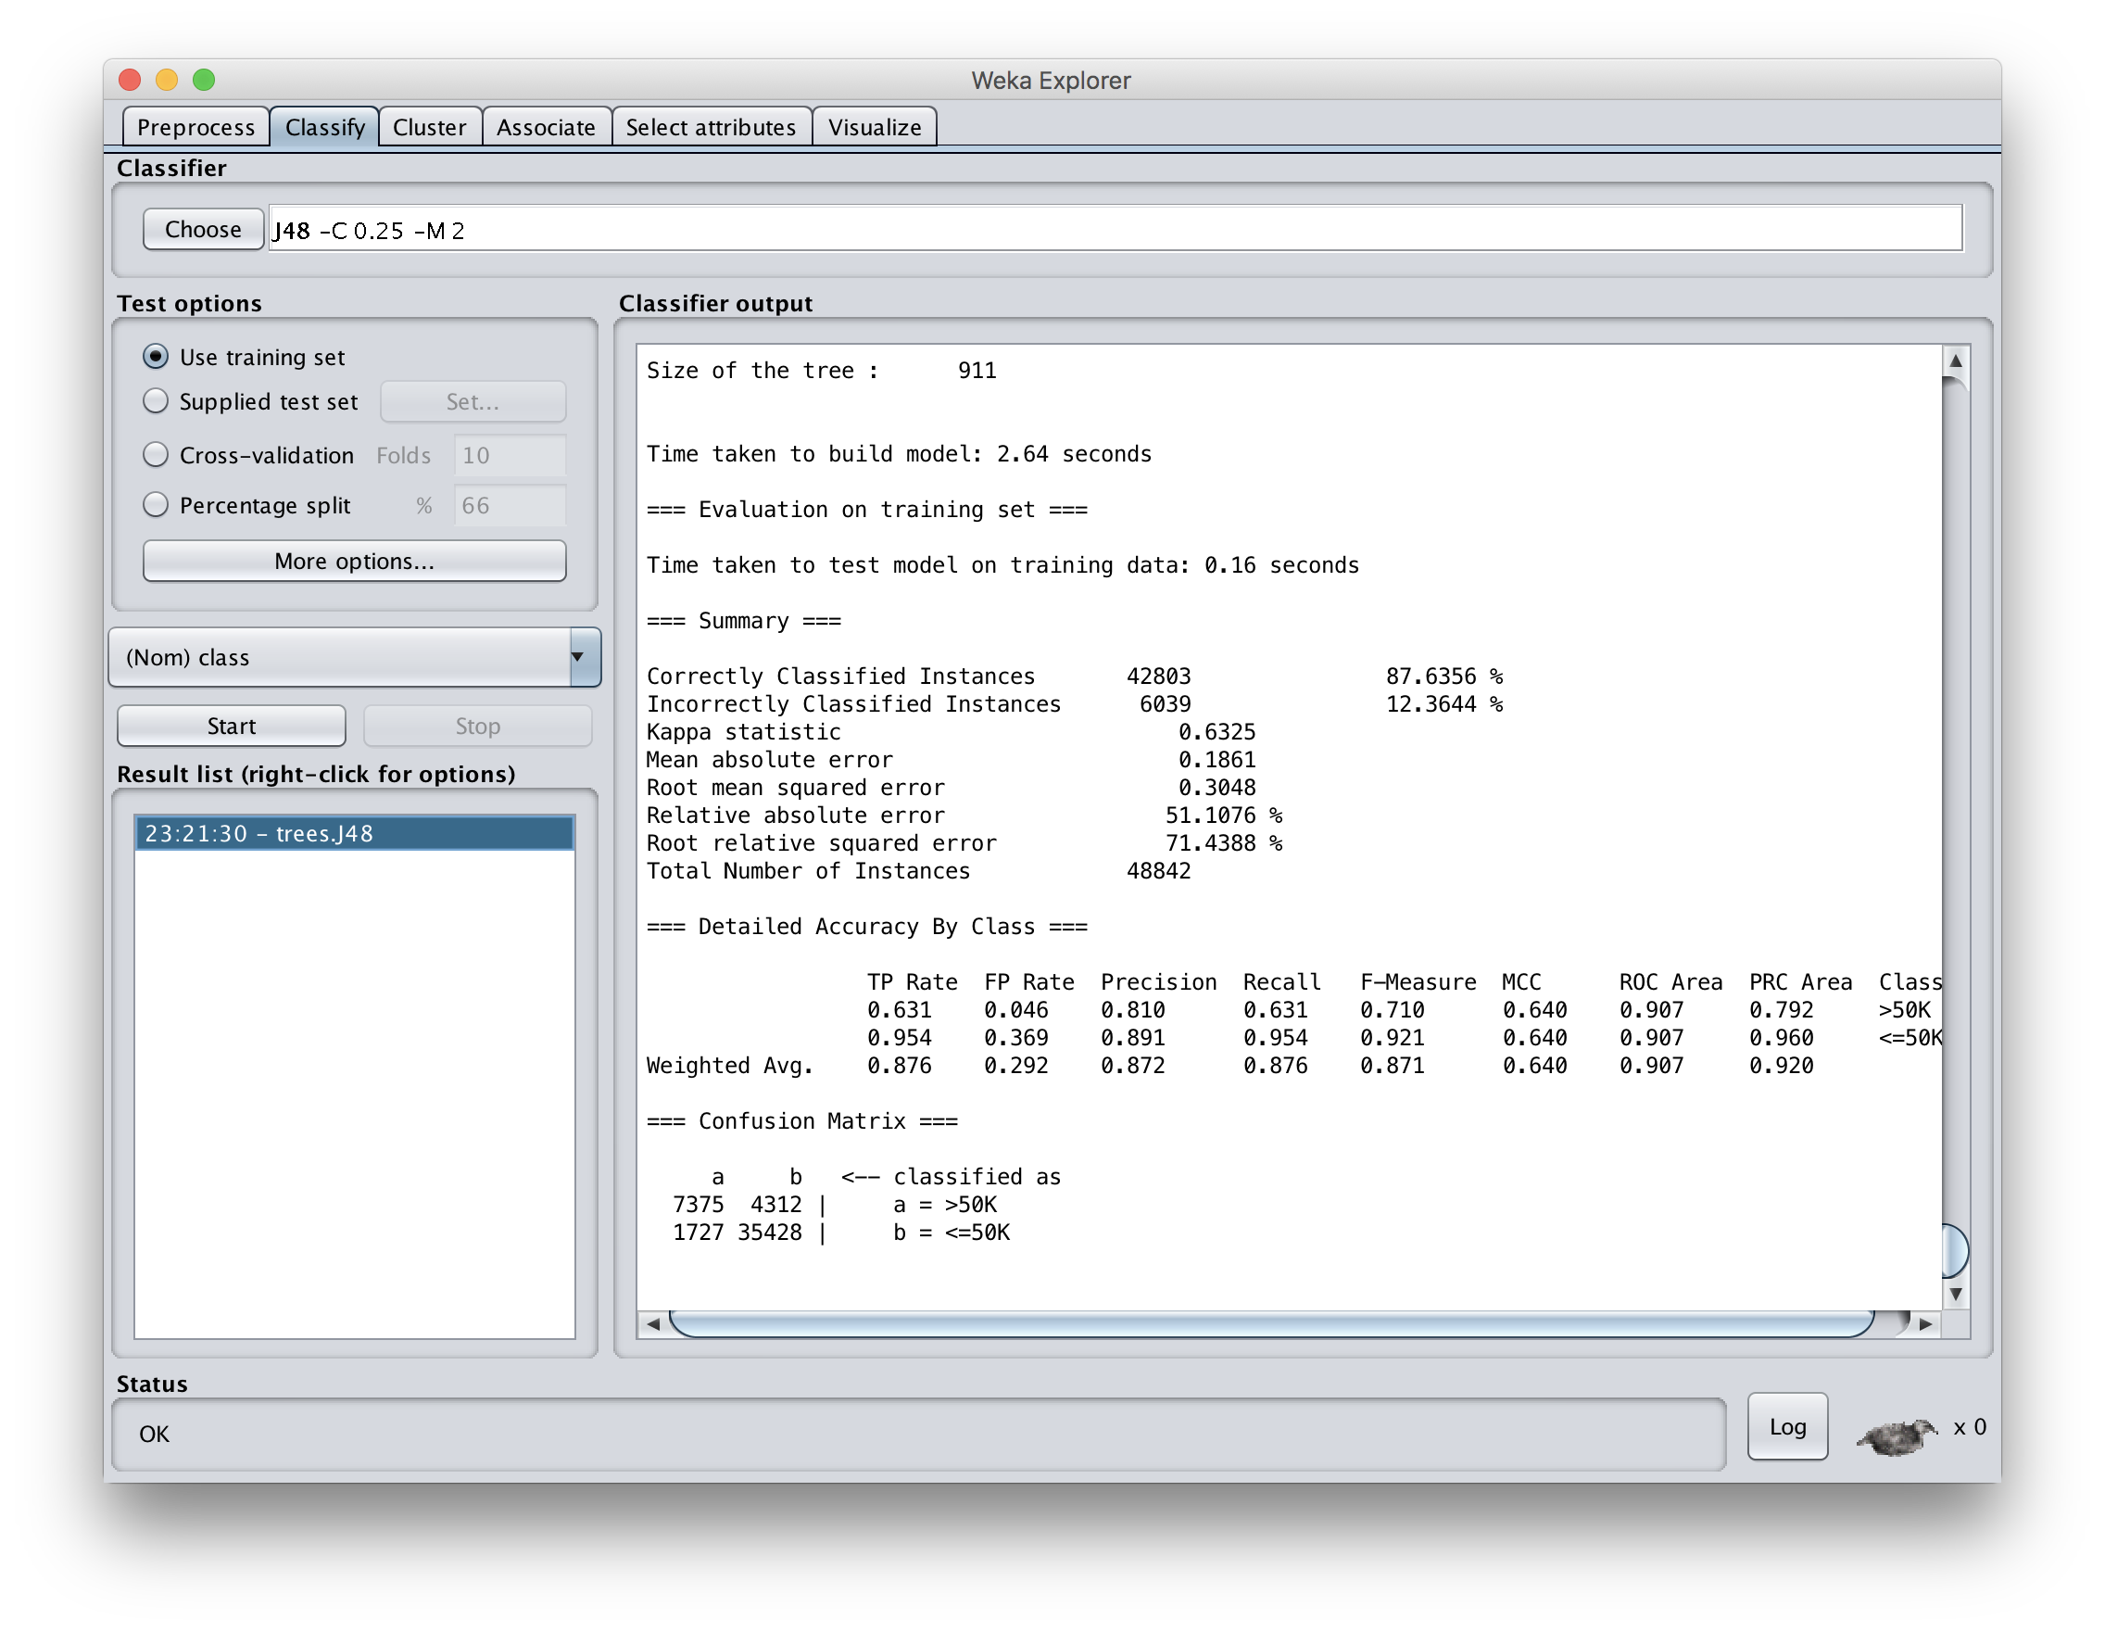

Slide 22
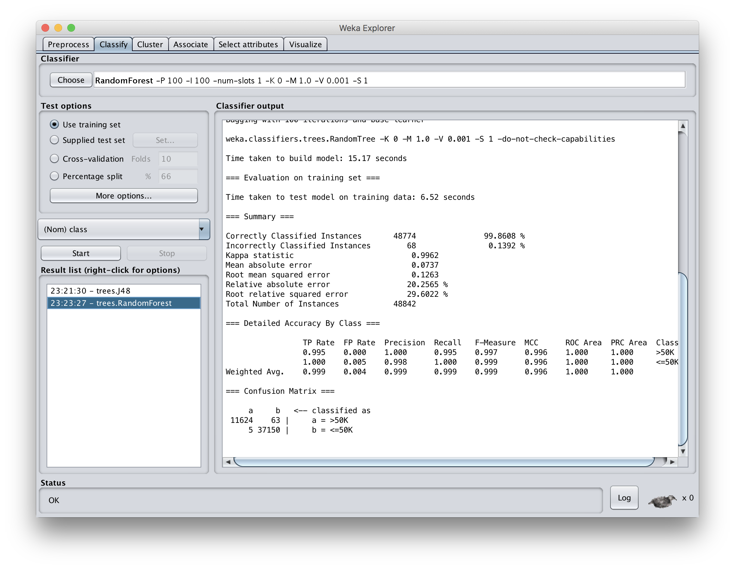

Slide 23
Result
Significant increase on F1 scores when both trained and evaluated on training set
This is considered to be poor methodology since it overfits to the particular training set

Slide 24
Create train and test collection
Train has ~95% of data, test 5%
Trained models for J48 and random forest using train dataset
Tested on test data set
Results were that random forest was (at best) about the same as J48
Large dataset reduced problem of overfitting, so random forest did not help

Slide 25
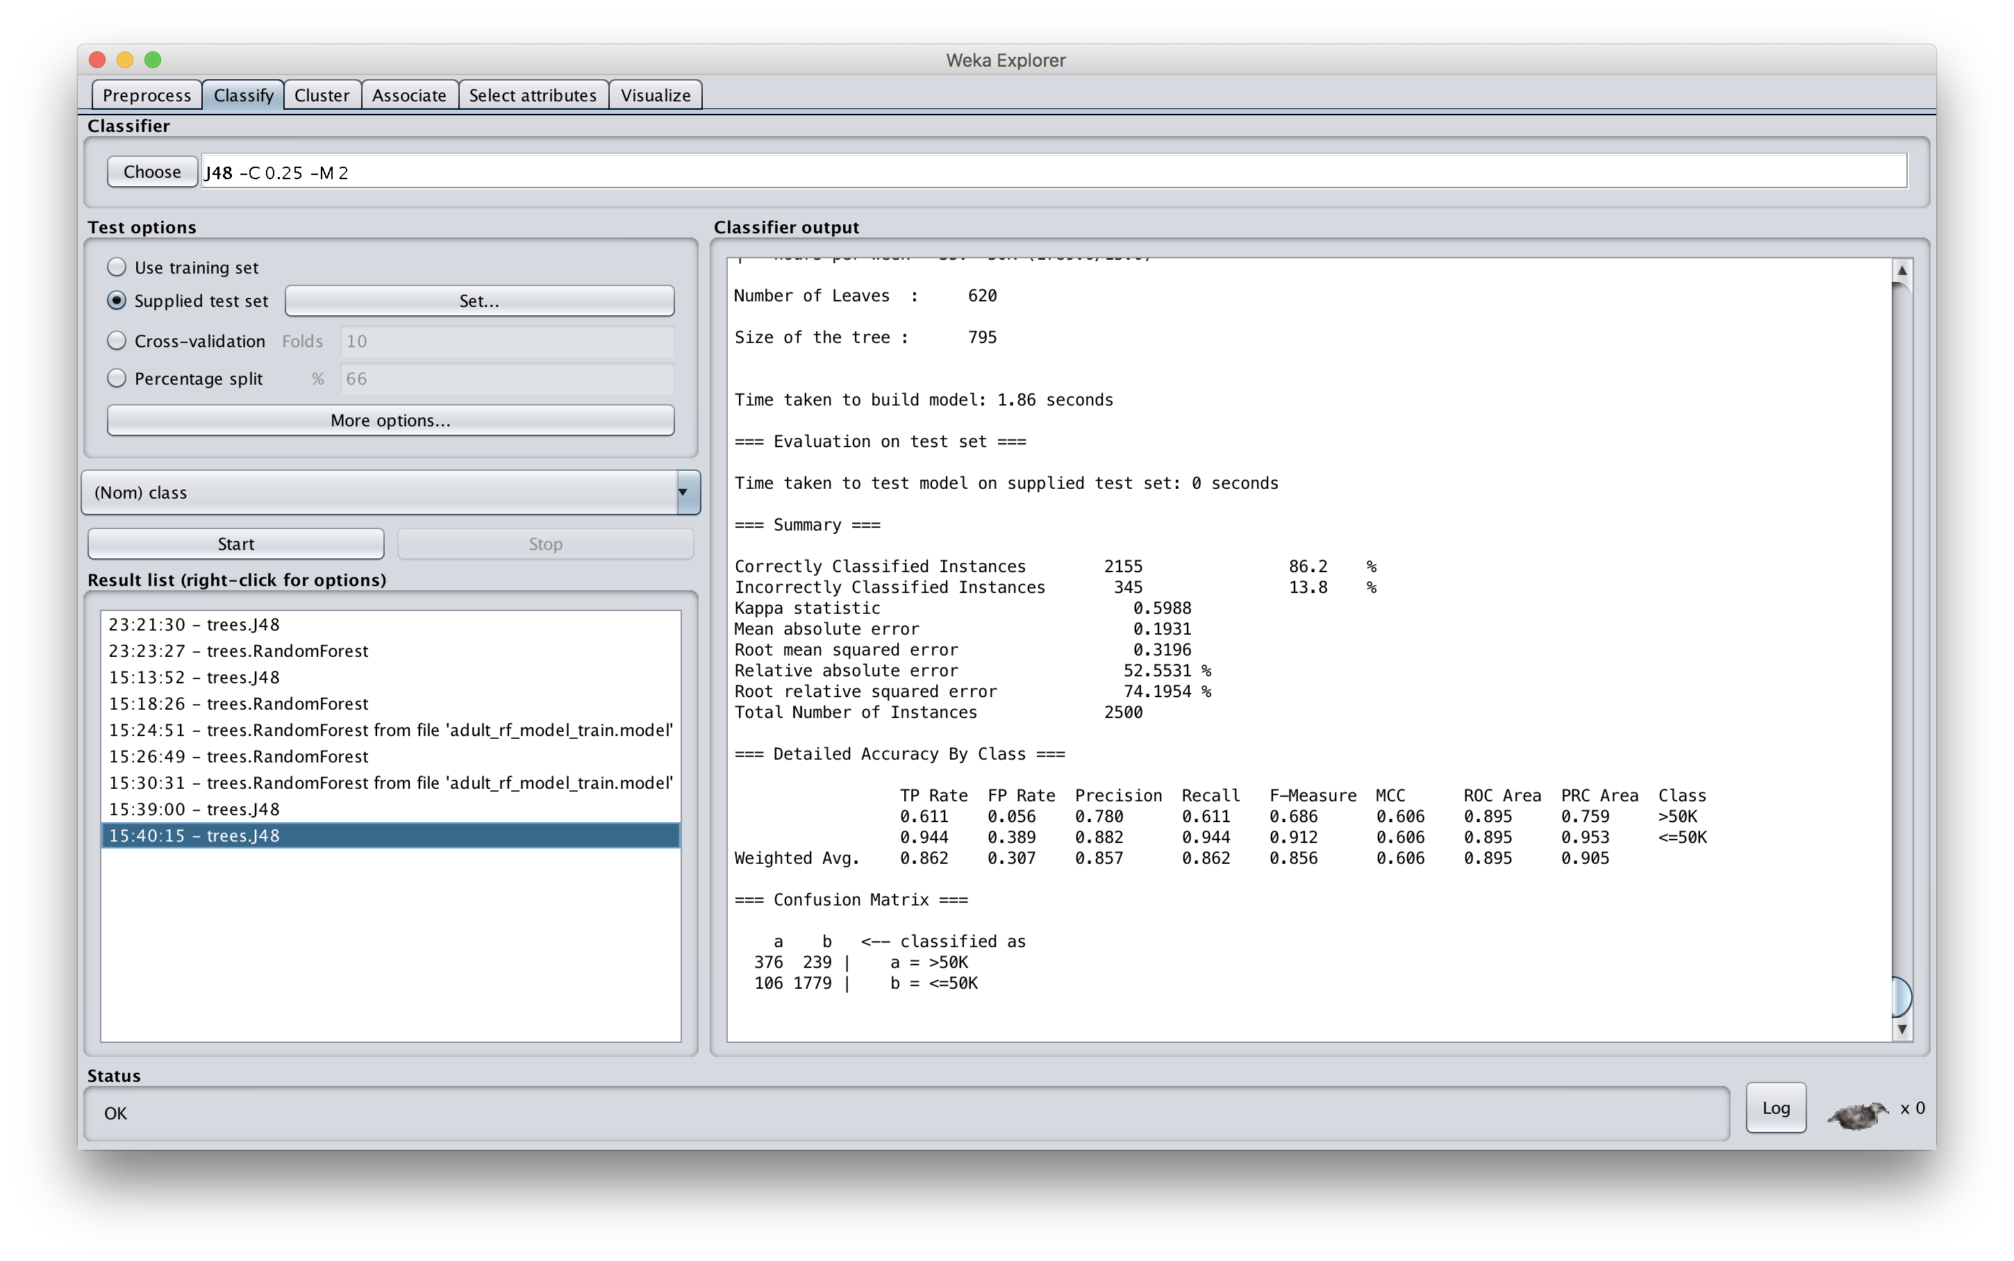

Slide 26
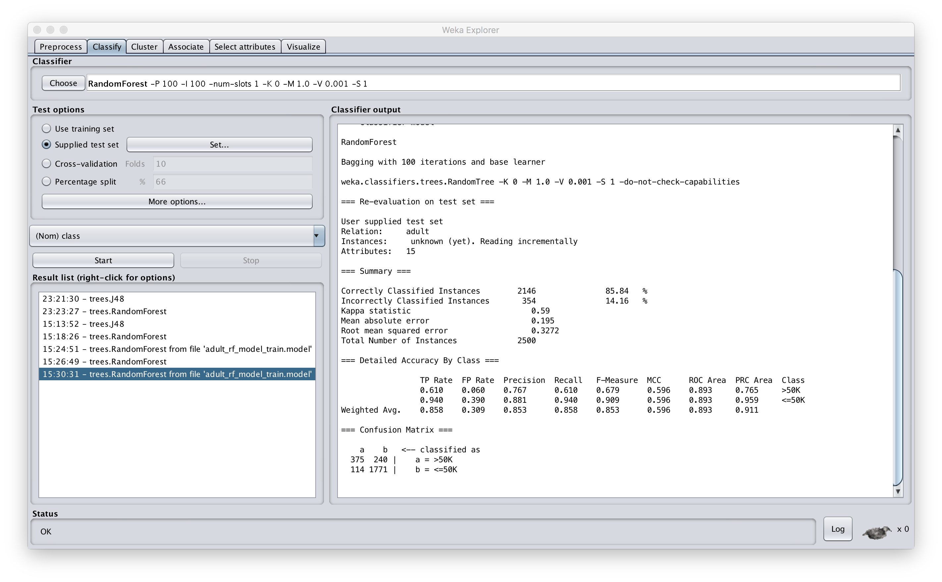

Slide 27
Conclusions
Bagging can help, especially if amount of training data adequate, but not as large as it should be
While we explore it using decision trees, it can be applied to any classifier
  Scikit-learn has a general module for bagging
In general, using any of several ensemble approaches to classification is often very helpful

Slide 28
Conclusions
Wait, there’s more…
A classification problem can change over time
  E.g.: recognizing a spam message from its content and metadata
We showed that an ensemble approach can detect a change in the nature of spam
  Which tells us its time to retrain with new data
  D. Chinavle, P. Kolari, T. Oates, and T. Finin, Ensembles in Adversarial Classification for Spam, ACM CIKM, 2009. link

Slide 29
Recognizing Concept Drift
Build ensemble of five models to classify spam comments left on a blog at time T1
Note the relative level of agreement
Detect when one of the models starts to diverge from the others with at time T2
  Time to get new data and retrain
  Examining disagreements can be enlightening
Used temporal data spanning several years to prove effectiveness
  E.g., spam moved from viagra to weight loss

