Slide 1
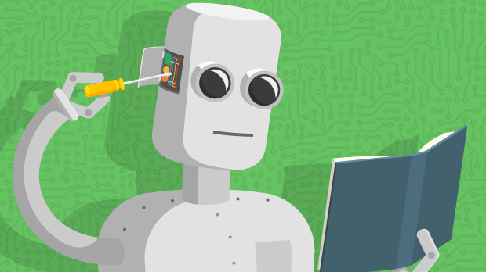
Machine Learning overview Chapter 18, 21
14.1

Slide 2
What we will cover
Some popular ML problems and algorithms
Take CMSC 478/678 Machine Leaning for more
Use online resources & experiment on your own
Focus on when/how to use techniques and only touch on how/why they work
Basic ML methodology and evaluation
Use various platform for examples & demos (e.g., scikit-learn, Weka, TensorFlow, PyTorch)
Great for exploration and learning

Slide 3
What is learning?
Learning denotes changes in a system that ... enable a system to do the same task more efficiently the next time – Herbert Simon
Learning is constructing or modifying representations of what is being experienced – Ryszard Michalski
Learning is making useful changes in our minds – Marvin Minsky

Slide 4
Why study learning?
Discover new things or structure previously unknown
Examples: data mining, scientific discovery
Fill in skeletal or incomplete specifications in a domain
Large, complex systems can’t be completely built by hand & require dynamic updating to incorporate new info.
Learning new characteristics expands the domain or expertise and lessens the “brittleness” of the system
Acquire models automatically directly from data rather than by manual programming
Build agents that can adapt to users, other agents, and their environment
Understand and improve efficiency of human learning

Slide 5
AI and Learning Today
50s&60s: neural network learning popular
Marvin Minsky did neural networks for his dissertation
Mid 60s: replaced by paradigm of manually encoding & using symbolic knowledge
Cf. Perceptrons, Minsky & Papert book showed limitations of perceptron model of neural networks
90s: more data & Web drove interest in statistical machine learning techniques & data mining
Now: machine learning techniques & big data play biggest driver in almost all successful AI systems
… and neural networks are the current favorite approach
seeAlso: Timeline of machine learning

Slide 6
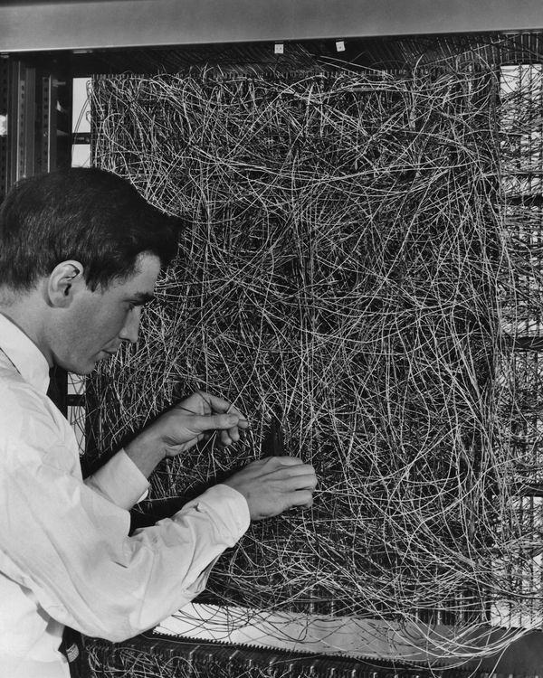
Neural Networks 1960
A man adjusting the random wiring network between the light sensors and association unit of scientist Frank Rosen-blatt's Perceptron, or MARK 1 computer, at the Cornell Aeronautical Laboratory, Buffalo, New York, circa 1960. The machine is designed to use a type of artificial neural network, known as a perceptron.

Slide 7
Neural Networks 2020
Google’s AIY Vision Kit ($89.99 at Target) is an intelligent camera that can recognize objects, detect faces and emotions. Download and use a variety of image recognition neural networks to customize the Vision Kit for your own creation. Included in the box: Raspberry Pi Zero WH, Pi Camera V2, Micro SD Card, Micro USB Cable, Push Button.
Currently $58.85 on Amazon

Slide 8
Machine Learning Successes
Games: chess, go, poker
Text sentiment analysis
Email spam detection
Recommender systems (e.g., Netflix, Amazon)
Machine translation
Speech understanding
SIRI, Alexa, Google Assistant, …
Autonomous vehicles
Individual face recognition
Understanding digital images
Credit card fraud detection
Showing annoying ads

Slide 9
The Big Idea and Terminology
Given some data, learn a model of how the world works that lets you predict new data
Training Set: Data from which you learn initially
Model: What you learn; a “model” of how inputs are associated with outputs
Test set: New data you test your model against
Corpus: A body of text data (pl.: corpora)
Representation: The computational expression of data

Slide 10
Major Machine learning paradigms (1)
Rote: 1-1 mapping from inputs to stored representation, learning by memorization, association-based storage & retrieval
Induction: Use specific examples to reach general conclusions
Clustering: Unsupervised discovery of natural groups in data

Slide 11
Major Machine learning paradigms (2)
Analogy: Find correspondence between different representations
Discovery: Unsupervised, specific goal not given
Genetic algorithms: Evolutionary search techniques, based on survival of the fittest
Reinforcement: Feedback (positive or negative reward) given at the end of a sequence of steps
Deep learning: artificial neural networks with representation learning for ML tasks

Slide 12
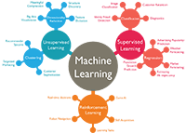
Types of learning problems
Supervised: learn from training examples
Regression:
Classification: Decision Trees, SVM
Unsupervised: learn w/o training examples
Clustering
Dimensionality reduction
Word embeddings
Reinforcement learning: improve performance using feedback from actions taken
Lots more we won’t cover
Hidden Markov models, Learning to rank, Semi-supervised learning, Active learning …

Slide 15
Supervised learning
Given training examples of inputs & corres-ponding outputs, produce “correct” outputs for new inputs
Two important scenarios:
Classification: outputs typically labels (goodRisk, badRisk); learn decision boundary to separate classes
Regression: aka curve fitting or function approxima-tion; Learn a continuous input-output mapping from examples, e.g., for a zip code, predict house sale price given its square footage

Slide 16
Unsupervised Learning
Given only unlabeled data as input, learn some sort of structure, e.g.:
Clustering: group Facebook friends based on similarity of post texts and friends
Embeddings: Find sets of words whose meanings are related (e.g., doctor, hospital)
Topic modelling: Induce N topics and words most common in documents about each

Slide 17
Inductive Learning Framework
Raw input data from sensors or a database preprocessed to obtain feature vector, X, of relevant features for classifying examples
Each X is a list of (attribute, value) pairs
n attributes (a.k.a. features): fixed, positive, and finite
Features have fixed, finite number # of possible values
Or continuous within some well-defined space, e.g., “age”
Each example is a point in an n-dimensional feature space
X = [Person:Sue, EyeColor:Brown, Age:Young, Sex:Female]
X = [Cheese:f, Sauce:t, Bread:t]
X = [Texture:Fuzzy, Ears:Pointy, Purrs:Yes, Legs:4]

Slide 18
Inductive Learning as Search
Instance space, I, is set of all possible examples
Defines language for the training and test instances
Usually each instance i ∈ I is a feature vector
Features are also sometimes called attributes or variables
I: V₁ × V₂ × … × V_{k}, i = (v₁, v₂, …, v_{k})
Class variable C gives an instance’s class (to be predicted)

Slide 19
Inductive Learning as Search
C gives an instance’s class
Model space M defines the possible classifiers
M: I → C, M = {m₁, … m_{n}} (possibly infinite)
Model space is sometimes defined using same features as instance space (not always)
Training data lets us search for a good (consistent, complete, simple) hypothesis in the model space
The learned model is a classifier

Slide 20
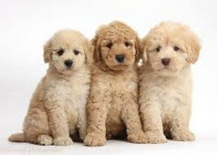
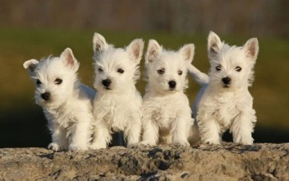
Inductive Learning Pipeline
Puppy classifier
Training data
Training
Classifier (trained model)

Slide 21
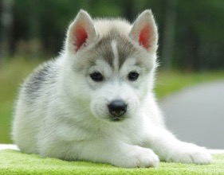
Inductive Learning Pipeline
Puppy classifier
Training data
Test data
Classifier (trained model)
Test
Label: +

Slide 22
Inductive Learning Pipeline
Puppy classifier
Training data
Training
Test data
Classifier (trained model)
Test
Label: +

Slide 23
Inductive Learning Pipeline
Puppy classifier
Training data, X
Training
Text-ure | Ears | Legs | Class
Fuzzy | Round | 4 | +
Slimy | Missing | 8 | -
Fuzzy | Pointy | 4 | -
Fuzzy | Round | 4 | +
Fuzzy | Pointy | 4 | +
…
Test data
Classifier (trained model)
x₁ = <Fuzzy, Pointy, 4>
Test
Label: +

Slide 24
Model Spaces
Decision trees
Partition the instance space I into axis-parallel regions
Labeled with class value
Nearest-neighbor classifiers
Partition the instance space I into regions defined by centroid instances (or cluster of k instances)
Bayesian networks
Probabilistic dependencies of class on attributes
Naïve Bayes: special case of BNs where class → each attribute

Slide 25
More Model Spaces
Neural networks
Nonlinear feed-forward functions of attribute values
Support vector machines
Find a separating plane in a high-dimensional feature space
Associative rules (feature values → class)
First-order logical rules

Slide 26
Machine Learning
ML’s significance in AI has gone up and down over the last 75 years
Today it’s very important for AI and data science
Driving ML are three trends:
Cheaper and more powerful computing systems
Open-source ML tools (e.g., scikit-learn, TensorFlow)
Availability of large amounts of data
Understanding ML concepts and tools allow many to use them with success

