Slide 1
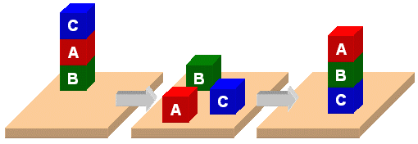
Classic Blocks World

Slide 2
Classic Blocks World
We’ll look at the classic blocks world domain
Starting with
  BW: a domain file
  Several problem files
We’ll use planning.domains to demonstrate solving the problems
And then show simple extensions to the domain by adding predicates and constants

Slide 3
bw.pddl 1
(define (domain BW)
(:requirements :strips)
(:predicates
(on ?x ?y) ; object ?x is on ?object ?y
(on-table ?x) ; ?x is directly on the table
(clear ?x) ; ?x has nothing on it
(arm-empty) ; robot isn't holding anything
(holding ?x)) ; robot is holding ?x
;; the four classic actions for manipulating objects
… actions in next four slides …
Allows basic add and
delete effects in actions
List all the predicates with
their arguments

Slide 4
bw.pddl 2
(:action pick-up
:parameters (?ob1)
:precondition
(and (clear ?ob1)
(on-table ?ob1)
(arm-empty))
:effect
(and (not (on-table ?ob1))
(not (clear ?ob1))
(not (arm-empty))
(holding ?ob1)))
Variable for the argument
of a pick-up action
These three statements
must be True before we
can do a pick-up action
After doing a pick-up
action, these become
True

Slide 5
bw.pddl 3
(:action pick-up
:parameters (?ob1)
:precondition
(and (clear ?ob1)
(on-table ?ob1)
(arm-empty))
:effect
(and (not (on-table ?ob1))
(not (clear ?ob1))
(not (arm-empty))
(holding ?ob1)))
Variable for the argument
of a pick-up action
These three statements
must be True before we
can do a pick-up action
After doing a pick-up
action, these become
True

Slide 6
bw.pddl 4
(:action put-down
:parameters (?ob)
:precondition (holding ?ob)
:effect
(and (not (holding ?ob))
(clear ?ob)
(arm-empty)
(on-table ?ob)))
(:action stack
:parameters (?ob ?underob)
:precondition (and (holding ?ob) (clear ?underob))
:effect
(and (not (holding ?ob))
(not (clear ?underob))
(clear ?ob)
(arm-empty)
(on ?sob ?underob)))
put-down means put the
think you are holding on
the table
stack means put the
thing you are holding on
another object

Slide 7
bw.pddl 5
(:action unstack
:parameters (?sob ?sunderob)
:precondition
(and (on ?sob ?sunderob)
(clear ?sob)
(arm-empty))
:effect
(and (holding ?sob)
(clear ?sunderob)
(not (clear ?sob))
(not (arm-empty))
(not (on ?sob ?sunderob)))
) ; this closes the domain definition
unstack means take the
first arg off the second
arg
First arg can’t have
anything on it and the
robt cannot be holding
anything
Here are the updates
to our knowledge base
describing the state of
the world

Slide 8
p00.pddl
;; The arm is empty and there is a stack of three blocks: C is on B which is on A
;; which is on the table. The goal is to reverse the stack, i.e., have A on B and B
;; on C. No need to mention C is on the table, since domain constraints will enforce it.
(define (problem 00)
(:domain bw)
(:objects A B C)
(:init (arm-empty)
(on-table A)
(on B A)
(on C B)
(clear C))
(:goal (and (on A B)
(on B C))))
C
A
B
B
A
C

Slide 9
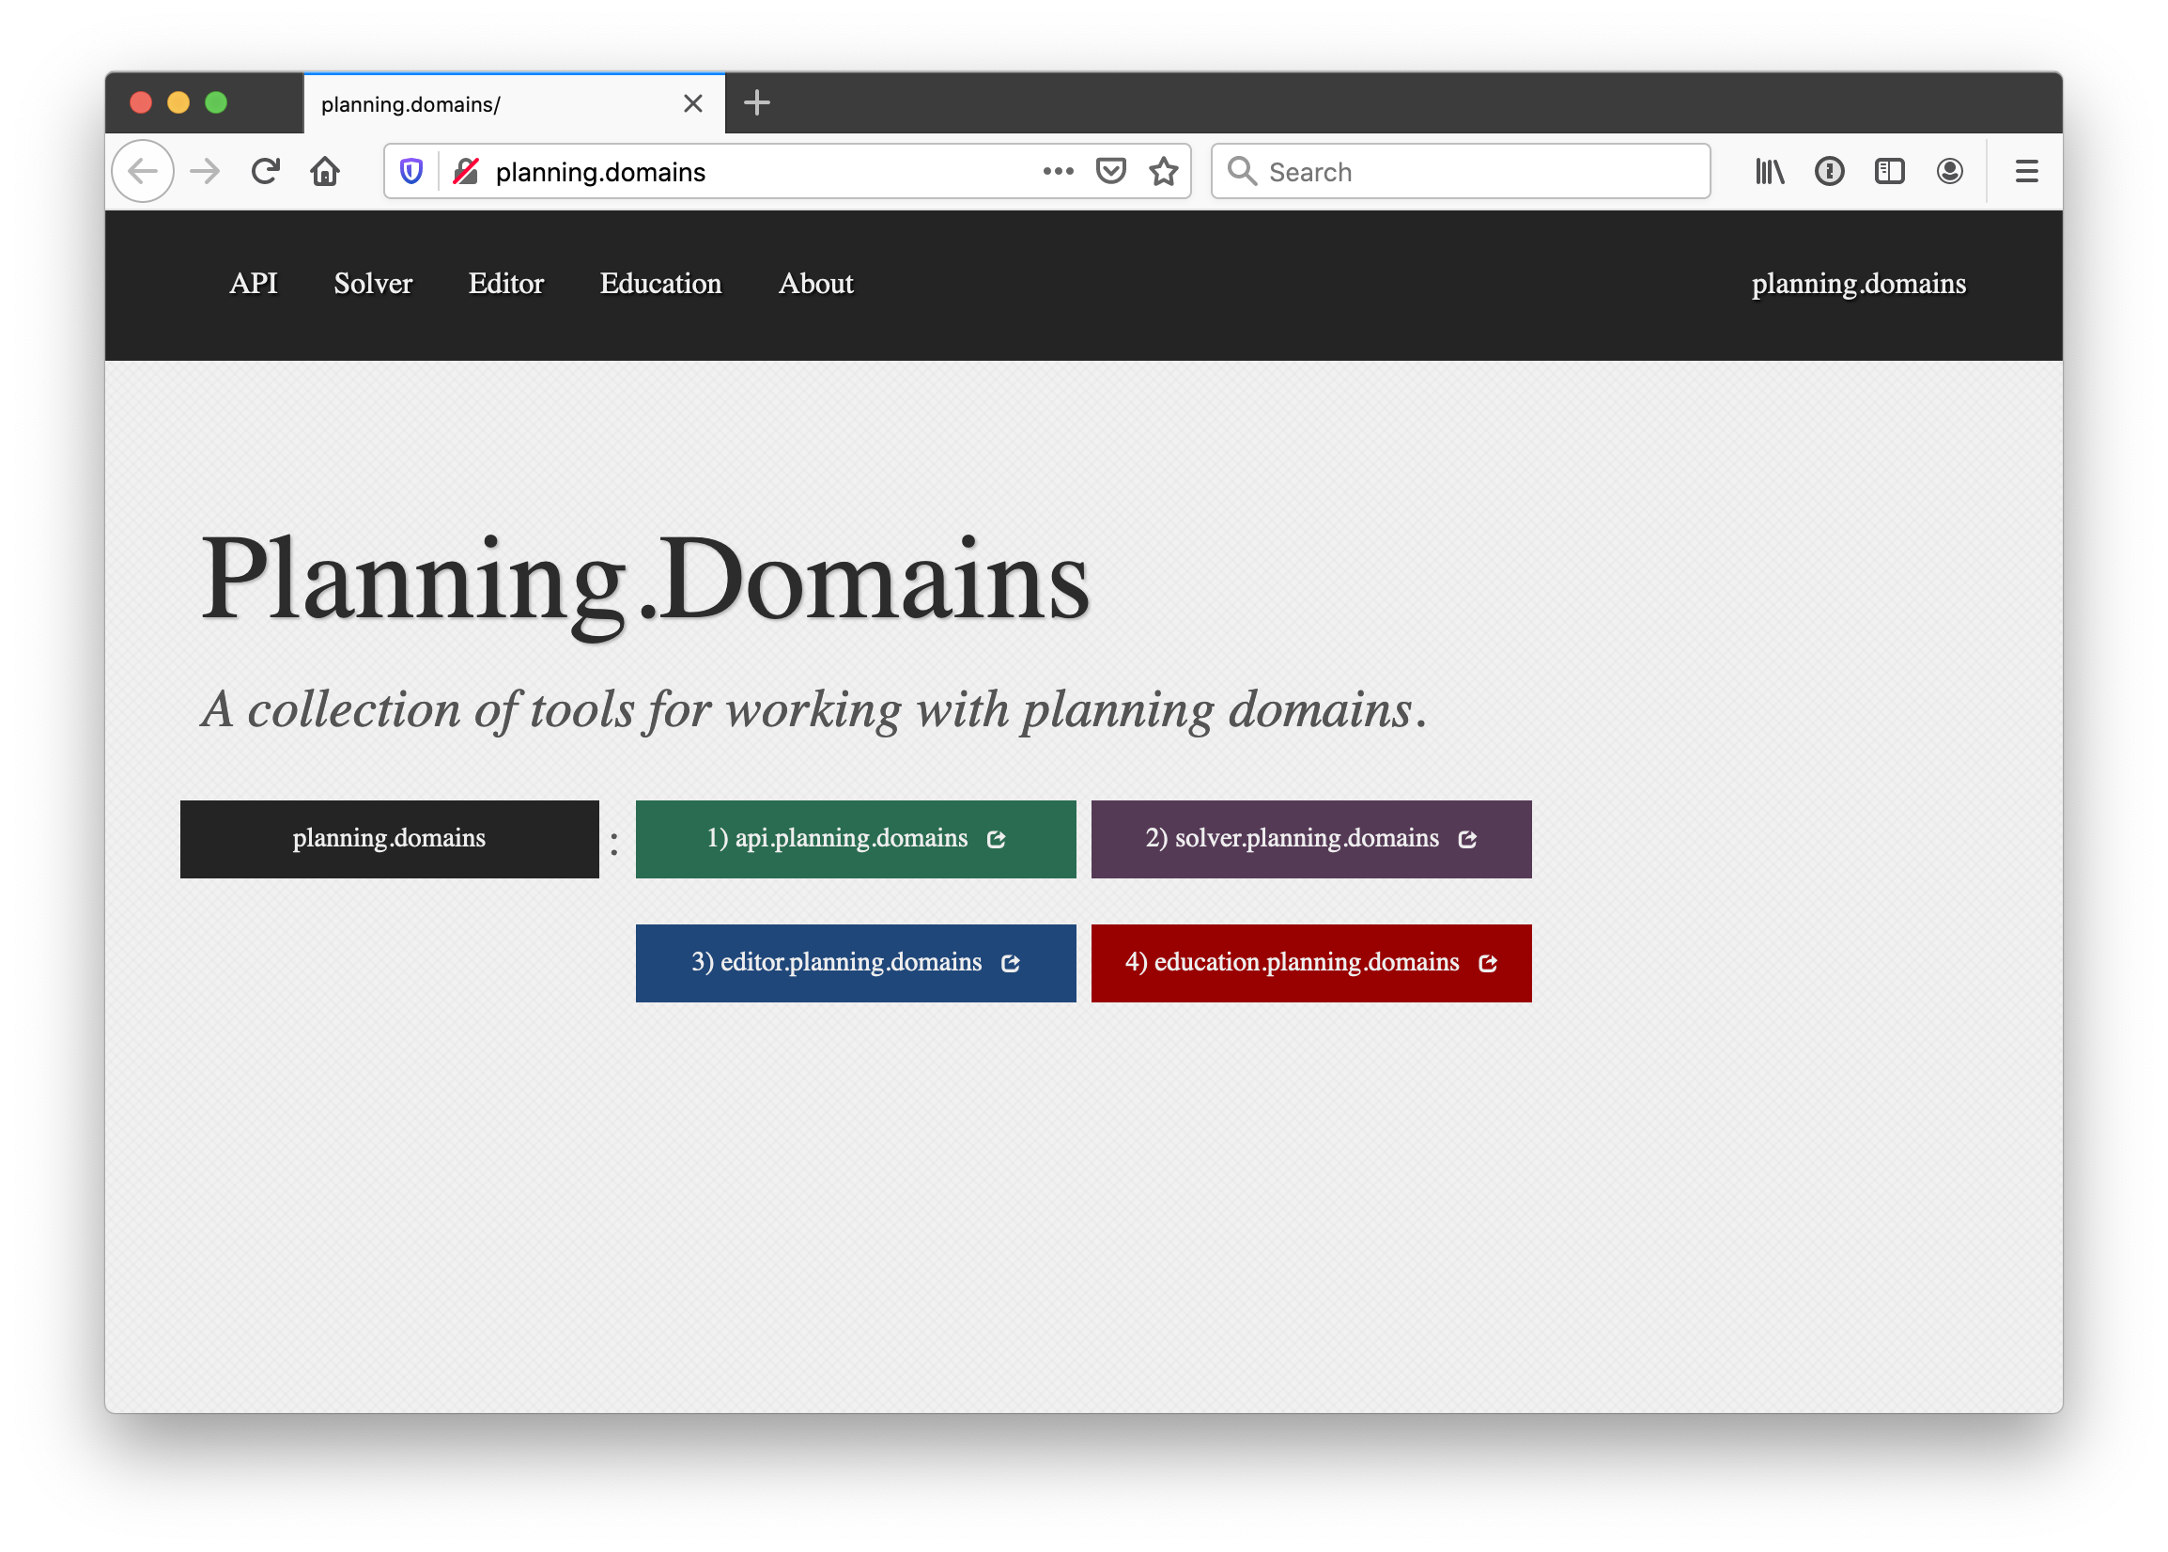
http://planning.domains/
Open the PDDL editor,
upload our domain and
problem files, and run
the solver.

Slide 10
Online Demonstration
We’ll try an online demonstration, using planning.domains and the files in the planning subdirectory of our 471 code repository
bw.pddl
p01.pddl
p02.pddl
p03.pddl
p12.pddl
p36.pddl

Slide 11
Fin

